Slide 1
OCCULTATION OF HIP 12740 BY ASTEROID 106 DIONE FROM INDIA
PAUL D. MALEY
NASA JOHNSON SPACE CENTER ASTRONOMICAL SOCIETY & IOTA
HOUSTON, TEXAS

Slide 6
DAMDAMA LAKE SITE

Slide 8
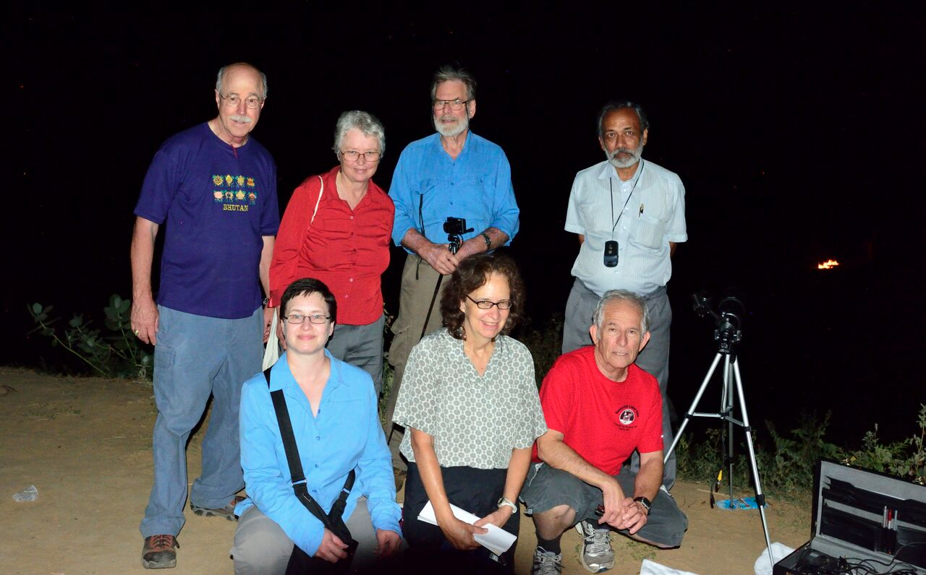
B.BRASWELL, A.BULLEN, P.STEWART, S.GURJAR
C.FASER, L. PALMER, P.MALEY (L-R)

Slide 9
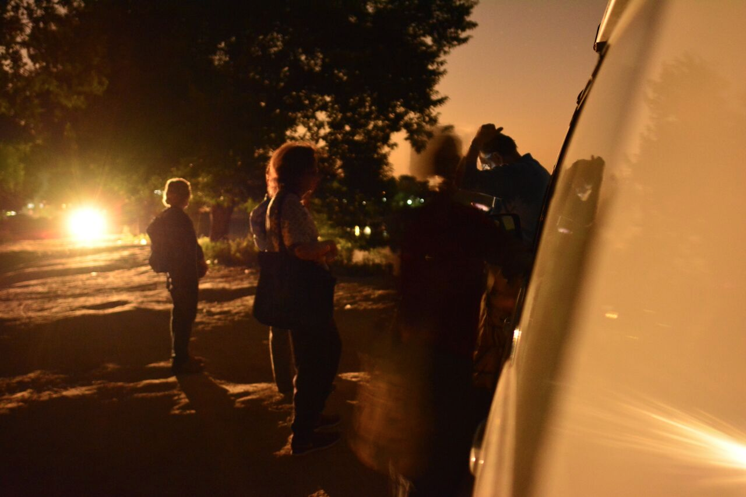

Slide 11
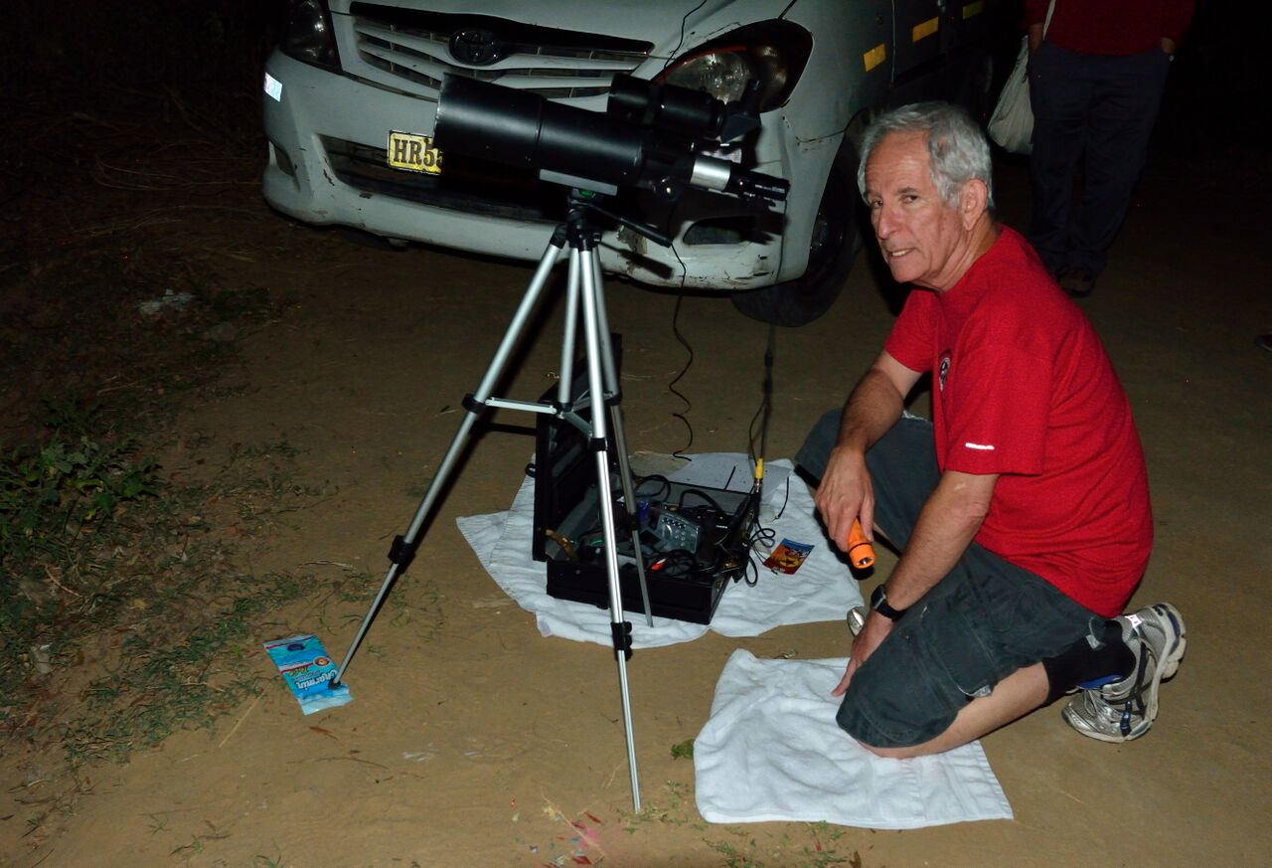

Slide 12
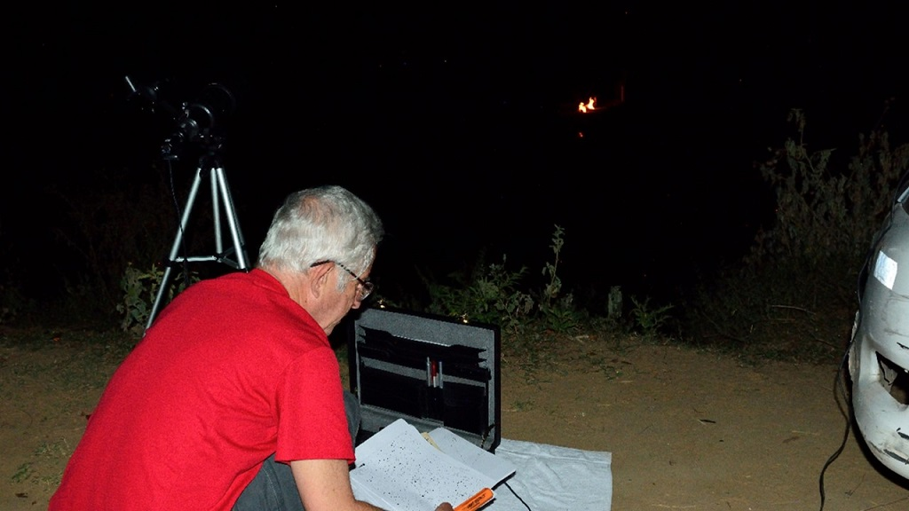

Slide 13
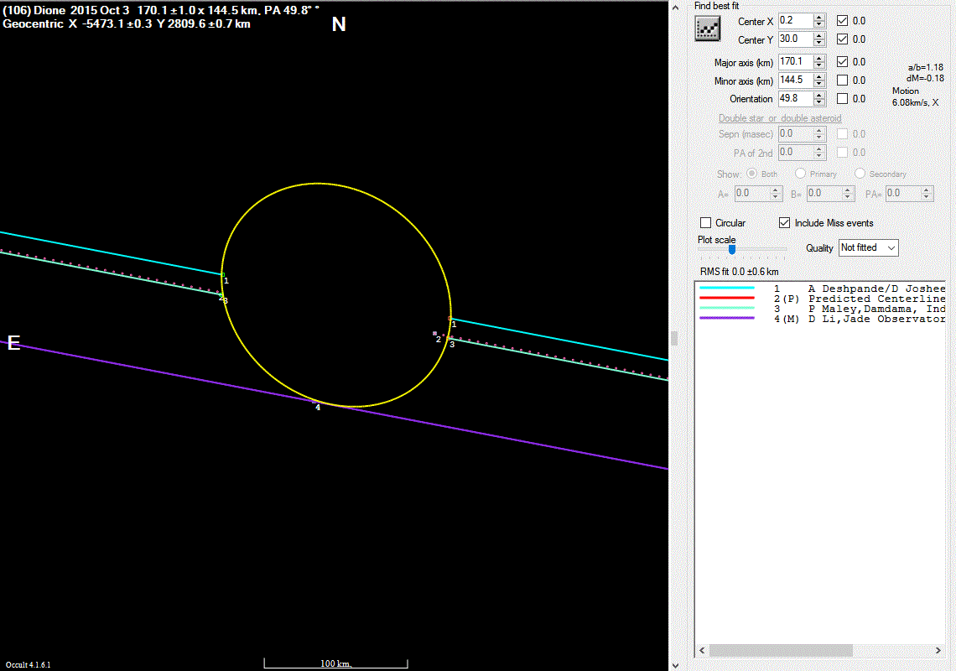

Slide 15
WHAT IS NEXT IN INDIA?

Slide 16
THE END

