Slide 1

S318p.15 – Sizes, Shapes, and Satellites of Asteroids from Occultations
David W. Dunham*, David Herald, Steve Preston,
Bradley Timerson, & Paul Maley, International Occultation
Timing Association (IOTA); Eric Frappa, IMCCE, Paris; Tsutomu
Hayamizu, Japanese Occultation Information Network; John Talbot,
RASNZ Occ’n Section; and Atila Poro, IOTA/Middle East Section, Iran
* Email dunham@starpower.net Cell phone 301-526-5590
International Astronomical Union - General Assembly Honolulu, Hawaii, 2015 August 3 – 7 - Control ID 2258262
For 40 years, the sizes and shapes of dozens of asteroids have been determined from observations of asteroidal occultations. Some of the first evidence for satellites of asteroids was obtained from the early efforts; now, the orbits and sizes of some satellites discovered by other means have been refined from occultation observations. Also, several close binary stars have been discovered, and the angular diameters of some stars have been measured from analysis of these observations. The International Occultation Timing Association (IOTA) coordinates this activity worldwide, from predicting and publicizing the events, to accurately timing the occultations from as many stations as possible, and publishing and archiving the observations.

Slide 2
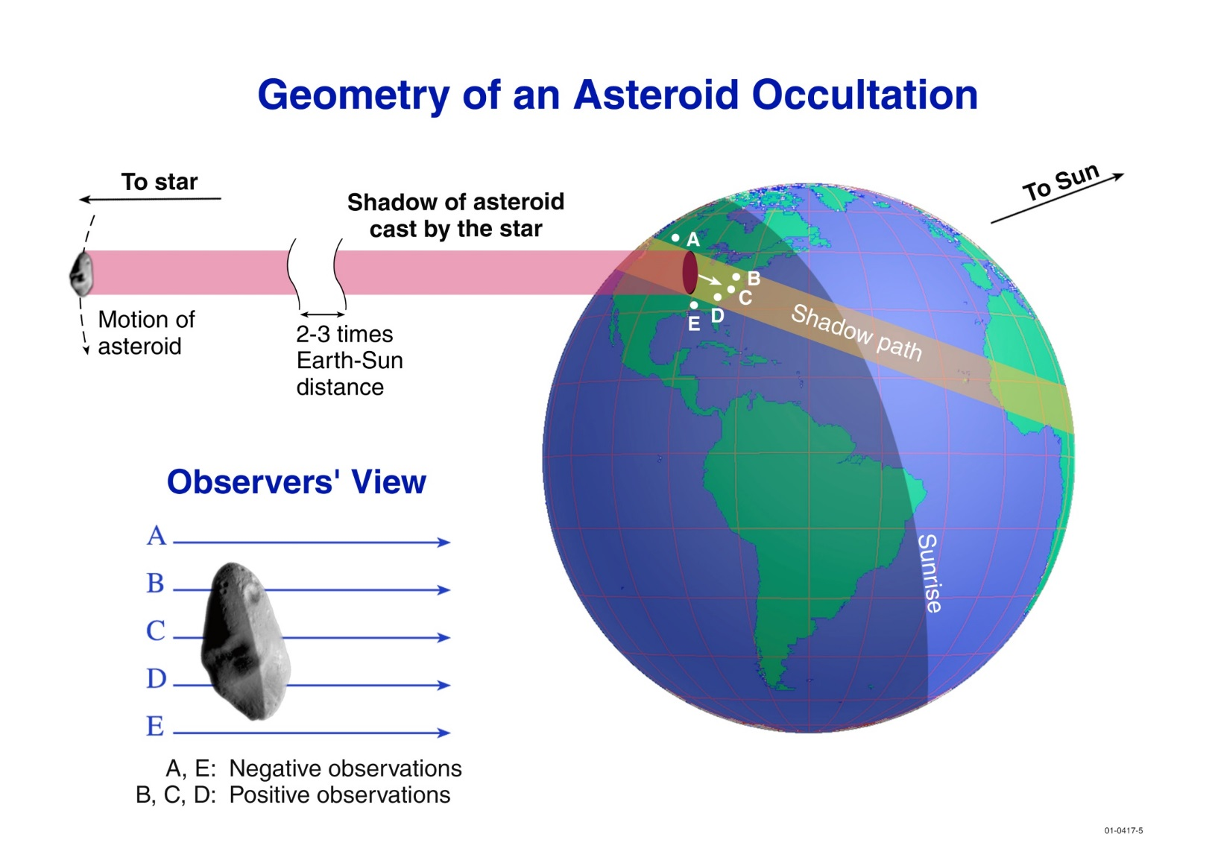
The release of the Hipparcos and
Tycho catalogs in 1997, from ESA’s
Hipparcos space mission, revolution
-ized asteroidal occultation work, in-
creasing the routine accuracy of the
predictions and the annual number of
observations by an order of magni-
tude. IOTA developed an efficient
procedure for predicting the occulta-
tions using a combination of new star
catalogs, based on Hipparcos, gener-
ated mainly at the U. S. Naval Obser-
vatory (USNO), and new observa-
tions of asteroids relative to the
improved astrometric nets mainly from USNO’s Flagstaff Astrometric Scanning Transit Telescope and JPL’s Table Mountain Observatory. In addition, many IOTA observers now use inexpensive low-light-level video
cameras and specially built GPS video time inserters to accurately time the events. This automation has also
allowed some observers to deploy multiple remote video stations across occultation paths. Then, one observer
can record several “chords” across the asteroid. The cameras are sensitive enough that easily-hidden tele
-scopes, many of which can be packed in standard air travel suitcases, can be used for many of the predicted
occultations. IOTA’s network of regional coordinators collect and reduce the observations, which are deposited
annually in Asteroid Occultations V12.0. EAR-A-3-RDR-OCCULTATIONS-V12.0. NASA Planetary Data
System, 2014, where they are available to researchers worldwide. We eagerly await the first results from the
Gaia mission in one or two years; our prediction accuracies should then shrink ∼2 orders of magnitude.

Slide 3
Remote Stations for Asteroidal Occultations - 1
From the first multi-station observations in the late 1970’s until 2001, there was always an observer at each station
That was necessary with visual observation
Video equipment operates automatically to record the occultation, once the observer sets it up
The decreasing cost of video equipment has allowed purchase of two or more systems, which at first just allowed redundancy, in case something went wrong and a camera, video recorder, or another component had to be replaced
Many observers prefer to set up their equipment so that it is operating well before an occultation event, but
My philosophy is different. I believe it is best to be ready as soon as the sky becomes dark enough in the evening, to “pre-point” a first system, “start” it, then drive several km
To set up another station, drive more km, and repeat, until the event,
Thus obtaining more chords across the asteroid with fewer observers

Slide 4
Remote Stations for Asteroidal Occultations - 2
Separation should be many km, much larger than for grazes, so tracking times & errors are usually too large, for acquiring target & tracking automatically
Unguided fixed telescopes can be used since the prediction times are accurate enough, to less that 1 min. = ¼°
Point the telescope beforehand to the same altitude and azimuth that the target star will have at event time and keep it fixed in that direction
Plot line of target star’s declination on a detailed star atlas; Guide 8 can be used to produce suitable charts
From the RA difference and event time for the area of observation, calculate times along the declination line
Adjust the above for sidereal rate that is faster than solar rate, add 10 seconds for each hour before the event (taken care of automatically by Guide 8)
Can usually find “guide stars” that are easier to find than the target star
Find a safe but accessible place for both the attended & remote scopes
Separation distance limited by travel time & tape length, but we have had some success with programmable remote control devices to turn on the recordings; then the only limit is battery life, which can be several hours
Sometimes it is better to have remote sites attended for starting equipment later (allows larger separations & dependence on programmable remotes, that usually but not always work) and security (but local attention then more likely)

Slide 5
Occultation of the 6.0-mag. Close Double Star SAO 78349 by (9) Metis on 2001 September 7
The star was known to be a close double, sep. about 0.08” with 6.5 and 6.9-mag. Components, from a photoelectric lunar occultation recording at McDonald Obs., Texas, on 1973 April 9
Best asteroidal occultation of 2001 in the U.S.A.
Unfortunately, 1 night before the occultation of a 7th-mag. Star by Uranus’ satellite Titania in Europe & n. S. America
I made the first REMOTE recording of an asteroidal occultation during this event, in the Sacramento Valley of northern California
Kent Okasaki tried a remote observation of this event, but he tried to track with a 20cm SCT, and the tracking wasn’t accurate enough

Slide 6
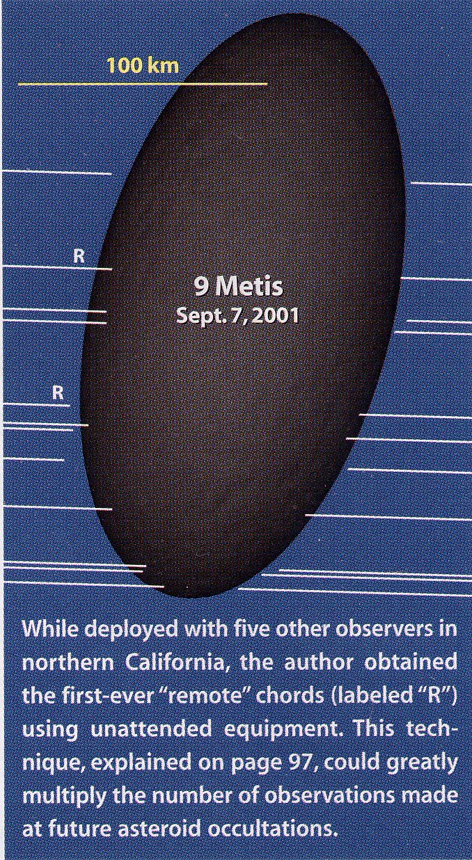
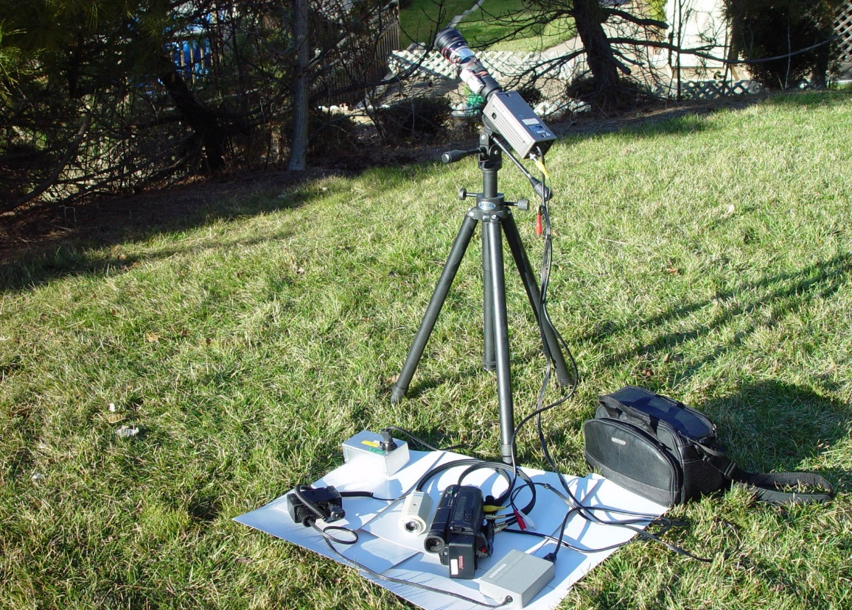
The First Mobile Remote-Station Asteroidal Occultation Success, 2001 Sept. 07
Remote station equipment used near Ormund,
California by David Dunham, using an image intensifier, medium-sensitive camera, and a 50mm Nikon lens. Cameras are sensitive enough now that
image intensifiers are no longer used.

Slide 7
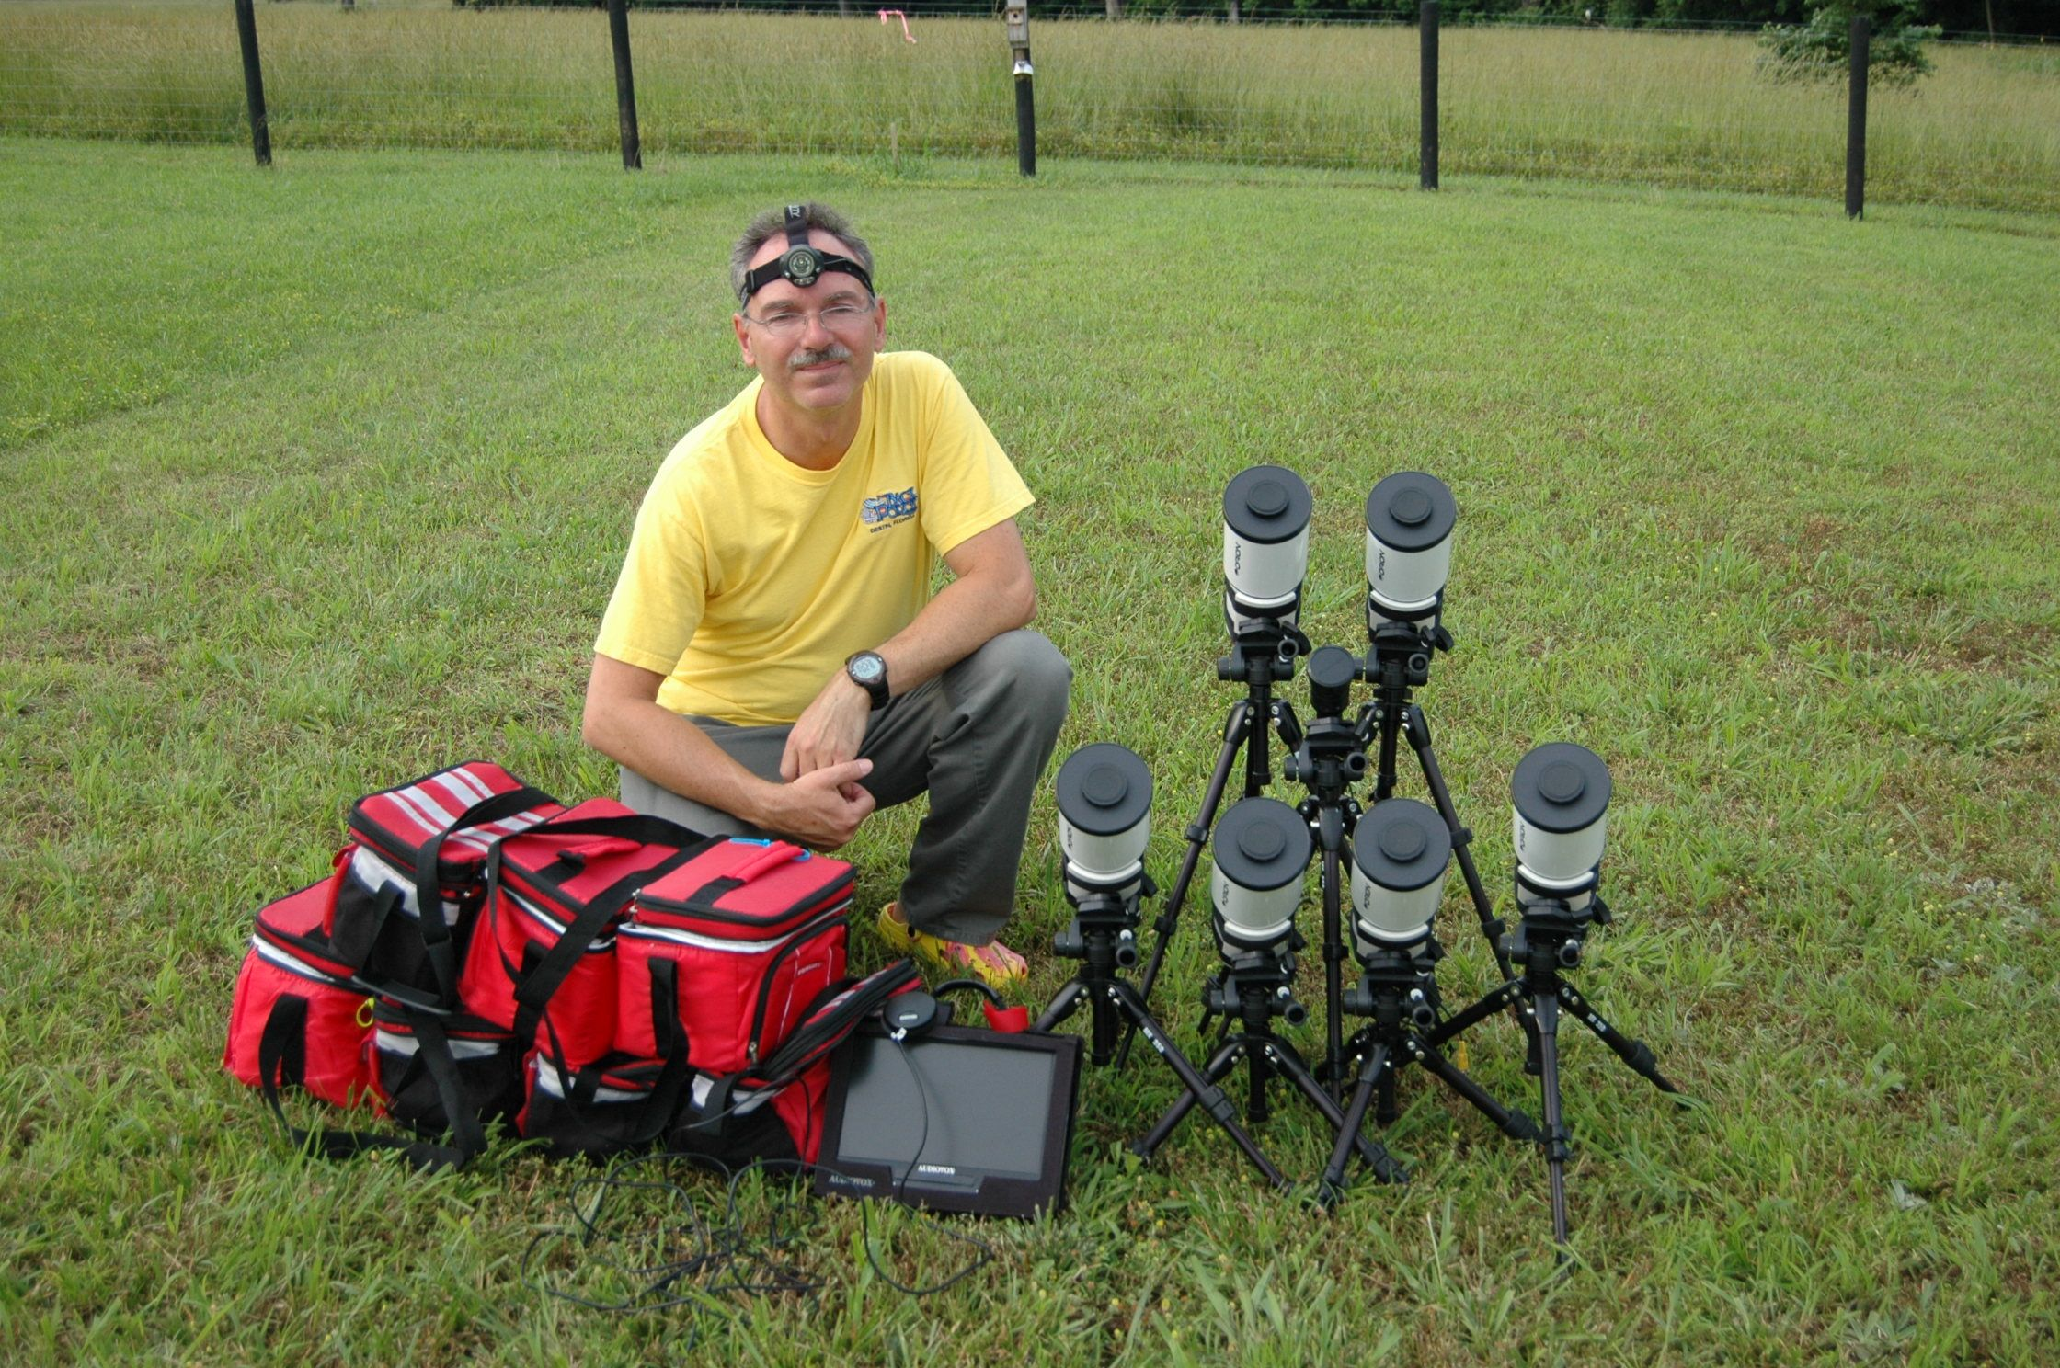
Multi-Station Occultation Observing with Galileo Sized Optical Systems
Scott Degenhardt, IOTA
Galileo’s Legacy 2009
Waianae, Hawaii

Slide 8
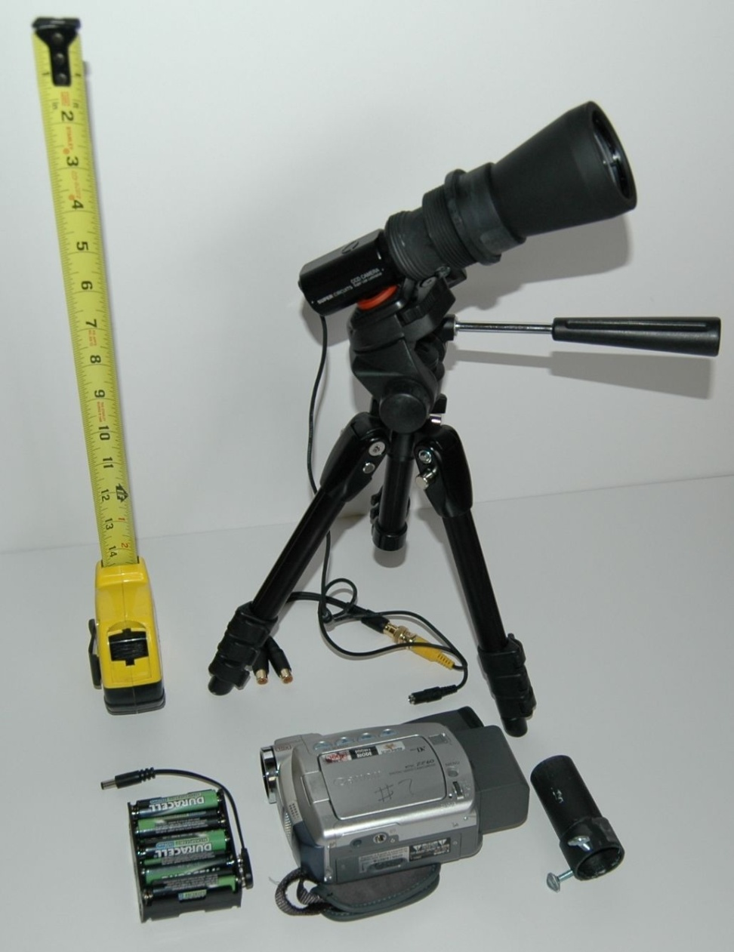
The Mighty Mini
Introduced to IOTA, 2008 Aug 21
It is a complete portable occultation
timing setup for air carryon,
capable of recording occultations of
Stars to mag. 9.5. The optics uses a
50mm lens from a $36 pair of bino-
culars (so two systems can be made
from each pair) and a low-light-level
PC164C-EX2 camera from Supercir-
cuits, supported on a small photo-
graphic tripod and a specially cut
section of PVC pipe. Canon MiniDV
tape camcorders are used to record
uncompressed video in digital format.

Slide 9
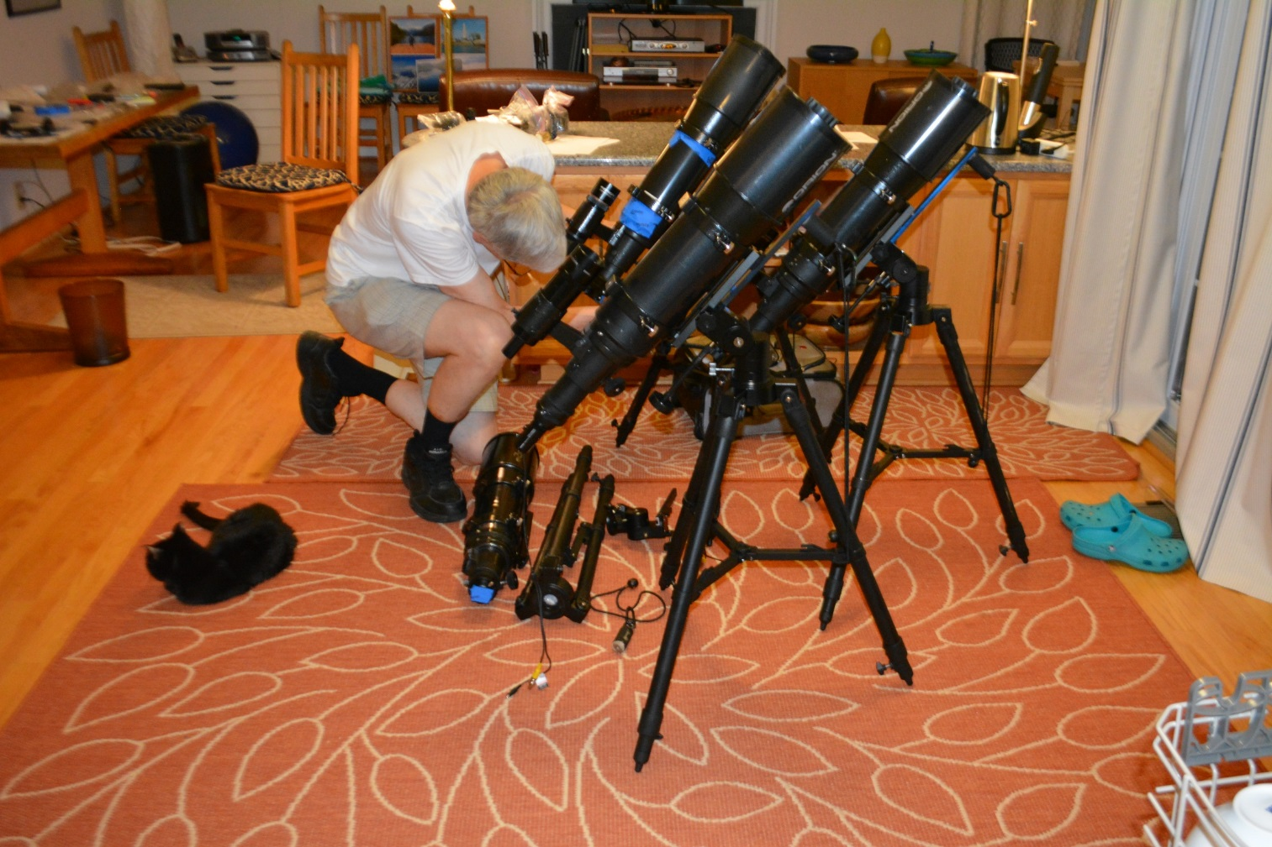
Mighty Maxi – Orion 120mm short tube
This can record occultations of stars to mag. 12.0, even mag. 12.5 under good conditions
this uses a visual finder scope and an alt-az tension mount that’s light-weight and doesn’t need a counter-weight, designed by IOTA member Ted Blank. Commercial mounts that can hold this weight cost hundreds of $, more than twice the $300 cost of the 120mm OTA.
In the photo below, 4 maxi systems are checked out before packing for an air trip to Missouri.
Not shown is a “midi”
system using an Orion
80mm short tube that
sells for about $120.
It can record events to
mag. 11.0 and a little
fainter. An OMX
photographic Tripod for
about $50 can be used
well enough for it.
6 midi’s are shown in
the picture with Scotty
Degenhardt

Slide 10
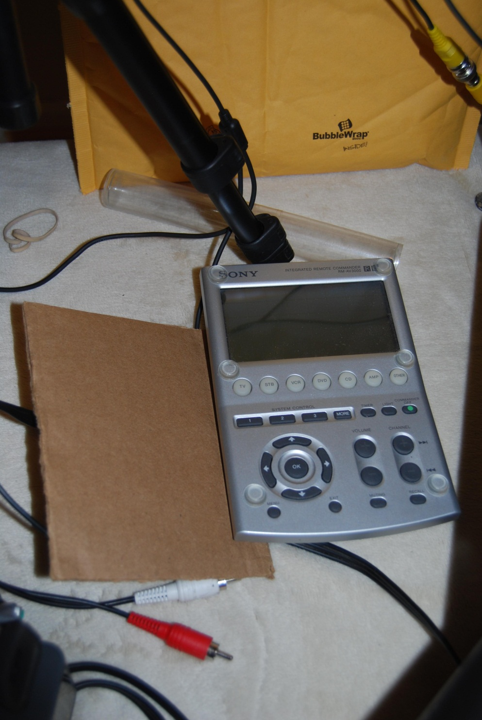
Programmable Remote for Timed Recordings
Suggested by Steve Conard. Scotty found a “100% effective” system. Place transparent plastic tube (I believe made from 2 coin holders fastened together with Scotch tape; shown at foot of tripod) at bottom of the brown mailing bag in the background. After setting the programmable remote, place it pointing down at the tube at the bottom. Turn the Canon ZR camcorder to the VCR position with front end down facing the tube. If cold, add some hand warmers. 6 plastic tabs glued to the edges of the front of the remote, and the piece of cardboard held on with the rubber band, prevent the programmable remote from turning on, which happens whenever the screen is touched.

Slide 11
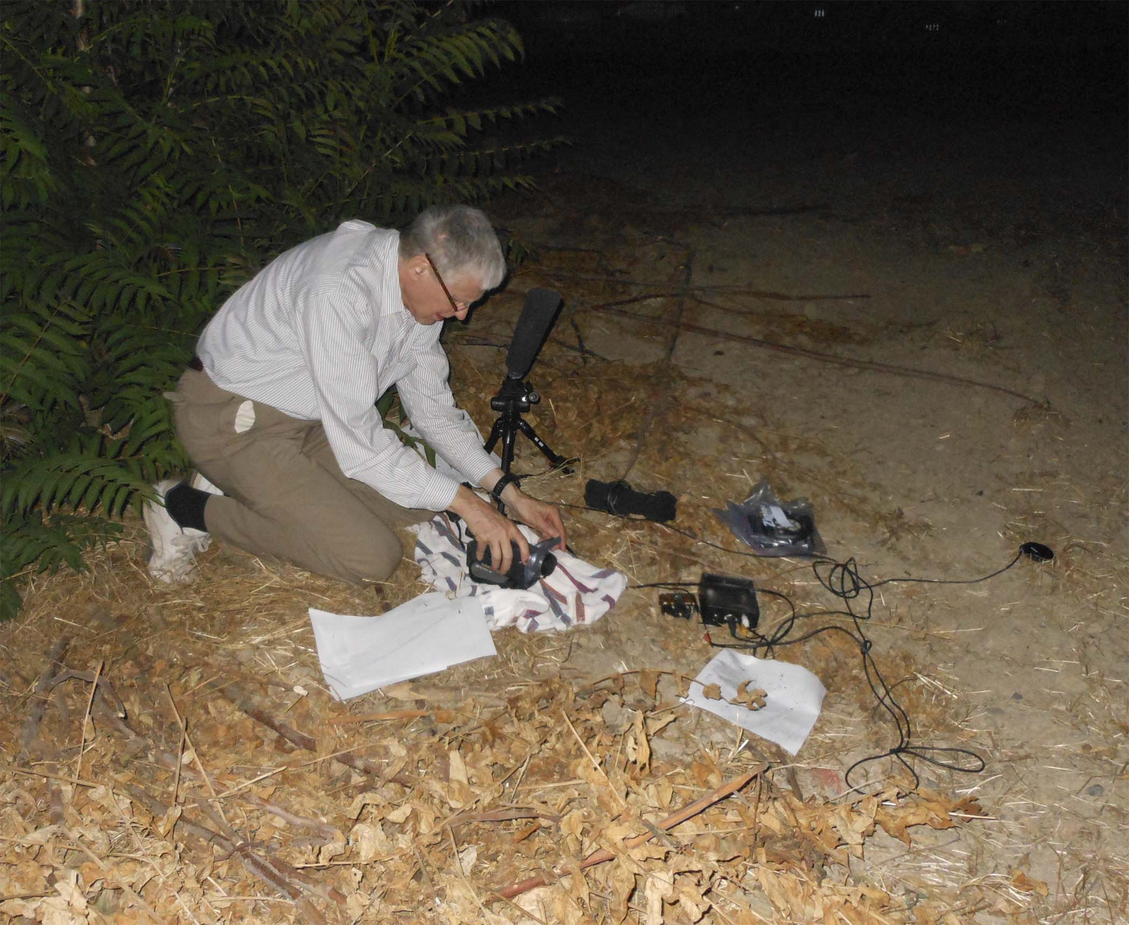
Dunham setting up a mighty mini at his station #5 in Newman, Calif., on 19 July 2011

Slide 12
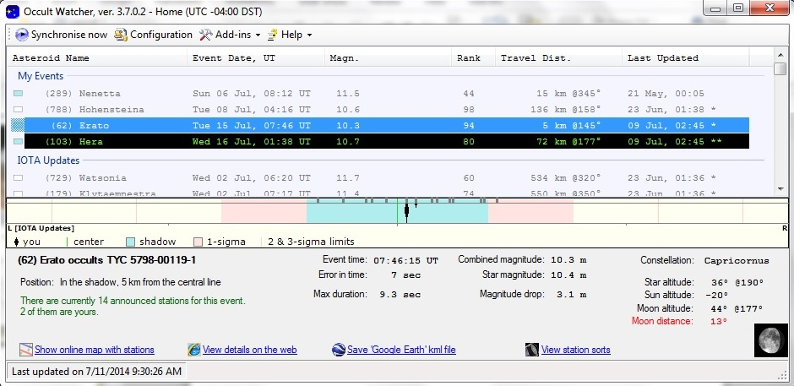
Occult Watcher Planning Tool
Used by observers to find potential occultations that they can observe, filtered by
distance (larger distances for mobile observers), star mag., etc., and give event details,
including links to star charts, etc. Through a Web interface, mobile observers can then
set up to fill gaps in coverage by those at fixed observatories.

Slide 13
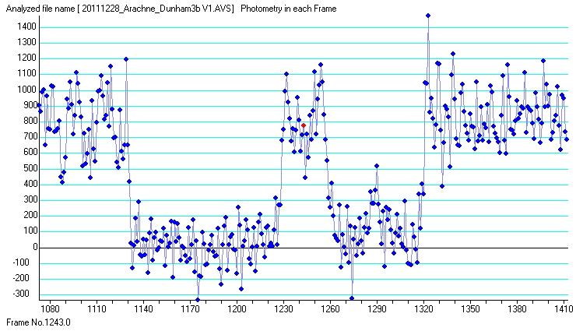
Lightcurve from Dunham Station #3 for 2011 Dec. 28th occ’n of SAO 138052 = HIP 54719 by (407) Arachne e. of Huntsville, TX
Video analyzed by Scotty Degenhardt. The site was a graze near the n. limit; the star disappeared completely behind 3 features on the edge of the asteroid.

Slide 14
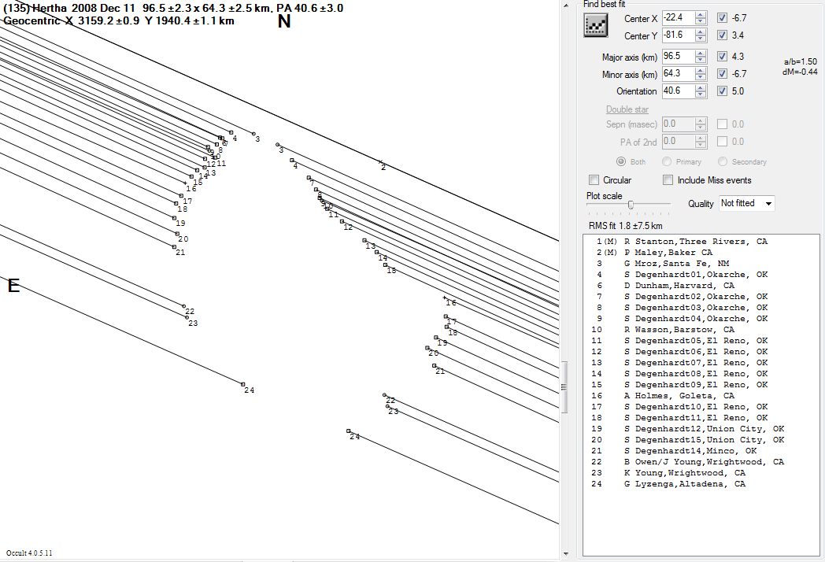
Still the record, Scotty observed from 14 stations in Oklahoma !
Scotty & I agreed
before that I would
cover the n. side & he the
s. side, so each of us could deploy more stations
across a shorter distance. This time, the path shifted
s. so he hit the jackpot. 3 LA region fixed observers expected no event,
but ended up defining the southern part of Hertha.

Slide 15
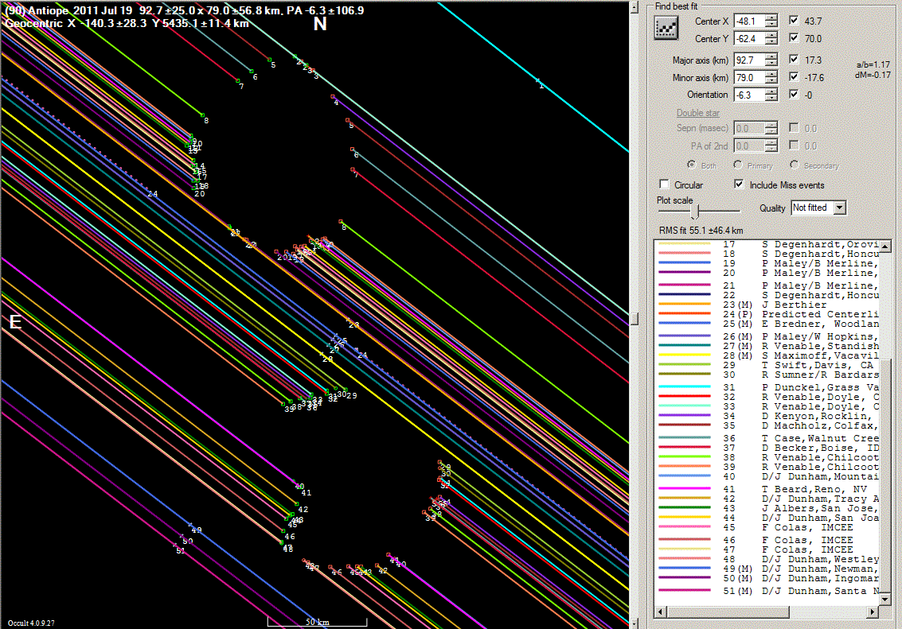

2011 July 19 occultation of LQ Aquarii by the binary asteroid (90) Antiope observed in western USA
Above is the best direct image of Antiope, by Bill Merline using AO with Keck
3d before the occultation; it allowed a good pre-diction of the objects’ orientation.

Slide 16
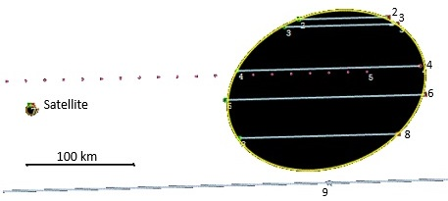
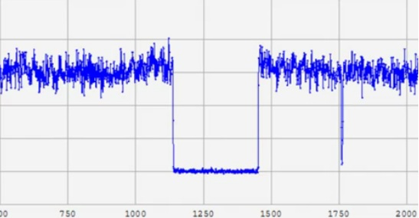
Sky-plane plot, 2012 Jan. 19th
(911) Agamemnon occultation
Below:
Light curve by Steve Conard (sta. 6) using a 14-in. SCT at his observatory at Gamber, Maryland
Above:
Agamemnon: Axes 190.6 ±0.9 by 143.8 ±1.5 km, PA minor axis -69.3° ±1.3°, center X 4661.6 ±0.4 km, Y 3113.7 ±0.6 km; Disappearances are on the right side. The probable satellite is plotted as 9-km circle (but it’s more likely about 4 km across) 0.0931″ (278 km in the plane) from Agamemnon’s center in PA 93.8°

Slide 17
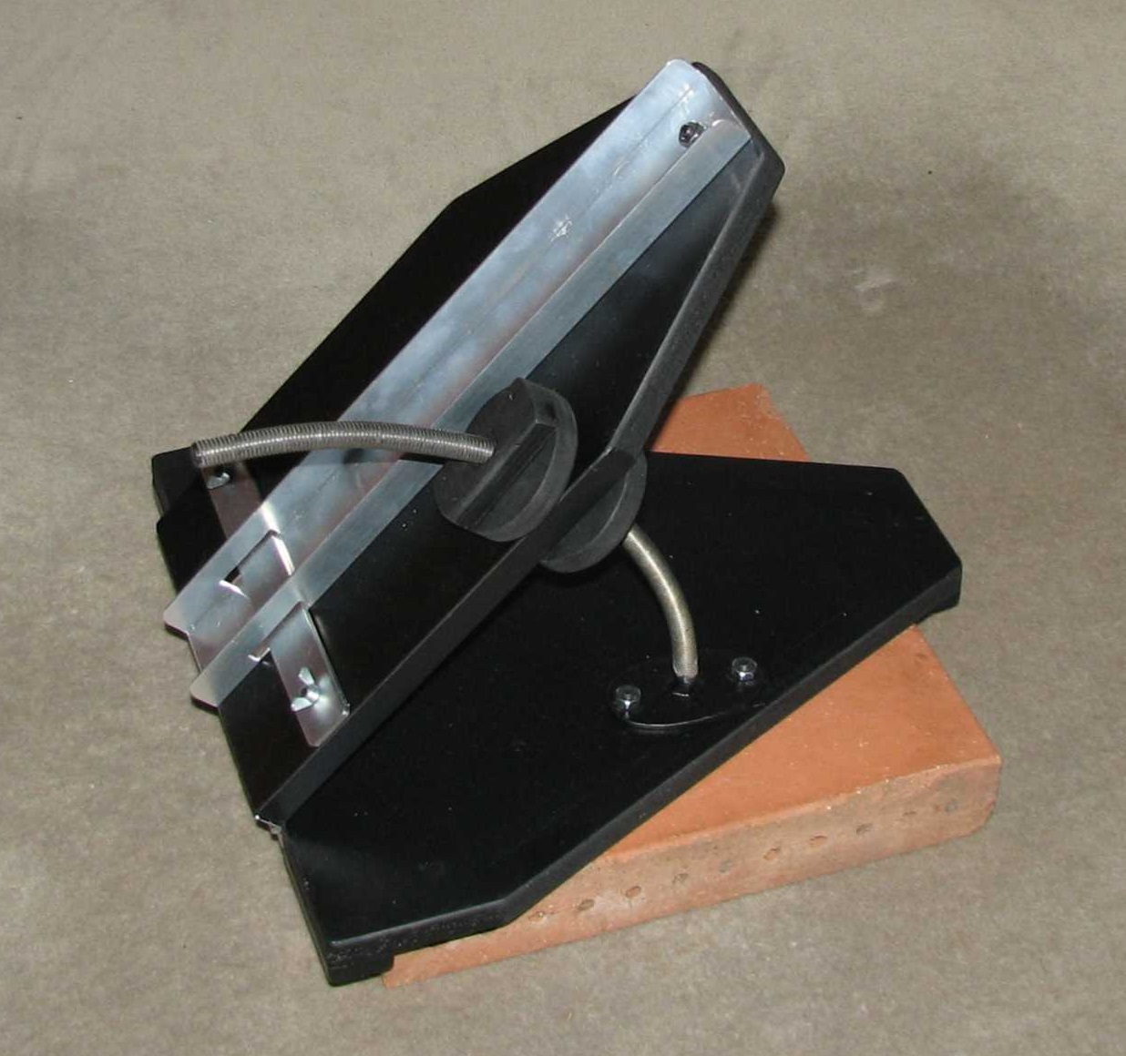
Paver mount for previous night pre-pointing
By
John Broughton,
Reedy Ck., Qld.,
Australia
The large “hinge” mount fits over the 12” paving stone that can be left in a remote
location during the day. We have started to have some success with these for events that occur early in the evening, that don’t give enough dark time to pre-point many stations in the same night before the event.

Slide 18
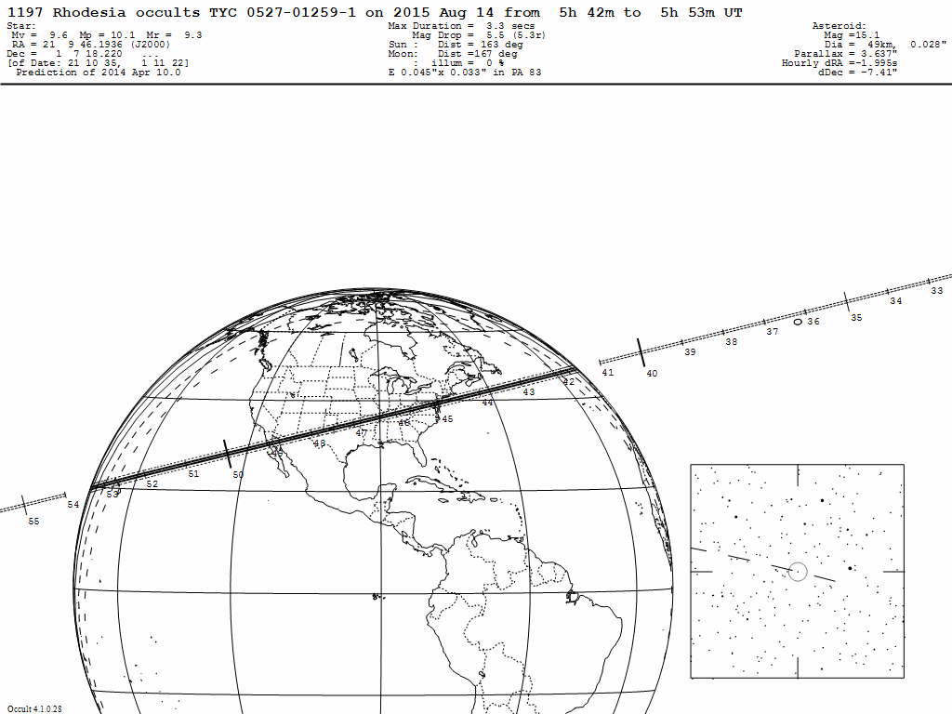
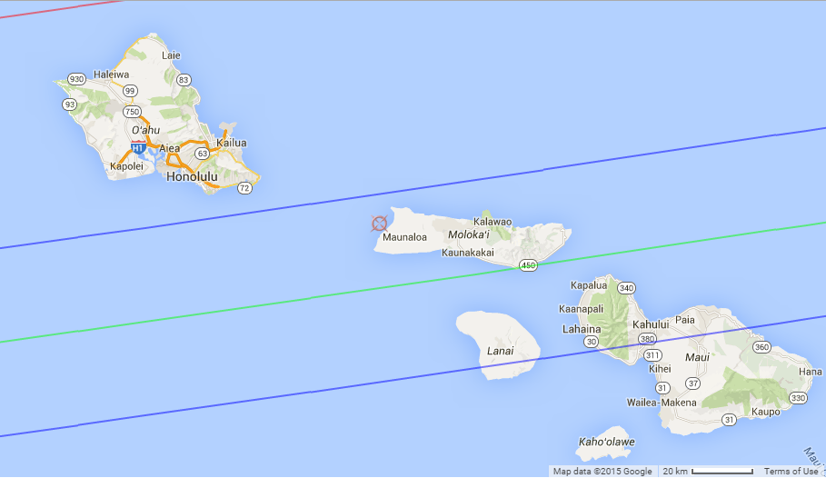
Possible Oahu occultation of 9.6-mag. PPM 171360 by (1197) Rhodesia predicted on 2015 August 13 at 7:53 pm HST
= PPM 171360
= PPM 171360
The target star is in
northern Aquarius
at J2000
RA 21h 09m 46.2s
Dec +01° 07’ 18”
Predicted size of (1197) is 49 km. The expected
central Duration is 3.3s with a 5-mag. drop. The
Predicted altitude is 24° in the east.
Northern limit if
1-σ shift to north
Predicted northern limit
More about this event will be posted here on Thurs. & Friday. Contact David Dunham if you might try to observe this. dunham@starpower.net
Cell 301-526-5590
Predicted central line
Predicted southern limit

Slide 19
Some More Comments
Also to be mentioned, recording video directly to a PC is probably the best way to record video at observatories, and also good for mobile efforts, but not for remote station use.
Another important technique is the CCD drift scan technique, since many amateur and professional observers have CCD imagers for other purposes that can be used for occultations with exposures of a minute or two – see http://www.asteroidoccultation.com/observations/DriftScan/Index.htm
Links to more hardware and software resources are at http://www.asteroidoccultation.com/observations/NA/ (and without NA/)
For reporting observations: http://www.asteroidoccultation.com/observations/Forms/AsteroidReportForms.html
Important software tools for analyzing video light curves have been developed by IOTA, including Limovie,Tangra, R-OTE, and AOTA.
To keep abreast of the latest observations and developments, ask questions, etc., you are encouraged to join the IOTAoccultations yahoo group:
https://groups.yahoo.com/neo/groups/IOTAoccultations/info

Slide 20

RASC Observer’s Handbook and
http://www.occultations.org
The RASC Observer’s Handbook contains predictions of the ∼70 best asteroidal occultations visible from North America and Hawaii during the year.
Many occultation YouTube videos are linked to from:
http://www.asteroidoccultation.com/observations/YouTubeVideos.htm
Listed on this web page are, in groups from top to bottom,
Lunar Occultation Videos; Asteroidal Occultation Videos; Jupiter/Saturn Satellite Events
Miscellaneous Events (most of them are solar eclipse videos made near the edges of total and annular solar eclipse paths)

