Slide 3
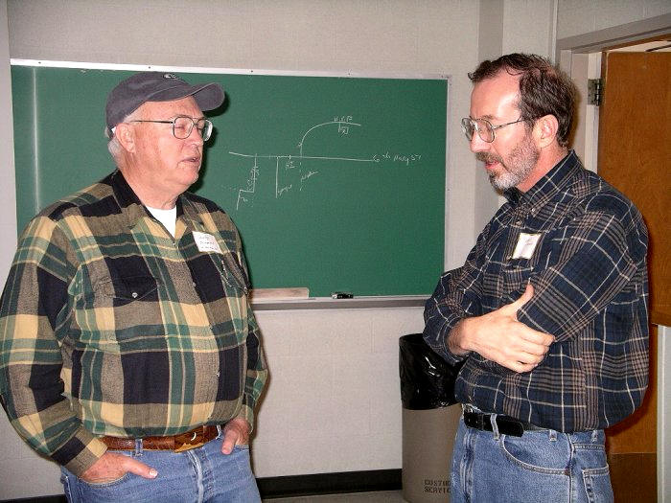
Sandy with Roger Venable at IOTA’s 2005 meeting in Stillwater.

Slide 4
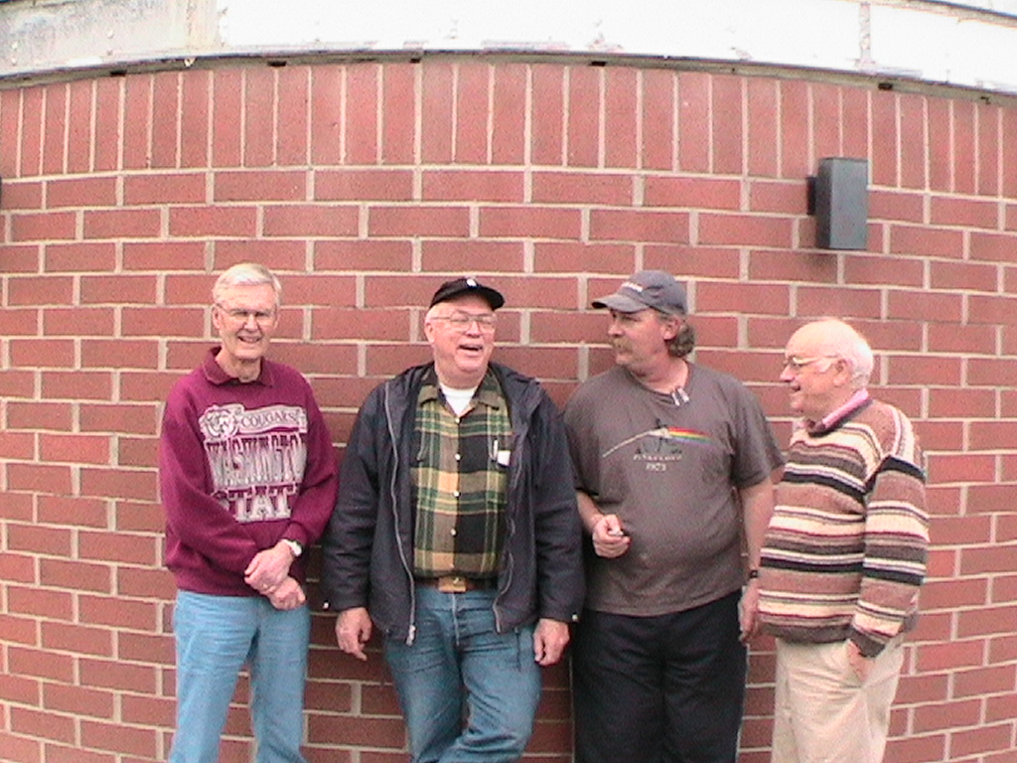
At Diablo Valley College Observatory. Left to right: Walt Morgan, Sandy Bumgarner, Derek Bright, Art Lucas.

Slide 5
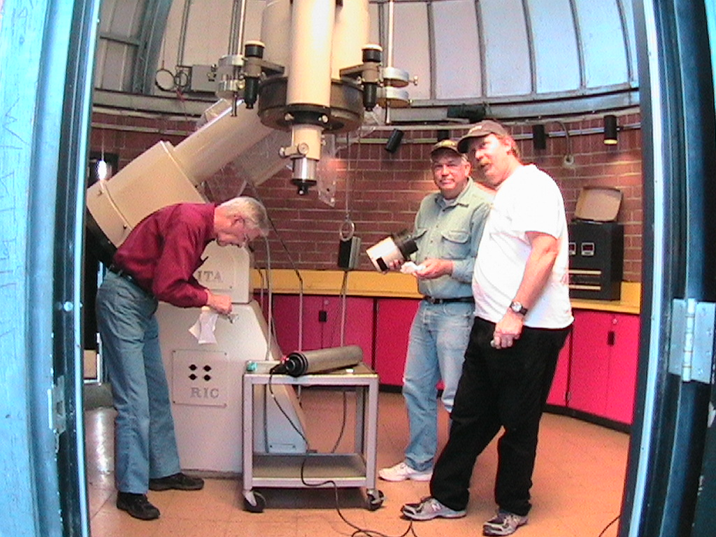
Restoring the 18-inch Cassegrain at Diablo College Observatory: Walt, Sandy, and Derek.

Slide 6
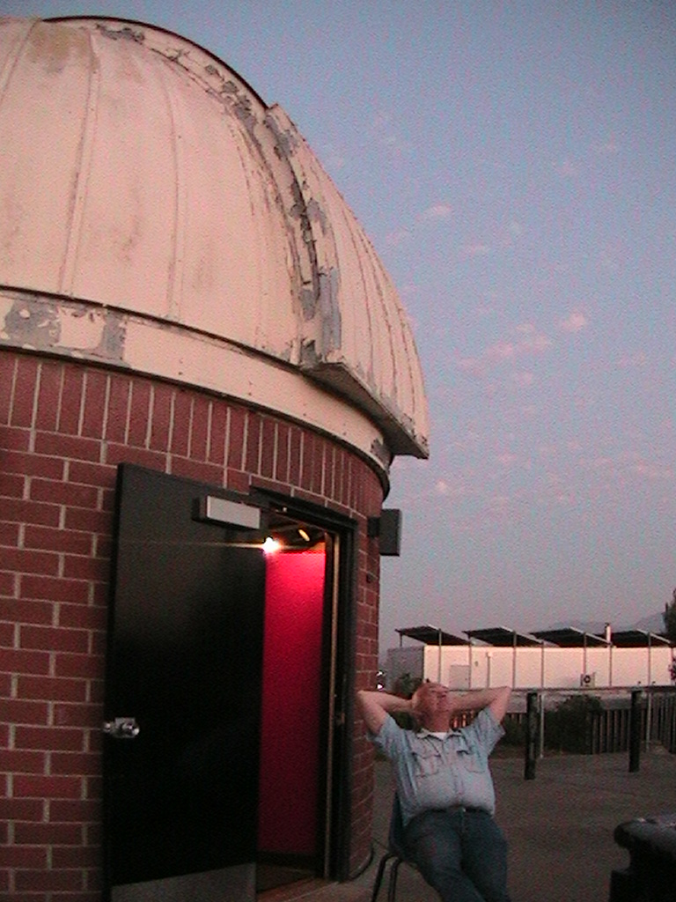
At Diablo College
Observatory:
Sandy, waiting
for darkness.
Most of Sandy’s
astronomical
observations
were made with
his Questar
Maksutovs.

Slide 7
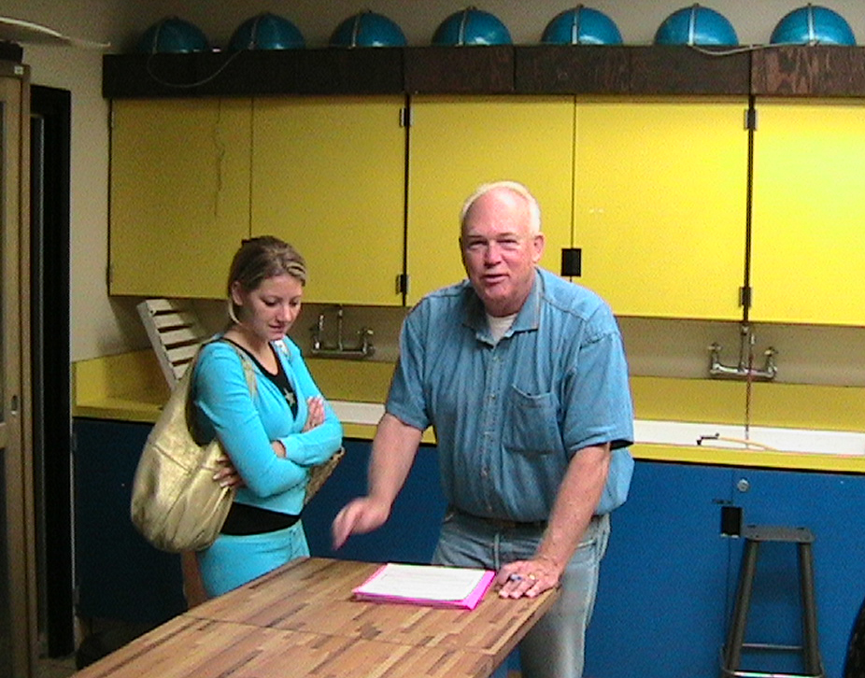
Sandy with a student. Sandy was animated, interested in everything, and always pleasant to be around.

Slide 13
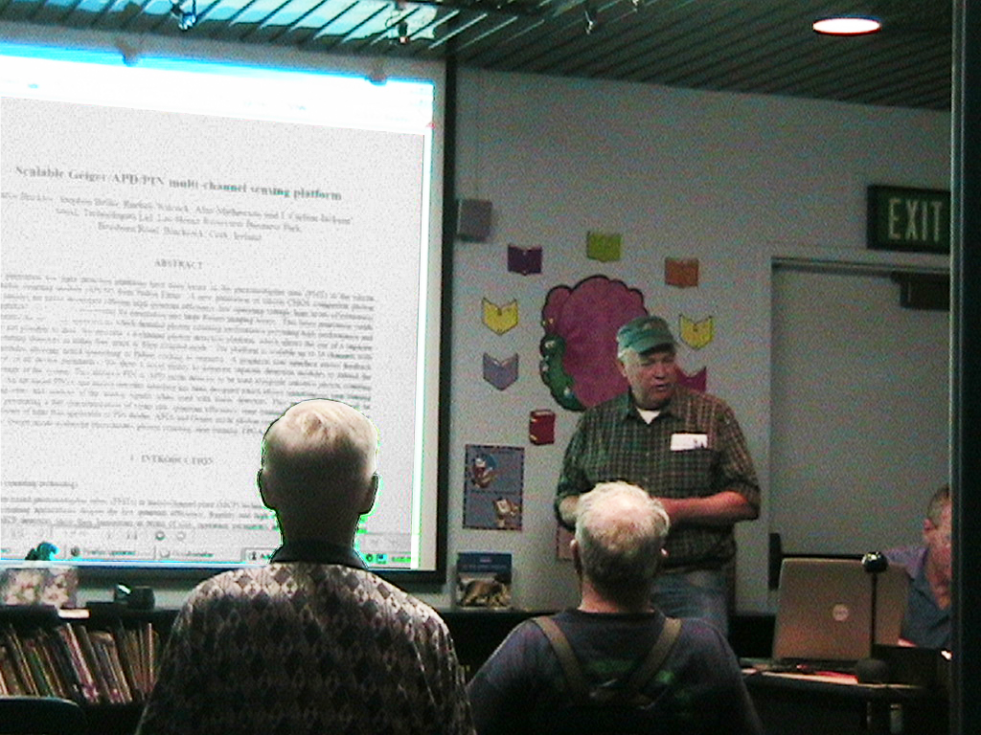
Sandy speaking at IOTA’s 2008 meeting, about EMCCD cameras, a new technology.

Slide 14
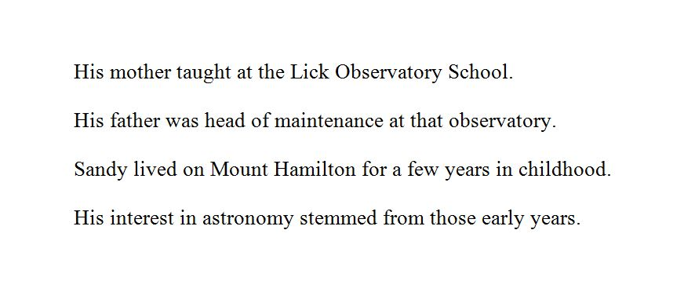

Slide 15
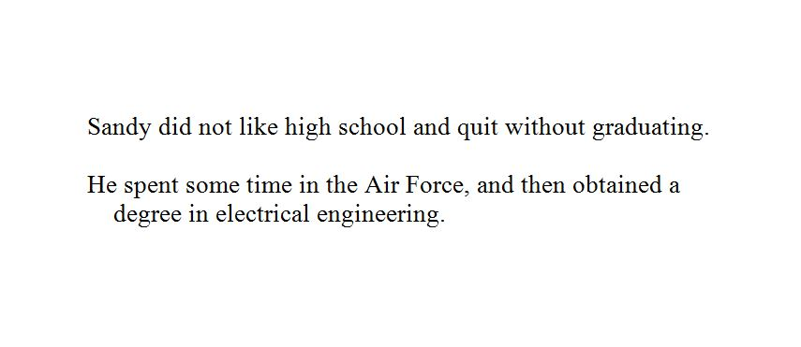

Slide 17
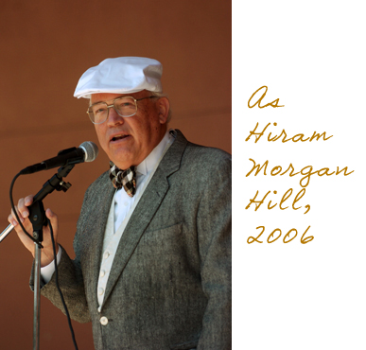

Slide 19
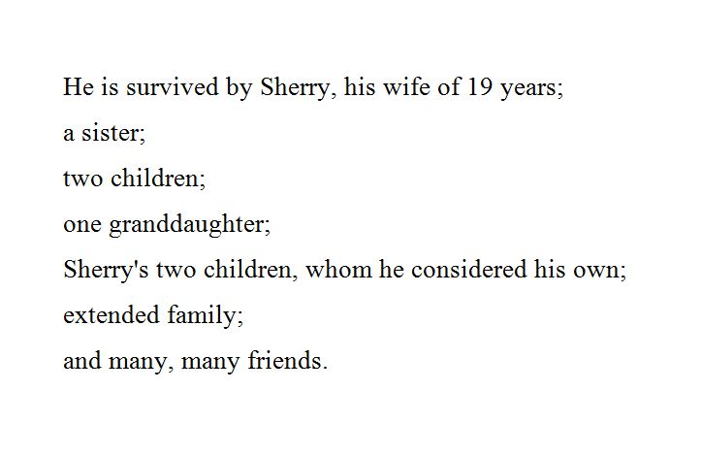

Slide 20
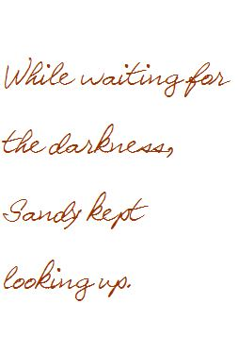

Slide 21
Thanks to Walt Morgan and Derek Breit for their assistance in preparing this presentation.

