Slide 1
Summer of `(MU)69
Marc W. Buie Southwest Research Institute
+
Many, many more

Slide 2
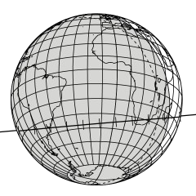
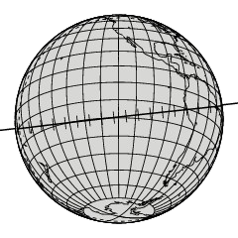
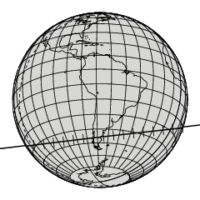
2017 Occultations
●
2017 June 3
South America and Africa Faint, g’=15.3
–
–
●
2017 July 10
–
–
Pacific
Faint, g’=15.6
●
2017 July 17
Southern South America Bright, g’=12.6
–
–

Slide 3
Deployment
●
MU20170603
13 systems to South Africa near Cape Town 12 systems to Argentina near Mendoza
–
–
●
MU20170710
–
SOFIA
No mobile ground stations
–
●
MU20170717
–
25 systems to Argentina near Comodoro Rivadavia

Slide 4
Ground track uncertainties
34 km = 1 mas
●
may25a → last orbit before June 3
–
HST data through May 25
●
lc1g2 → last orbit before July 10/17
–
HST data through July 4
●
rf3a → current provisional orbit
–
Includes Aug 2017 HST data and July 17 occultation
may25a |  |  |  | lc1gr |  |  | rf3a
Event | x-track [mas] | in-track [mas] | x-track [mas] | in-track [mas] |  | x-track [mas] | in-track [mas]
June 3 | 1.449 | 2.172 | 0.420 | 0.768 |  | 0.240 | 0.882
July 10 | 1.520 | 2.073 | 0.447 | 0.582 |  | 0.260 | 0.241
July 17 | 1.536 | 2.102 | 0.464 | 0.697 |  | 0.283 | 0.254

Slide 5
June 3 occultation goals
●
Detect or eliminate large and dark case for 2014MU69 (D=40 km)
–
–
<3% chance of a null result Only one continent required
●
Good size result if D=20 km
–
3% chance of a null result is a practical floor Both continents required
Harder to detect due to shorter chords and signals
–
–
●
Search for extra material around 2014MU69
–
–
Optically thick, narrow rings
Diffuse material, search region within 30,000 km of central body
●
Some important values to keep in mind
–
Geocentric target distance = 43.3 AU
31,400 km/arcsec, 31.4 km/mas, 1 km = 32 μas Star position (Gaia DR2) good to 100 μas
Cross-track error 44 km, timing error 3.3 sec (1σ)
–
–
–

Slide 6
June 3 deployment and result
●
22 portable 40-cm telescopes, CMOS detector with GPS timestamps
–
R=14.6, 2 Hz sampling rate, SNR~5, max chord length = 2s
●
3 portables from UVa
South America (12 in Argentina) and Africa (10+3 in South Africa) One telescope broke in shipment to Cape Town
●
●
–
mirror came loose from mount
used for spares to fix other systems
–
●
Weather good for Argentina
Weather turned in western South Africa
●
–
6 teams drove east to get away from clouds
●
24 stations collected data at desired time
–
One station strongly affected by clouds but not wiped out
●
No diffuse material or solid body signatures seen in data

Slide 7
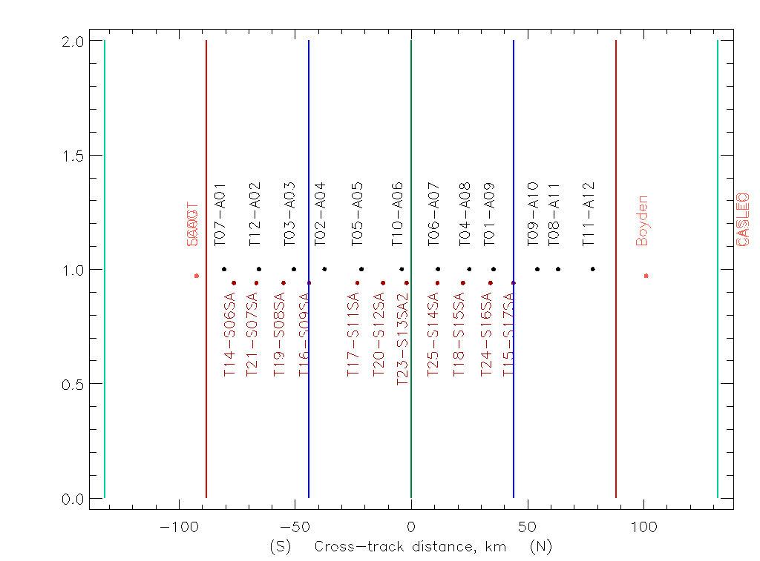
June 3 picket fence

Slide 8
July 10 occultation goals
●
Search for diffuse or ring material
–
±30,000 km for stability region = 45 minutes
●
Probe as close to the solid body as possible
–
Solid body event would be a bonus result
Target within 1-2 km and 1 sec of predicted path
–

Slide 9
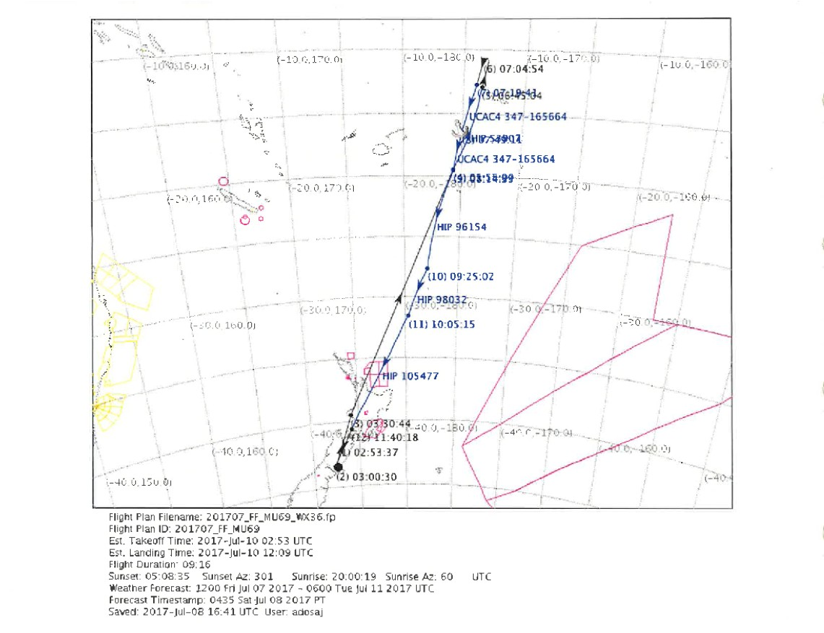
SOFIA flight path

Slide 10
July 10 preliminary results
No diffuse material or rings seen
No obvious solid body signature seen
Aircraft got to the requested location and time within requested bounds
●
●
●

Slide 11
July 17 occultation goals
Strike-out? Or, third time’s charm Solid-body event a top priority Cover larger uncertainty range
–
●
●
●

Slide 12
July 17 deployment
Coverage of ~4.5σ (~100 km) Spacing was ~4-5 km
Centerline passed over Comodoro Rivadavia
●
●
●
–
5 chords
Longest was ~1 sec Shortest was ~0.3 sec
–
–
●
Shape is not simple

Slide 13
July 17 results
●
Centerline passed over Comodoro Rivadavia
–
5 chords
Longest was ~1 sec Shortest was ~0.3 sec
–
–
●
Cross-track error was reasonable
In-track error is larger than it should be Shape is not simple
●
●

Slide 14
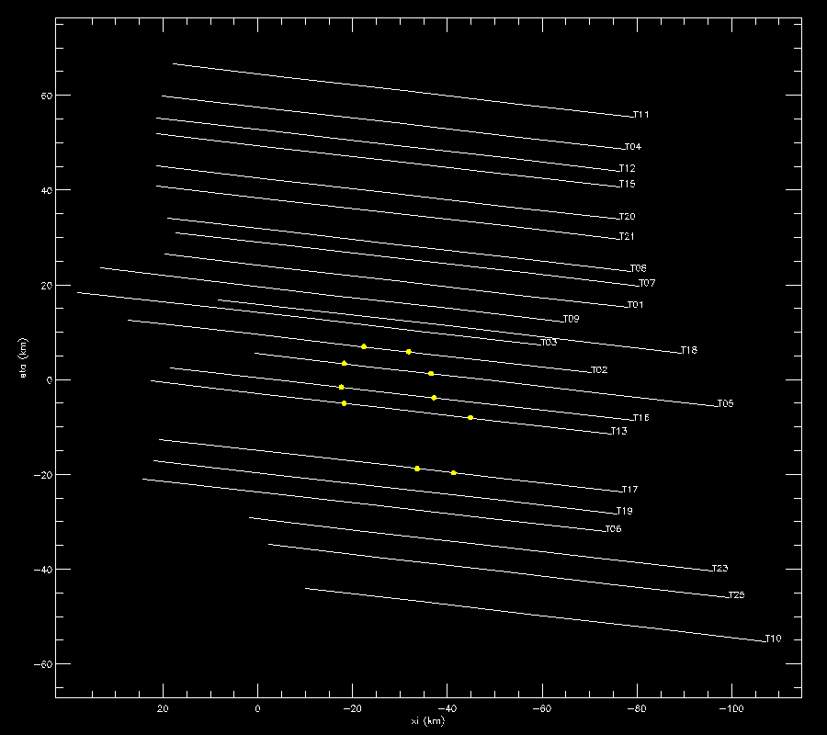
July 17 data

Slide 15
Shape interpretation
●
Single object
–
34x20 km, very irregular in shape
●
Contact binary
–
34x19 km
●
Close binary
D₁=20 km D₂=16 km
–
–

Slide 16
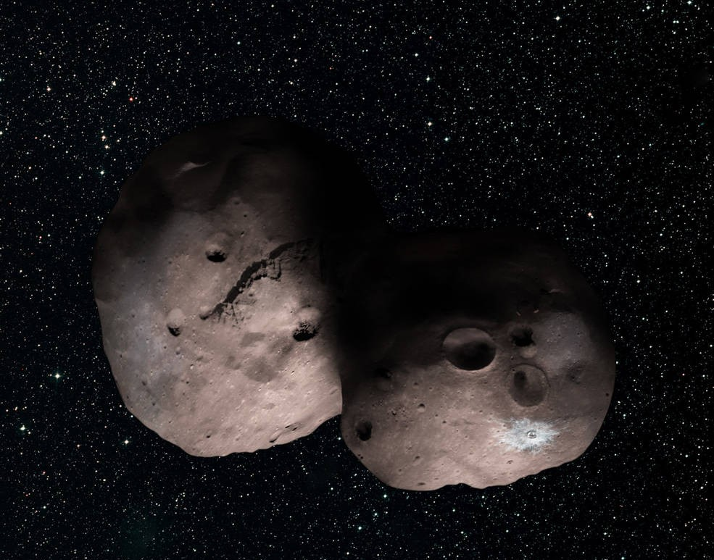
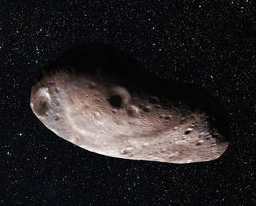
Open Questions
Explain the June 3 miss Explain the July 10 miss
Explain the tension between HST and occultation astrometry
●
●
●

Slide 17
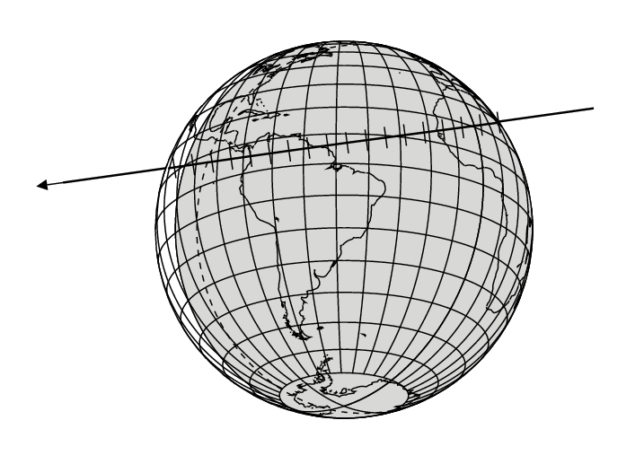
What’s Next?
●
MU20180804?

Slide 18
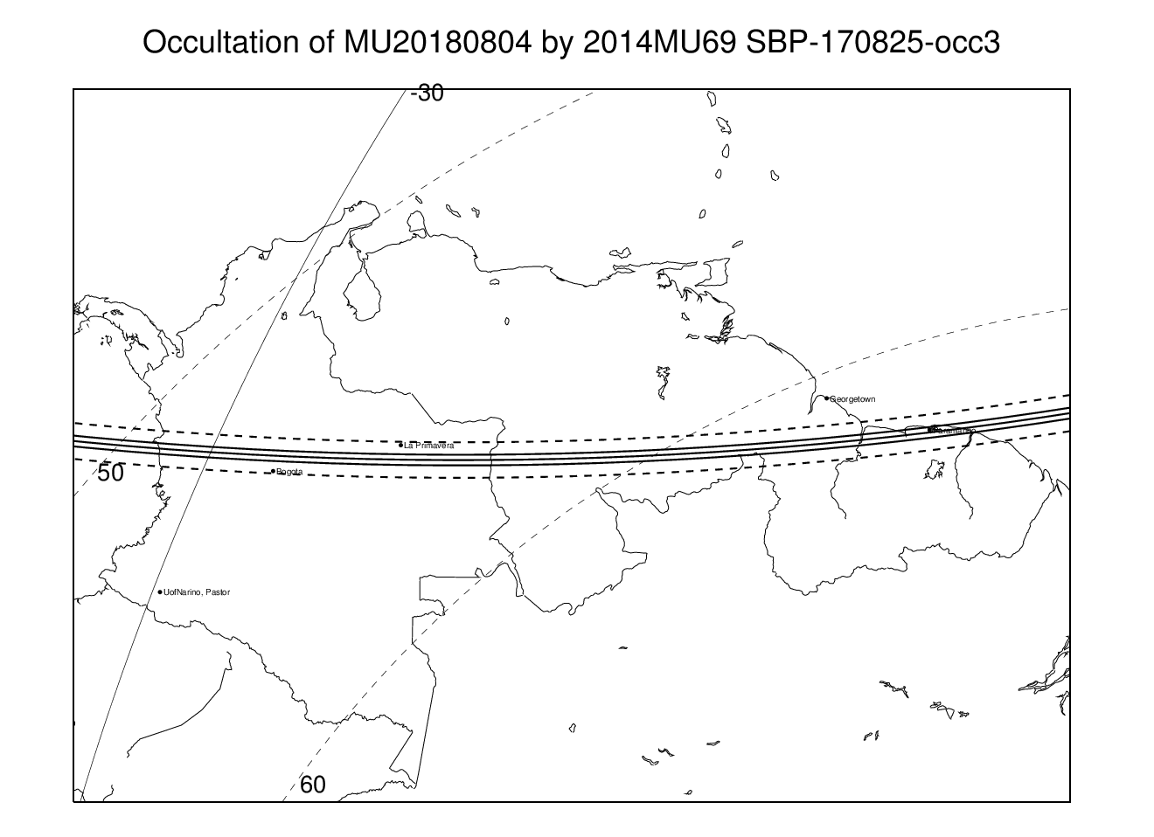
South America

Slide 19
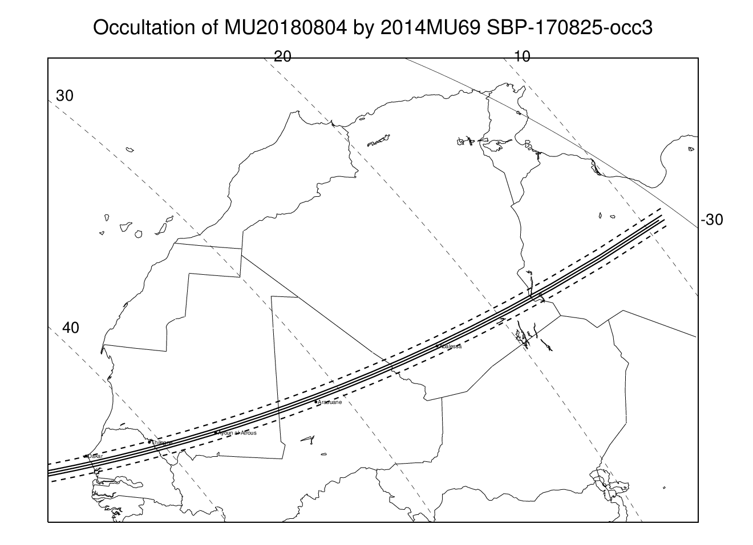
South America

