Slide 1



Teachers, Students, & Communities Exploring the Outer Solar System
Marc Buie, Southwest Research Institute, Boulder CO John Keller, Cal Poly, San Luis Obispo, CA
This material is based upon work supported by the NSF under Grant No. 1212159.

Slide 2
Project Goals
TNO size and shape measurements
Minimum diameter, 100 km
Improved densities for those with moons
Probe for secondary objects
Improved resolution compared to HST
Probe for extended structures
Rings, dust, atmospheres
High-precision astrometry

Slide 3
RECON
Research and Education Collaborative Occultation Network
Fixed network of sites, we let the shadows come to us
6-8 campaigns per year
Each site is a community team, teachers, grade 4-12 students, amateur astronomers
For more details, see Astronomical Journal, volume 151, article number 73 (2015).

Slide 4
Site Organization
One (or two) team leaders
Usually teachers, but can also be community members
Central point of contact
Team members, ideally 4-5
Teachers, community members (all adults)
Student Participants
As many as each team can attract
Goal: students run the equipment and take data with training and supervision provided by the adult team members

Slide 5

Lessons Learned: Recruiting
Face-to-face recruiting used
Going to the site helped make a statement about the importance of their location to the overall effort
Very high recruiting rate
Initial target was 40 sites, we found ways to accommodate a dozen more
Picked up extra self-funded volunteer sites along the way

Slide 6
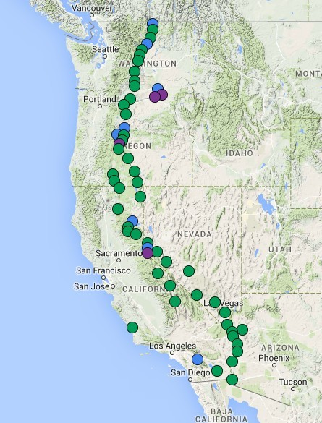

Slide 7
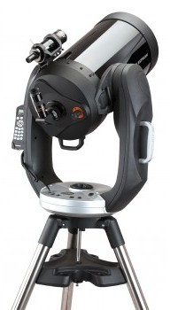
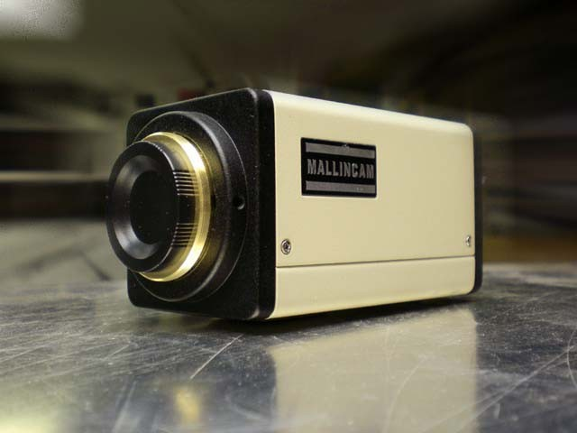
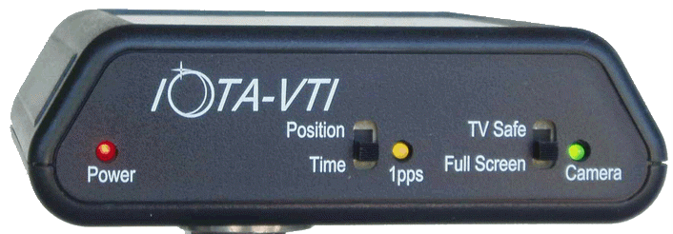

Mallincam RECON 428/828 video camera
Total cost per site, $5000
IOTA-VTI
GPS timer
28-cm telescope Celestron CPC 1100
Laptop computer

Slide 8
Lessons Learned: Training
Three initial training workshops, 180 attendees in all used to provide seed knowledge to each team
2.5 day workshops sufficient to train those that never used a telescope before
Local mentors have been a significant resource to help inexperienced observers learn the system

Slide 9
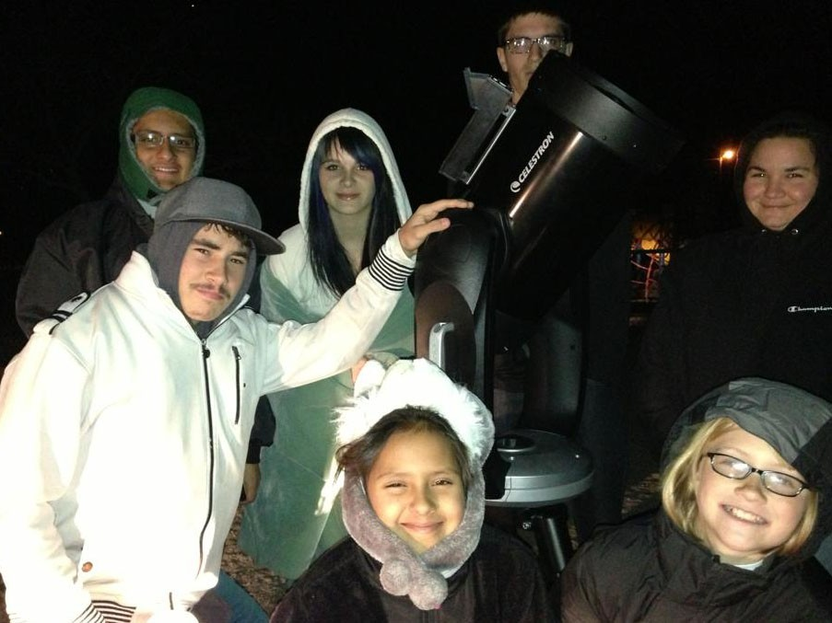
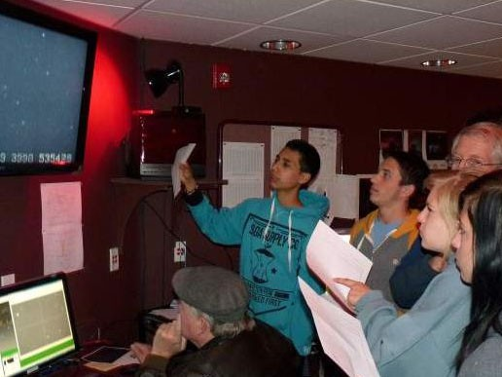
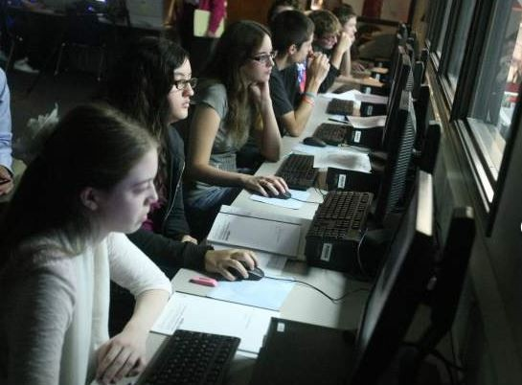
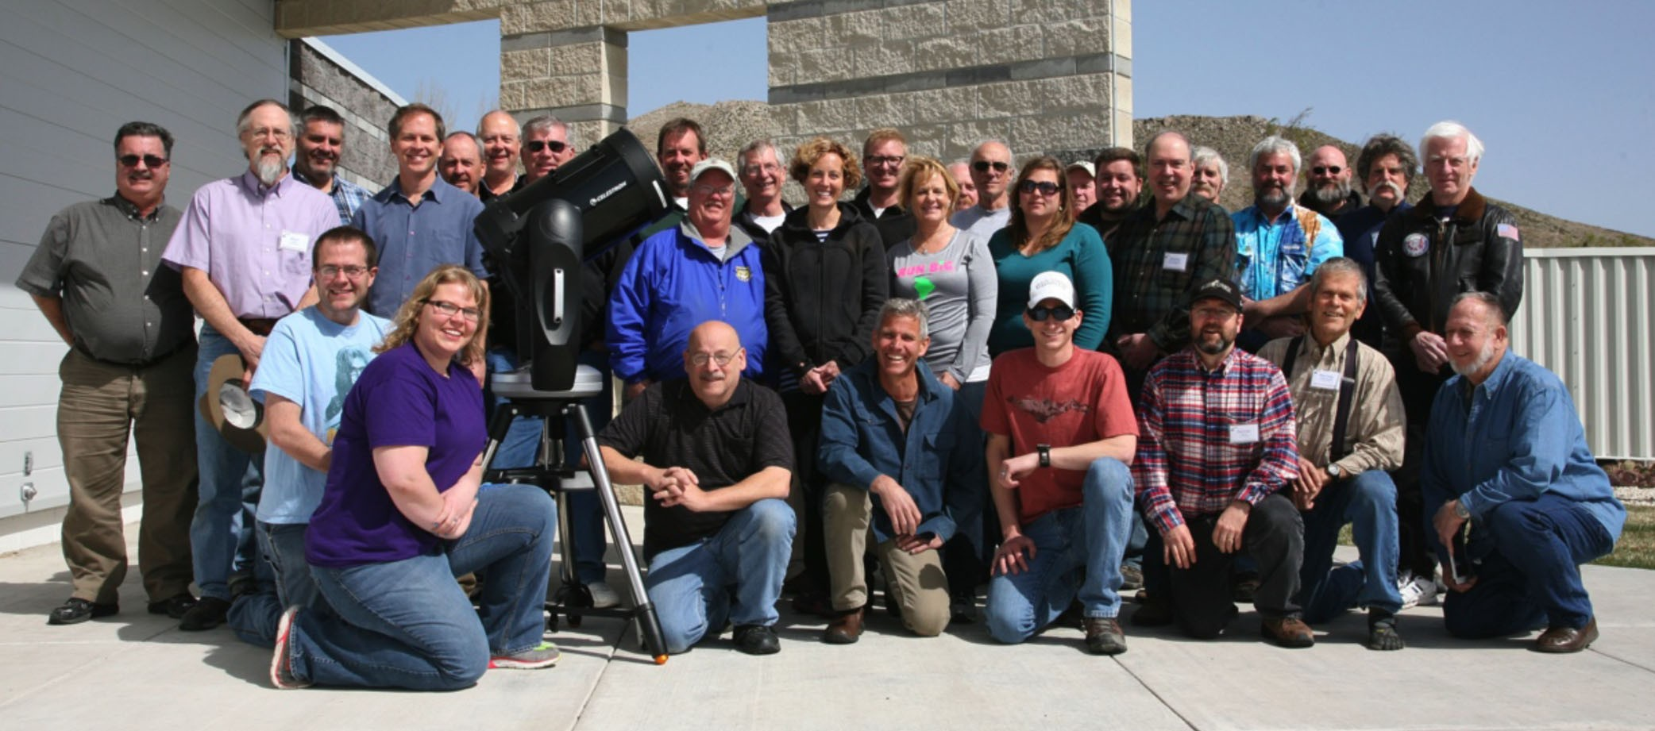
Credit: RECON
Pilot: Carson City, Nevada, April 4-7, 2013

Slide 10
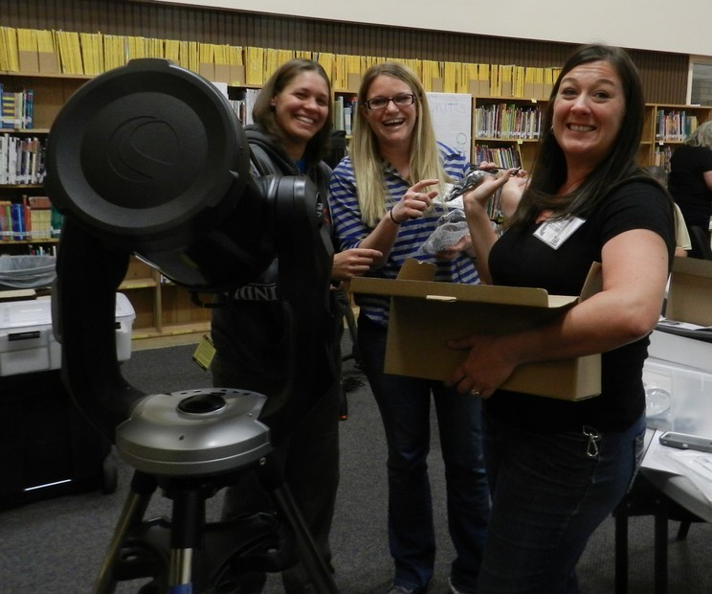
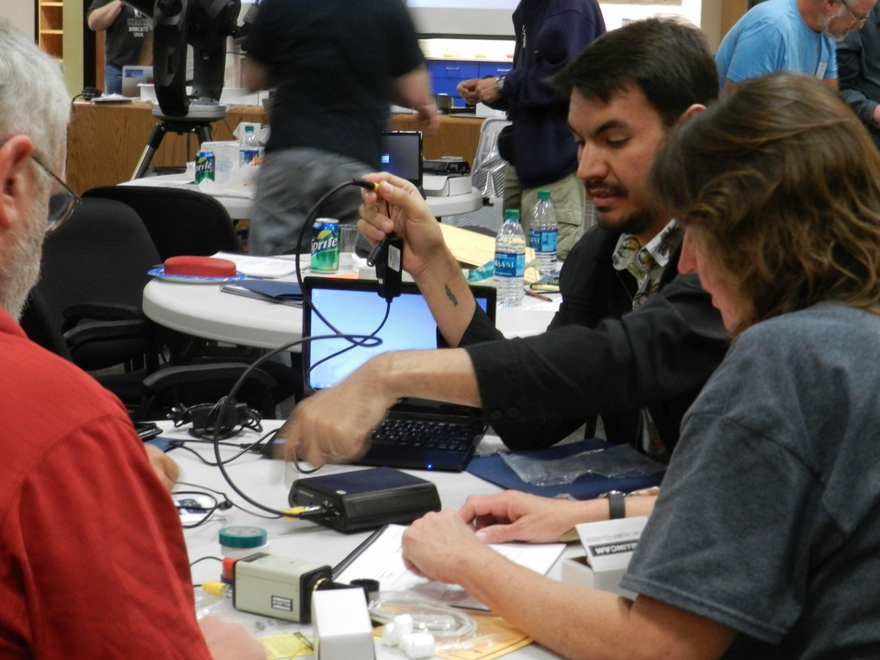
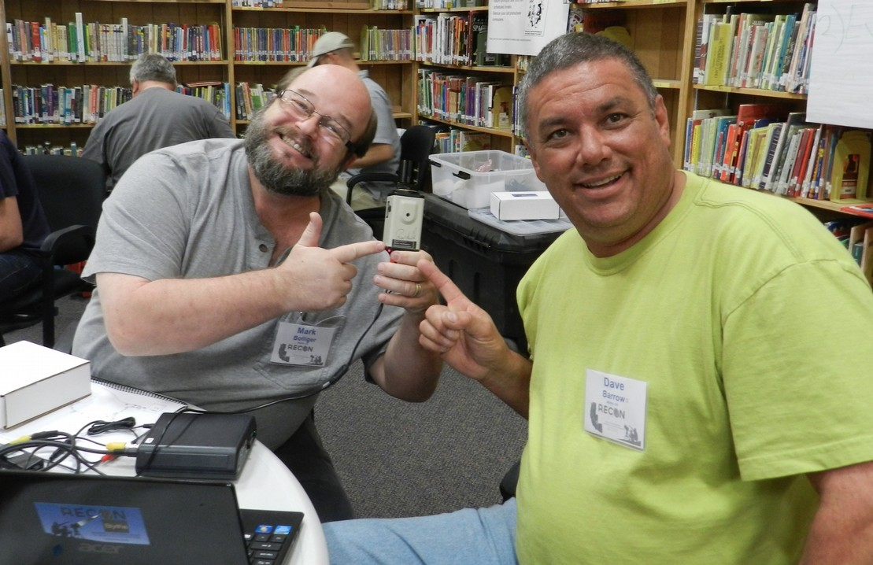
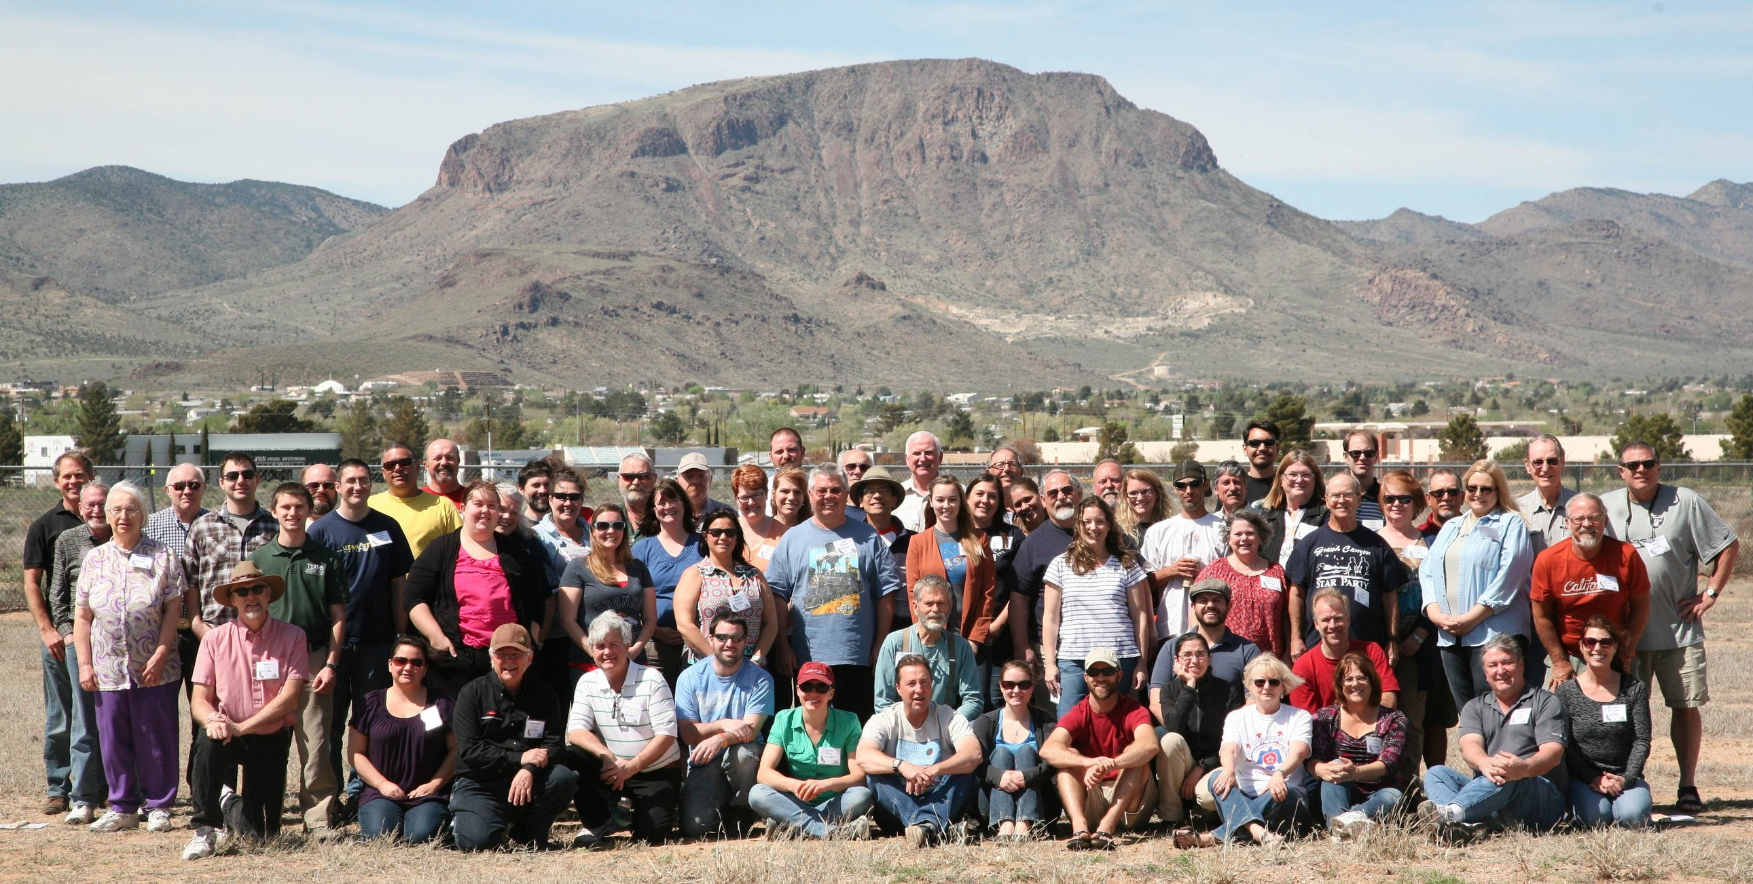
Kingman, Arizona, March 19-22, 2015

Slide 11
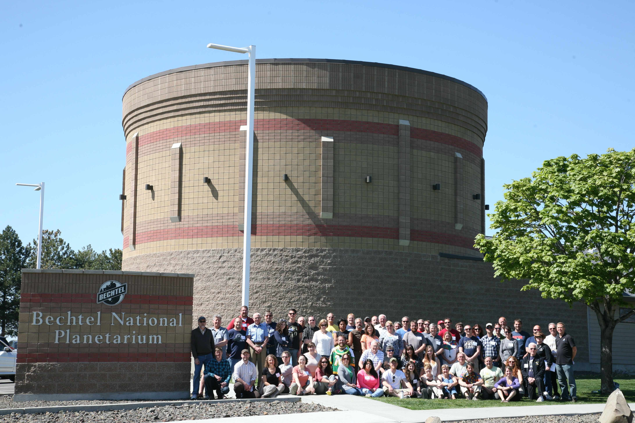
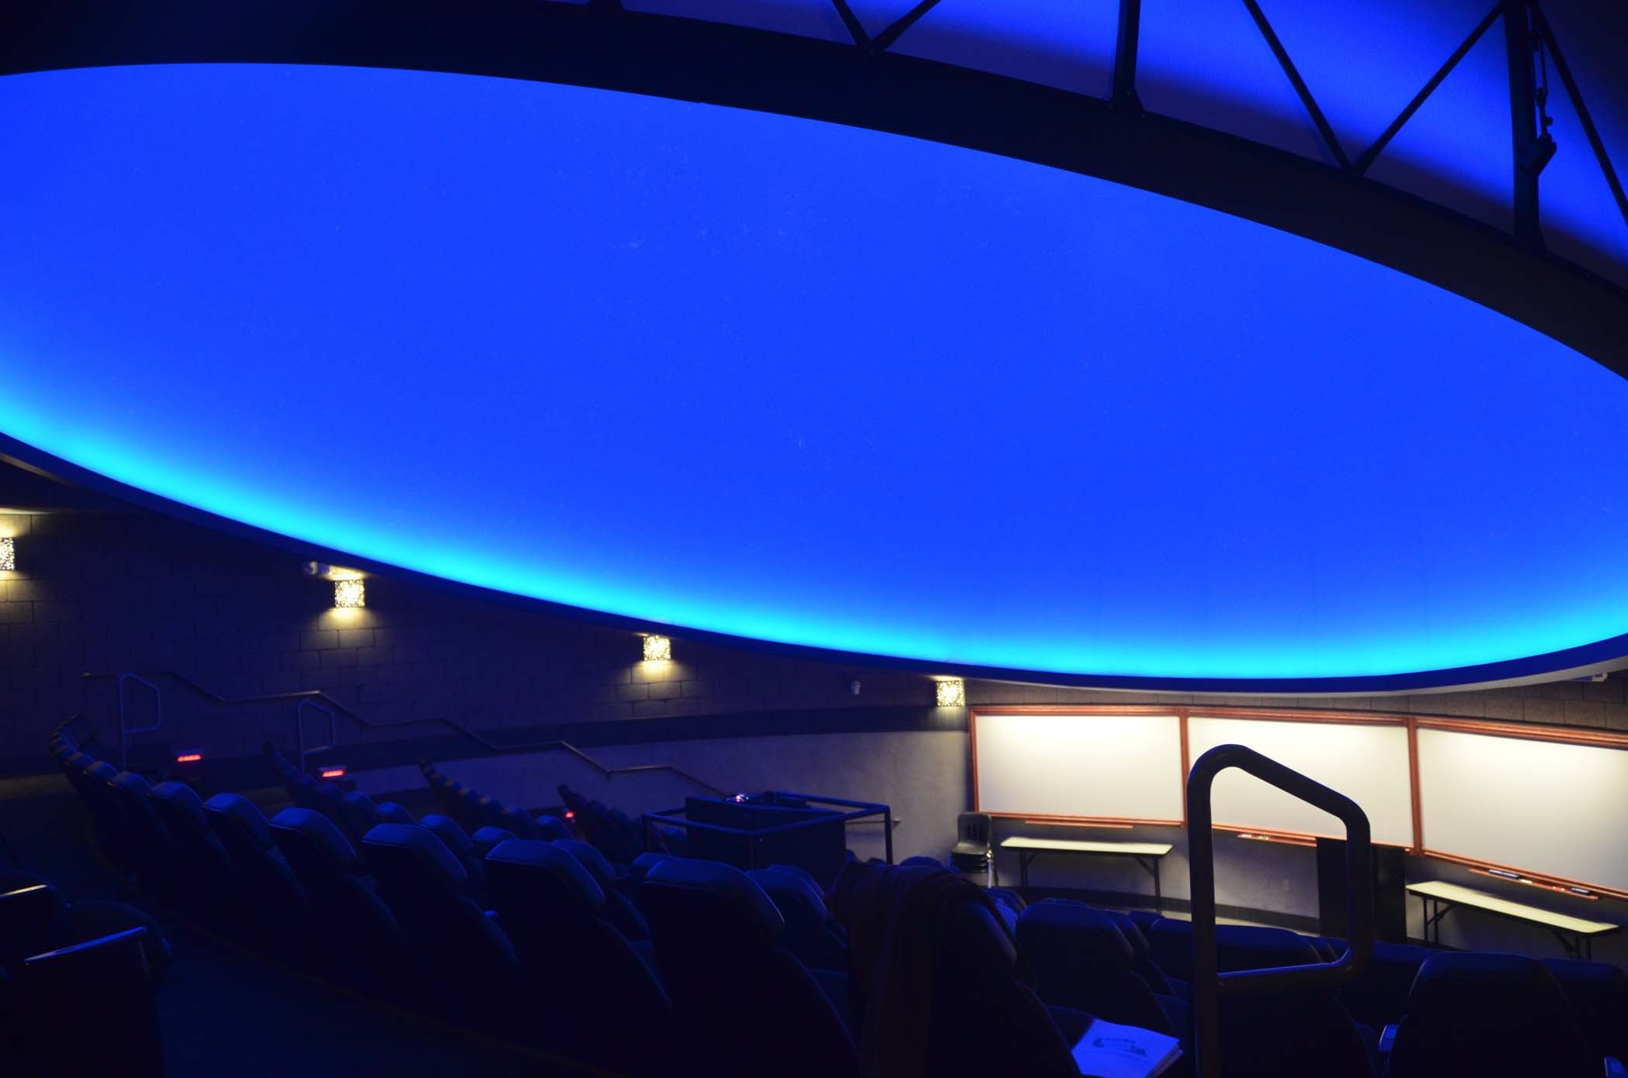
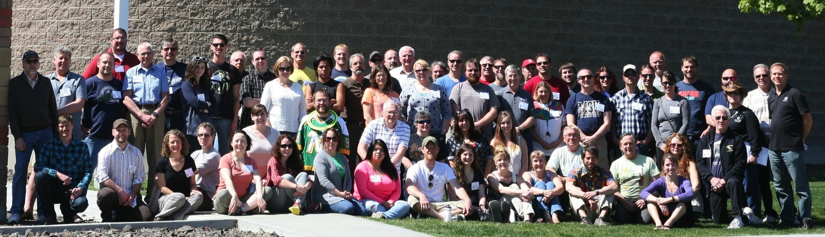
Pasco, Washington, April 16-19, 2013

Slide 12
First published campaign
Astronomical Journal 149, 113 (2015)
Patroclus/Menoetius
Jupiter L₅ Trojan
Equal mass binary
Discovered in 1906
Binary discovered in 2001
Rotation period 103.5±0.3 h, pair assumed to be doubly synchronous
Thermal data during mutual event in 2006
Total area diameter of 145 km

Slide 13
Occultation on 2013 October 21
Very large IOTA campaign
Last minute prediction
Important test of RECON system
Orbital phase unknown, requiring a very large deployment
Double object led to enhance interest in the event

Slide 14
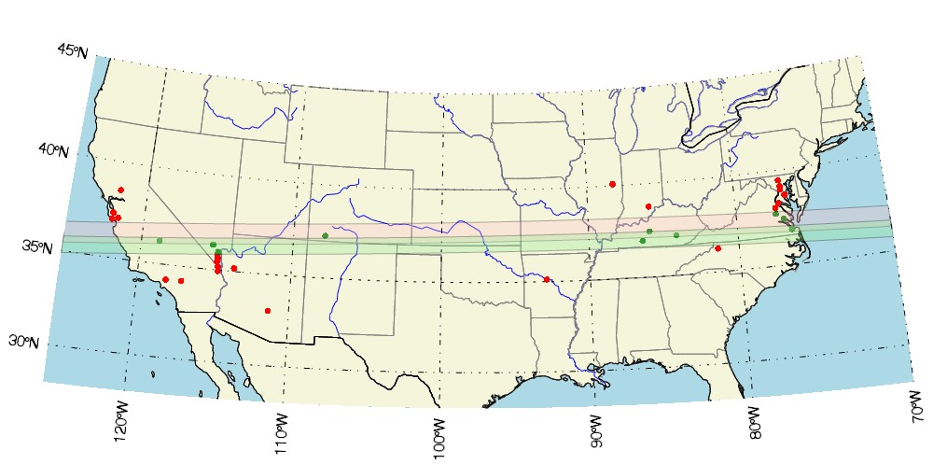
Ground-tracks
Dots show all attempts red – no event seen green – event(s) seen

Slide 15
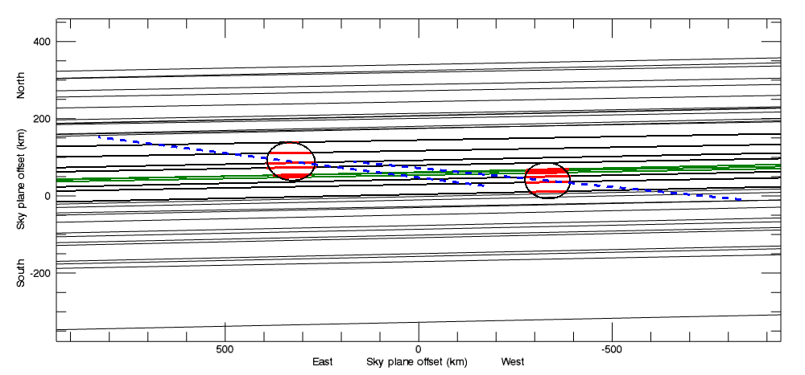
Observations, wide-view
Major-axes are aligned with each other an line between objects

Slide 16
Additional Results
Patroclus: 127 x 117 x 98 km
Menoetius: 117 x 108 x 90 km
System bulk density 0.88 g/cm³
More oblate in shape than prolate
Current shape is not in equilibrium with current spin
Consistent with rotation periods of 6-9h
Prior separation of 7-8R (now 12R)
Perhaps an escaped TNO
Final flyby target of new Discovery Mission: Lucy

Slide 17
First TNO, (229762) 2007 UK
126
Astronomical Journal, 152, 156 (2016)
2014 November 15 event
– pilot network only
Scattered disk (SCATNEAR)
– a=73.6AU, e=0.50, i=21.4
One known moon, orbit unknown (Δm=4)
H_{V} = 3.5 (estimated R=300 km)

Slide 18
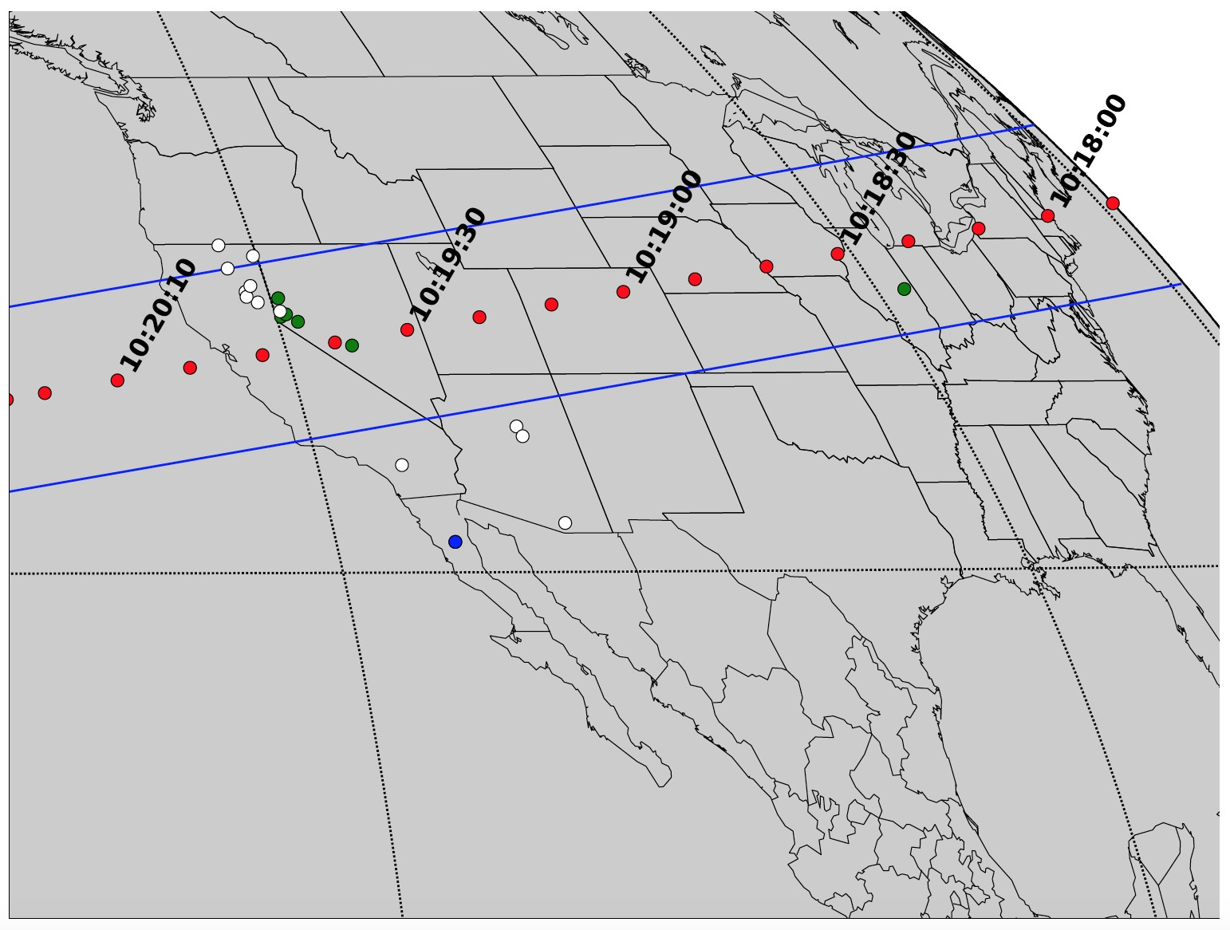
Path of (229762) 2007 UK
126
2014 November 15

Slide 19
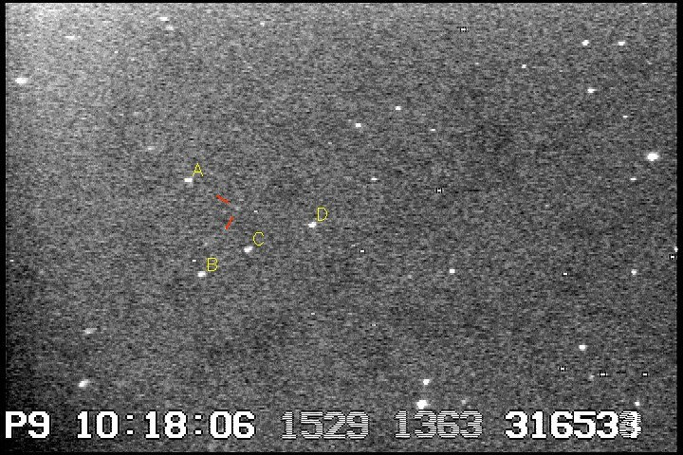
Field
UCAC4 448-006503, R = 15.7

Slide 20
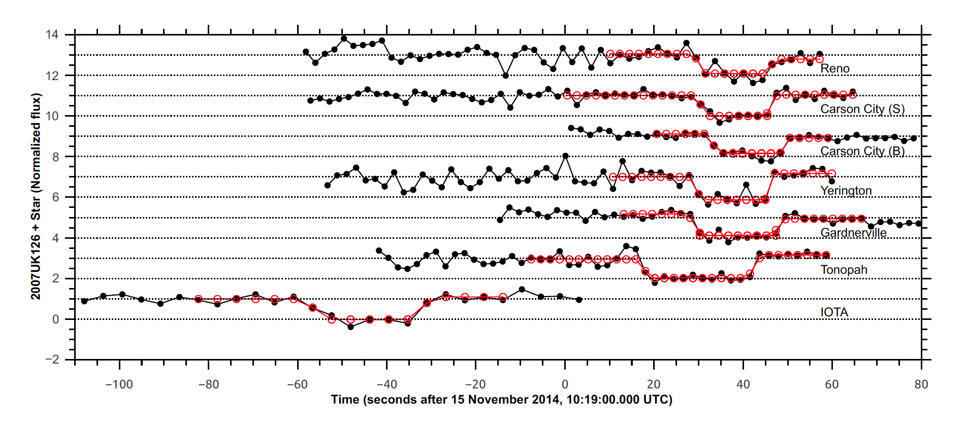

Slide 21
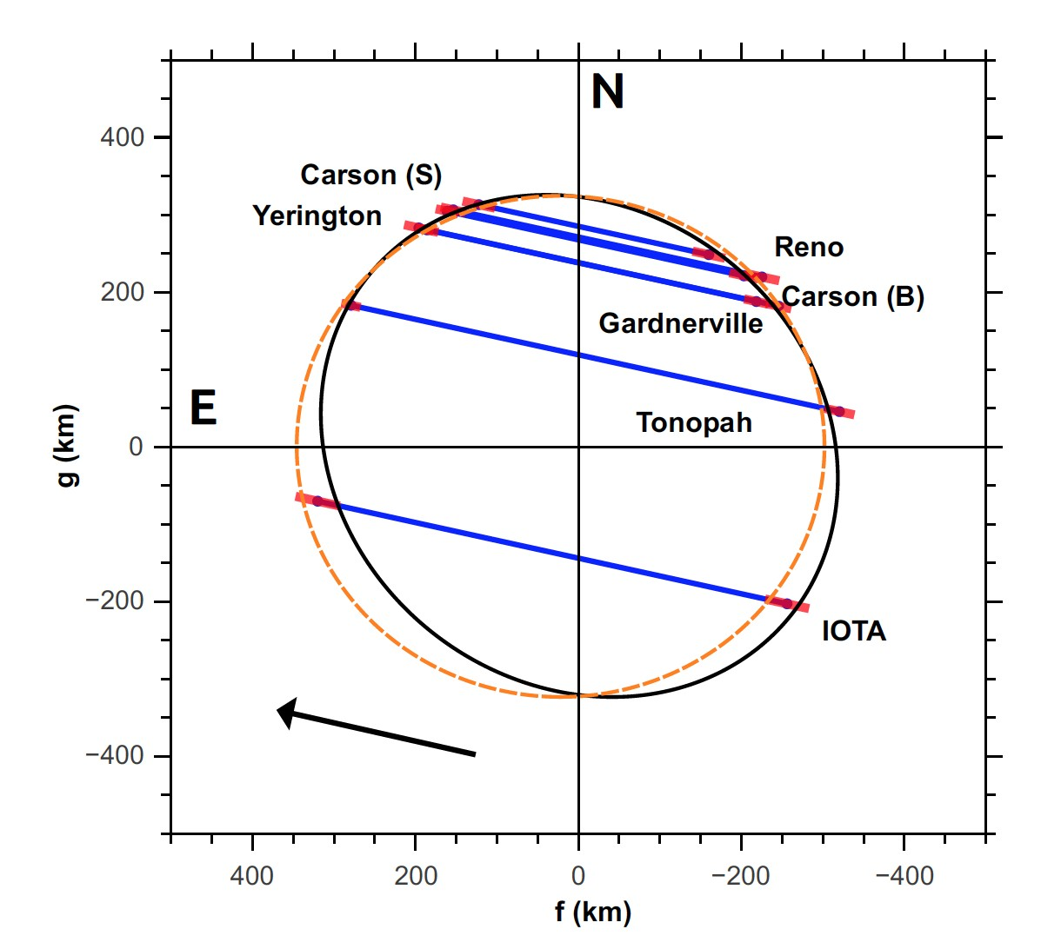

Slide 22
Results
Long axis (radius) = 340±10 km
Apparent oblateness 0.12±0.05
Circular fit radius = 328±25 km
Density < 1.6 g/cm³
Albedo, 0.16 – 0.19 (depends on H_{V} choice)

Slide 23
Tools We Use
Periodic face-to-face visits
Annual team meetings
Periodic video conferencing (virtual office hours)
Email list (membership moderated)
Twitter (@tno_recon), Facebook (TNORECON)
Website (tnorecon.net)
Experimenting with slack communication tool
Custom automated web content
Custom web/php/mysql tracking system
Member contact information
Campaign status tracking (pre- and post-event)

Slide 24
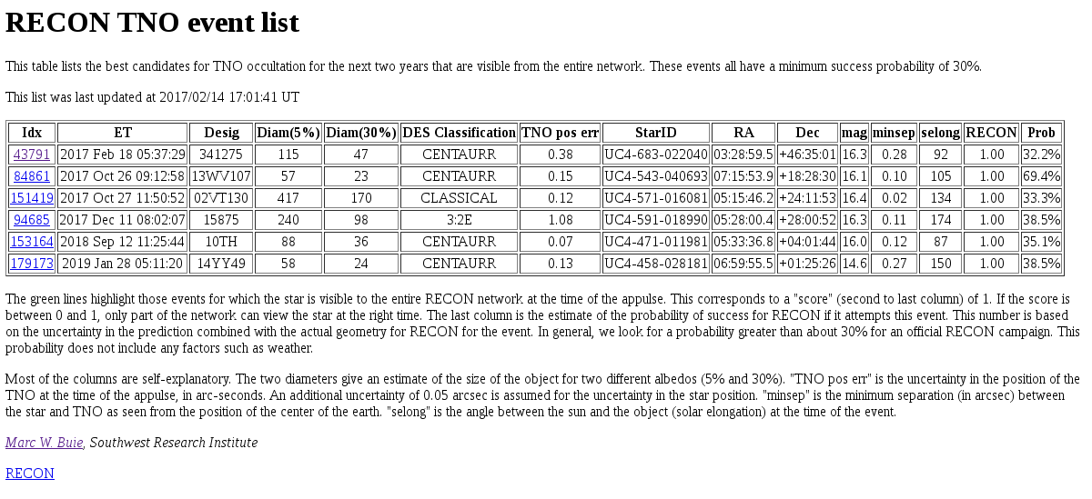
RECON predictions
http://www.boulder.swri.edu/~buie/recon/reconlist.html Updated daily

Slide 25
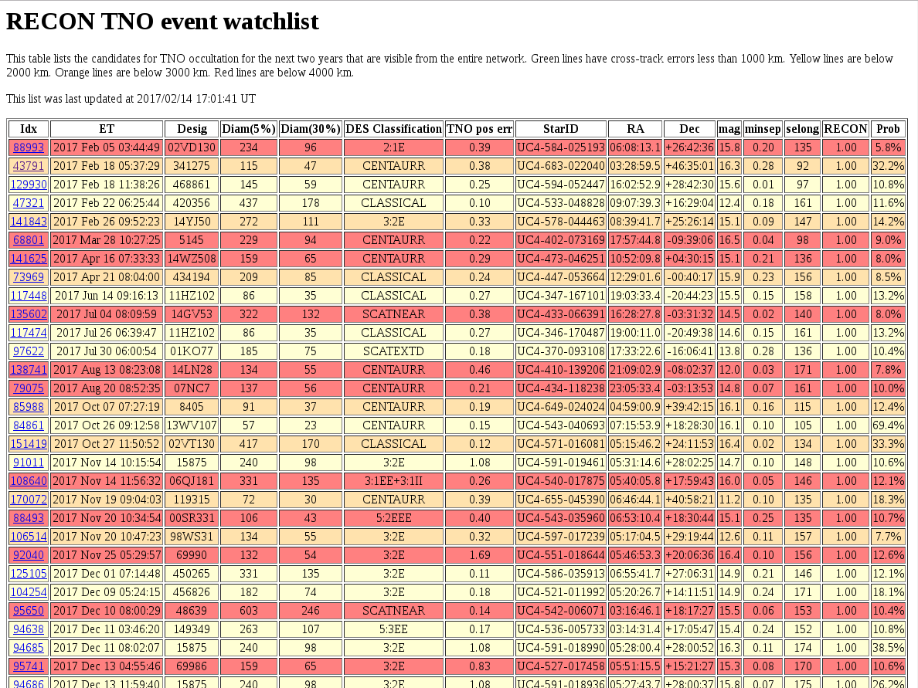
http://www.boulder.swri.edu/~buie/recon/reconwatch.html Updated daily

Slide 26
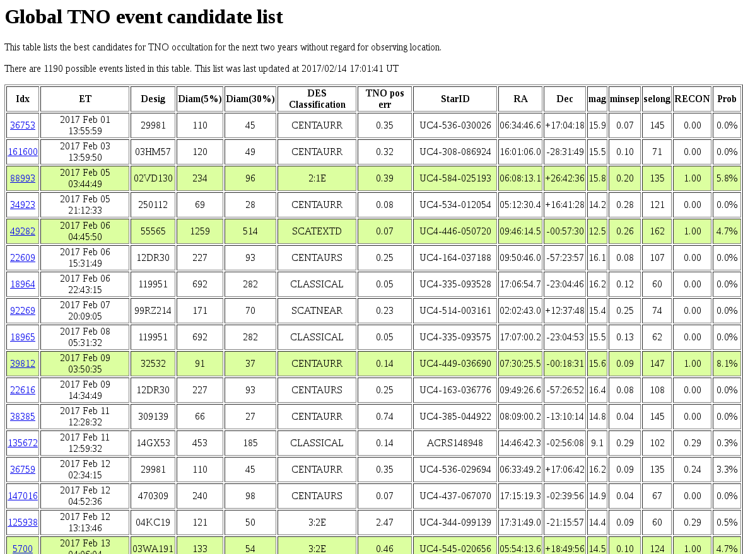
http://www.boulder.swri.edu/~buie/recon/allevents.html Updated daily

Slide 27

Lessons Learned: Retention
Sites that meet organization goals are doing well, departures are replaced by efforts of remaining team
Smaller teams and communities are fragil
Significant turn over within and between school years
These sites require targeted re-recruitment efforts

Slide 28
Engagement Results
UT Date | Ready to go | Trying but concerned | Unable to participate | No response | K-12 students involved | College students involved | Adults involved
2016-10-24 | 46 | 1 | 1 | 4 | 36 | 4 | 103
2016-11-23 | 44 | 0 | 6 | 2 | 34 | 3 | 93
2016-12-11 | 41 | 3 | 8 | 0 | n/a | n/a | n/a
Engagement is strong and improving due to better tracking tools and automated reminders
Non-participation is a consequence of sub-optimal team size and schedule conflicts (usually)
We continue to work toward increasing student involvement

Slide 29
Engagement challenges
In some rural communities, teachers live elsewhere – nighttime activities require much more effort
Not all students can make it for observation campaigns
Pushes the project to needing more parental involvement
Developing curriculum elements to bring data into classroom for daytime activiities to complement nighttime work
Some teachers consider using the equipment to be a privilege to be given out rather than a project goal for students to run the experiment

Slide 30
Online Resources
Stay current and connected to RECON activities:
RECON Blog and Website: Visit www.tnorecon.net
Facebook: Like us at TNO RECON
Twitter: Follow us @tno_recon

