Slide 1
John Broughton’s Updated Portable Telescope Design
John Broughton and David Dunham

Slide 2
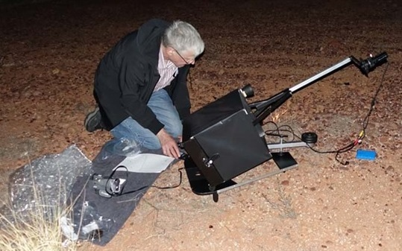
The 10-inch ‘Suitcase’ Telescope
Old Design,
In Action
(David
Dunham,
2015)
Built by
John Broughton,
Reedy Creek, Queensland, Australia
The camera is at prime focus, so the images are reversed (one reflection); it is normally used for pre-pointed occultations of faint stars by asteroids. f/4.0 mirror.

Slide 3
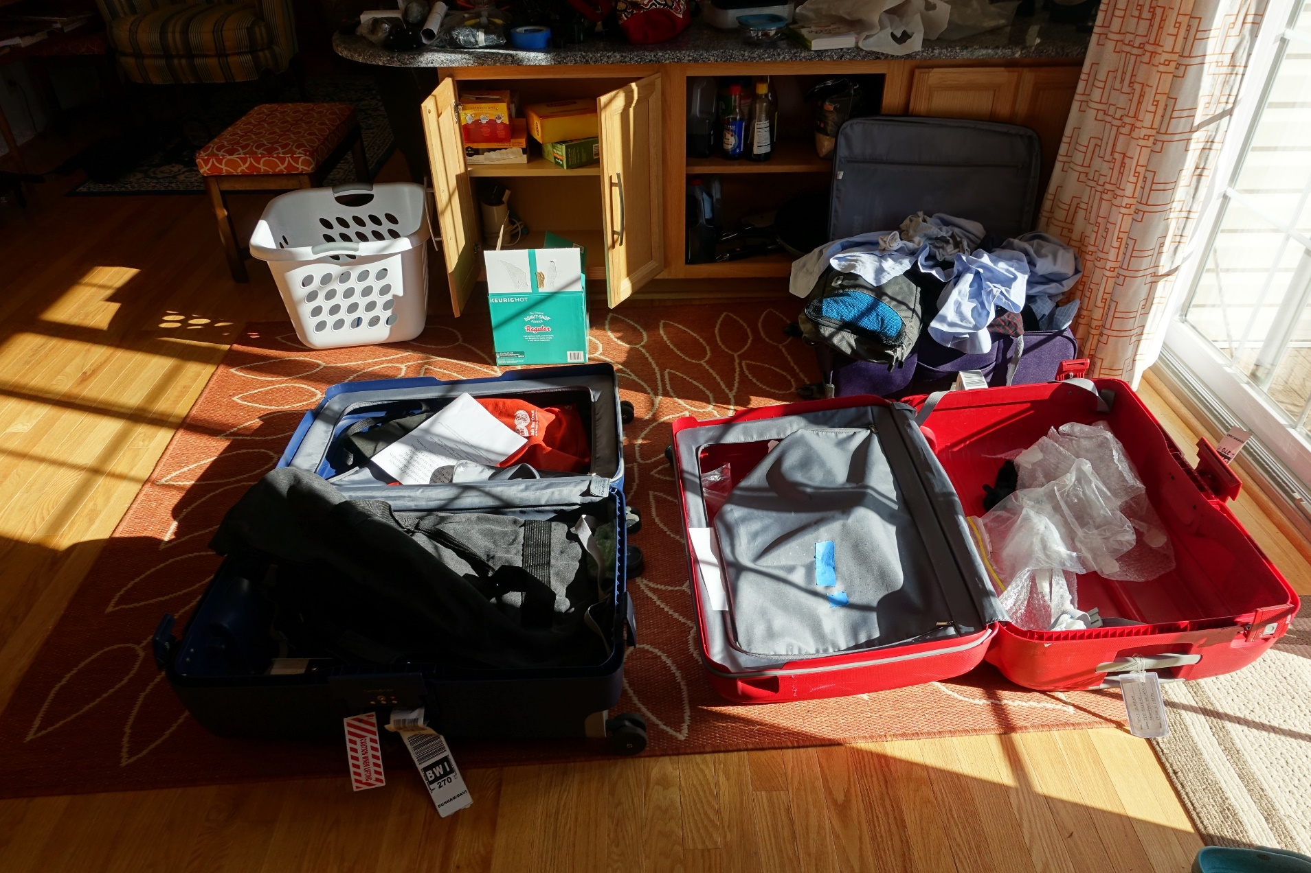
The new (2016) design brought to Maryland
The new scope, in two halves of two suitcases (although it fits easily in one suitcase)
with towels & dirty clothes at home when we returned from our Oct. 2016 trip to Australia. Can’t see much here with the other things in the suitcases.

Slide 4
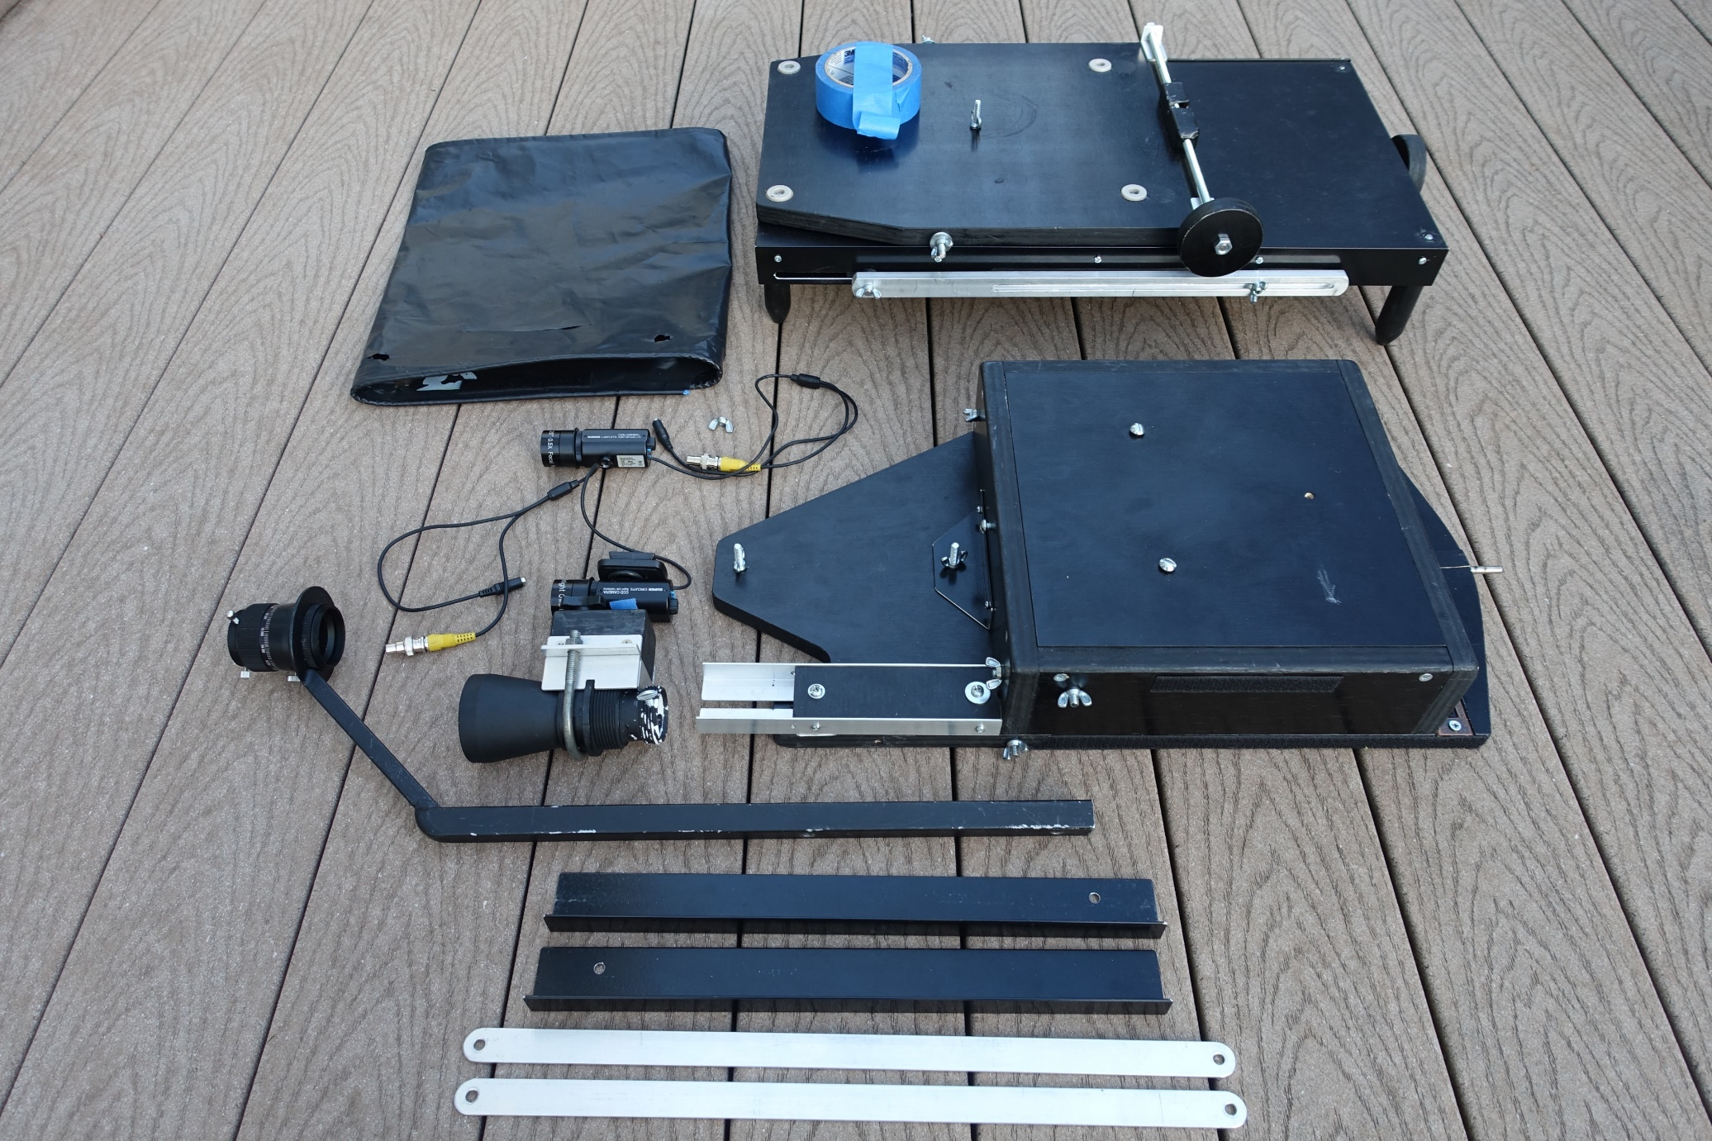
The new (2016) design components
All components, on our deck. The 2 PC164C-EX2 cameras shown were in carry-ons.

Slide 5
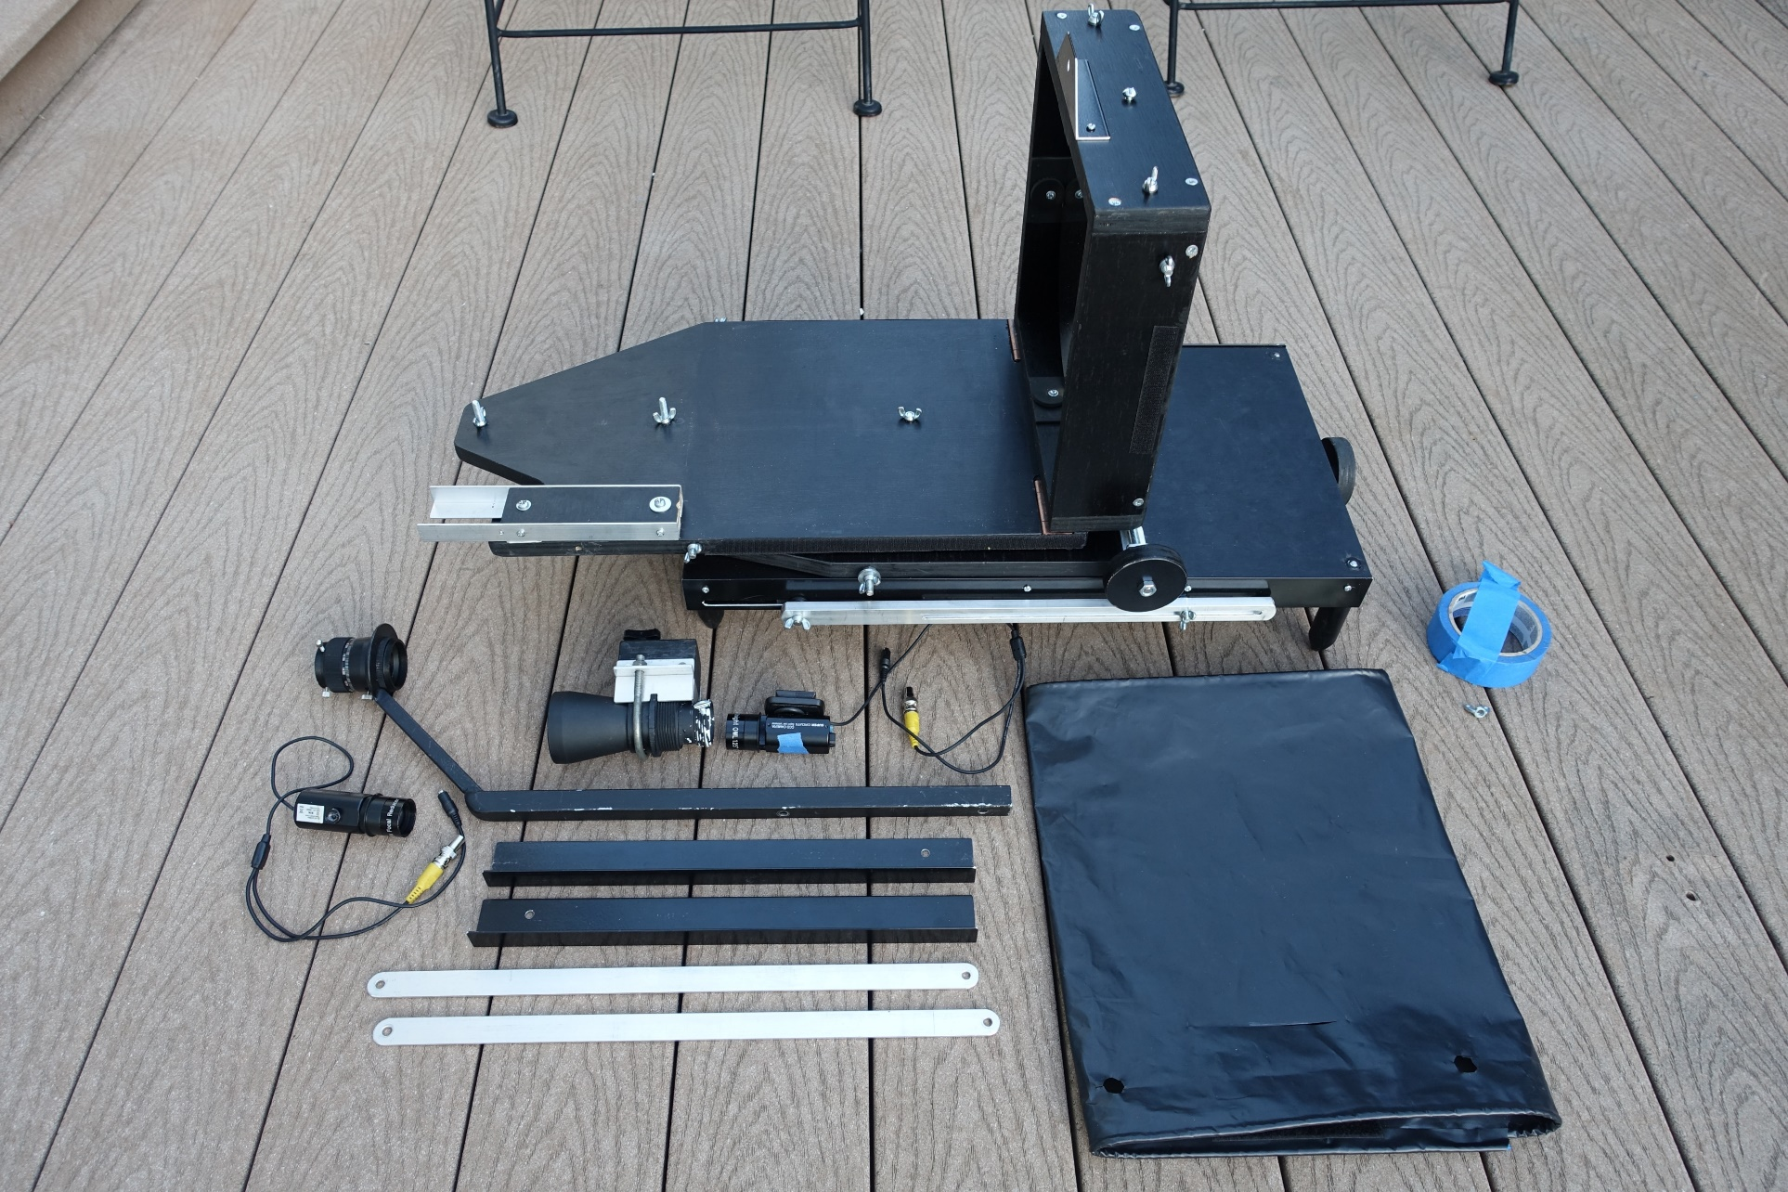
Assembling the Telescope - 1
The two major halves are attached together, with a single wingnut. All connections are with wingnuts; no tools are needed for the assembly.

Slide 6
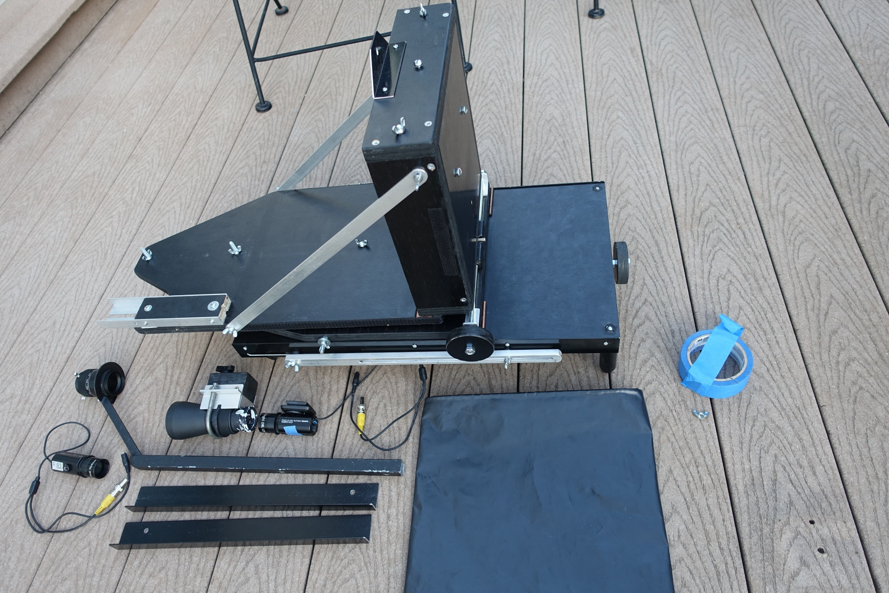
Assembling the Telescope – 2a
Side struts have been added.

Slide 7
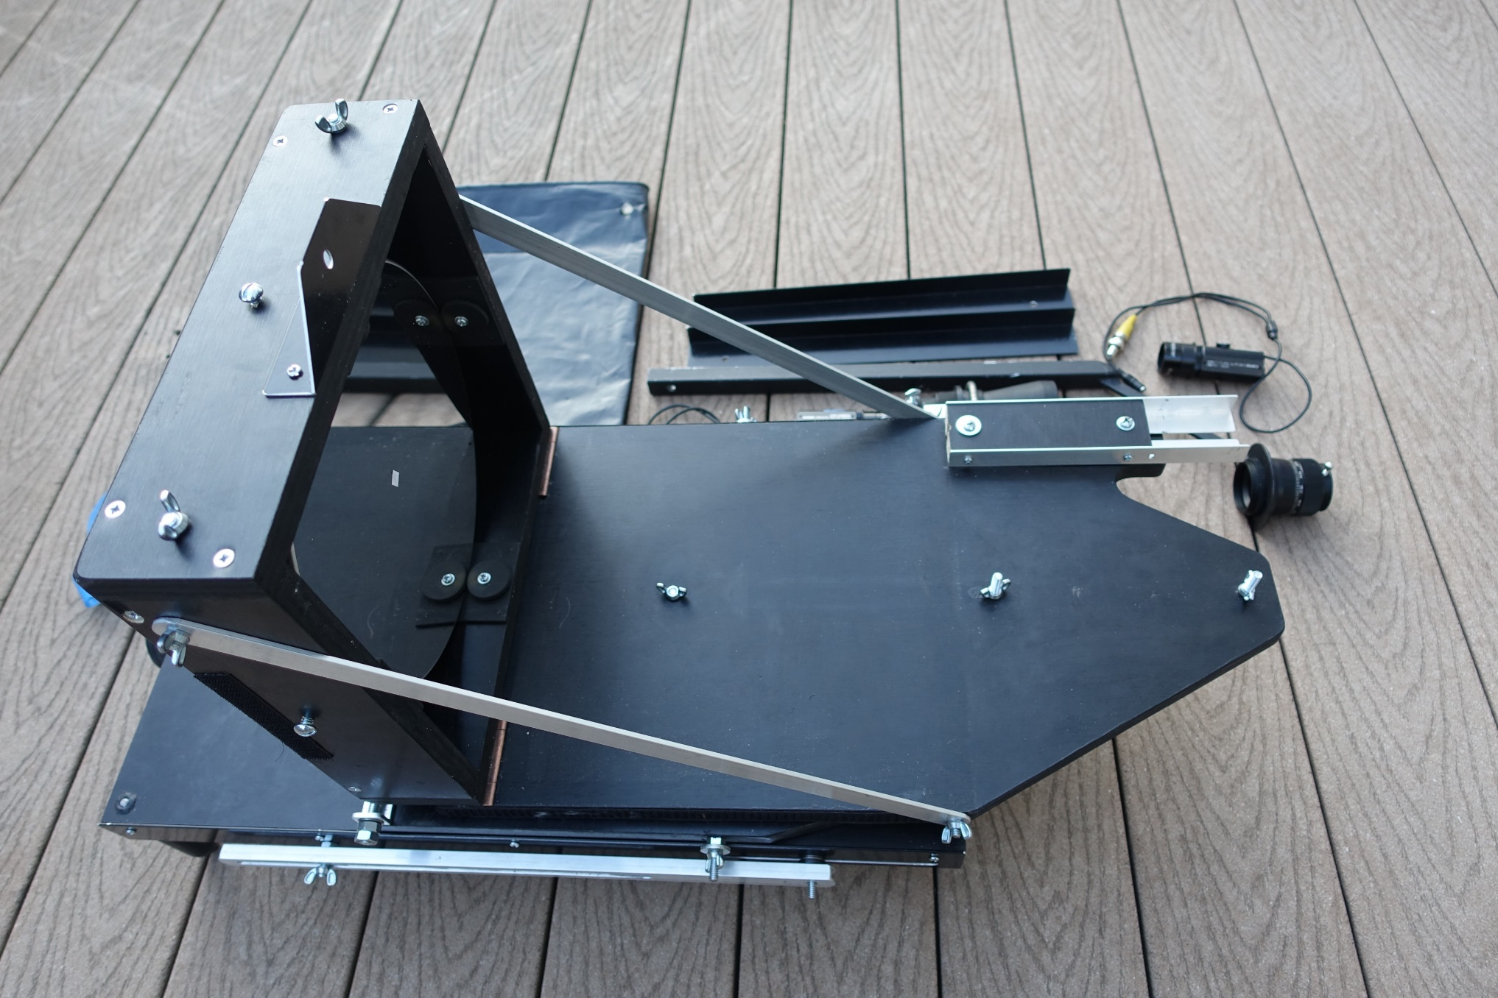
Assembling the Telescope – 2b
View from the other side showing the mirror in its box held up by the side struts.

Slide 8
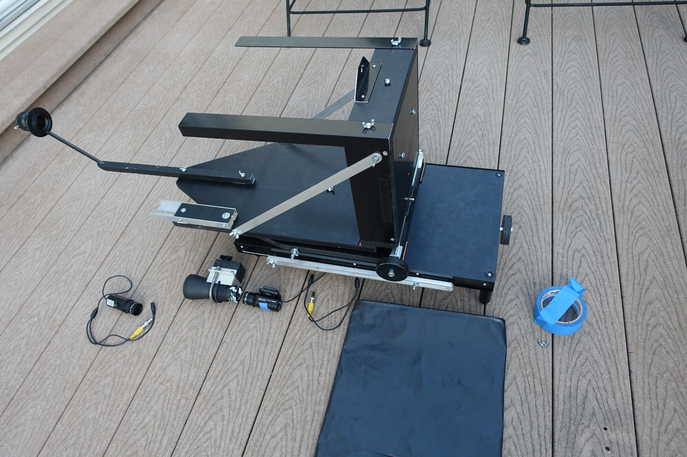
Assembling the Telescope – 3
Adding the 2 frame pieces and the prime focus camera holder.

Slide 9
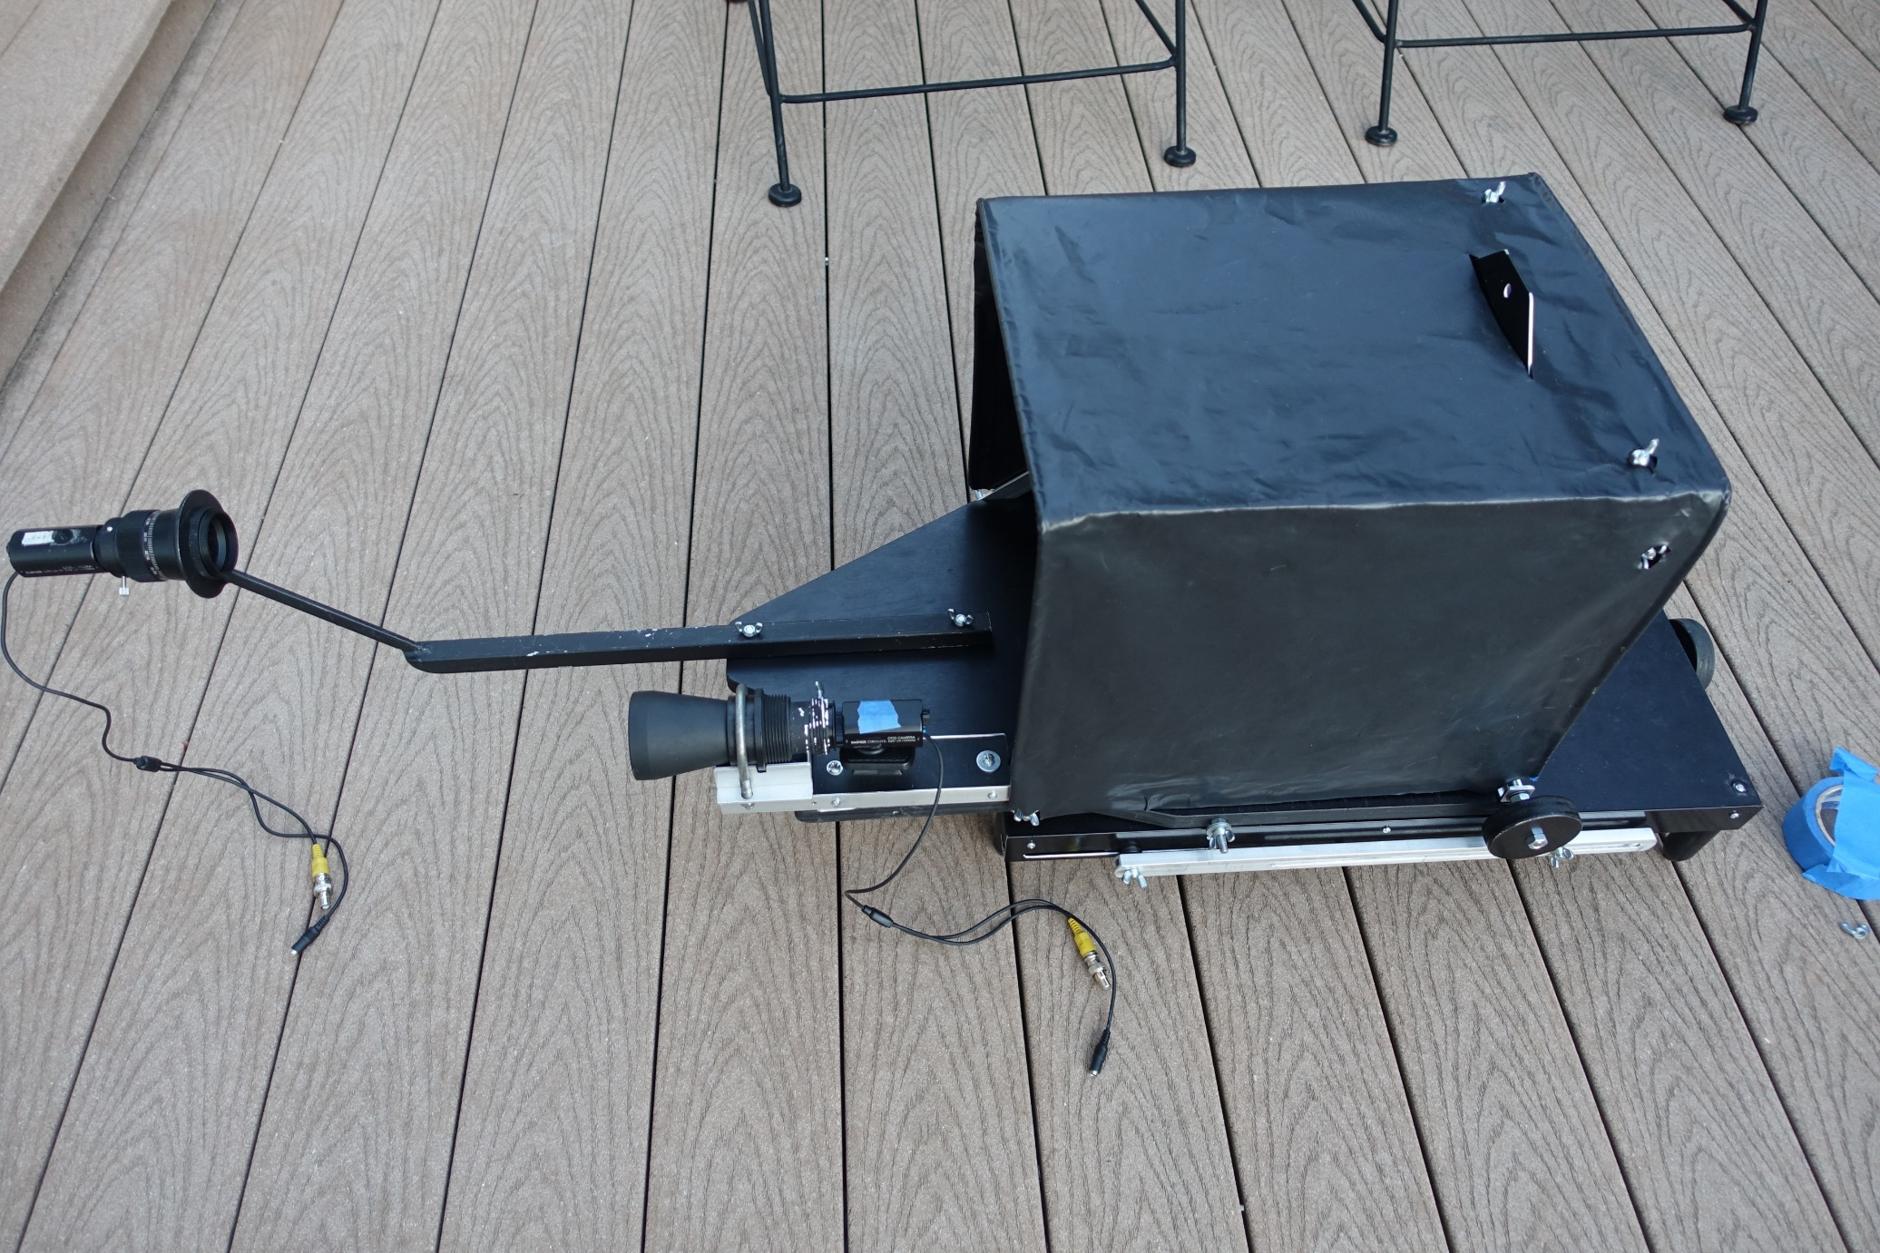
Assembling the Telescope – 4
Adding the mighty mini finder, the camera at the prime focus, and the velum cover.

Slide 10
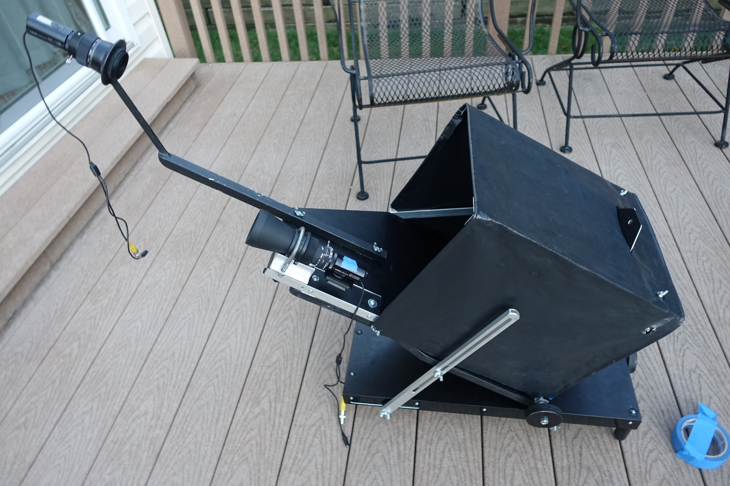
Assembling the Telescope – 5
The altitude adjustment bars are attached; the scope is then ready to use. The upper wingnuts are tightened at the approximate event altitude; the lower ones are kept loose.

Slide 11
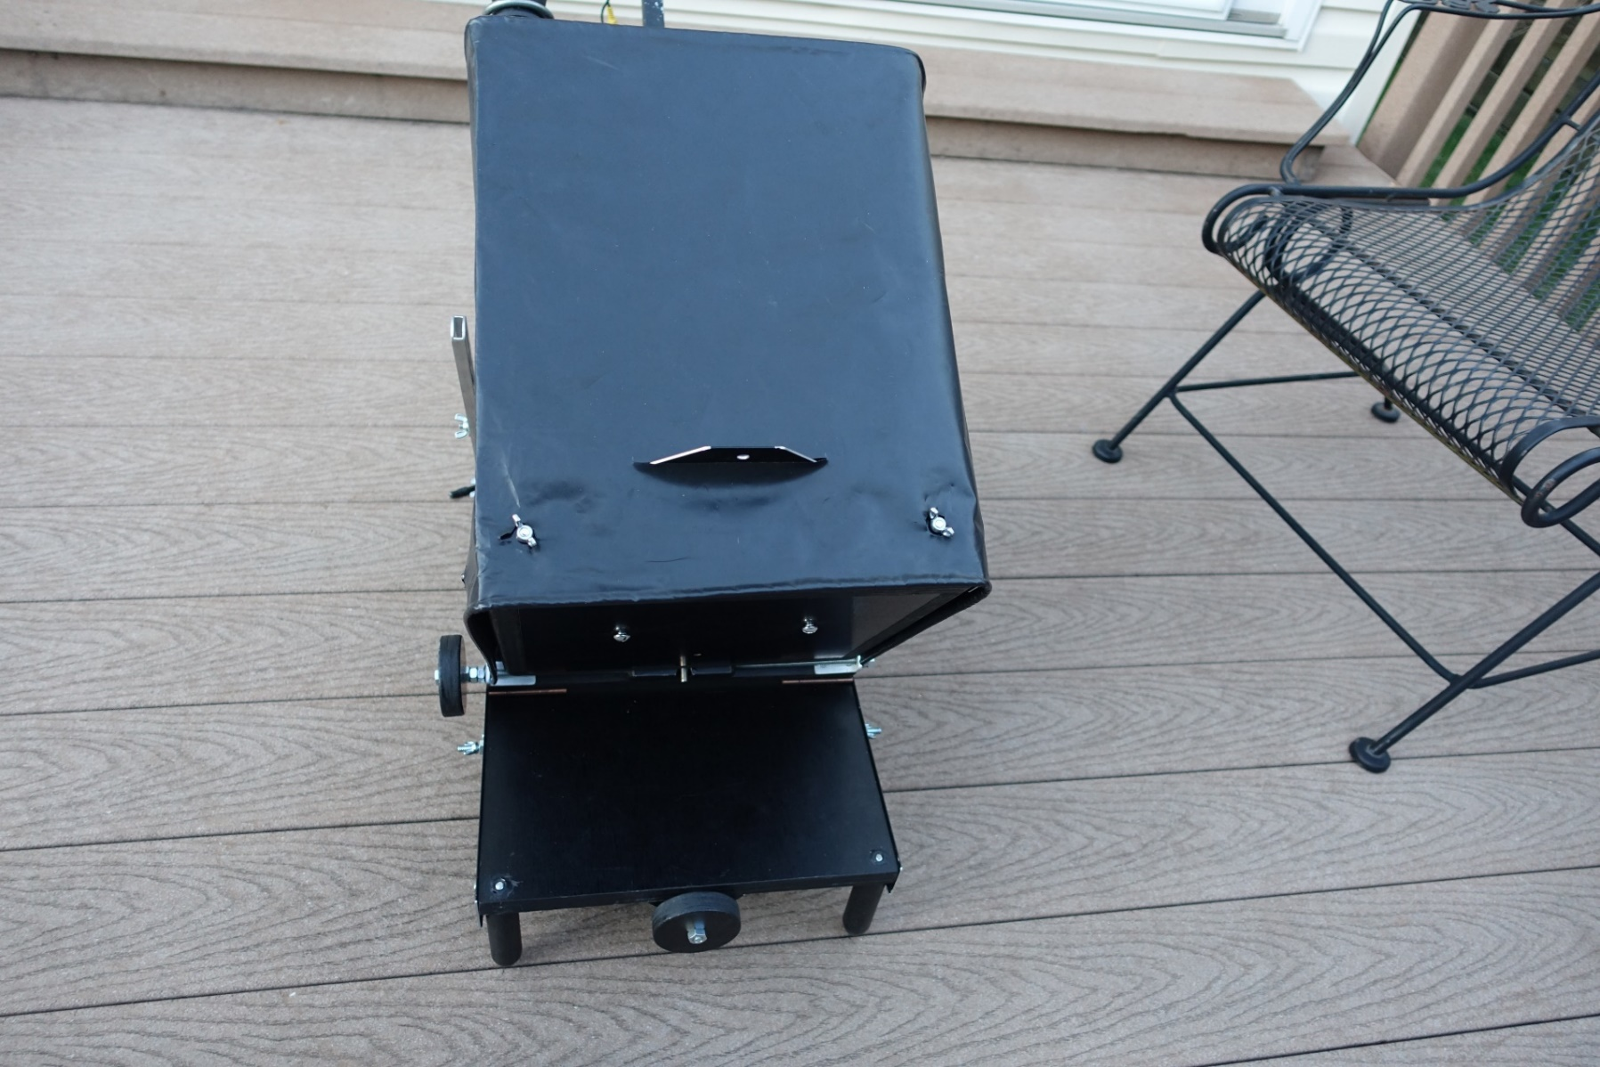
Fine Pointing the Telescope – Back View
The knob at the lower back turns a long screw to make fine adjustments in altitude. The knob at the side is for fine adjustment in azimuth (actually, orthogonal altitude). The alt-alt design allows smooth pointing at the zenith; a rock on the front end of the platform gives stability. The 2 screws on the back of the mirror box need a slot screw driver, to collimate the mirror, if needed.

Slide 12
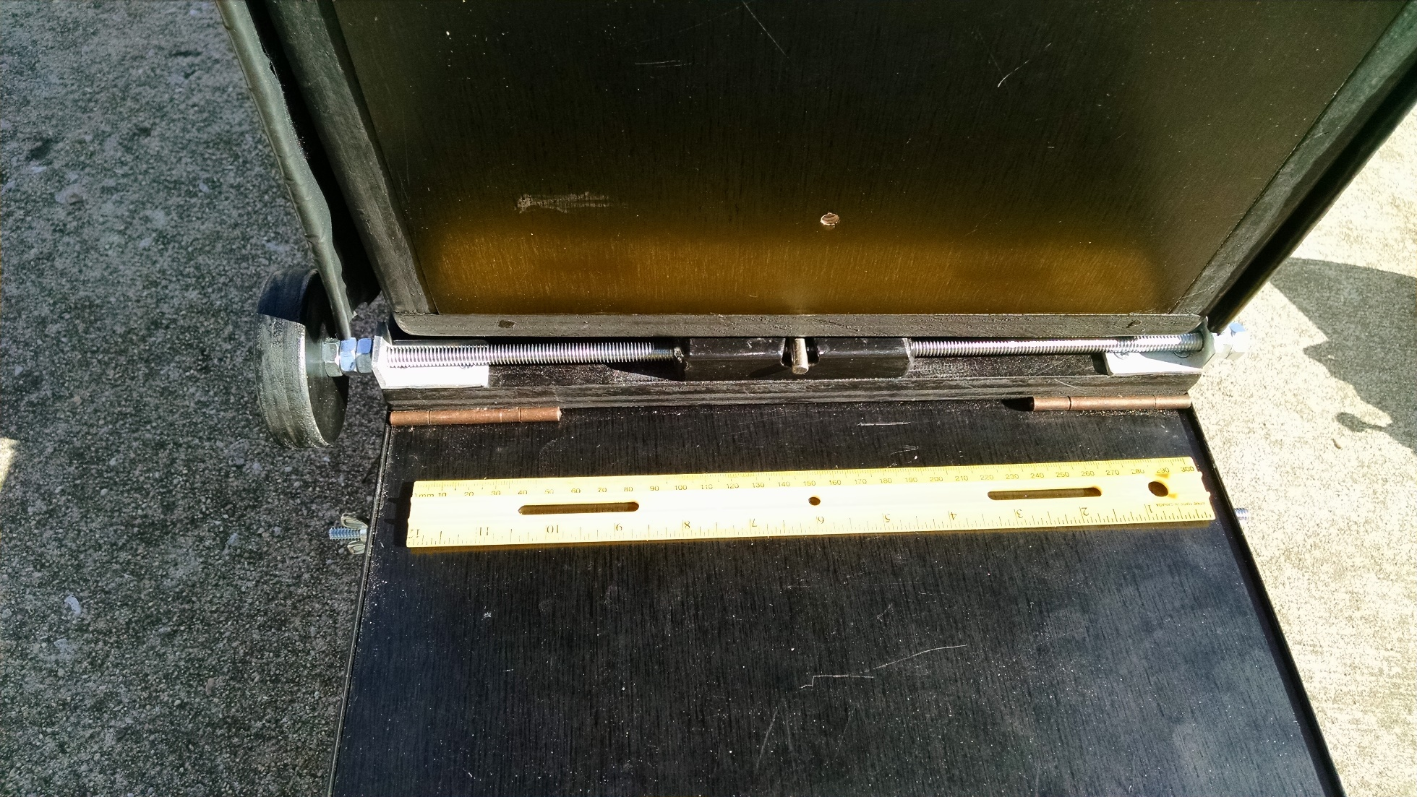
Closeup of Left-Right Adjustment Mechanism
With foot-long plastic ruler.

Slide 13
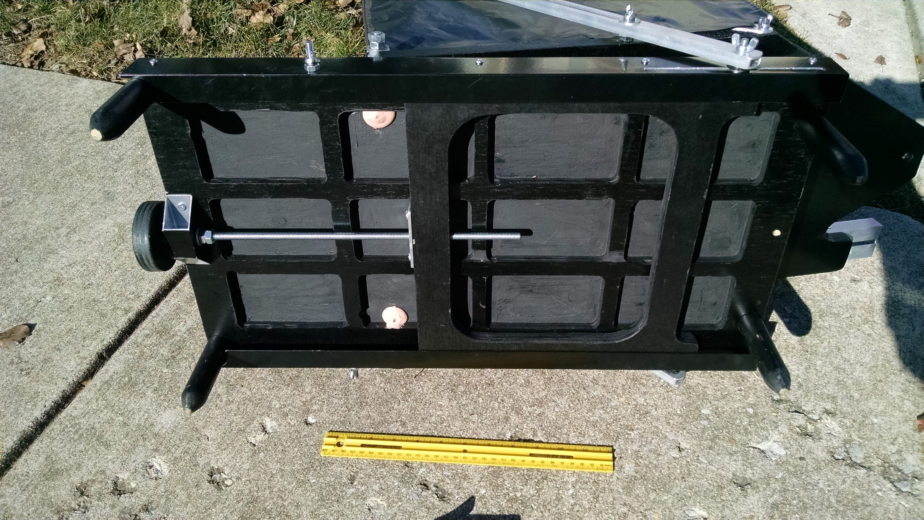
Bottom, with Altitude Adjustment Mechanism
With foot-long plastic ruler. Turning the screw with the knob at the end moves the rectangular carriage (with rounded cut-outs in the corners), which then changes the altitude by moving the altitude struts with it; the wingnut at the bottom of the strut must be loose (but just tight enough to keep the strut in place) so that the strut bottom can move with the rectangular carriage.

Slide 14
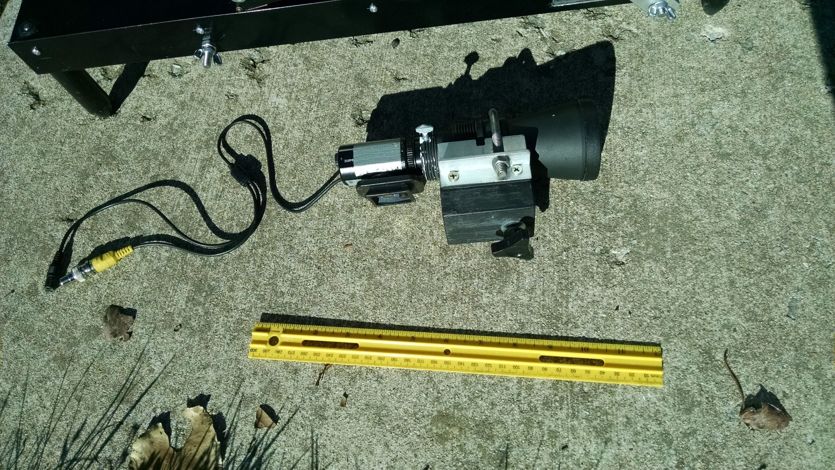
Mighty Mini Video Finder with its Holder
With foot-long plastic ruler. The black block of wood at the bottom slides in the finder rail, as shown in Assembly #4 and #5, tightened in place with the knob at the bottom.

Slide 15
Weight for Travel
Lbs. Description
10.0 Suitcase
0.5 Roll of blue tape (to protect suitcase separation liner from a screw that sticks up)
26.8 The telescope (not including PC164C-EX2 cameras for main scope & mighty mini finder)
37.3 Sum of above
6.5 Towels for protection for transport
43.8 Total weight of packed suitcase, including the towels

Slide 16
The New (2017) Design

Slide 17
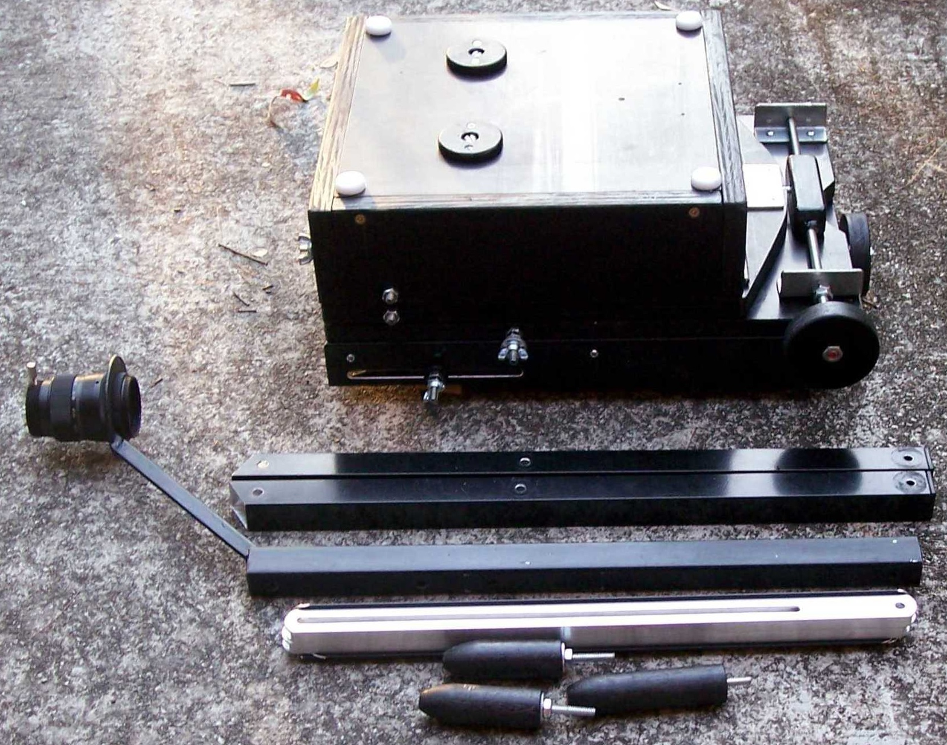
The new (2017) design components

Slide 18
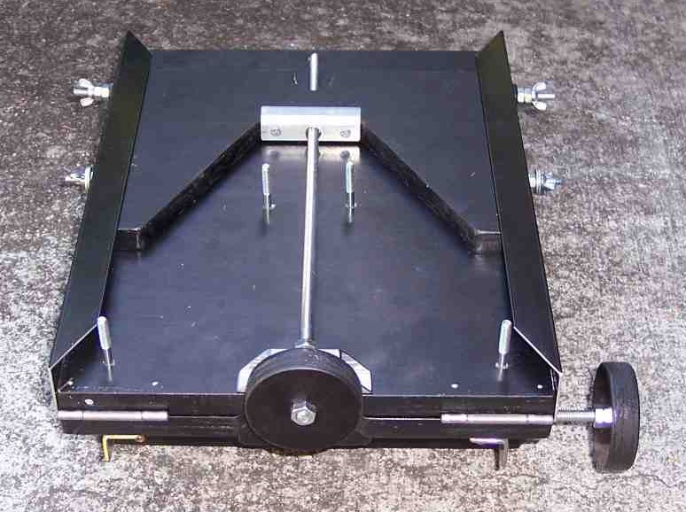
Underside

Slide 19
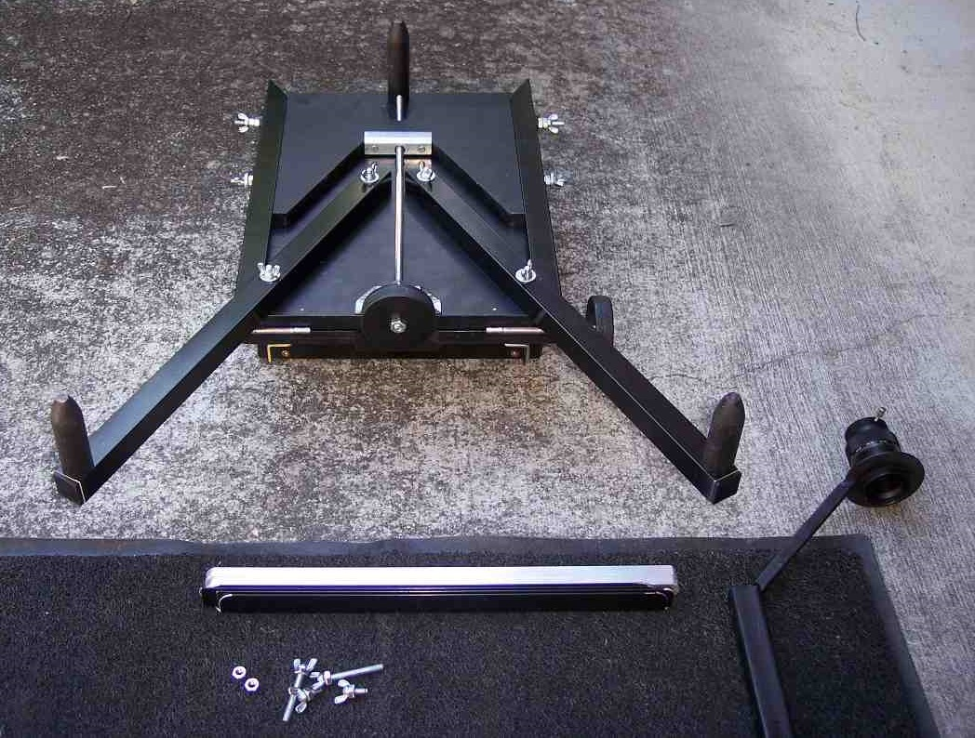
Legs Attached

Slide 20
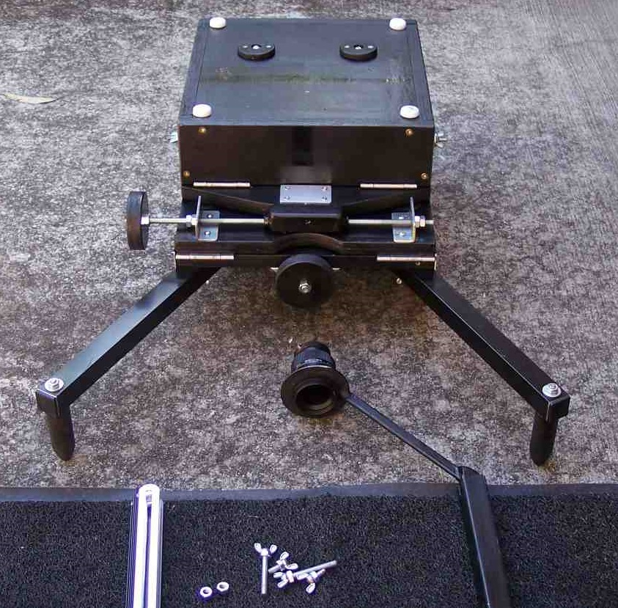
Flipped (right side up)

Slide 21
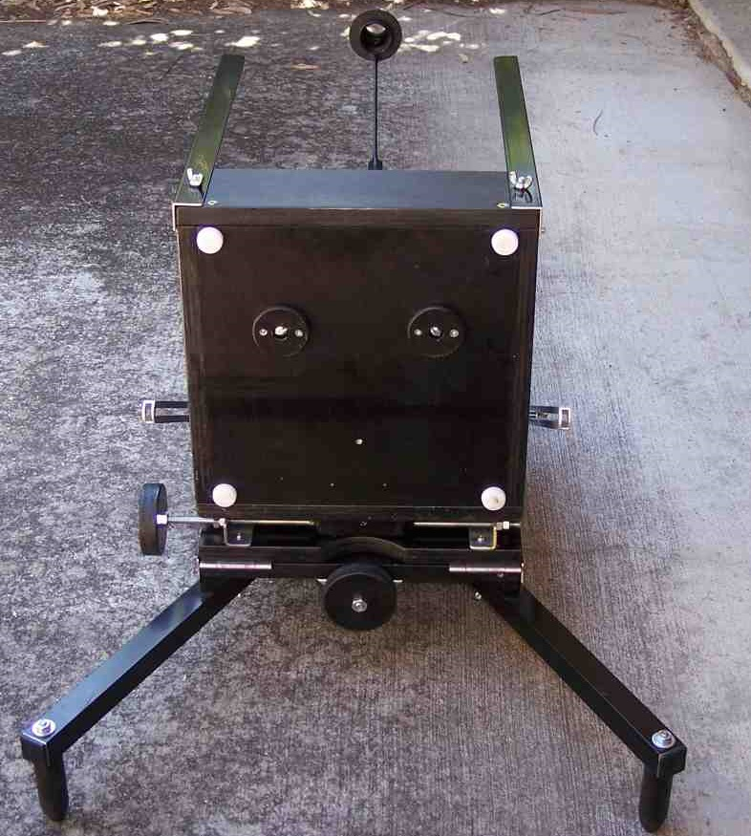
Mirror Box Raised and Strutts Attached

Slide 22
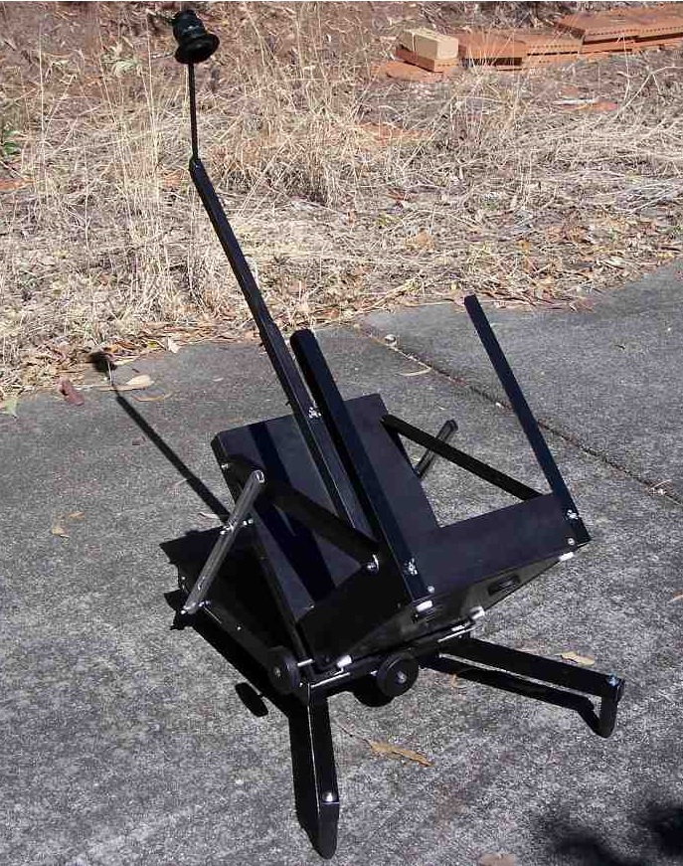
Rear Oblique View

Slide 23
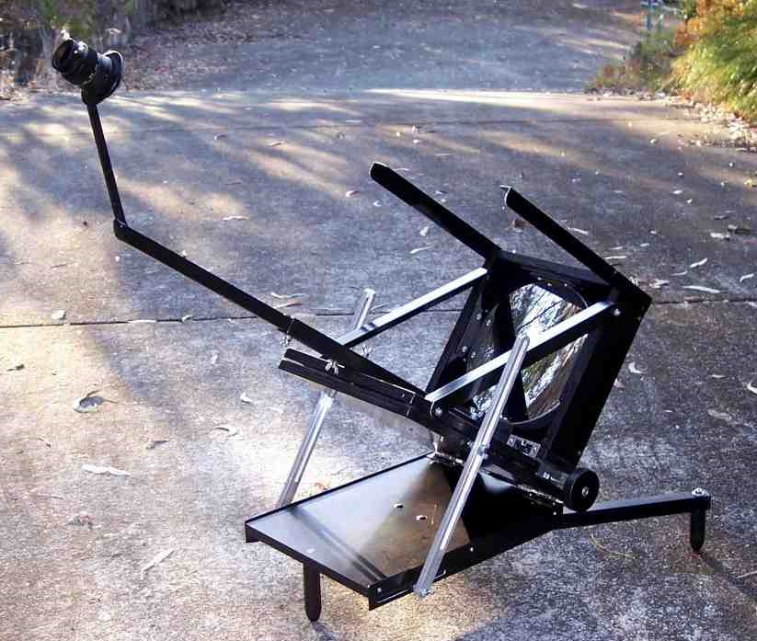
Forward Oblique View

Slide 24
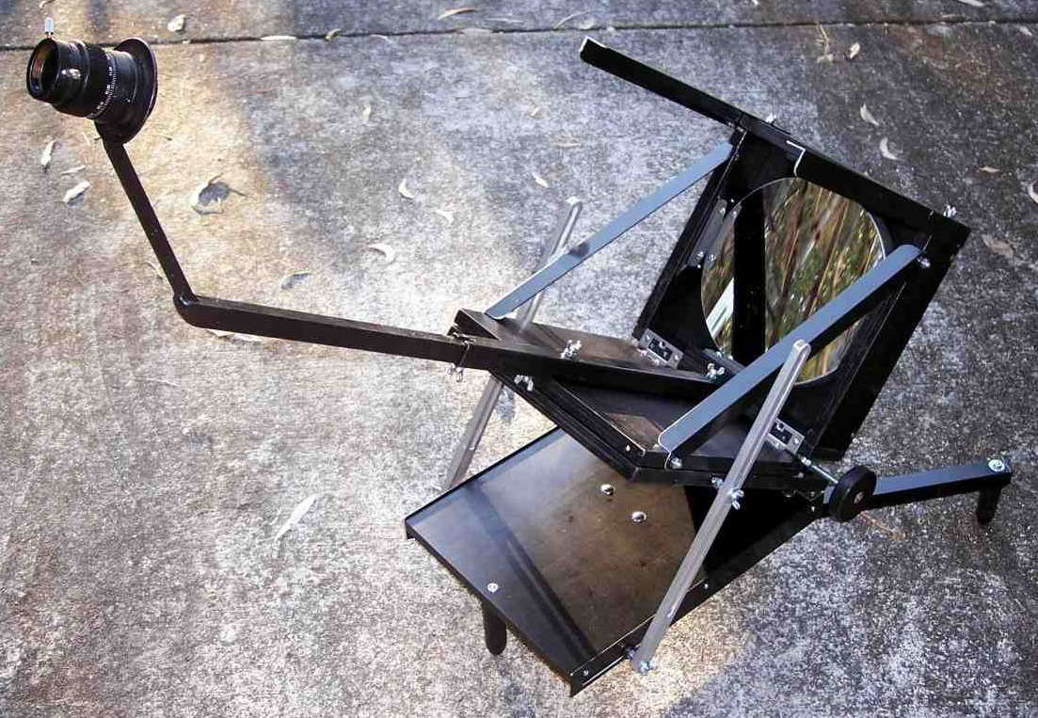
Forward Close-up

Slide 25
The new (2017) design components

Slide 26
Some Thoughts on Manufacture
The scope saw first light on Saturday night and will be fully operational once I add a mount for a video finder and dew shield. It's a pleasure to finally have lateral slow-motion control and nudge-proof pointing. In being so compact when folded up, this is surely the ultimate form factor, so I plan to make three more for my own use by next April and retire the others.
What I'm wondering is whether there'd be enough interest for many of these amongst the occultation community. With 100 pre-orders, maybe a telescope manufacturer would be willing to develop a commercial version. This isn't necessarily a niche design though; it could also serve as a general-purpose visual telescope with the addition of motor drives, handpad, and an alternate focuser strut that takes only a minute to attach. If you'd like to have a demo model to show the US manufacturers, I'll make one or two spares during the same timeframe I'm building the others.
I believe the design be patented first so that the number of manufacturers with the right to build them could be limited to one or preferably two (avoiding a monopoly) for a period of perhaps five years - what company wouldn't want a headstart into something new with so much potential!

