Slide 1
IOTA Membership and Subscription Numbers
Print
18 USA vs 28 in 2016 July
1 Outside USA vs 5 in 2016 July
Online-only
48 subscribers vs 71 in 2016 July
Net decrease of 37 members

Slide 2
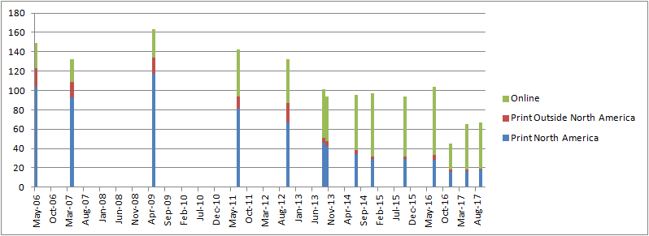
IOTA Membership Trends
Date | Print North America | Print Outside North America | Online | Total
Sep-17 | 18 | 1 | 48 | 67
May-17 | 17 | 1 | 47 | 65
Dec-16 | 16 | 2 | 27 | 45
Jul-16 | 28 | 5 | 71 | 104
Oct-15 | 29 | 3 | 62 | 94
Dec-14 | 29 | 3 | 65 | 97
Jul-14 | 34 | 4 | 57 | 95
Oct-13 | 43 | 5 | 46 | 94
Sep-13 | 46 | 5 | 50 | 101
Oct-12 | 67 | 20 | 45 | 132
Jul-11 | 81 | 13 | 48 | 142
May-09 | 117 | 17 | 29 | 163
Apr-07 | 93 | 16 | 23 | 132
May-06 | 104 | 19 | 26 | 149

Slide 3
IOTA Financial Overview
Starting Balance: 2016 July 21
$10,416.06
Ending Balance: 2017 September 7
$10,496.81
Net increase in Balance:
$80.75

Slide 4
IOTA Financial Details
IOTA-VTI Royalties: $392
Down $104 from last annual meeting
Last check lost due to recent move?
PayPal Balance: $2764.04
Up $1049.28 from last annual meeting
Layout/publishing not paid for many issues!
Expenses
JOA print costs Consistent
Web service: Still donated
Awards Paid for last meeting

Slide 5
IOTA Business Items
JOA publication
Still behind on issues. Lost 2 issues from 2015, 1 from 2016 & behind 1 issue for 2017 …causing distribution problems!
Membership need to write/submit more!
Online access
New password protocol seems to be working fine
Remembering passwords is the only problem.
Complaints
Hardly any…though maybe there should be.

