Slide 1
Gaia impact on asteroidal occultations
© Dave Herald
Murrumbateman
May 2017

Slide 2
Situation pre GAIA
A number to remember. For Main Belt asteroids, 1mas equates to about 2km on the Earth
Typical uncertainty in star position 50mas
Typical uncertainty in asteroid position 150mas
For any one event, there is little basis to attribute the path shift between the star or the asteroid. That is, with the current accuracy of star catalogues and asteroid ephemerides, we cannot improve predictions based on recent observations

Slide 3
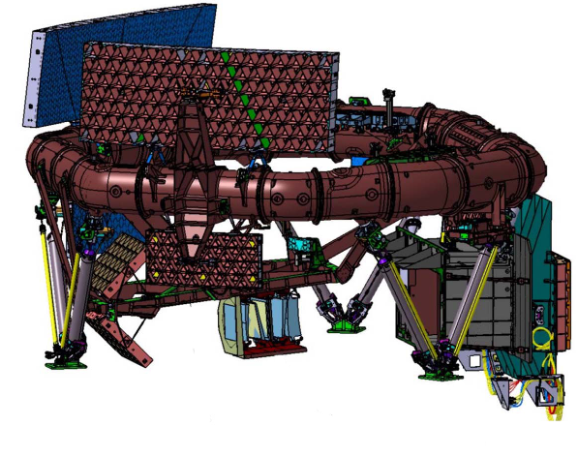
GAIA spacecraft
The CCD detectors are saturated at mag 12. However they can measure to mag 3, and expect to be able to measure all 243 stars brighter than 3.

Slide 4
Gaia scanning pattern
Left – global star distribution
Right – number of observations in a 6-month period

Slide 5
Gaia impact – star positions
Gaia will produce the following:
μ-arcsec positions, proper motions & parallaxes down to mag ≈20 (∿1 billion stars)
Radial velocities and spectral types – stars down to mag ≈16 (∿150 million stars) {yes – it has a spectroscope…!}
Element abundances for stars brighter than 11
Positions and orbits of asteroids and TNOs, to ∿mag 20

Slide 6
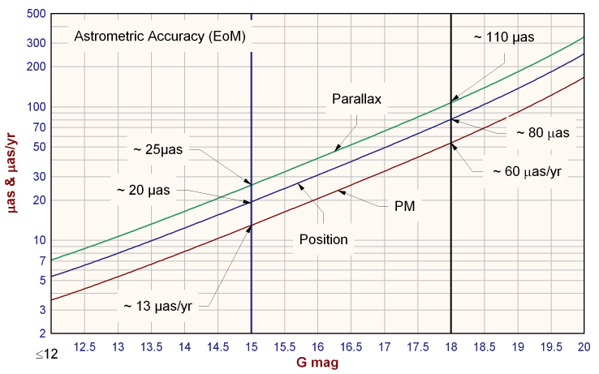
Astrometric accuracy against magnitude – final catalogue

Slide 7
Gaia impact - variables
Multi-epoch photometry for everything brighter than mag 20. Detects variability on time scales between seconds and ∿5 years. Estimated total variables ~18 million, including:
5,000,000 ‘classic’ Cepheids
3,000,000 eclipsing binaries, with precise physical and orbital parameters for ∿10,000
300,000 with rotationally induced variability
250,000 Miras and SR variables
60,000 - 240,000 δ Scuti variables.
70,000 RR Lyrae
20,000 supernovae
AAVSO Index catalogue has a mere 342,000 entries

Slide 8
Gaia impact - doubles
Estimated results:
700,000 radial velocity orbits
800,000 radial velocity + astrometry orbits
2,000,000 astrometry orbits
4,000,000 non-linear-proper-motion systems
40,000,000 resolved binaries
Resolve all binaries with separations >20mas which have a moderate magnitude difference.
Washington Double Star catalogue: 135,000 pairs
USNO 6th Interferometric catalogue: 83,000 pairs

Slide 9
Gaia 1st release
Sept 2016
• Positions (α, δ) and G magnitudes for stars with acceptable formal standard errors on positions (about 70% of stars).
• Five-parameter astrometric solution - (α, δ, μ_{α}, μ_{δ}, π) - for stars in common between the Tycho-2 Catalogue and Gaia [The Tycho-Gaia solution]

Slide 10
Follow-on cats with proper motions ‘added’
Gaia14 – Tycho-Gaia, plus all Gaia stars to mag 14.0, with proper motions derived using UCAC4 mean epoch positions
HSOY - Hot Stuff for One Year (Uni of Heidelberg) Proper motions derived from PPMXL positions
UCAC5 – Proper motions derived from a re-reduction of UCAC images using Tycho-Gaia to derive early epoch positions

Slide 11
Gaia data release 2
∿May 2018
• Five-parameter (α, δ, μ_{α}, μ_{δ}, π) solution for all objects with single-star behaviour
• Positions (but not orbits) for ~100,000 asteroids
• Integrated Blue Photometer (BP) & Red Photometer (RP) photometry,
• Mean radial velocities will be released for objects showing no radial-velocity variation

Slide 12
Gaia – Final data release (2022)
• Full astrometric, photometric, and radial-velocity catalogues.
• All available variable-star and non-single-star solutions.
• Source classifications (probabilities) plus multiple astrophysical parameters (derived from BP/RP, RVS, and astrometry) for stars, unresolved binaries, galaxies, and quasars.
• An exo-planet list.
• All epoch and transit data for all sources.
• All ground-based observations made for data-processing purposes.

Slide 13
Issues with the 1st release
Proper motions & parallaxes for 70% stars brighter than ~11.5 are available in the Tycho-Gaia catalogue
For fainter stars - positions , but no proper motions or parallaxes But three catalogues have now issued with proper motions added
No entries for stars that show evidence of a companion Coverage is about 75% of all stars
for events up to 2018, positional uncertainty of stars at mag 12 ∿4mas (≈ 8km); at mag 15 ∿10mas (≈20km)

Slide 14
Situation for asteroids
Uncertainty in the asteroid orbit is the prime limitation on current prediction accuracy
Asteroid orbits from Gaia - not available until 4th release Aug 2019
2nd release (May 2018) expected to include observed positions for ~100,000 asteroids
Improved orbits should quickly become available [e.g. MPC will incorporate the Gaia positions in their orbit solutions.]

Slide 15
Long-term situation
Path predictions will be accurate to about 1km
Will be able to plan an event with certainty (apart from the weather)
Focus may move from observing anything that happens nearby, to efforts to study particular asteroids
We will need to develop capability to incorporate shape model predictions to predict path edge locations, and distinguish between shape model solutions

Slide 16
Other issues for asteroids (1)
Will need to identify asteroids that we should focus our attention. Issues such as:
Binary asteroids
Asteroids with shape models
Asteroids having some other characteristic of importance. (Eg a member of certain classes of asteroids – whether that be based on composition, orbit type, or some other consideration)

Slide 17
Other issues for asteroids (2)
Also need to think about the frequency of events involving a selected asteroid.
For example, do we focus on asteroids when they move through star-rich regions of the sky – such that we get numerous events over a few months at different rotational orientations, which we can then match to shape models.
Events involving faint (and therefore small) asteroids may be predicted more often.

Slide 18
Overall summary
Gaia Release #1 has largely eliminated the star position as a cause of uncertainty.
The position of the asteroid remains as the greatest source of uncertainty.
Release #2 offers the promise of high prediction accuracy (path location better than 10km)
We will need to develop a strategy for selecting events we want to focus on, and for placing mobile observers across a path.

Slide 19
The future for asteroidal occultations is exciting….
Any questions?!

