Slide 1
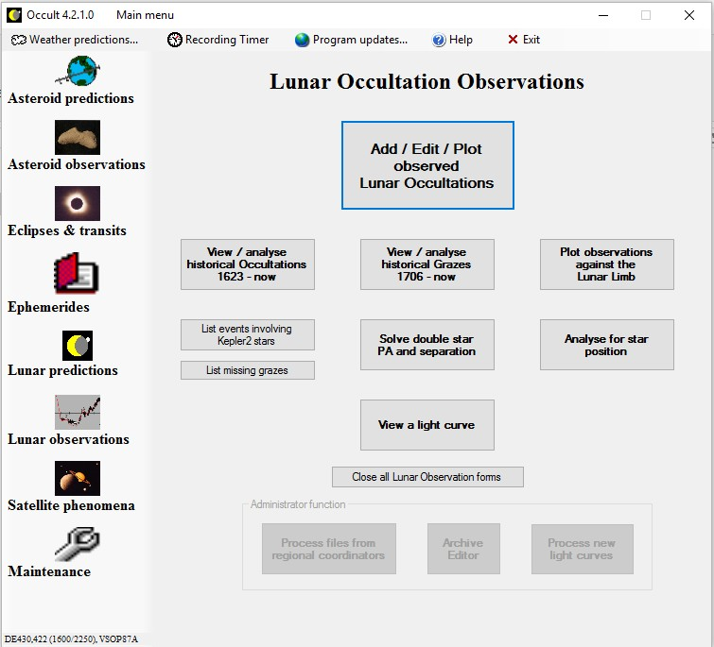
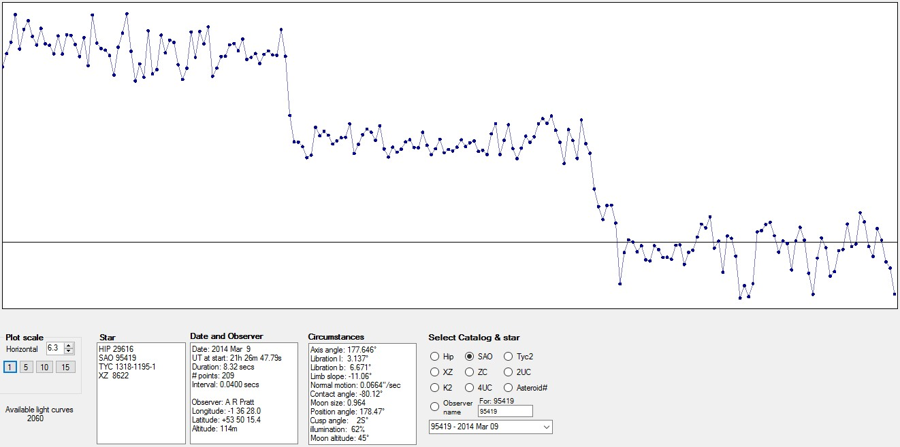

Uploading light curves to Occult4
Alex Pratt Dave Herald
IOTA-ES BAA

Slide 2
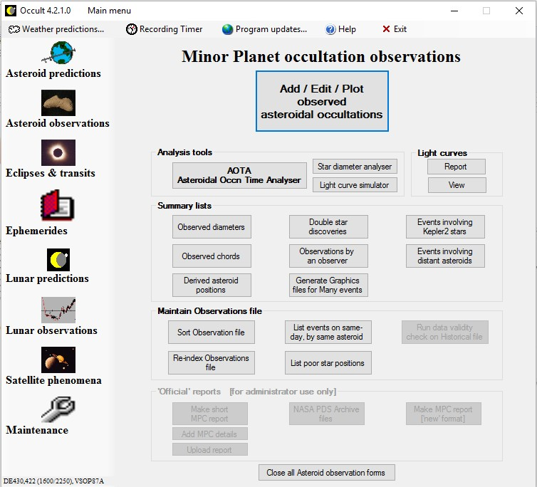
Occult4 – Dave Herald (Murrumbateman, Australia)

Slide 3
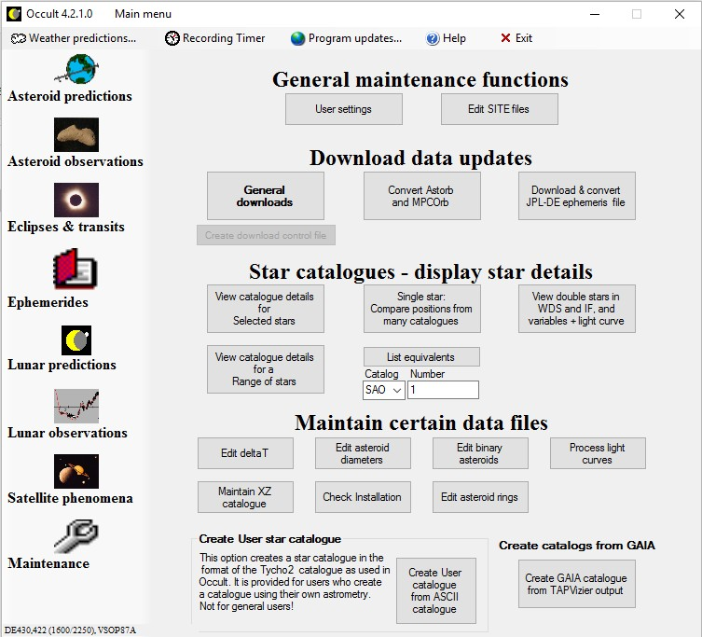
General maintenance functions – General downloads

Slide 4
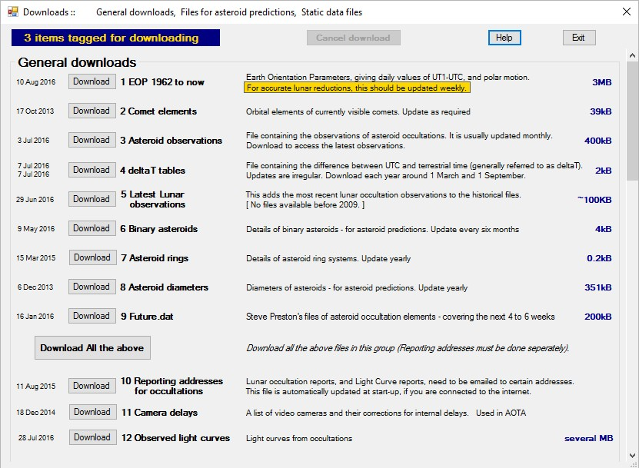
Download observed light curves

Slide 5
Viewing a light curve
…but not PHEMU light curves

Slide 6
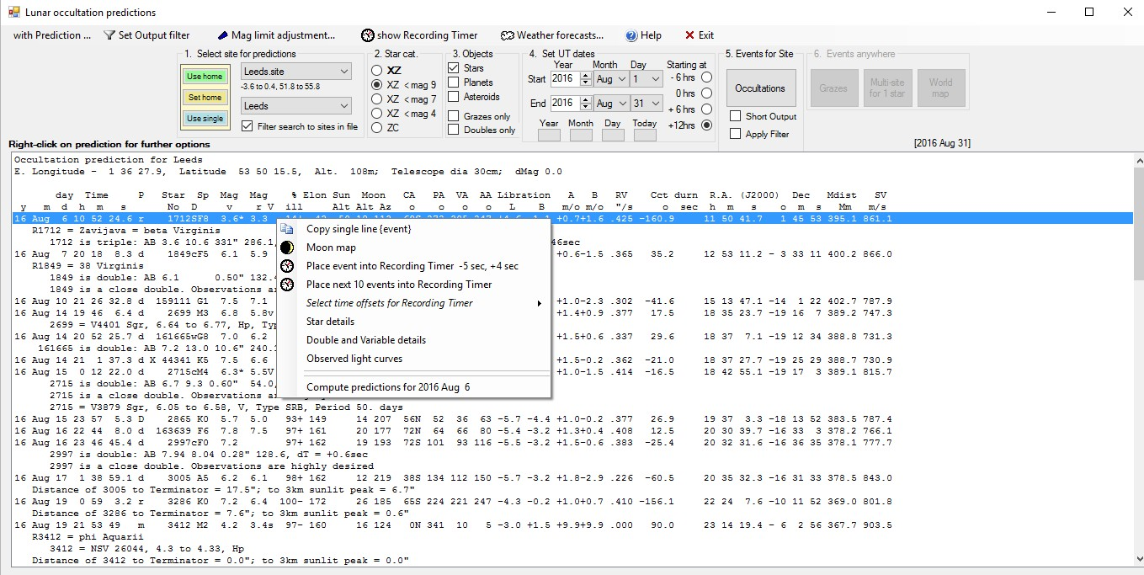
Viewing a light curve

Slide 7
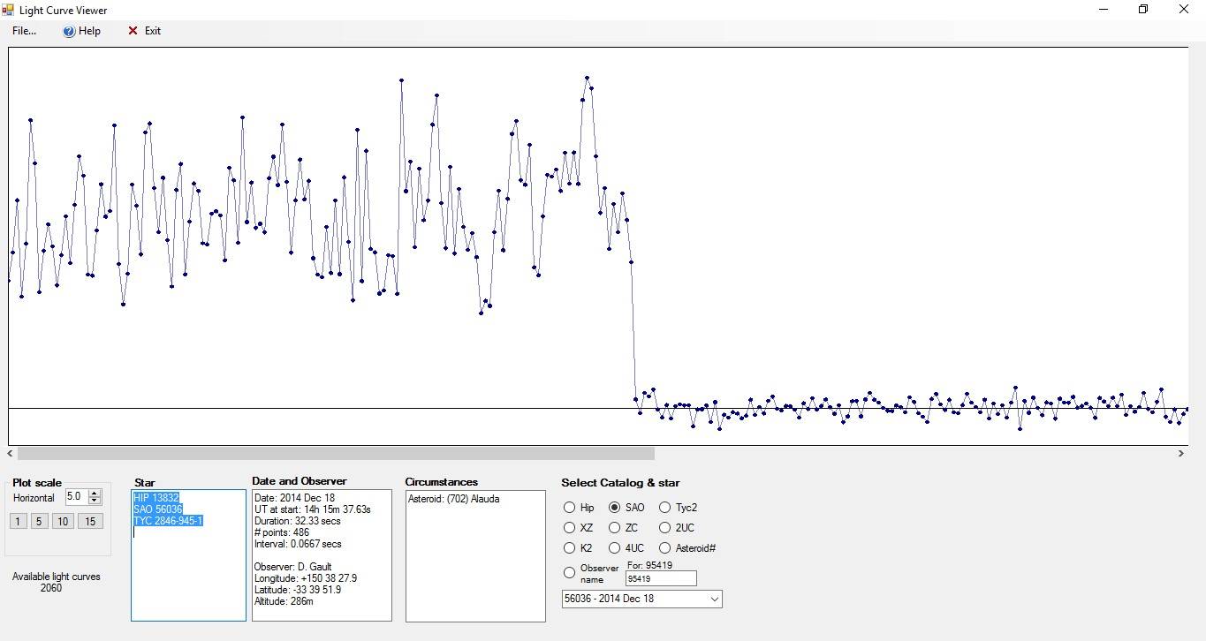
Light Curve Viewer – asteroidal occultation

Slide 8
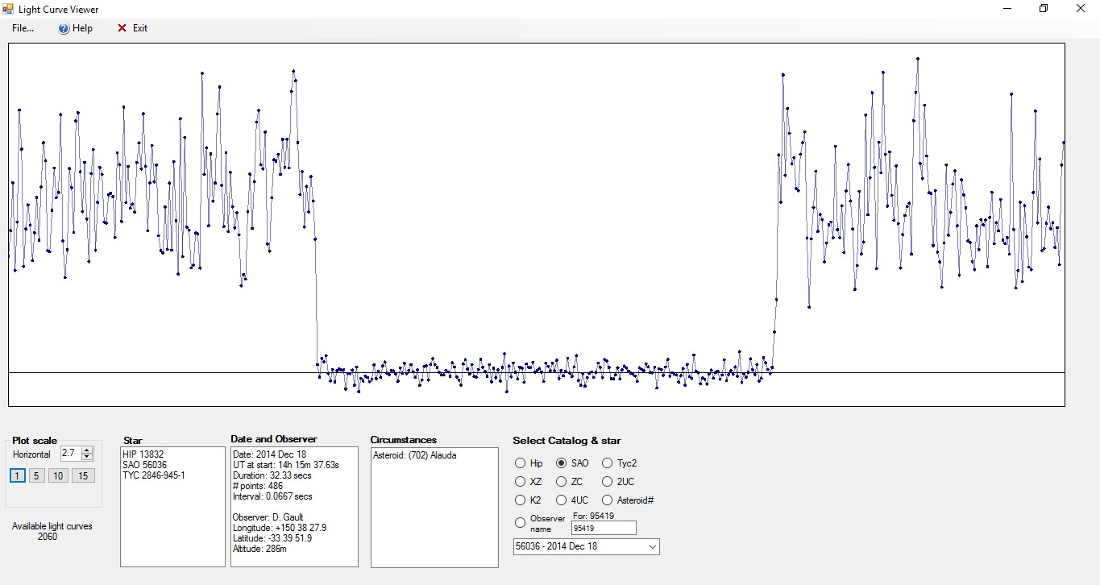
Light Curve Viewer – asteroidal occultation

Slide 9
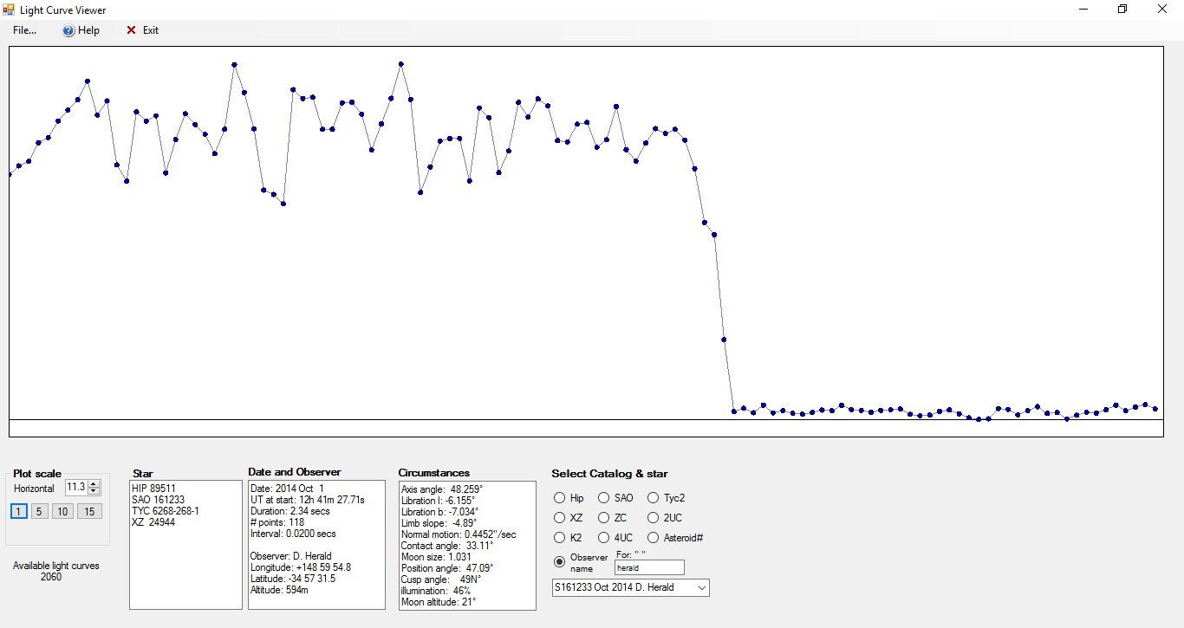
Light Curve Viewer – lunar occultation disappearance

Slide 10
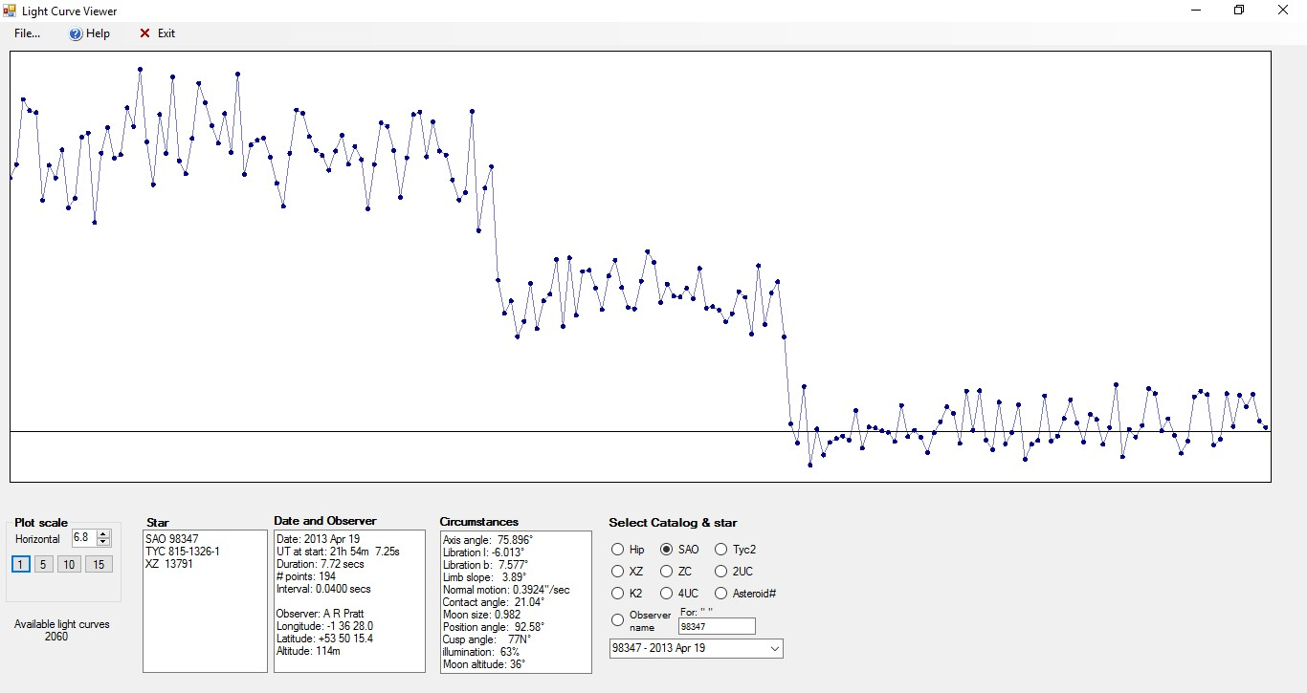
Light Curve Viewer – double star disappearance

Slide 11
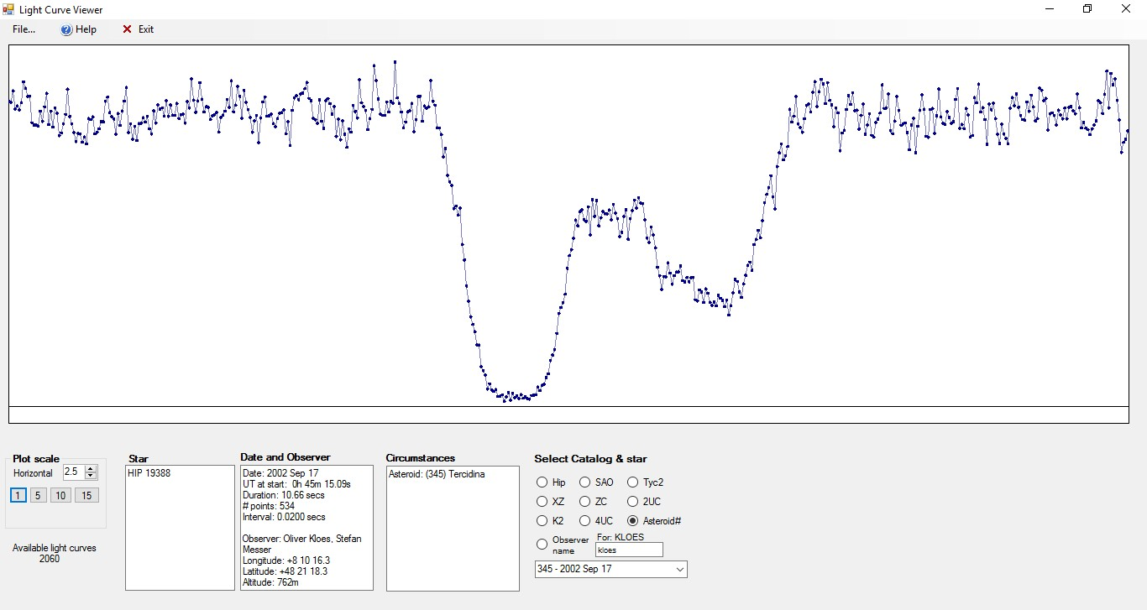
Light Curve Viewer – (345) Tercidina occultation

Slide 12
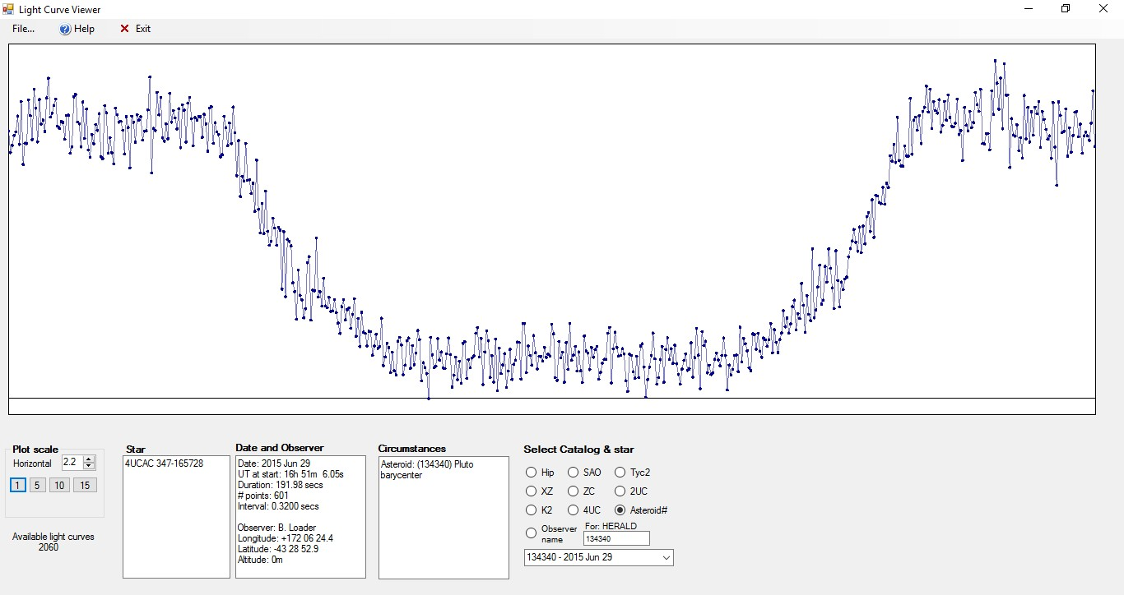
Light Curve Viewer – (134340) Pluto occultation

Slide 13



After the observation has been entered, make sure the observation entry is highlighted in the Events screen – then click the menu item
Enter the observation into the OCCULT Lunar Observations editor, in the usual fashion
13

Slide 14



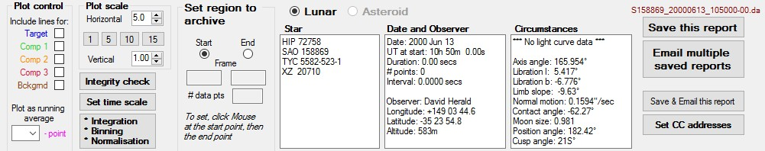
Occult generates all the information required
to support the observation
All you need to do is copy the light curve as a CSV file from Limovie or Tangra, and paste into the report.
14

Slide 15
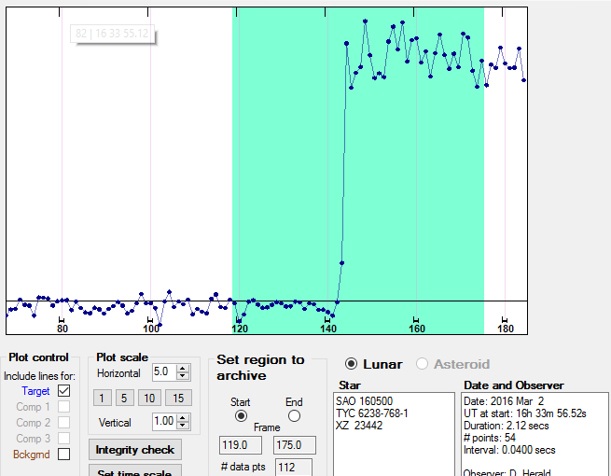
Reporting a light curve – Lunar (3)
Select the start and end of the segment of the light curve to be reported
15

Slide 16

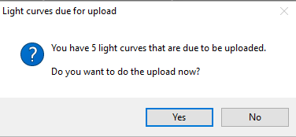
Click Save this report to save on your PC
Periodically, click Email multiple saved reports to submit them. Occult will periodically remind you.
Default reminder interval is one month
16

Slide 17

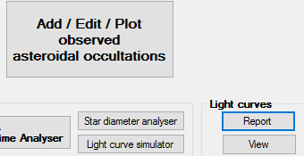
From Asteroid Observations tab, click Light curves – Report
This will open the Light Curve report form,
with some changes specific to asteroids.
17

Slide 18


First step – Paste (or open) the light curve report
Second step – click
and then enter the details.
18

Slide 19
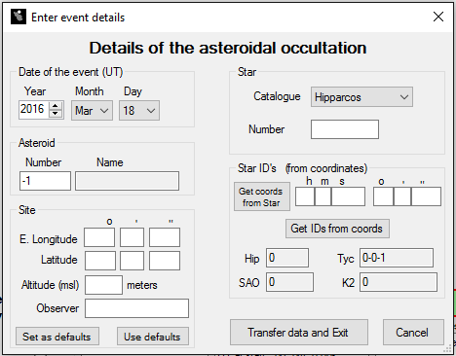
Site details can be set as default values
Click Get coords from Star to retrieve equivalents
Click Transfer data and Exit when done
19

Slide 20

Select the start and end of the segment of the light curve to be reported – as per lunar occs. However the light curve will usually be much longer
Save as per lunar occs. The light curve will be saved in the same location as lunar light curves
Submit in same manner as for lunar light curves
20

Slide 21
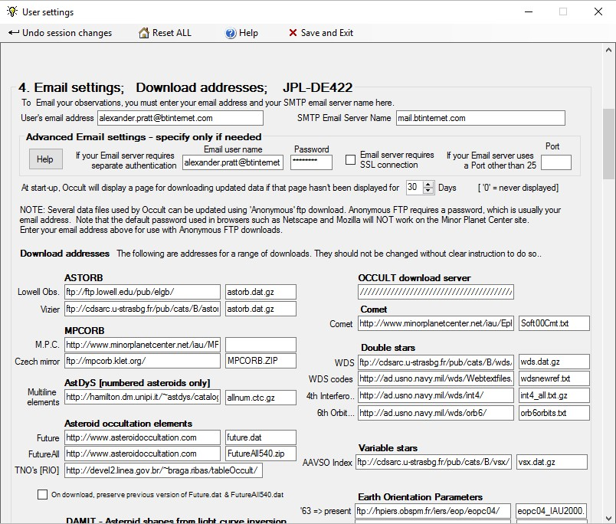
General maintenance functions – User settings – Email settings

Slide 22








VizieR catalogue: B/occ
Can query using Star ID, observer name, and more…
Can plot, by clicking the LCxxx Seq no.
1671 light curves, soon to exceed 2000.
22

Slide 23

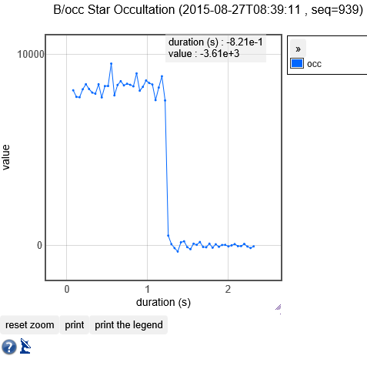
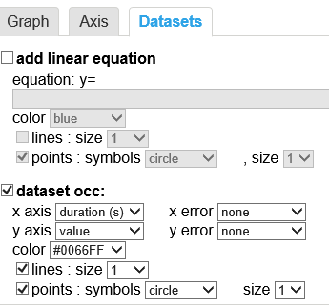
23

