Slide 1
Diameters, Volumes and bulk densities of 40 asteroids
Dave Herald

Slide 2
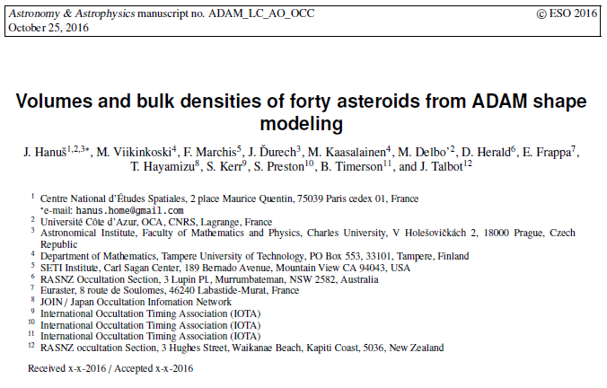
An overview of recent results

Slide 3
Why are diameters important?
Diameters are a primary characteristic of asteroids
Several Infra-red satellite missions have measured diameters for 1000’s of asteroids
Infra-Red Astronomy Satellite - IRAS (1992)
Asteroid catalogue using AKARI - AKARI (AcuA) (2011)
Wide-field Infrared Survey Explorer - WISE (2013)
[Other measures from 2MASS, SMBAS, SDSS MOC, SKAD, MSX & ISO]
Important for planning occultation observations

Slide 4
Why is density important?
The density of an asteroid tells us much about its composition and origin
Because some asteroids are analogs to the building blocks of the solar system, the density and internal structure could tell us much about the formation conditions and evolution processes of planets and the solar system
To determine density, we need to know the mass and volume of the asteroid

Slide 5
The challenge
Density is Mass/Volume
Need to use:
Reliable mass measurements, and
Reliable volume measurements
Mass measurements are only available for a relatively small number of asteroids
Satellites like IRAS, WISE & AKARI (AcuA) derive mean diameters from IR measurements for a huge number of asteroids. But the linkage to ‘real’ diameters is largely untested.

Slide 6
The Mass of asteroids
Most mass determinations are derived from orbit deflections/perturbations
Gaia will greatly increase the number of asteroids with reliable (<20%) mass determination
For binary asteroids, masses can be determined from the system dynamics

Slide 7
Volume of an asteroid
Literature provides measures of the ‘mean diameter’ of an asteroid
A ‘mean diameter’ is simply the diameter of a sphere that is in some manner equal to the asteroid.
For density measurements, we want the VOLUME-equivalent sphere
Light reflection measurements inherently provide the SURFACE-equivalent sphere

Slide 8
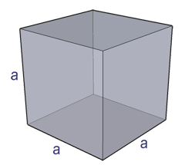
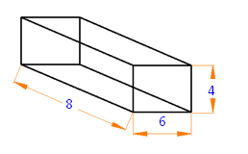
Examples
For a sphere, surface-equivalent dia is the same as the volume-equivalent dia
For a cube, the surface-equivalent dia is 12% larger than volume-equivalent dia.
For a slightly-elongated cube, difference is 14%
For an asteroid like 128 Kleopatra (217km x 94km x 94km) difference is 16%

Slide 9
Mean Diameter - summary
Photometric measurements give a mean diameter based on equal surface area
Density determinations require knowledge of the volume
The mean diameter based on equal volume is almost always smaller than that based on equal surface area
For irregular asteroids, the difference can be greater than 15%
We need a method to derive volume equivalent diameters

Slide 10
Shape of an asteroid
Shape can be determined by:
Space craft imaging (exceedingly rare)
Direct imaging with large telescopes (very rare)
Radar imaging (mainly NEO’s)
Multiple occultations – excellent single-event profiles, but exceedingly hard to combine results from different events
Light curve inversion - common

Slide 11
Light curve inversion
All asteroids exhibit light variation as they rotate
Light curve inversion is only possible when there is significant variation in the inclination of the asteroid’s axis of rotation as viewed from Earth
The technique models the shape of the asteroid that would reproduce the light curves
Volume-equivalent and Surface-equivalent diameters are given by the model

Slide 12
Light curve inversion limitations
Assumes the surface of the asteroid is of uniform albedo
For most models, the surface is assumed to be entirely convex
Generally there is an ambiguity in the determination of the rotational axis ⇒ two shape models (with one being wrong!)
The size of the asteroid is completely indeterminate

Slide 13
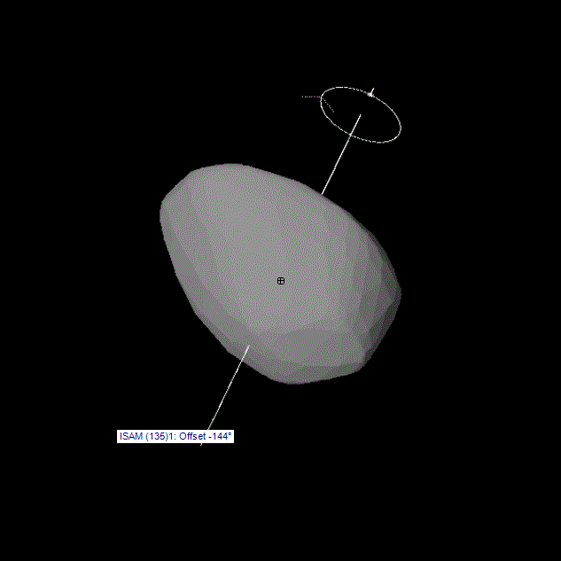
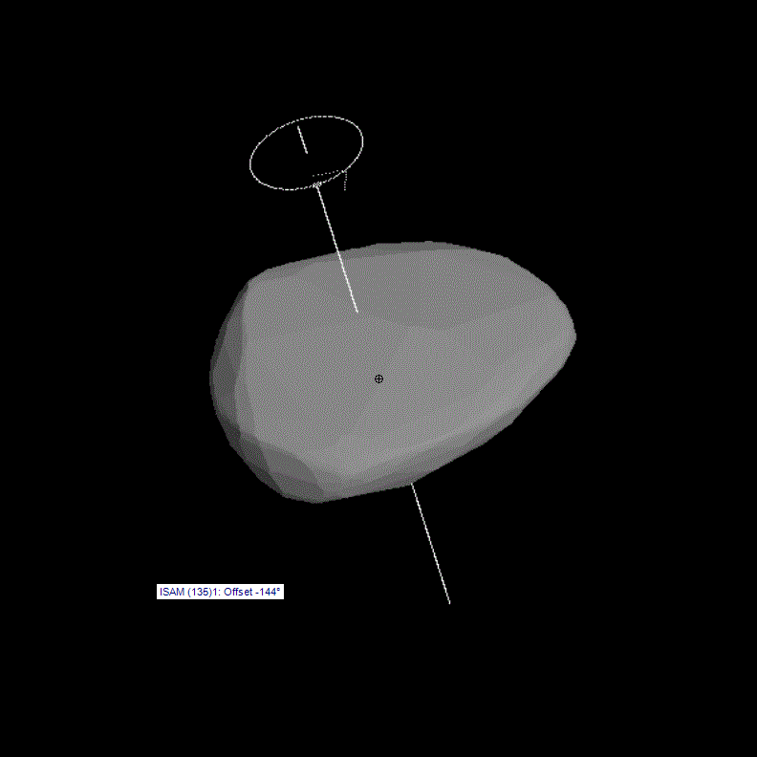
Light-inversion shape model (135) Hertha

Slide 14
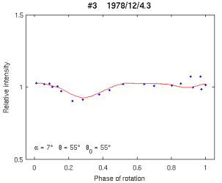
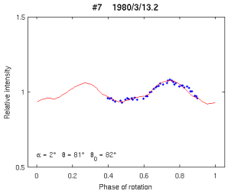
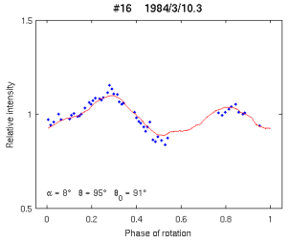
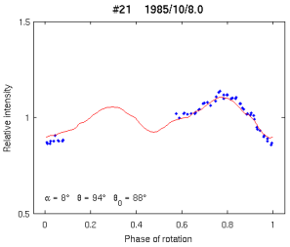
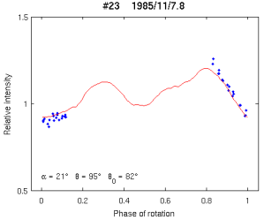
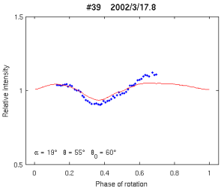
Some illustrative fits to light curves of (135) Hertha

Slide 15
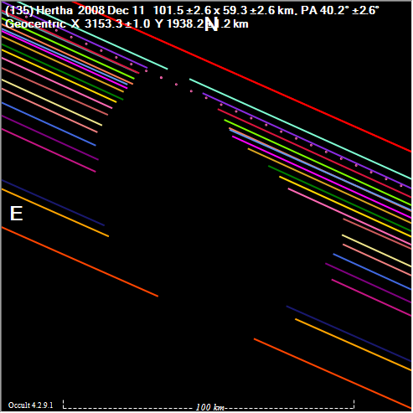
Asteroidal occultations - gives profile & dimensions to ~1km (Asteroid dia = 77km; apprnt dia = 0.071”; resolution ~1mas)

Slide 16
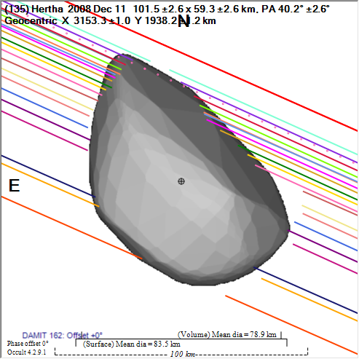
Can fit shape model to occultation

Slide 17
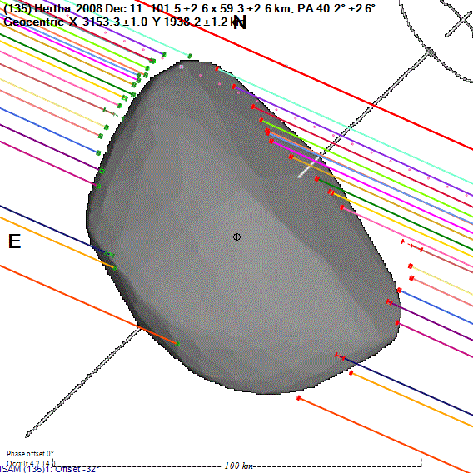
Can vary shape model rotation

Slide 18
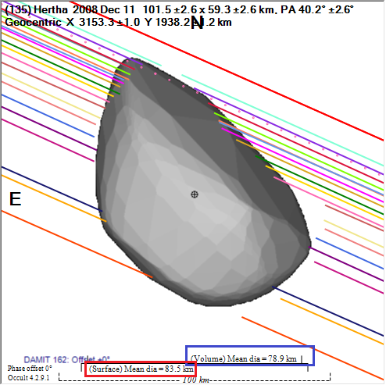
Mean diameters determined
Volume equivalent 79km
Surface equivalent 84km
IR Satellites
IRAS 79km
AcuA 73km
WISE 77km

Slide 19
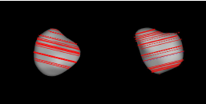
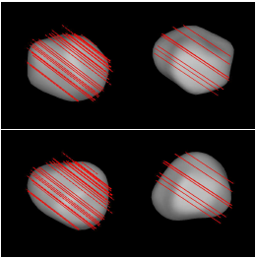
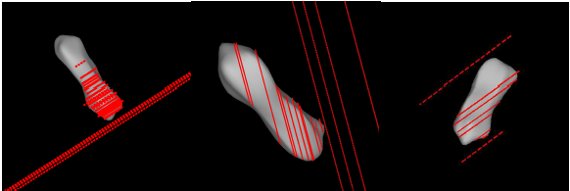
Fit model to multiple occultations
(9) Metis
51 Nemausa
(216) Kleopatra

Slide 20
Comparison – diameters from satellites
Compared ‘measured’ diameters against those from IRAS, AcuA and WISE
Mean differences are:
IRAS +1% AcuA -2% WISE +5%
Standard deviations
IRAS 8% AcuA 8% WISE 8%
On average, IRAS is best
HOWEVER for individual asteroids IRAS and AcuA are equally reliable – at ±8%

Slide 21
Bulk density of asteroids: Combine Mass with Volume
Typical bulk densities of meteorites
Chondrites 3.3; Carbonaceous chondrites 2.1-3.5; stony irons 4.5; Irons 7-8

Slide 22
Any questions?!

