Slide 1
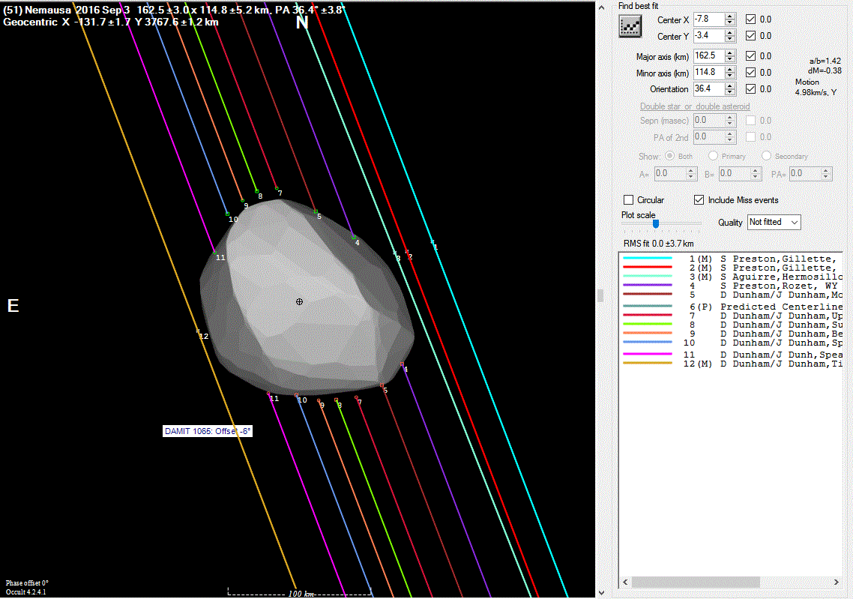
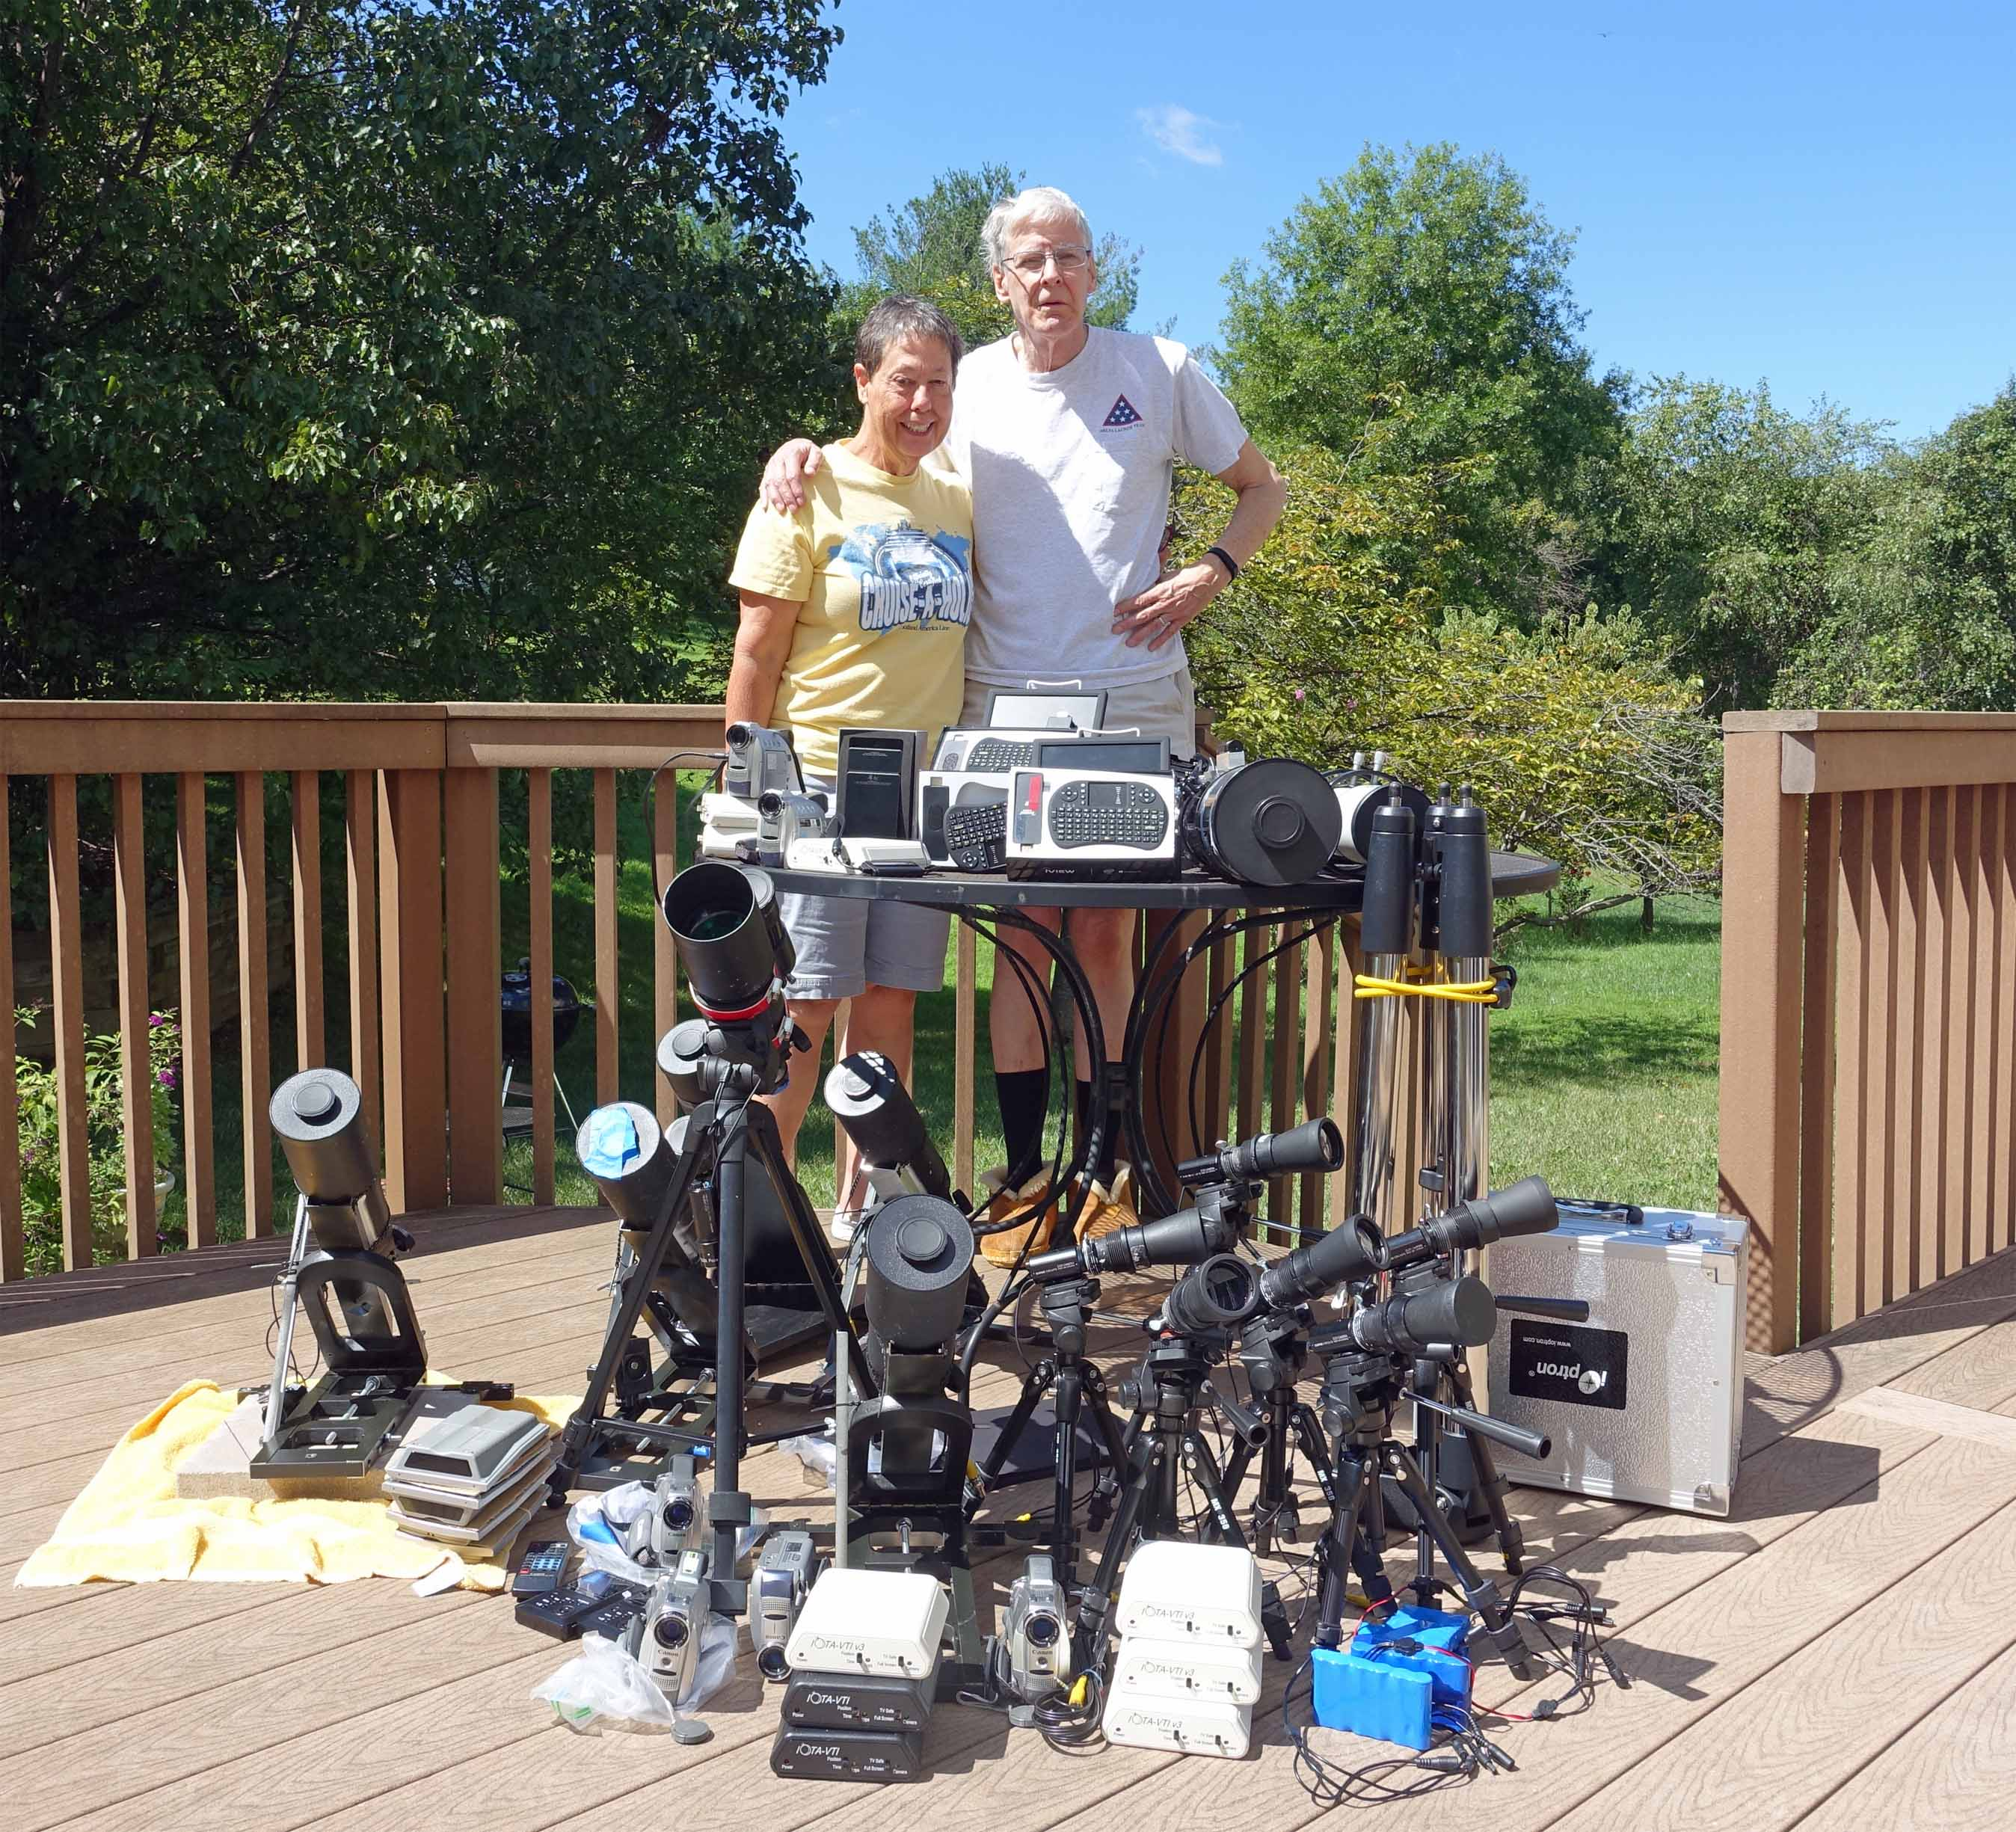
International Occultation Timing Association
IOTA
is the primary scientific organization that predicts, observes and analyzes lunar and asteroid occultations and solar eclipses.
We invite you to join us in the hunt for new scientific data as we “chase the shadows!”
Observations of the 9/3/16 occultation by the asteroid Nemausa compared to a shape model.
Since 1962, IOTA members have travelled worldwide to observe and record occultations and eclipses.
With small, inexpensive telescopes, lightweight recording systems, the IOTA VTI and IOTA predictions and software, an individual can deploy multiple remote stations to record events automatically.

