Slide 1
Posters for IOTA
September 2017
Joan Dunham

Slide 2
Poster Requirements
Interesting
Convey message that attracts observers
Portable and transportable
Inexpensive
Easily and quickly produced
Up to date
Sturdiness less import than cost and appearance

Slide 3
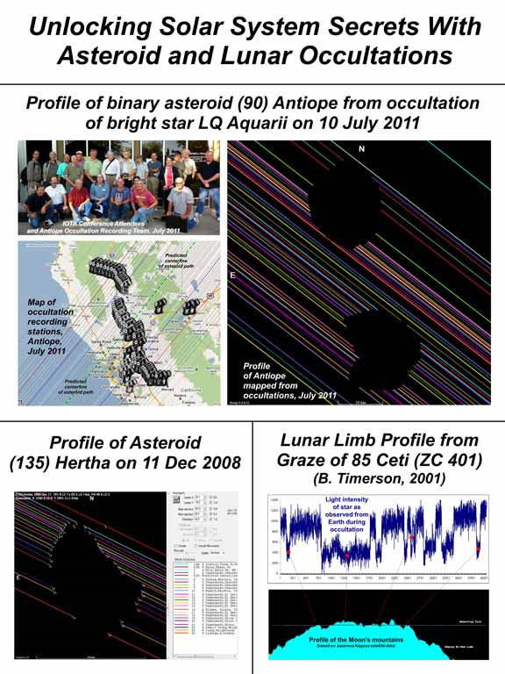
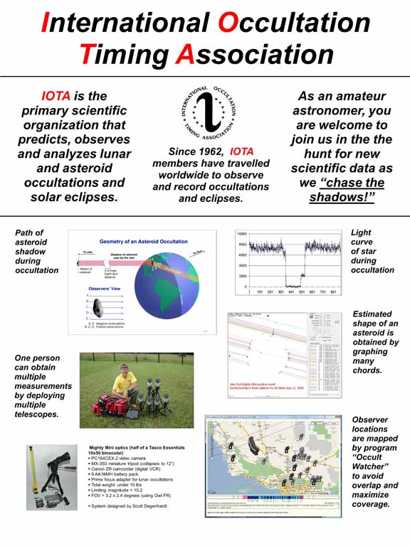
Posters from 2013
These posters, created by Ted Blank and featuring Scotty Dagenhardt and the Antiope occultation of 2011 were attractive and interesting. They were panels glued to large rigid boards and difficult to transport except by car. They also needed updating.

Slide 4
Posters for 2017 Meetings
A current message for early 2017
Various display options
Two different stands for the posters
A floor stand
Posters can also be tacked or taped to walls
Display plan
A floor poster at the front of the IOTA booth or display space
Multiple posters inside the IOTA booth
The IOTA banner across the back
Flyers and displays for further explanation of the poster subjects
Volunteers to answer questions and run the display equipment
Conclusions after 4 meetings:
The floor poster in front worked as “bait” at our NEAF booth
Tacking to walls OK as an alternative
Posters were attractive and well received
All need updating
Note that the banners and stands were provided to IOTA as a gift.

Slide 5
2017 Posters
Floor Banner
Bait to draw meeting attendees into the IOTA display
On a free-standing stand in front of the displays
Four Posters
Eclipse plans for 2017
Occultations from prediction to reduction
Remote stations
IOTA Video Capture
Poster stands
Two photography backdrop stands
Study (good), have large components (not so good)

Slide 6
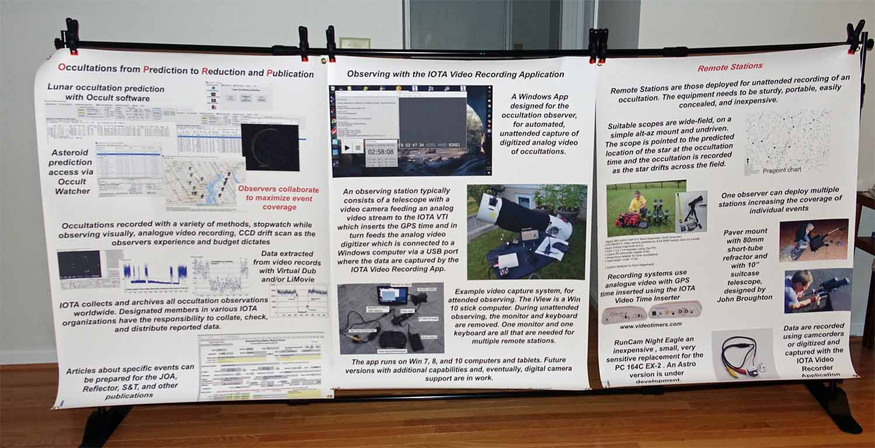
Posters for 2017

Slide 7
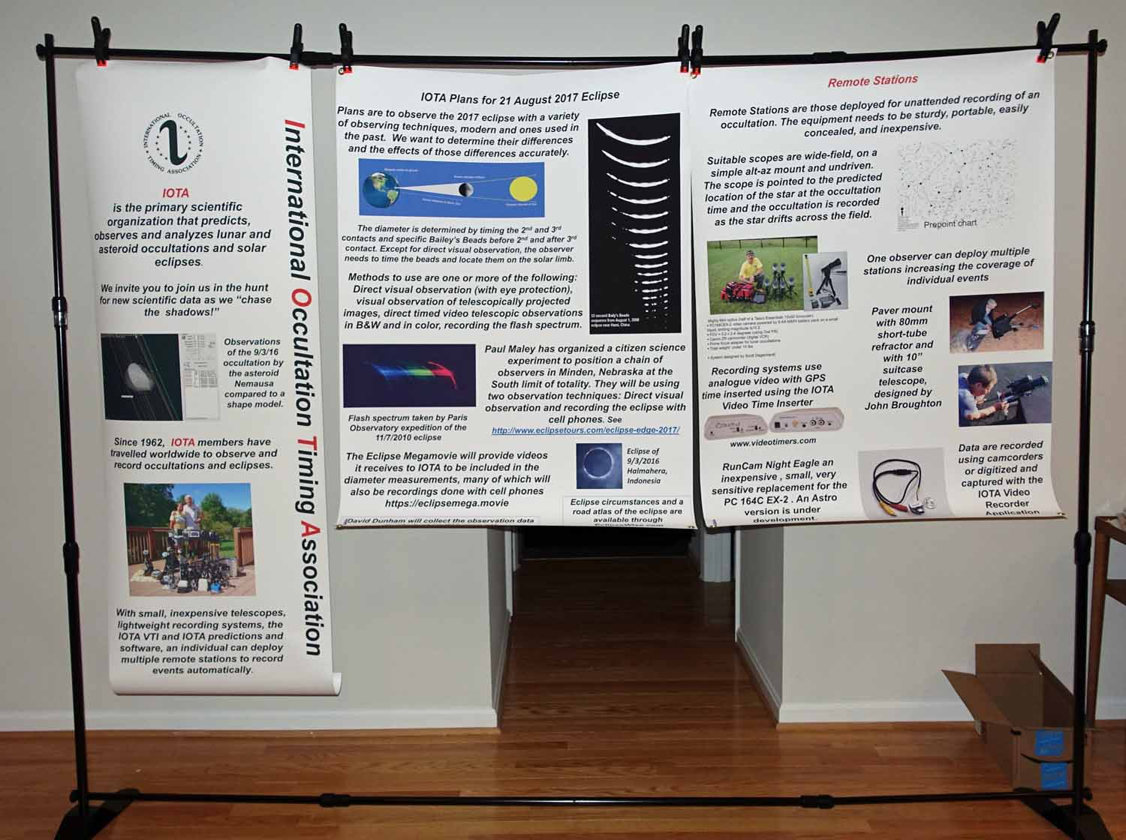
Posters for 2017 (con’t)
Banners and posters as full-sized PowerPoint slides are available upon request.

Slide 8
Usage
Some or all displayed at
AAS eclipse meeting – IOTA banner, floor poster, eclipse poster, 2 stands
NEAF – all of the posters and stands
St Louis Eclipse Expo - floor poster and eclipse poster
ALCON – floor poster and eclipse poster, discarded both after the meeting
Conclusions after 4 meetings:
The floor poster in front worked as “bait” at our NEAF booth
Stands too large to ship or take as luggage
Tacking to walls OK as an alternative
Posters were attractive and well received

Slide 9
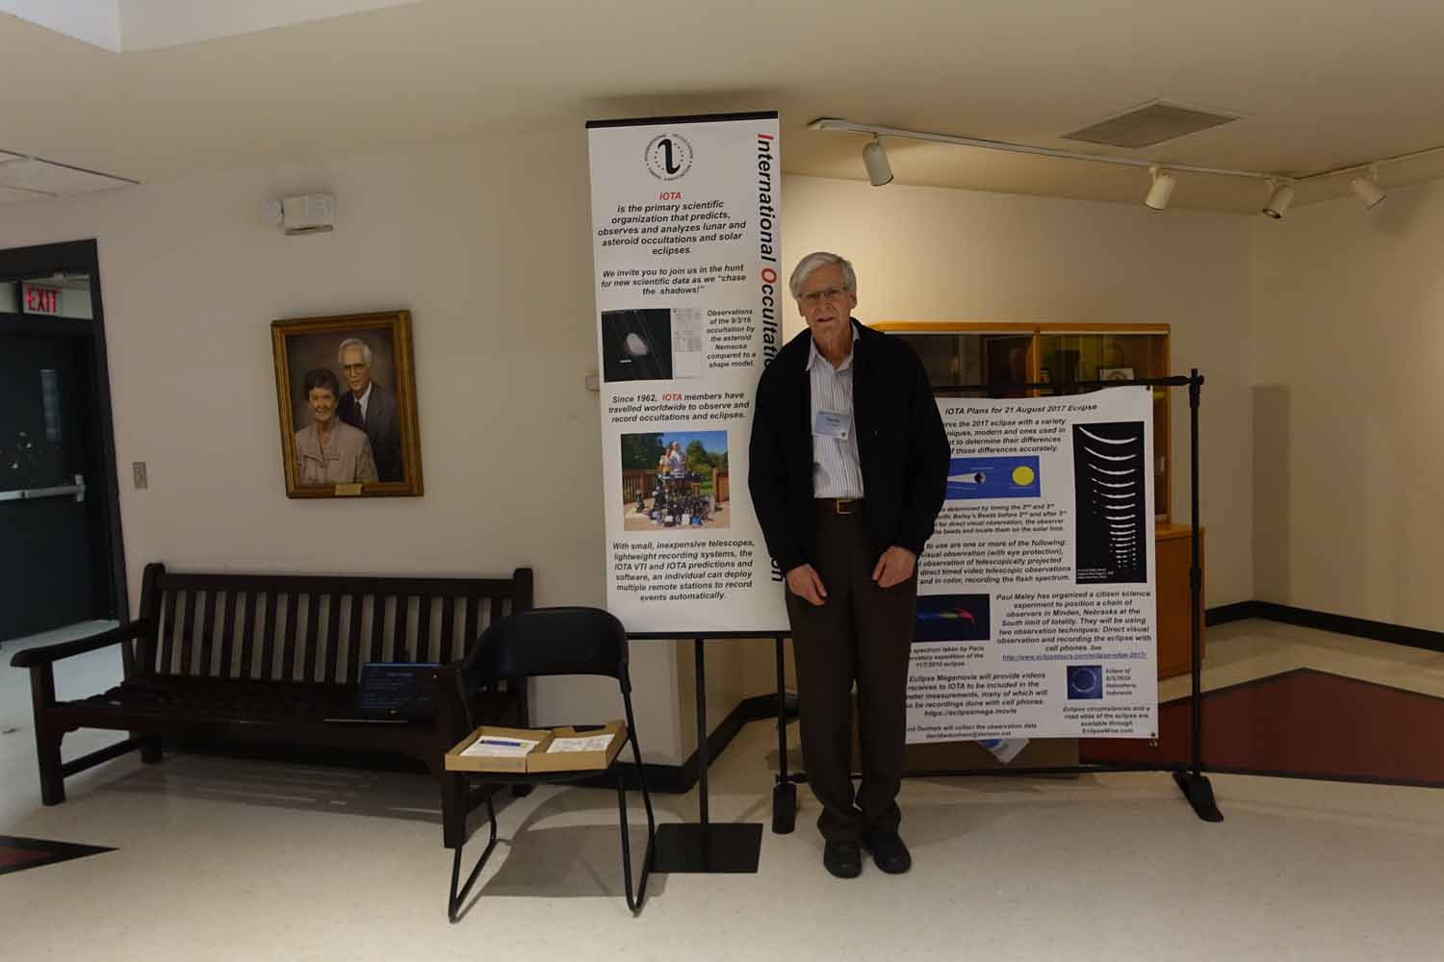
First use at AAA Solar Eclipse Workshop, April 1

Slide 10
Mechanics of Poster Production
Prepare as PowerPoint Slides
Dimensions
Posters - 36x48 inches
Floor poster – 24 x60 inches
Dimensions need to be set Design>Slide Size>Custom Slide Size
Printed using Staples online services
Some editing service available, not as good as with PowerPoint
Generate PDF files with PowerPoint to upload for printing – PowerPoint files are too large
Print to lightweight white plastic film (indoor vinyl) – assuming posters will need updating frequently, perhaps paper would be a better choice
Cost
$36 for floor banner + tax, total cost $38.15
Posters, 4 @ $42 apiece + tax, total cost $151.34, includes $25 discount
Turnaround time – Approximately a week

Slide 11
Stands
Floor stand
Adjustable Banner Stand, black metal, sold by Metropolitan Display - $34 + $8.89 S&H
Photo background stands
LimoStudio Photo Video Studio 10ft Adjustable Muslin Background Backdrop Support System Stand AGG1112 $34, sold by KimOutlet via Amazon
Yescom 8’ Step and Repeat Display Backdrop Banner Stand Adjustable Telescopic Trade Show Wall Exhibitor $55 Sold by Yescom via Amazon
Heavy Duty Muslin Clamps 4 ½ inch 6 pack for $8 sold by SimpleStudio via Amazon
S&H waived for these two stands

Slide 12
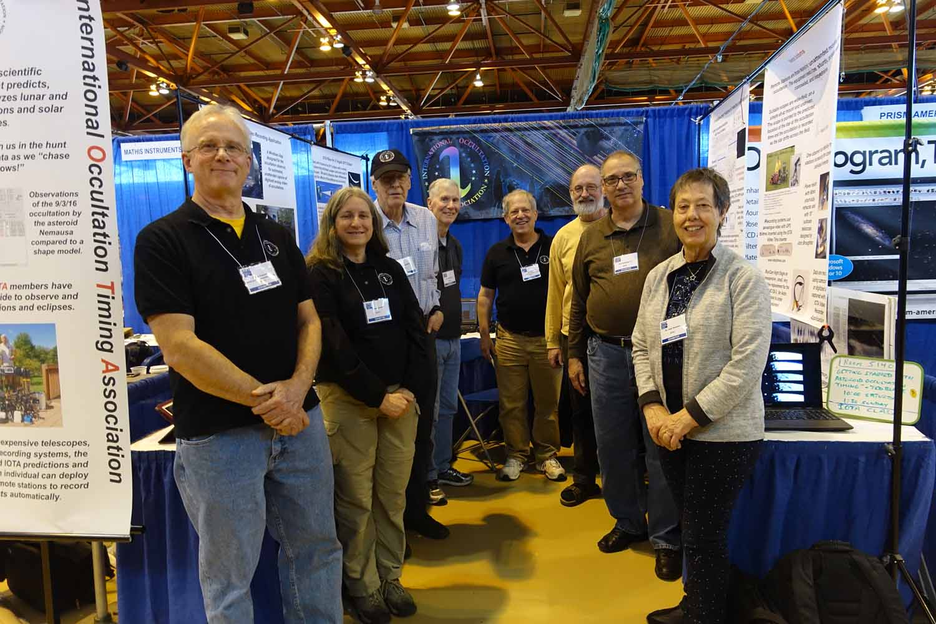
IOTA booth at NEAF April 8-9

Slide 13
Options for the Future
Stands
X-banner style – lightest weight, least expensive, needs a lot of space for the feet
Easel style – needs a lot of space if a floor stand
Photo backdrop display – has room for multiple posters, heavier
Feet for floor stand
Tripod feet – takes more room, sturdiest
Flat feet - may have stability problem
Table-top (smaller poster)
Retractable roll-up banner – easiest set-up, less flexible, more expensive
Print media (Staples for example)
Poly film– light weight (indoor poly), good color
Heavy weight vinyl – sturdy, outdoor use, good color, expensive (outdoor scrim vinyl)
Paper – cheapest, least durable (color engineering prints, $12 for 36”x48”)
Photo print or poster print – glossy or semi-gloss or heavier paper ($30 for 24” x 36”, largest size from Staples)

Slide 14
Discussion
Posters need updating for 2018
Ideas?
Suggestions?
Volunteers?
This discussion will continue online!
IOTAoccultations@yahoogroups.com or dunhamjoan@Verizon.net

