Slide 1
Occultation activities of Jyotirvidya Parisanstha, India
Suhas Gurjar, Aniruddha Deshpande, Deepak Joshee, Sameer Godbole
Jyotirvidya Parisanstha, Pune
India’s Oldest Association of Amateur Astronomers

Slide 2
Our vision
To make available 10 sets of instruments for occultation observations and train volunteers in and around Pune to record occultation using these set ups.
Record maximum possible occultations happening in India, within capability of our sets, at least near by to our home town.
With 10+ stations positioned at right angle line to the asteroid occultation path, generate observational records, to enable us / IOTA to profile the asteroid’s size and shape.

Slide 3
Occultation of TYC 2430-01124-1 by asteroid, 22 Calliope: 24/25 December 2016 Occultation path

Slide 4
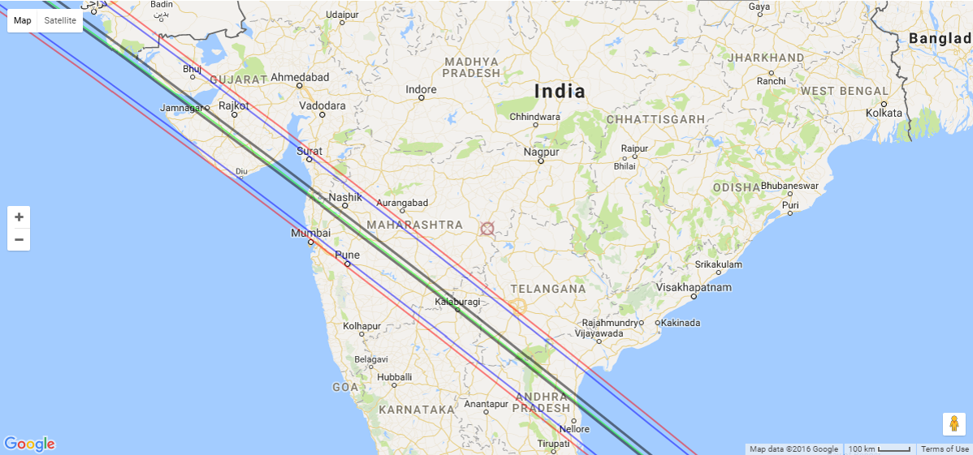
JVP’s observation stations for occultation

Slide 5
Observation stations
No. | Place | Longitude (E) | Latitude (N) | Telescope | Observers
1 | Sanaswadi Unique Petrol Pump | 74.0697425 | 18.64896 | 5 inch Cassegrain | Atharva Pathak, Amit Kadlaskar
2 | Suraj Petrol Pump | 74.18606 | 18.71956 | Paul's Set up | Dinesh Khairnar, Vishwajeet Anjali
3 | Ranjangaon | 74.25295 | 18.75934 | 6 inch Cassegrain | Siddharth Birmal, Prathamesh Kale
4 | Siddhant Petrol Pump | 74.34220858 | 18.80848542 | Paul's Set up | Vivek Shende, Sayali
5 | Durga Lawns | 74.41689 | 18.87392 | Paul's Set up | Pooja Naniwadekar, Nisarg Ingole
6 | Samarth Multiservices | 74.48802 | 18.93001 | 6 inch refractor | Shubham Kulkarni
7 | Smilestone | 74.57558 | 18.98523 | Paul's Set up | Paul Maley, Suhas Gurjar
8 | Occultation centre line | 74.61092049 | 19.015221 | 8 inch reflector | Harshad Abhyankar, Rishikesh Kulkarni
9 | Simaratmal Kundanmal Petrol Pump | 74.66099 | 19.03987 | 10 inch reflector | Ranchandra Karanje, Mayuresh Wagh
10 | Ahmednagar | 74.741238 | 19.090309 | Paul's Set up | Shruti Deshpande, Harsha Kulkarni
11 | Effort Planetarium | 74.77026072 | 19.1869516 | 4 inch and 8 inch reflectors | Madhavi Patankar, Ketaki Dave
12 | Baba Petrol Pump | 74.83017 | 19.2482 | Paul's Set up | Mohan Tembe, Monika Gundecha
13 | D S Petrol Pump | 74.86947 | 19.332966 | Paul's Set up | Siddharth Kamat, Madhuri, Prabhanjan Bongarde
14 | Hotel Arya | 74.661 | 19.0396 | 8 inch reflector | Ranchandra Karanje, Mayuresh Wagh
15 | Essar Renuka Petrol Pump | 74.94104 | 19.49494 | Paul's Set up + 5 inch reflector | Harshada Kavi, Shruti Deshpande, Aniruddha Deshpande
16 | Manjari Hadapsar |  |  | 8 inch reflector | Umesh Ghule
17 | Kesariwada | 73.84909543 | 18.51613532 | 11 inch cassegrain | Milind Joshi
18 | IUCAA | 73.82606238 | 18.55902915 |  | Sonal, Abhay Dasharath
19 | Navsari | 72.97669899 | 20.95081804 |  | Avik Dasgupta

Slide 6
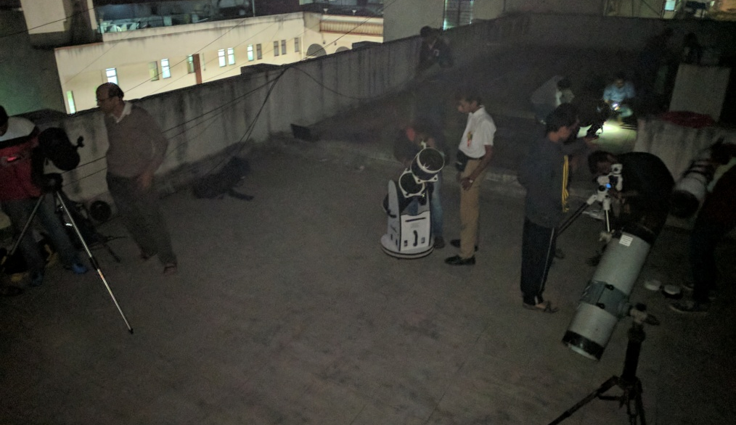
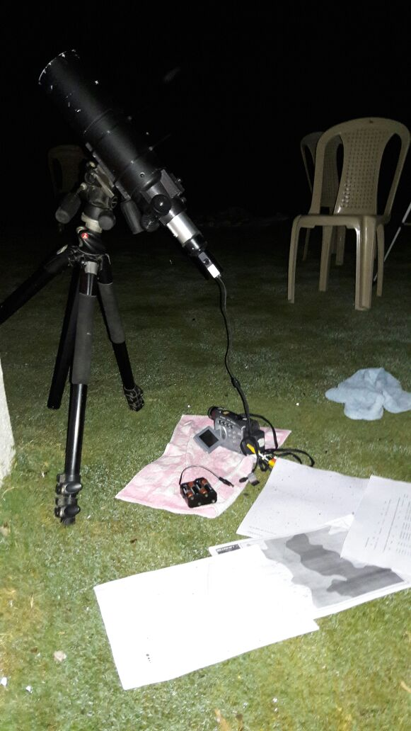
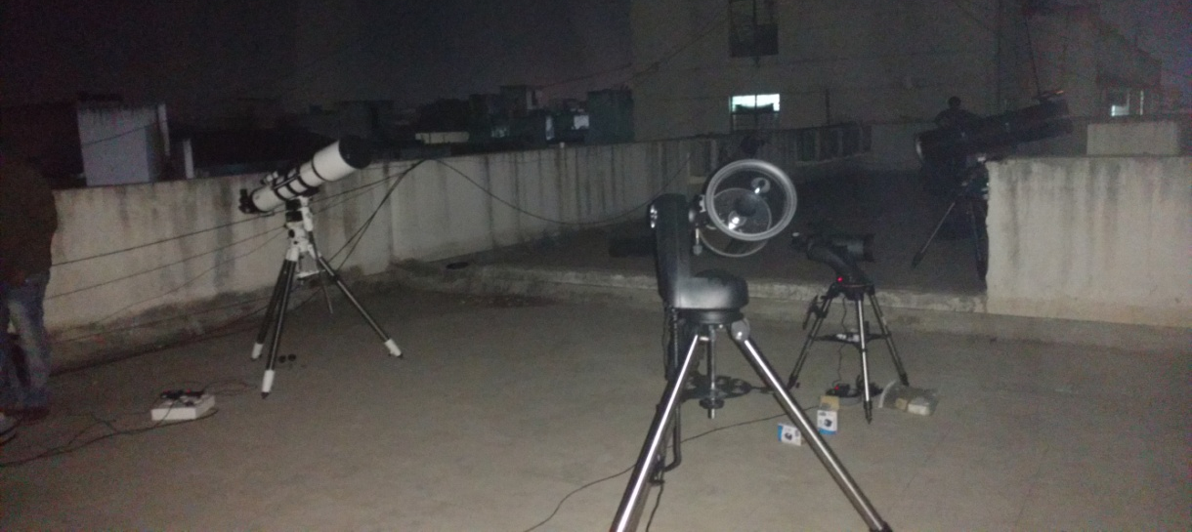
Instrument set ups

Slide 7
Team JVP

Slide 8
Analysis of observations to predict asteroid shape

Slide 9
Analysis of observations to predict asteroid shape

Slide 10
Superimposing asteroid shape to observation locations

Slide 11
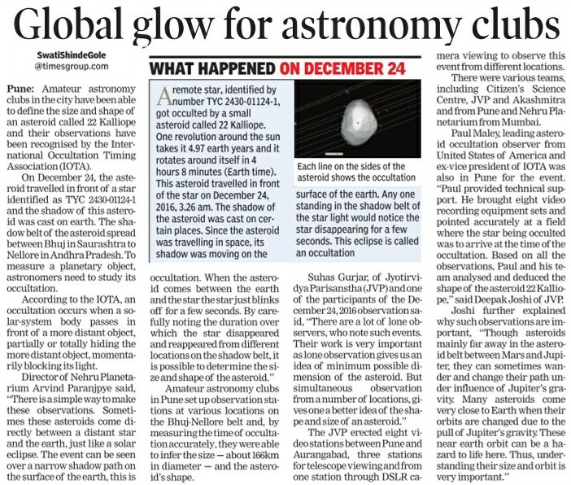
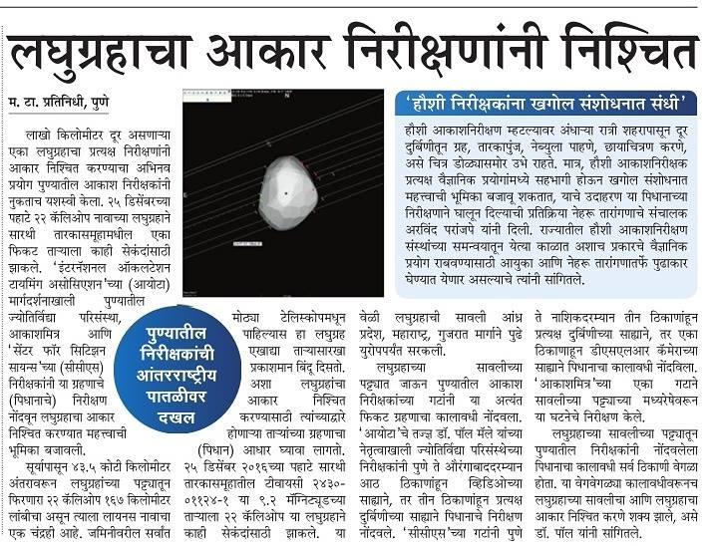
News reports in local news papers

Slide 12
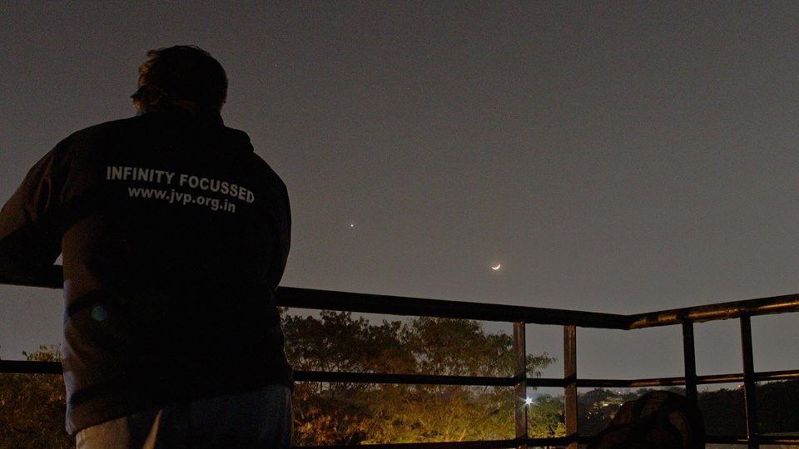
Thank You

