Slide 1
Observations of the 2022-07-09 Occultation by Titan
Phil C. Stuart
2022-08-13

Slide 2
Titan
Largest moon of Saturn
5150 km diameter (40% of Earth, 1.5 x Moon)
Only solar system moon with a “significant” atmosphere
1.5 x Earth sea level pressure
Triton = 1/20,000 x Earth¹
Io = 1/200,000,000 x Earth¹
Callisto = 1/40,000,000,000 x Earth¹
Lower gravity than Earth means a larger atmosphere
Cover image: NASA/JPL/Space Science Institute PIA06139
Ref 1: https://www.planetary.org/articles/04081101-a-moon-with-atmosphere

Slide 3
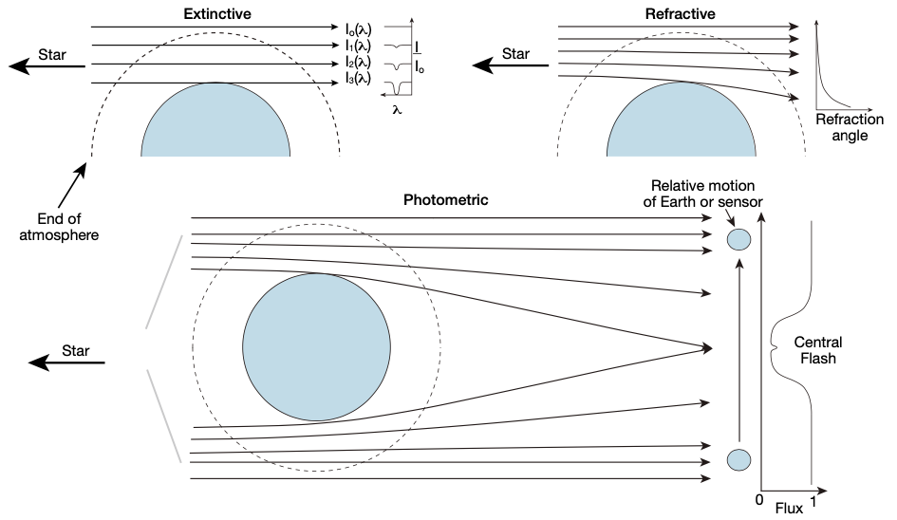
Possible atmospheric phenomena
Vervack Jr., R. J., et al., “The MSX/UVISI Stellar Occultation Experiments: Proof-of-Concept Demonstration of a New Approach to Remote Sensing of Earth’s Atmosphere”, Johns Hopkins APL Technical Digest, Vol. 32, No. 5, 2014

Slide 4
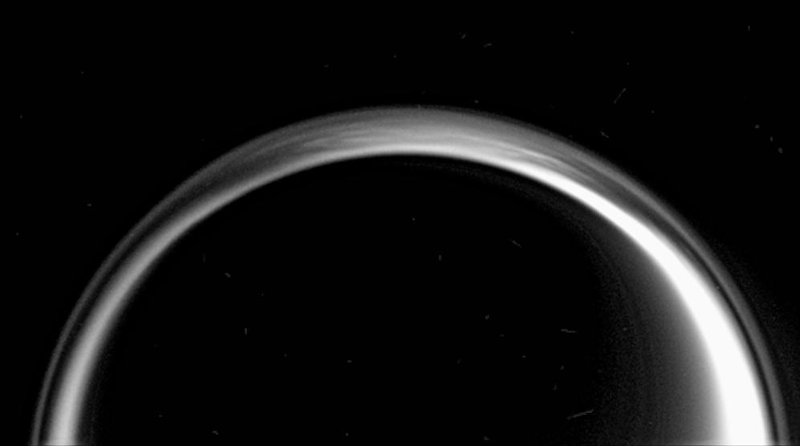
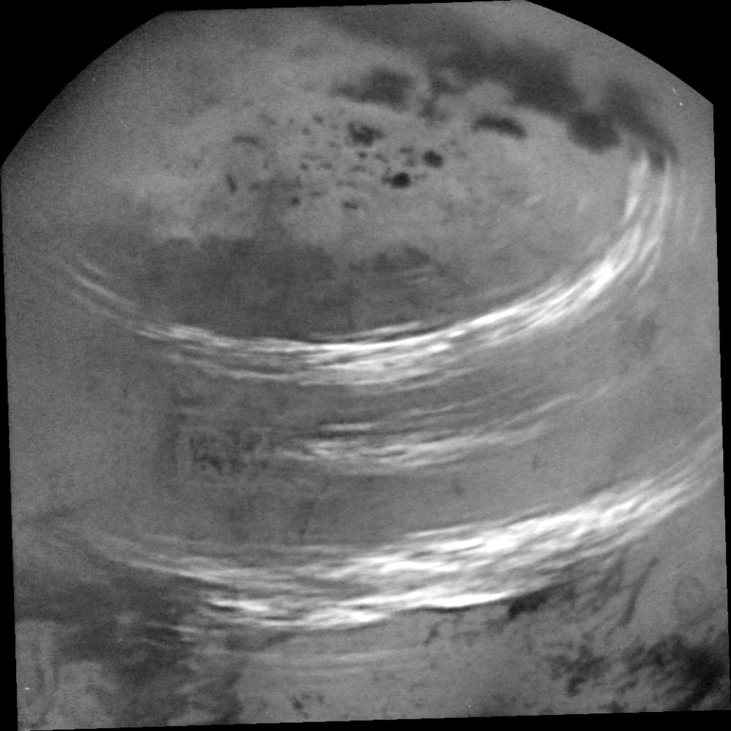
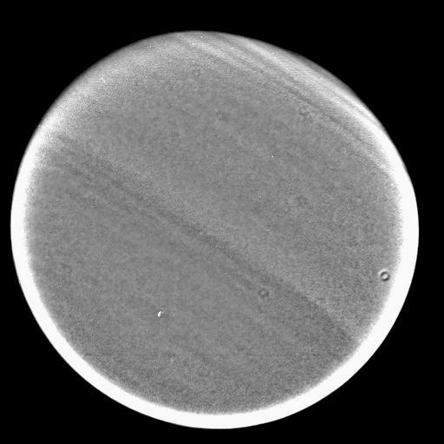
Haze
layers
PIA06160
Polar
Cap
PIA08127
PIA21450
Methane
clouds
Possible sources of extinction
Atmospheric
banding
All images from: NASA/JPL/Space Science Institute
https://photojournal.jpl.nasa.gov
PIA06152

Slide 5
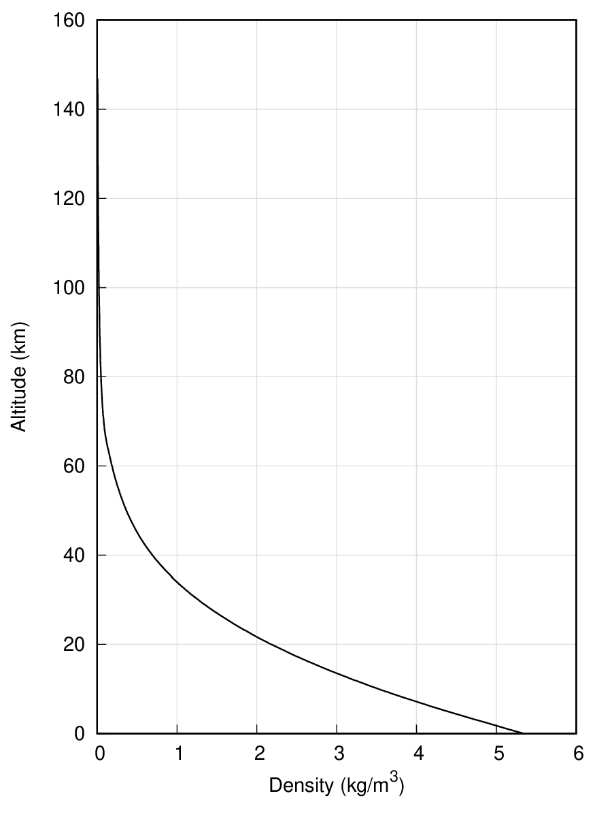
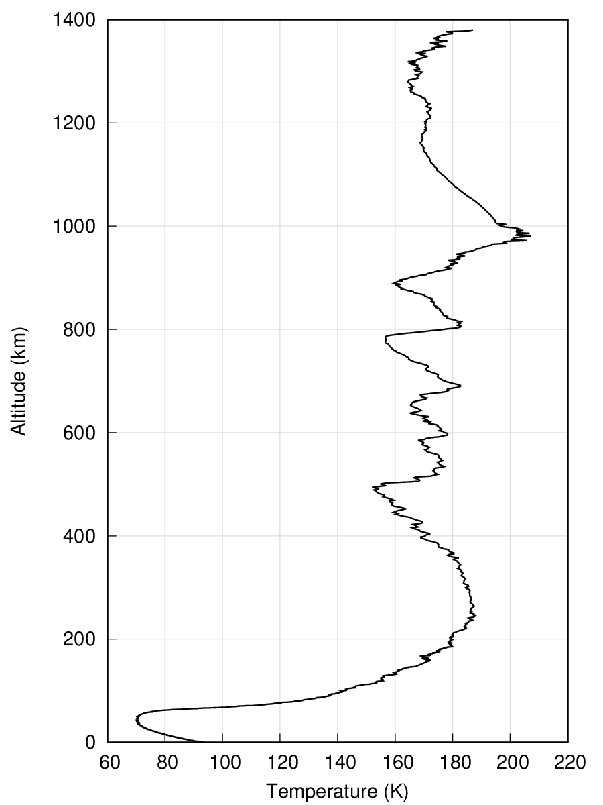
Refraction effects
Density gradients cause brightness changes
Density gradients are proportional to temperature gradients
Plot based on data from the Huygens probe
M. Fulchignoni, Universite Paris VII
ESA Planetary Science Archive
www.cosmos.esa.int/web/psa/huygens

Slide 6
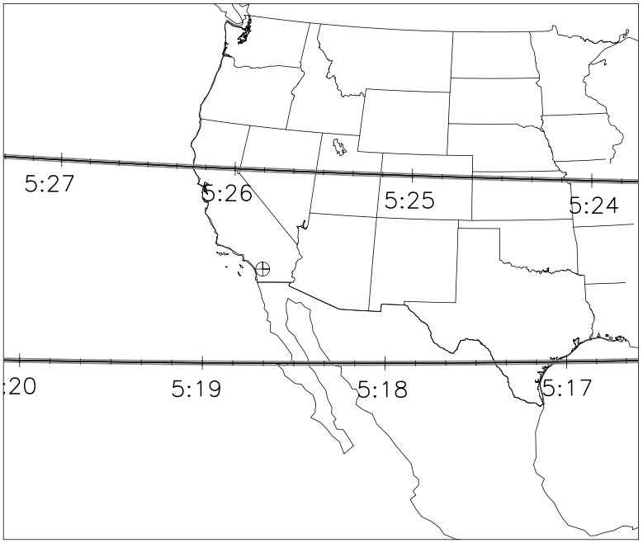
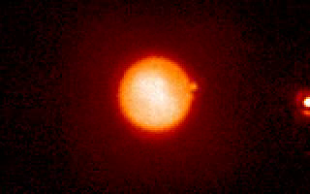
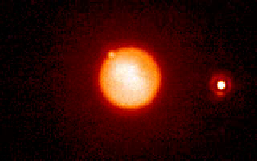
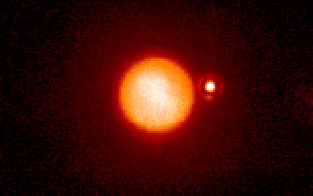
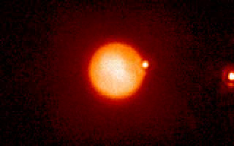
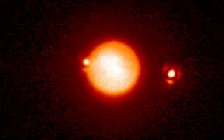
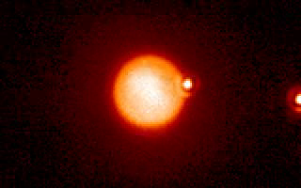
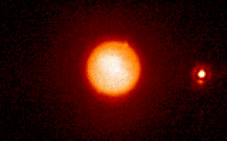
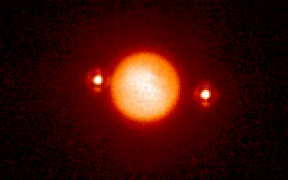
What does all of this really look like?
Palomar 200” 20-Dec-2001
71
262
Titan occulting a
double star
Picture # in upper left
1
72
395
Palomar
60
220
468
Bouchez, A. H., “Seasonal Trends in Titan’s Atmosphere: Haze, Wind, and Clouds”, PhD Thesis, California Institute of Technology, 2004
https://occultations.org/publications/rasc/2022/20220709Titan.htm
Note the flashes as the moon’s atmosphere passes the star and the refracted star images at two points above Titan’s surface

Slide 7
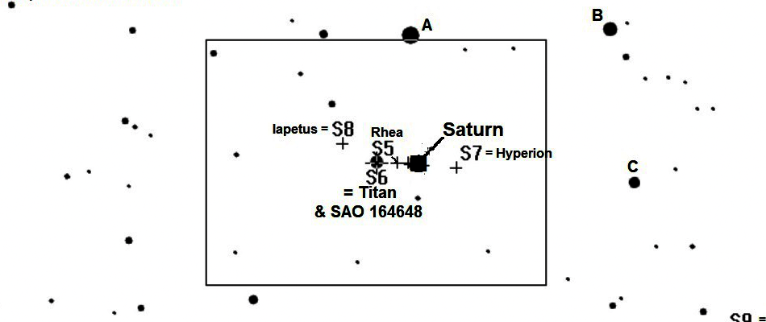
The Event
09 July 2022, 09:13 to 09:31 UTC
Titan
Magnitude 8.5
Star
HIP 107569, SAO 164648
Magnitude 8.7
Event
Magnitude drop: 0.66 (low SNR)
Max duration: “326.6” seconds
Close in
8” SCT
David Dunham
https://occultations.org/publications/rasc/2022/20220709Titan.htm

Slide 8
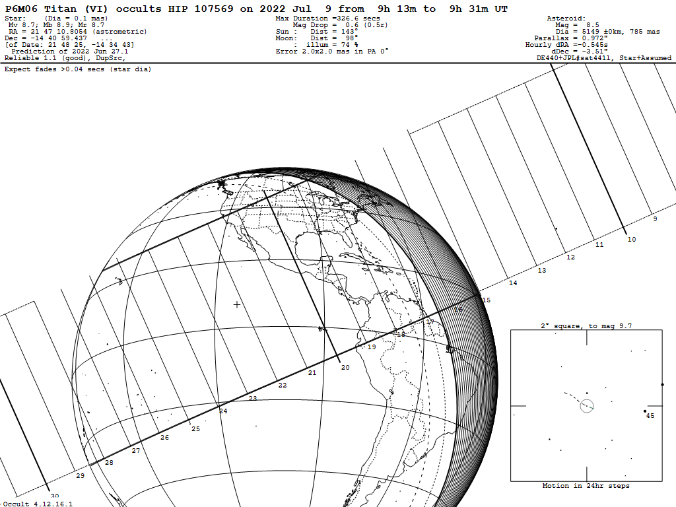
Shadow Path

Slide 9
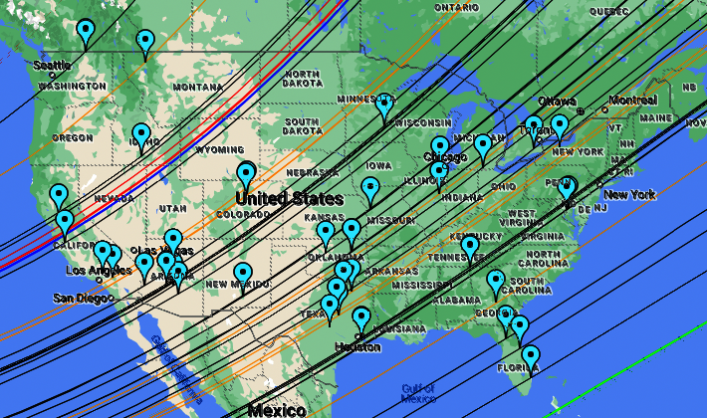
Observers
45 Total
36 Successes
39 USA
2 Canada
1 Russia
Anderson
Barton
Bender
Blank
Ceravolo
Collins
Dunford
Dunham
Eisfeldt
George
Getrost
Hanna
Harris
Hodapp
Howell
Jewell
Jones
Kelley
Kenyon
Lyzenga
Maley
Messner
Miller et al.
Mitchell eV
Moore
Nikitin
Nolthenius
Nugent
Olsen
Richmond
Romanov R
Sada
Sandy
Schiff eV
Smith, M.
Smith, N.
Stuart
Swift
Thomas
Venable
von Ahnen
Whitehurst
Wilson
Wing
Yoblansky eV
R: remote
eV: eVscope

Slide 10
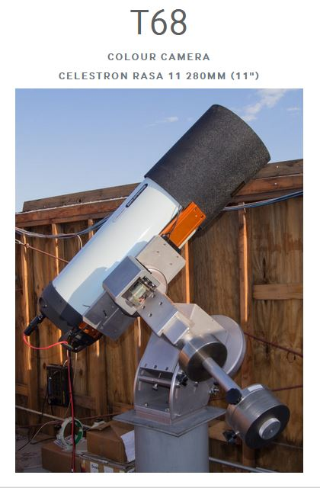
Filipp Romanov
Remotely observed from Russia using an online telescope from iTelescope.net located in New Mexico
No charge for use
Limited to single 30 minute session ever 18 hours, regardless of moon phase
10 second exposures
Data supplied is from the green channel of a color camera
40 seconds between exposures
First time to use the scope
Interval can be shorter, at least as small as 8 seconds
While the rate was too low to see atmospheric phenomena, it would be useful for longer duration, high priority objects such as TNOs

Slide 11
Results
Unlike most occultations, the D and R times are poorly defined and can’t be used to find the actual event times or chord offsets.
Light curves from different observers were first aligned using predicted event times and chord offsets.
The event times were then all adjusted by taking the absolute value of the times and tweaking the central times until the D and R regions overlapped.
Chord offsets were adjusted by plotting vs. distance instead of time and changing the offset until the moon’s projection became a circle.

Slide 12
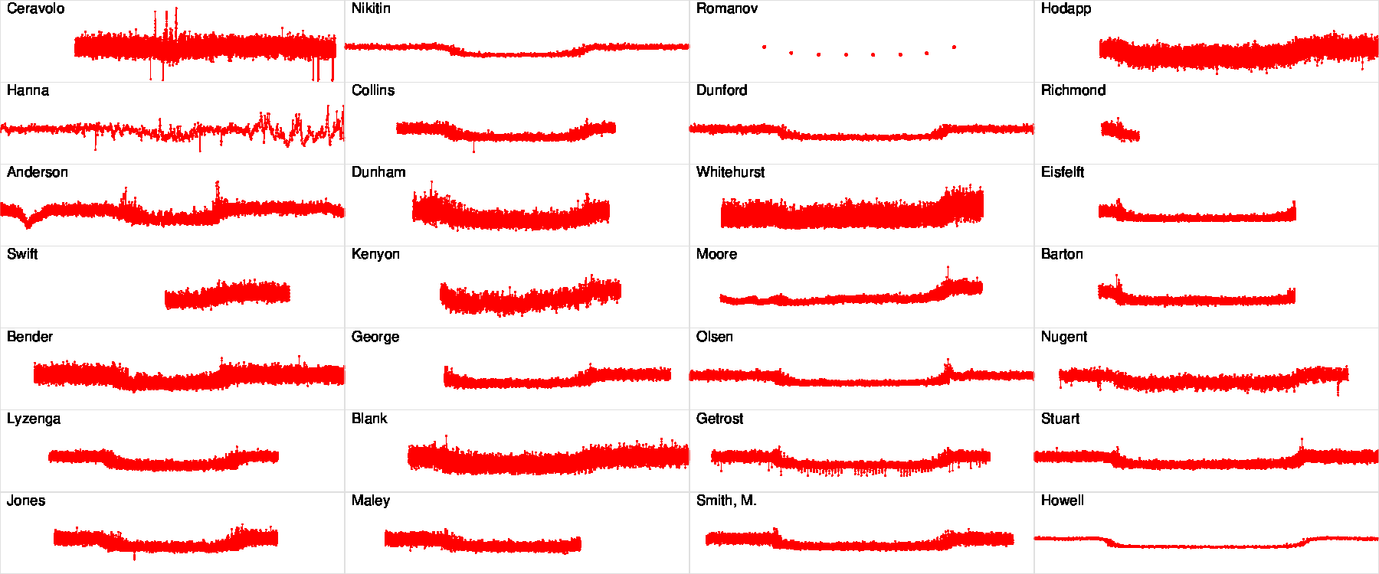
Almost all available chords
Farthest from moon’s center
Nearest to moon’s center

Slide 13
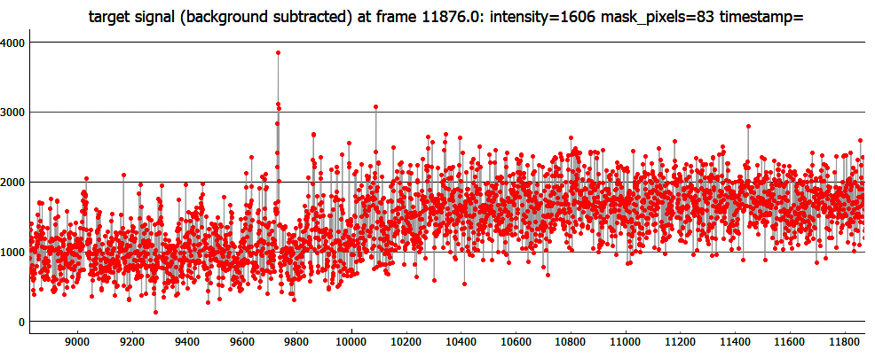
...and Rick Nolthenius’

Slide 14
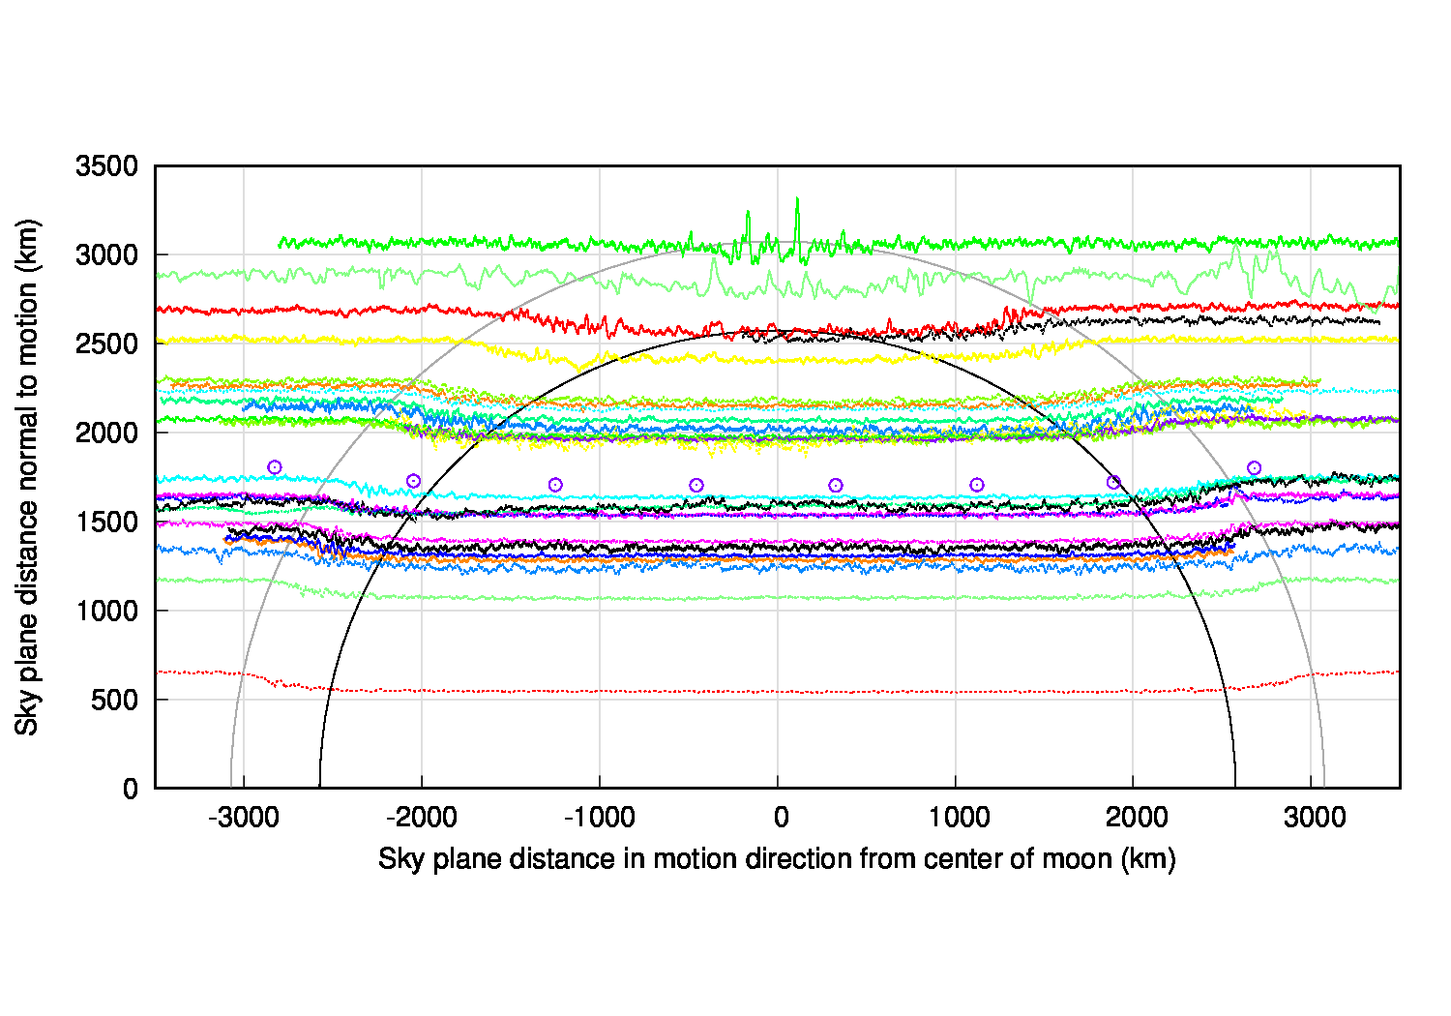
Data averaged to 1 second intervals

Slide 15
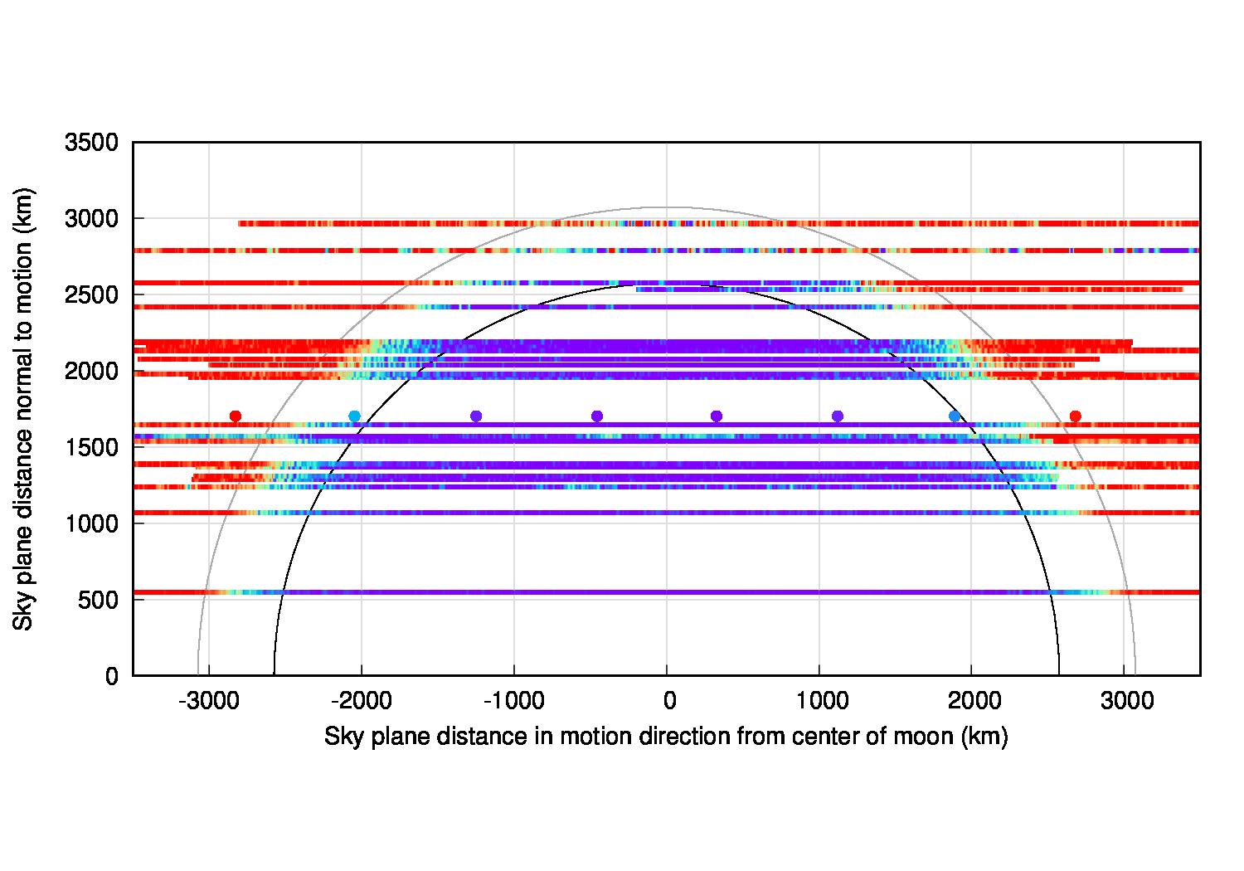
Data averaged to 1 second intervals

Slide 16
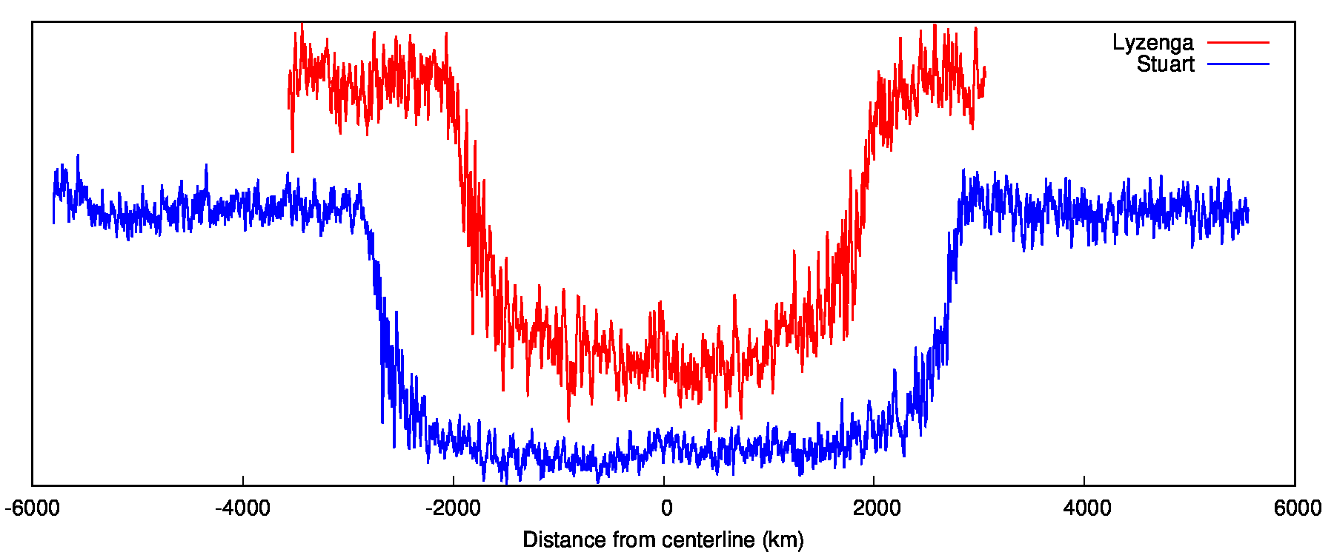
Large scale refraction effects
Cloud
Central peak?
Rounded bases
1 second running avgs

Slide 17
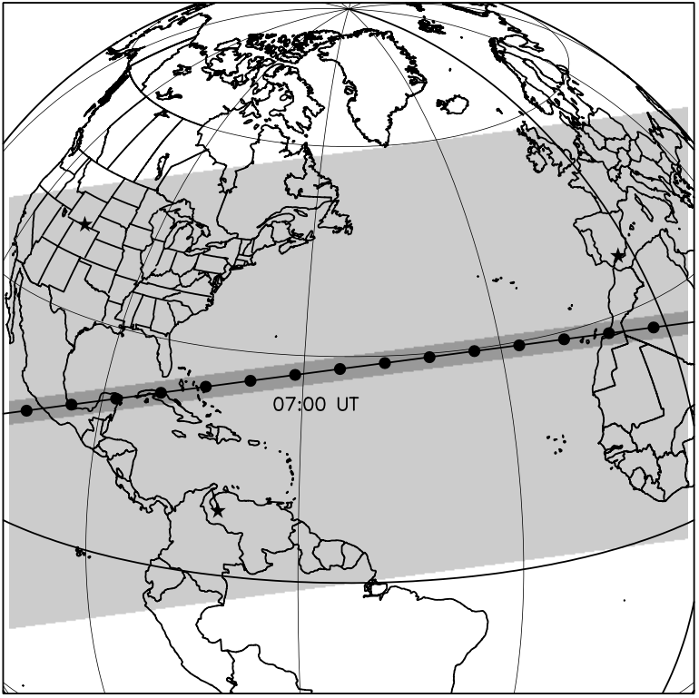
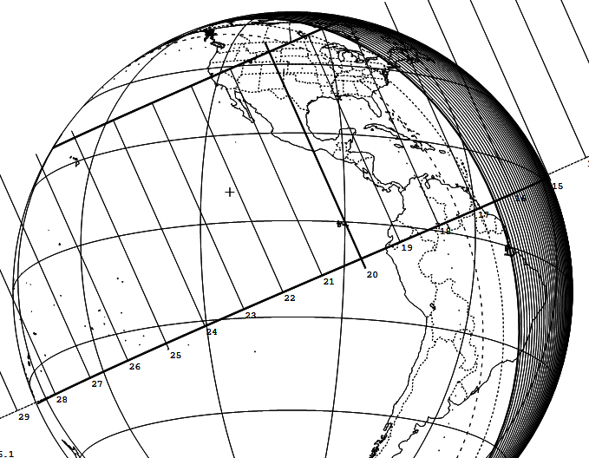
A 2003 Titan occultation map shows the central peak probably should not have been detectable by the observers of the 9 July 2022 event.
Region where
central flash could
be detected
14 November 2003
9 July 2022
The footprints of the two occultations were very similar so the central peak was probably south of Florida.
Sicardy, B. et al., “The two Titan Stellar occultations of 14 November 2003”, Journal of Geophysical Research, Vol 111, E11S91, 2006

Slide 18
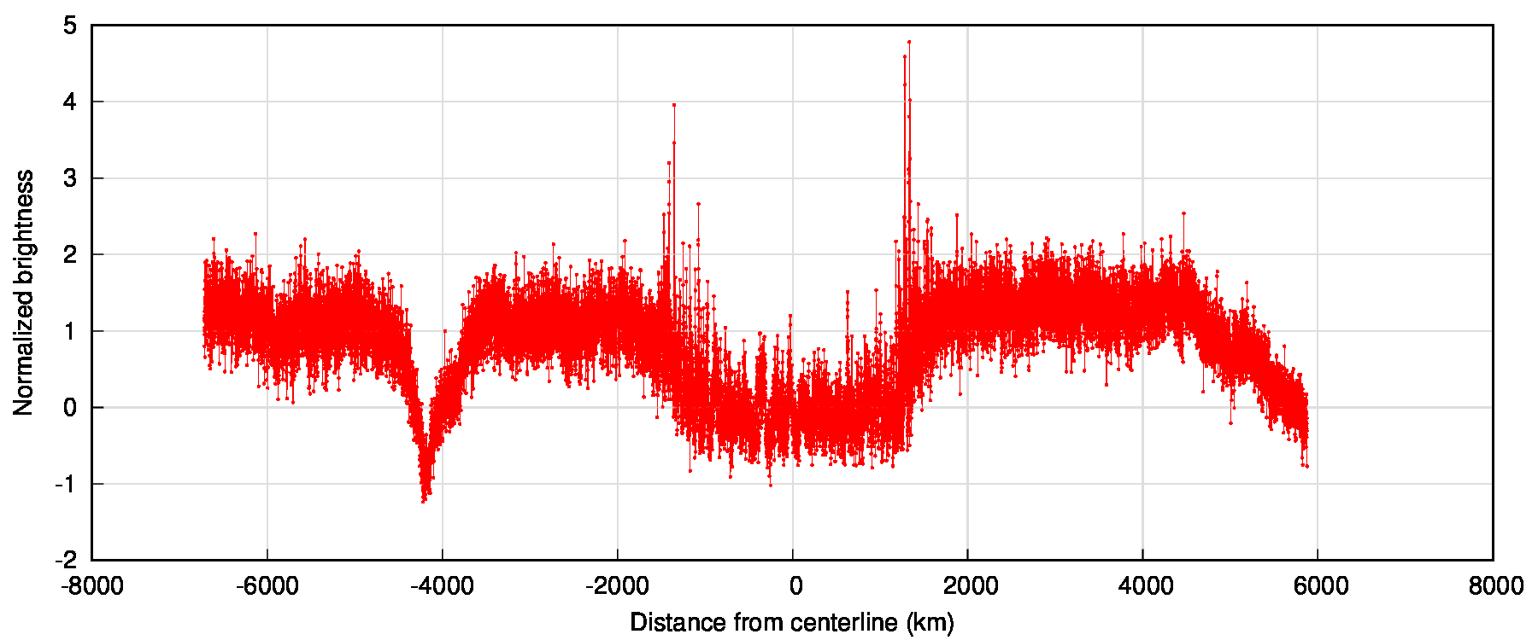
Chris Anderson: Most pronounced spikes
Cloud
Cloud

Slide 19
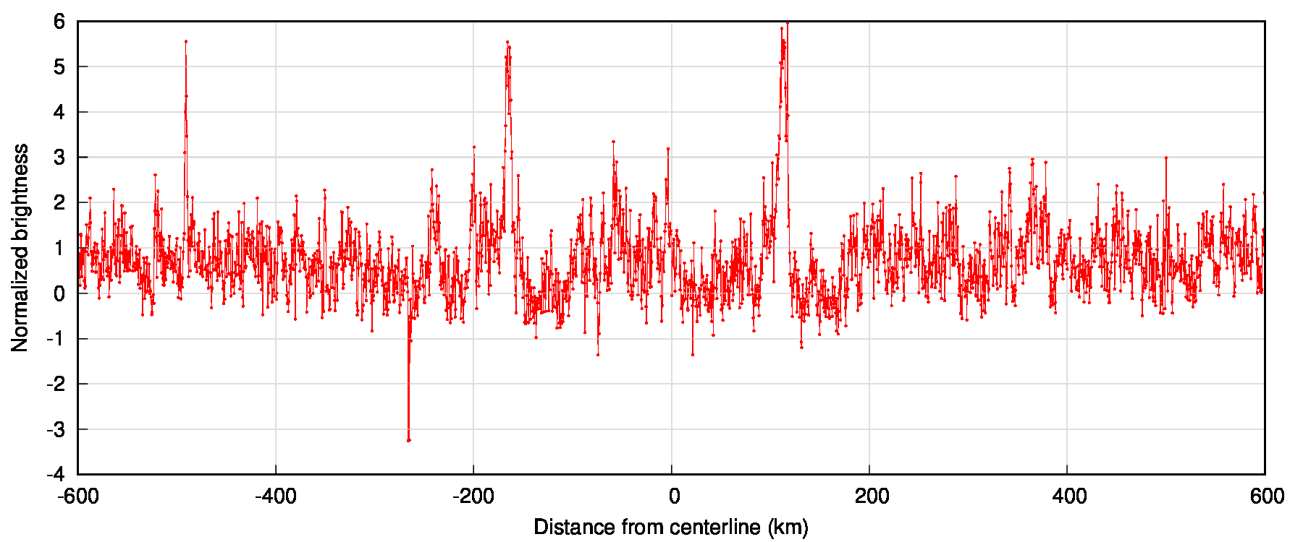
Peter Ceravolo: Farthest chord from center
Multiple-point
spike
Symmetric spikes
Lucky Star
prediction
Single-point spike

Slide 20
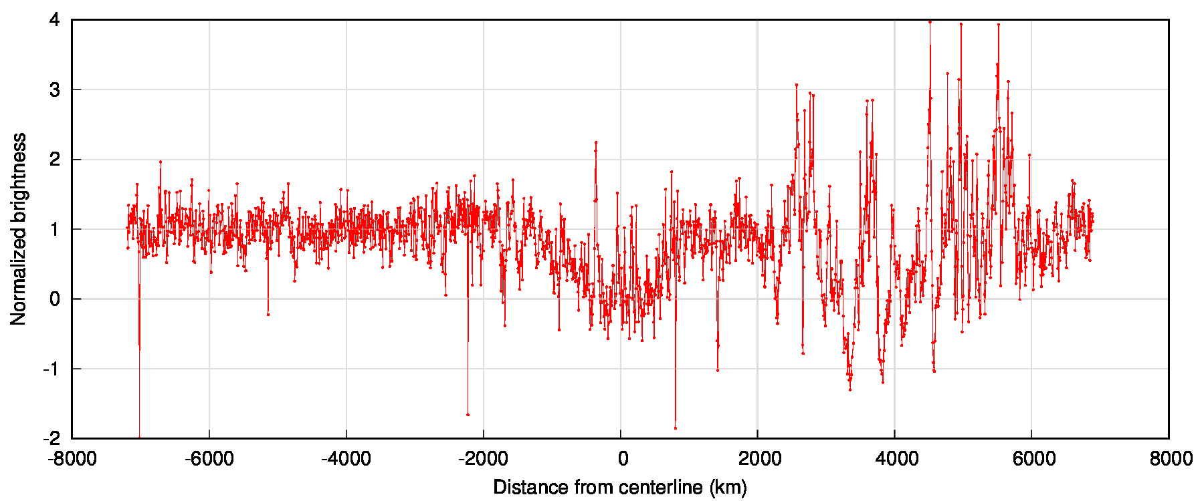
Bill Hanna: Chord outside moon shadow
3 spikes similar
to Peter Ceravolo’s
1
2
3
Asymmetric D and R,
Clouds?
Asymmetric atmosphere?
Clouds

Slide 21
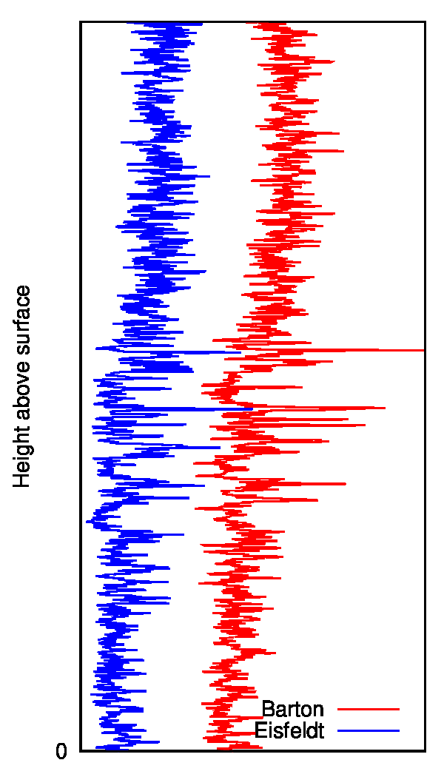
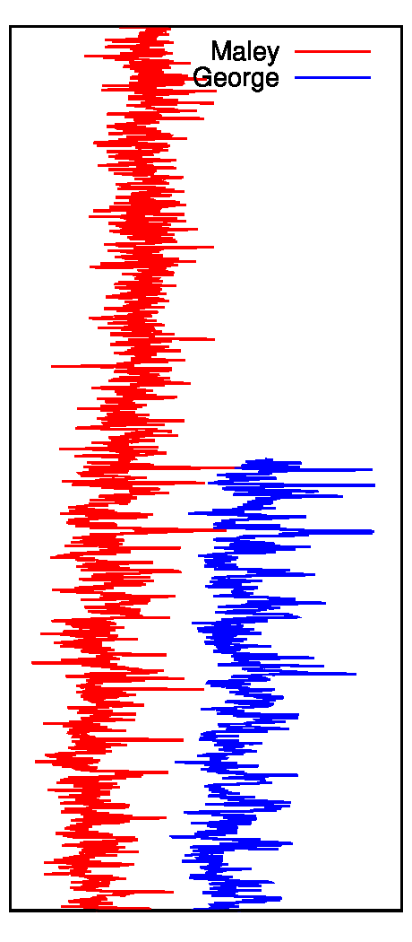
The largest spikes are seen in both light curves of nearby chords.
In general, matches are easier to find at D than R.
D
R

Slide 22
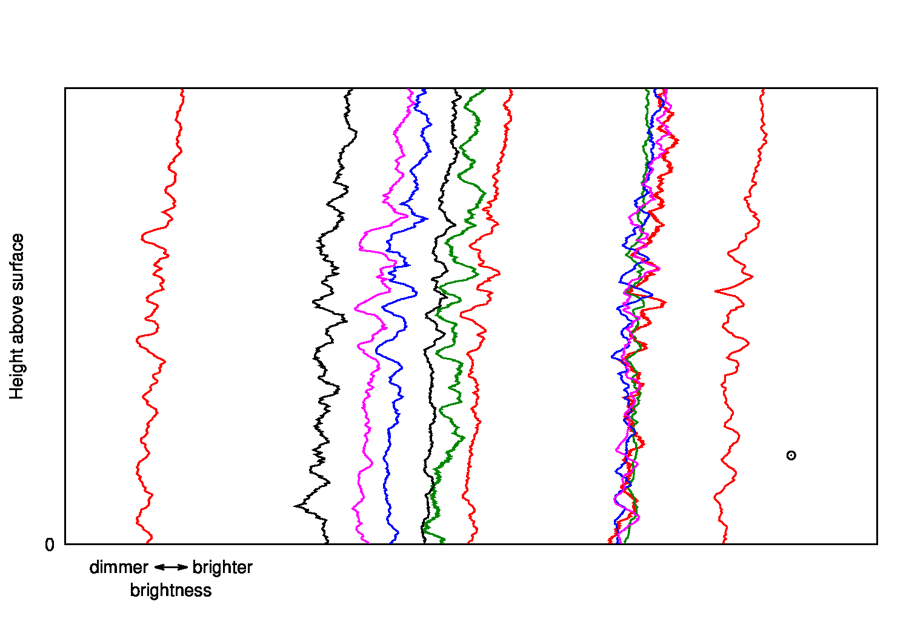
Matches are also visible in larger scale structure, including drops in intensity.
Data smoothed with 1 sec
moving avg.
Note:
The lines should be horizontal.
This may indicate the event time and/or chord offsets are still not exact.
?
?
Outside the three lines there are
essentially no matches.

Slide 23
Considerations for the Future
Atmospheric phenomena may be detected far outside a ground track prediction based on the main body diameter
Bright spikes can cause saturation even if the target is not saturated before the event
Take calibration frames near the time of the event
Comparison stars are important
Don’t drop shutter speed below frame rate, instead lower gain and/or defocus

Slide 24
Closing remarks...
If you haven’t done it yet, upload your videos to the Lucky Star Occultation Portal
There were 36 successes but they only have 29 data sets
https://occultation.tug.tubitak.gov.tr
Calibration data, too

