Slide 1
Discovering a moon of polyemele
Tony George
IOTA Conference 2022

Slide 2
Introduction
December 8th, 2021, the Southwest Regional Institute (SwRI) launched a major undertaking to measure the size and shape of the Trojan asteroid Polymele, an asteroid that is part of the Lucy mission. As a result of this organizing effort, 26 observers from all over North America converged on several observing area with the objective to put the most glass in the clearest skies possible. As two of the participants, my wife and I traveled from Scottsdale, AZ to Salina, KS to contribute one chord to the team observation. Little did we know as we set off for this trip that we would return with the honor of discovering a new moon of Polymele.

Slide 3
Polymele is one of the Trojan asteroids, shown here as they orbit the sun

Slide 4
Polymele is one of the Trojan Asteroids, shown here as the orbit relative to Fixed Jupiter

Slide 5
Polymele is part of the Lucy mission whose objective is to visit 6 Trojan asteroids and one main belt asteroid as shown and listed to the right:
Asteroid and Pronunciation
Eurybates: "yoo-RIB-a-teez" or "you-ri-BAY-teez"
Queta: "KEH-tah" (named in honor of modern Olympian Enriqueta Basilio)
Polymele: "pah-li-MEH-lee" or "pah-LIM-ah-lee"
Leucus: "LYOO-kus" or "LOO-kus"
Orus: "OR-us"
Patroclus: "pa-TROH-klus" or "PAT-roh-klus"
Menoetius: "men-EE-shus"

Slide 6
The Lucy Mission will tour the trojan asteroid belt in several loops around the solar system using earth as a gravity assist
P-type asteroids are asteroids that have low albedo and a featureless reddish spectrum.

Slide 7
Animation of lucy trip to the 7 asteroids of the mission

Slide 8
Mission timetable to reach Polymele
Launched – October 2021

Slide 9
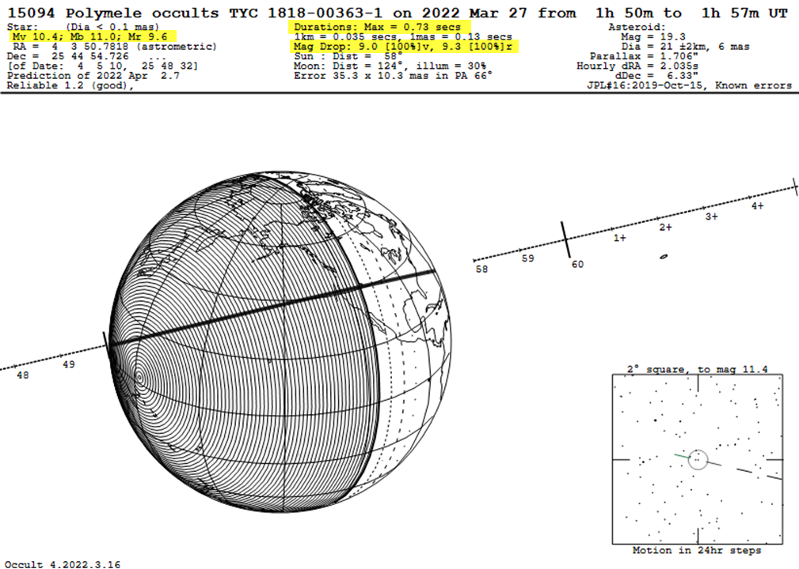
Predicted Path Map

Slide 10
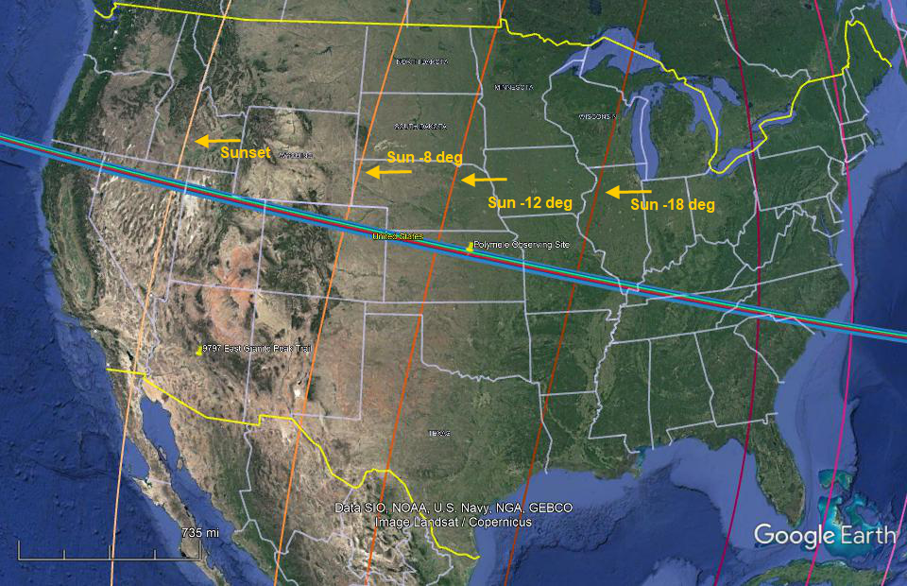
Polymele occultation path crossed the entire north American continent however, only half the path was in twilight where the sun was 10 degrees or more below the horizon

Slide 11
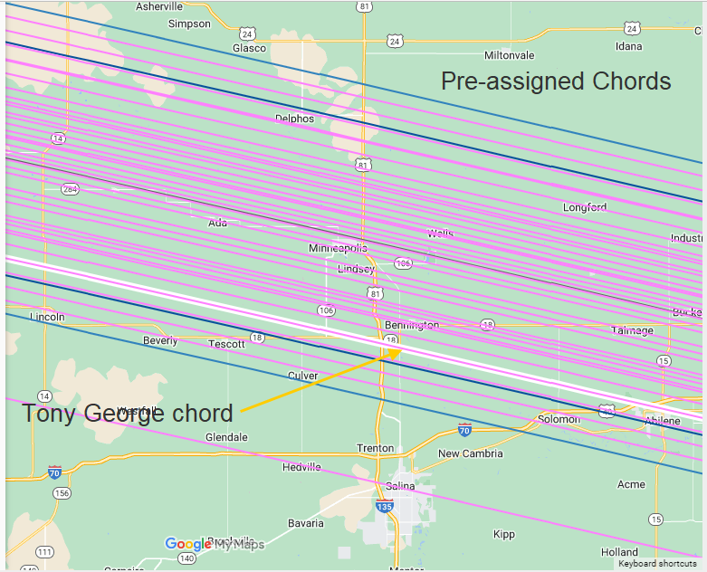
Observing chords were preassigned by SwRI

Slide 12
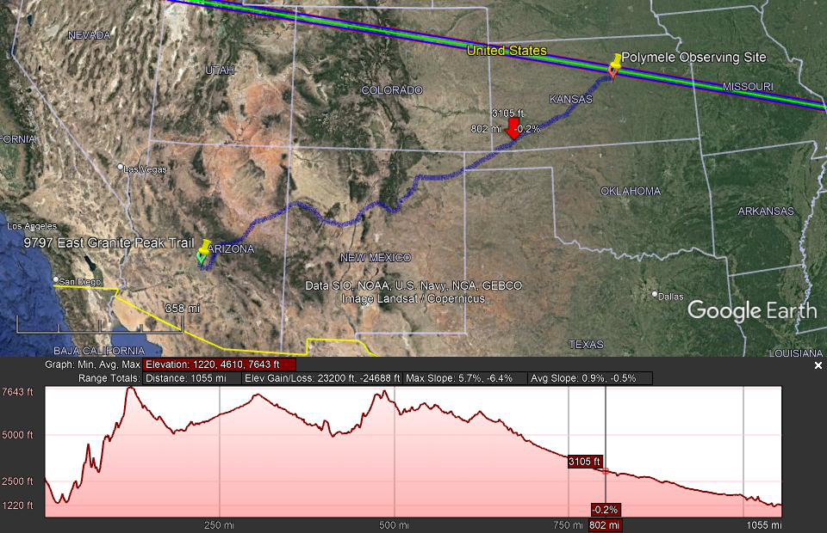
Route traveled by tony and connie George Scottsdale, Arizona to Salina, Kansas distance and elevation gain

Slide 13
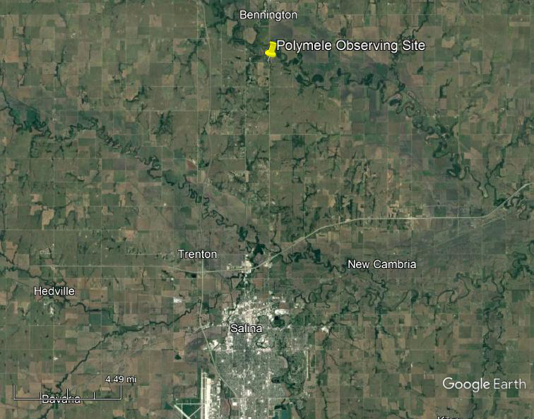
Tony George Polymele observing site near salina, ks

Slide 14
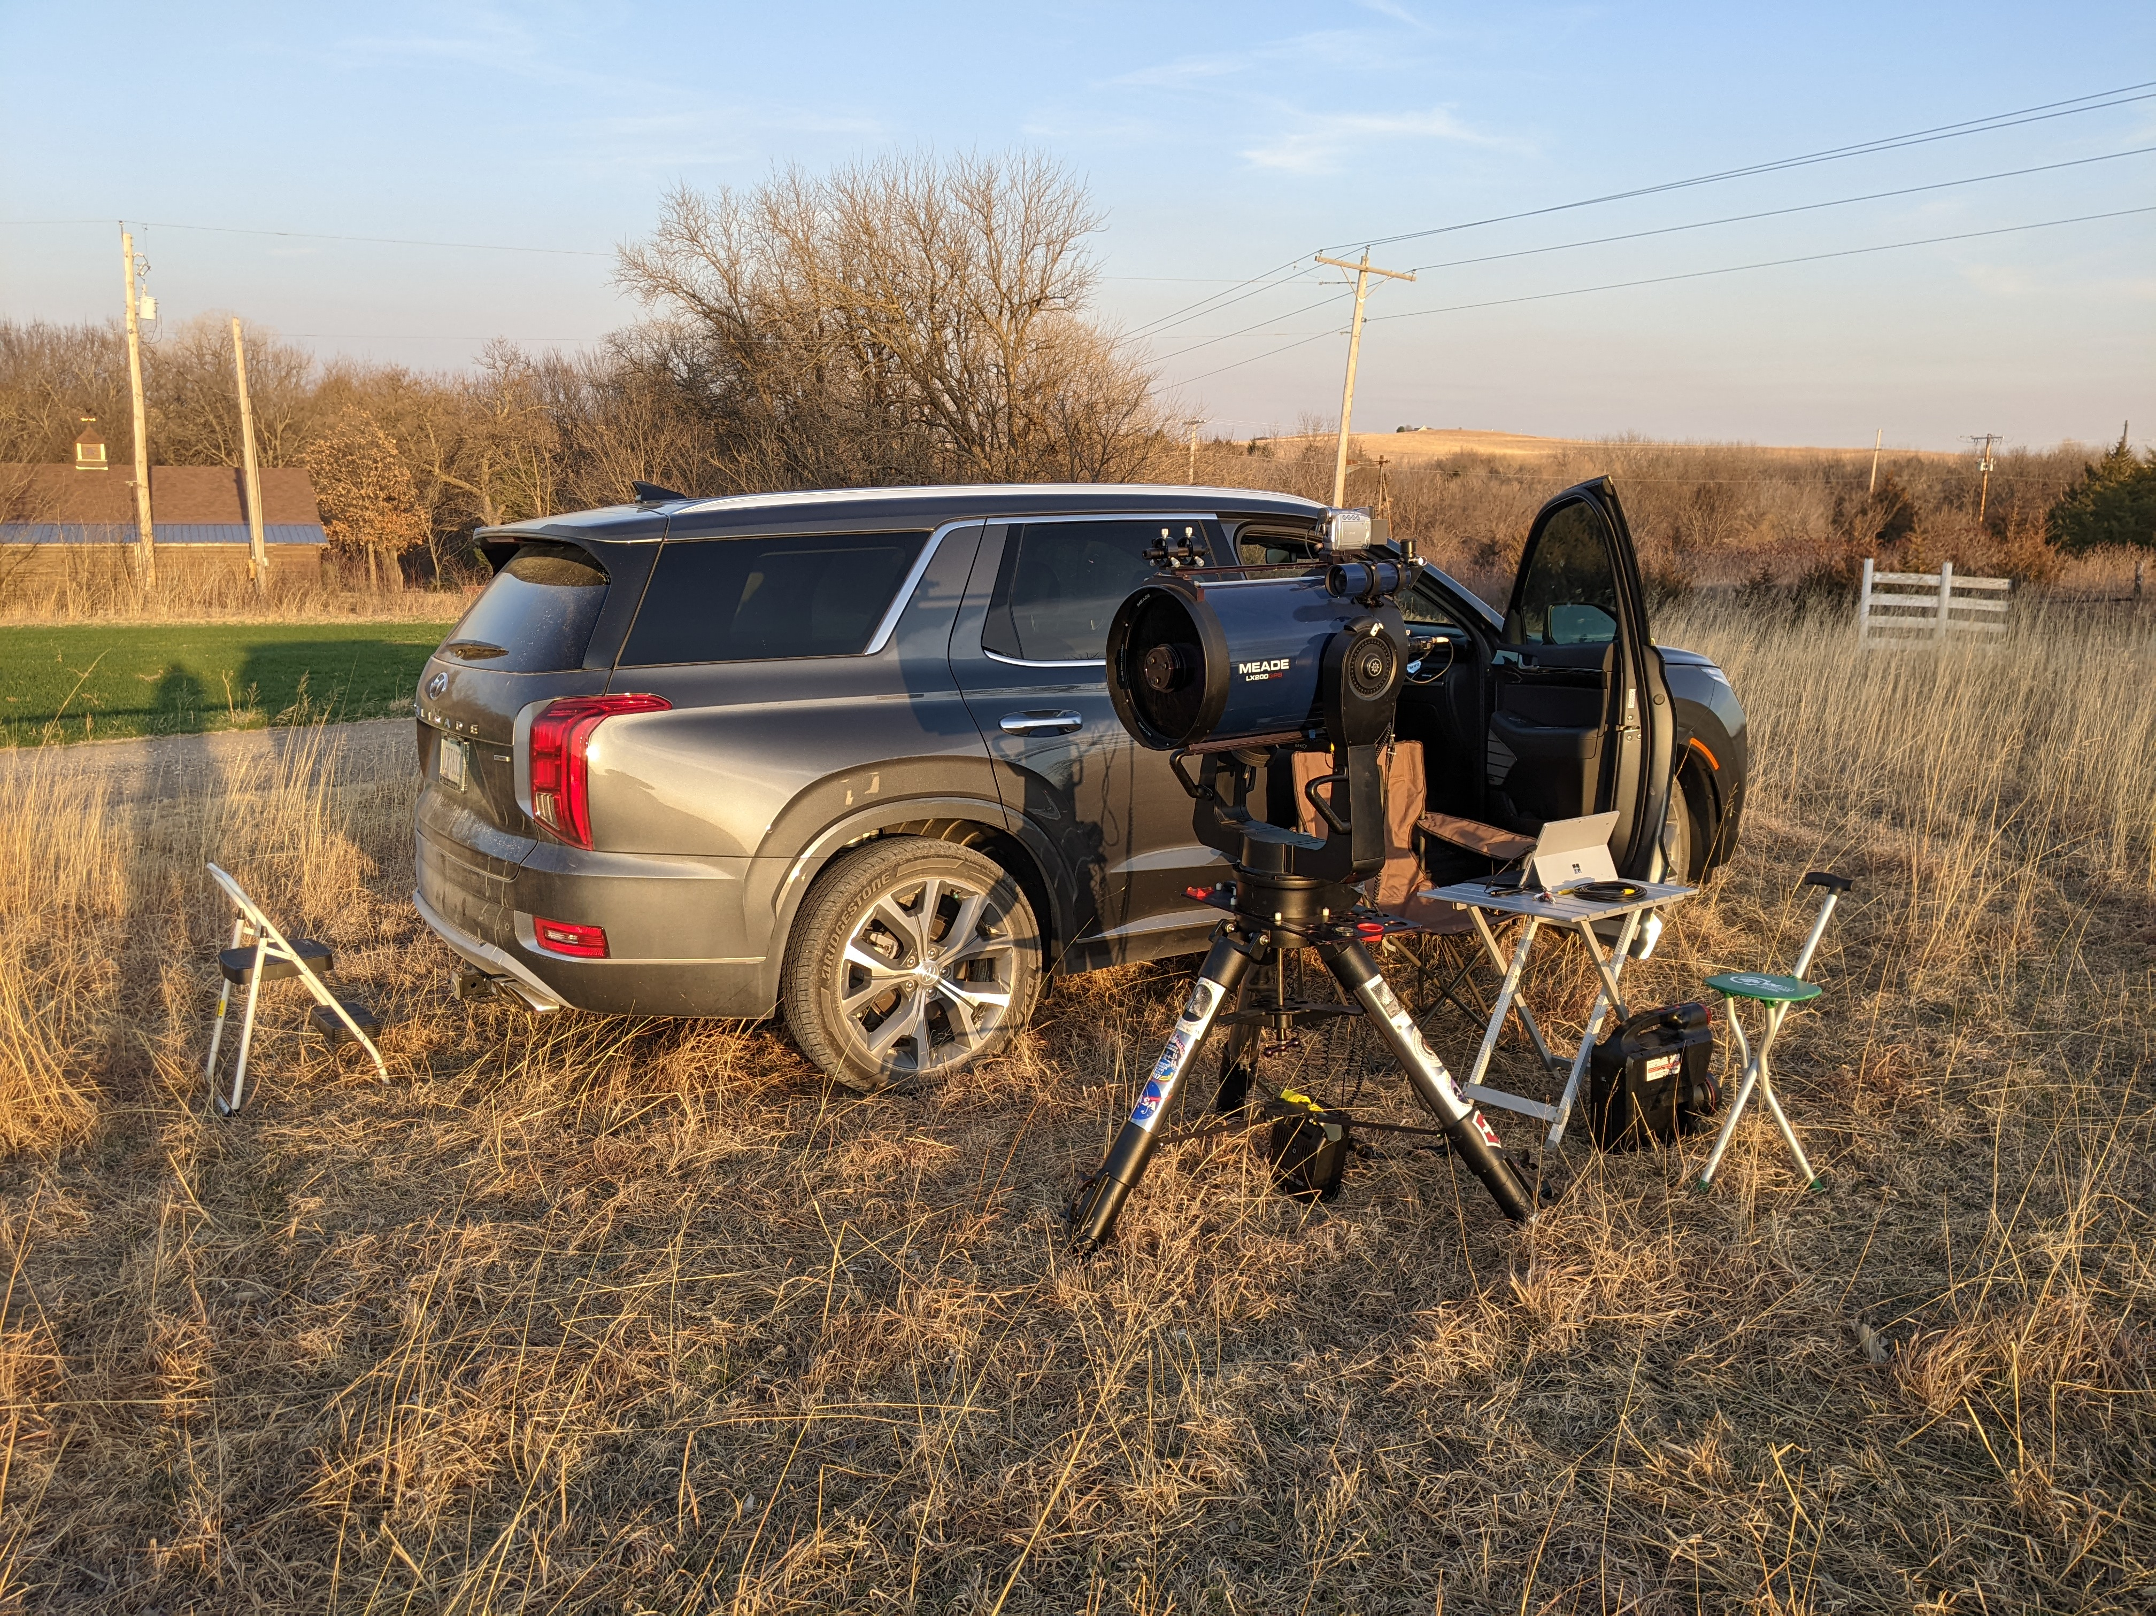

Slide 15
My Pymovie observation light curve

Slide 16
Pyote event solution

Slide 17
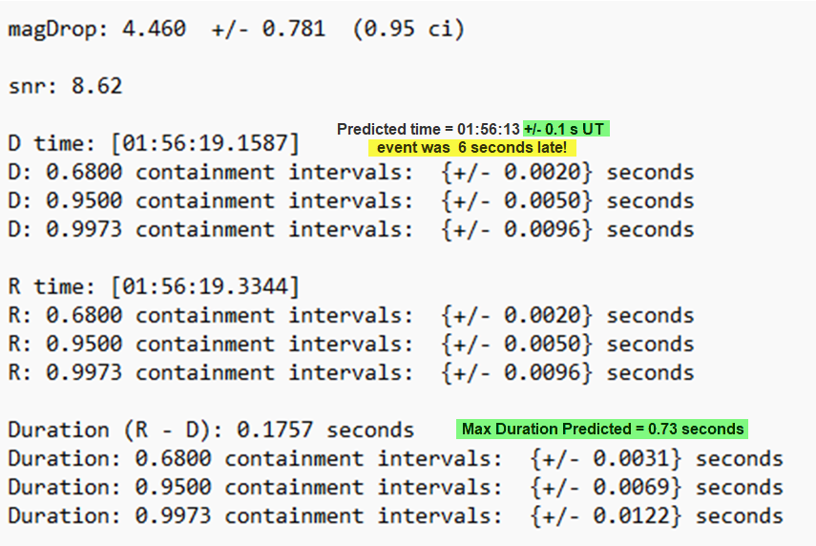
Pyote analysis results

Slide 18
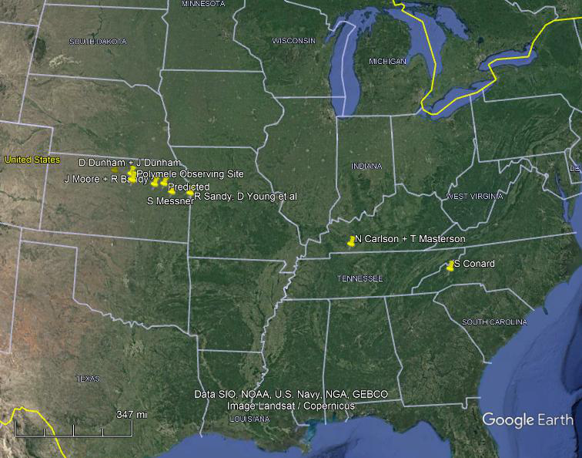
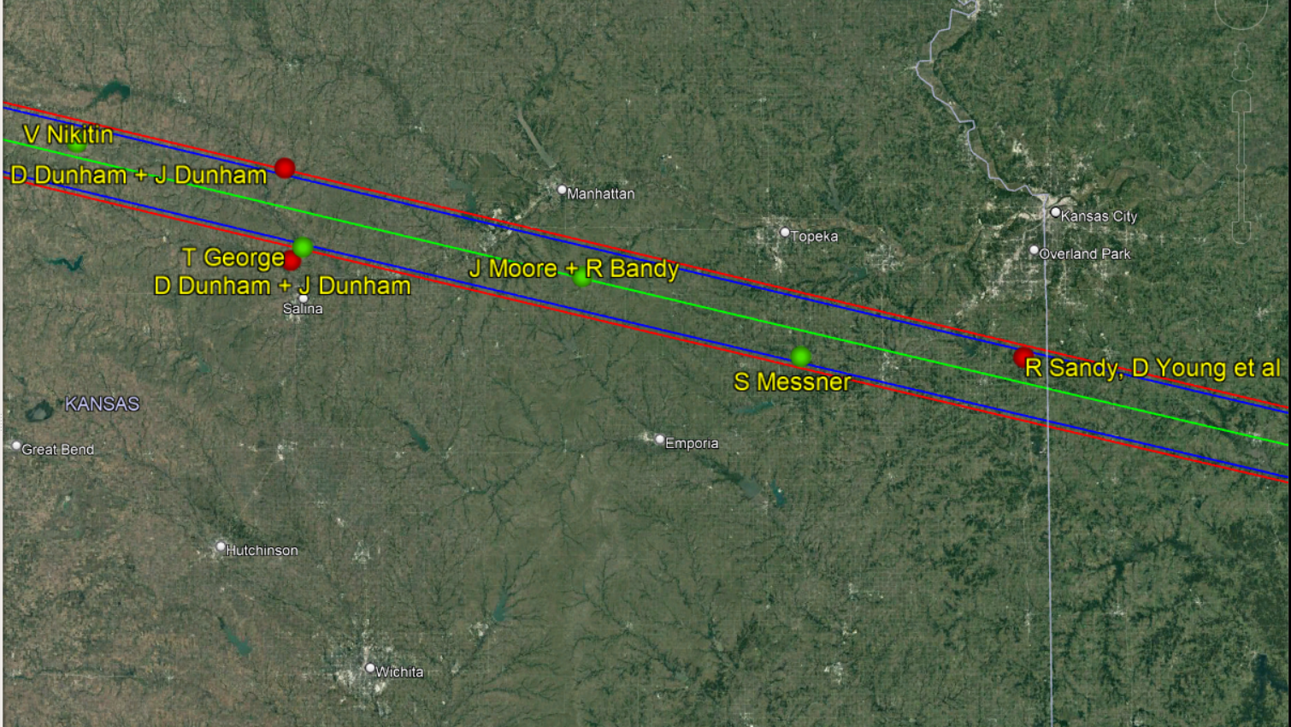
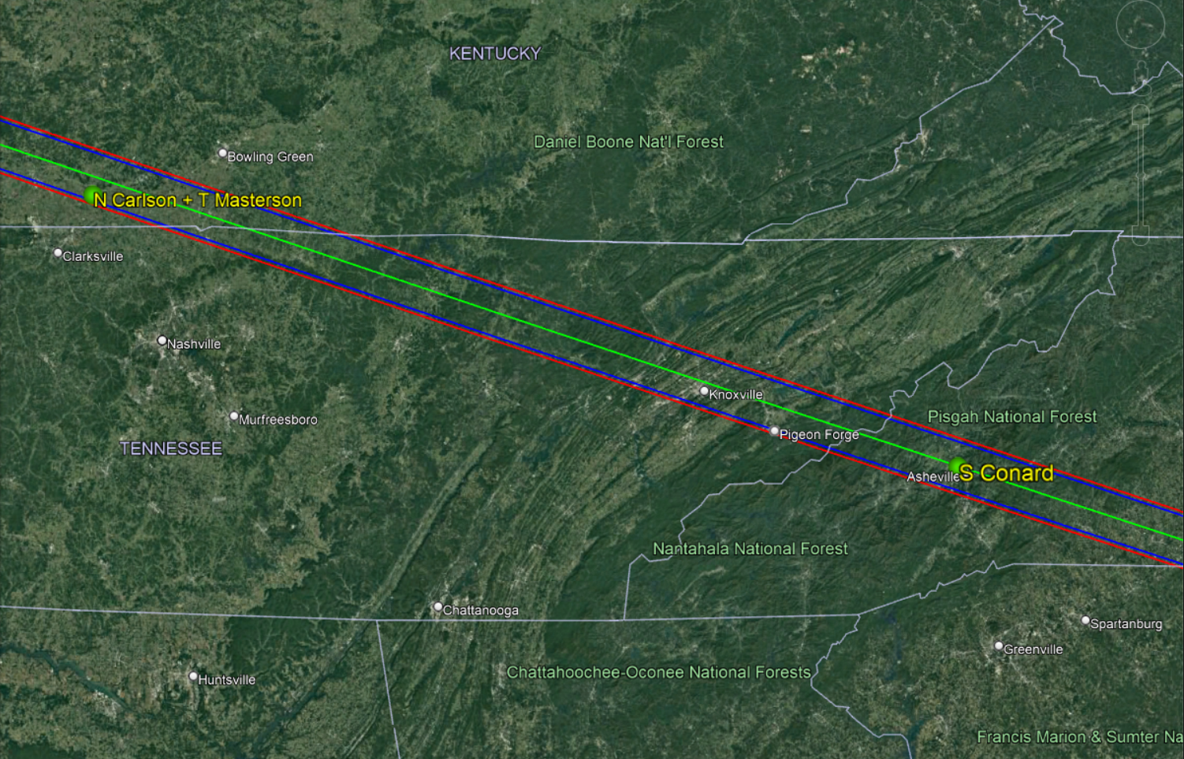
Distribution of IOTA Member sites Most of the Swri participant sites were located in the Missouri, Kentucky, Tennessee area Green dots are positive red dots are negative (misses)

Slide 19
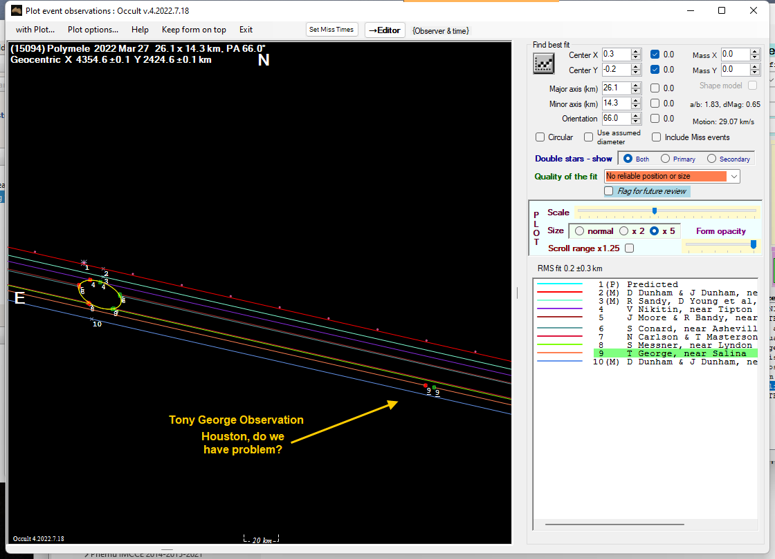
IOTA observers preliminary ellipse of best fit

Slide 20
Houston, do we have a problem?
My observation was offset from the predicted event time by 6 seconds, when the error bars for the event were fractions of a second.
My observation was offset from the primary ellipse created by other positive IOTA observations by about 200 km on the sky plane.
My observation was also offset from other SwRI positive observations. It blew up Marc’s ellipse fitting program!
Marc Buie and John Moore asked me to check my time base and geographic coordinates. They checked out spot on
I asked Marc Buie to check observers closest to me to see if they had anything unusual. When he checked the chord closest to me, Keving Cobble, it came back with a similar but shorter positive. Marc said, ‘Holy cow!’ Based on these two chords and the ensemble of other positive observations. It appeared we discovered a moon!
Marc asked me to keep the discovery under wraps until SwRI released a formal announcement. I had to tell John to just ignore my discordant observation for now and we’ll get back to it later.
Then, SwRI released an announcement to the SwRI observers and later, a news article was posted. Unfortunately, it buried the lead in about the new moon in an announcement about the analysis of the solar panel not locking. Here is the link: Ninth asteroid added to Lucy mission; optimism grows on solar array issue - the black hole

Slide 21
Final Analysis results Polymele has a moon!
Note the third chord that crosses the moon – it was a ‘no observation’ due to technical problems. Too bad, we could have had three chords on the moon. Graphic courtesy of Marc Buie, SwRI.

Slide 22
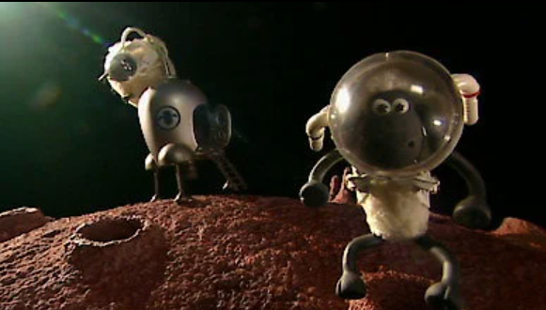
Now that we have a new moon, we have to come up with an unofficial name for it. SwRI observers decided to call the new moon ‘shaun’, after the shaun the sheep – it turns out that the mythical Polymele translates to ‘many sheep’ [at least as reported by one of the team]!

Slide 23
Summary
On a whim (really), I decided to be part of the SwRI Polymele team. My wife even agreed to the trip. What seemed like a long shot observation paid off with the observation of a lifetime, the clear discovery of a moon of a distant Trojan asteroid by occultation. Now, we must wait 5 years and one month for the visual confirmation by the Lucy spacecraft. I believe this will be the first visual confirmation of the discovery of an asteroid moon by occultation, using a visiting spacecraft.

Slide 24
Thank you
Marc Buie and then entire SwRI Research Team for organizing this ‘expedition’, providing observation results, and graphics
NASA for funding our travel expenses
All observers who contributed to this event, especially Kevin Cobble, who provided the confirming chord that agreed with my observation
John Moore for coordinating IOTA observations and providing preliminary information
My wife Connie for accompanying and assisting me for an arduous 5-day roundtrip to the heartland of North America

