Slide 1
IOTA / North America
2022 Summary
John Moore – NA Coordinator

Slide 2
2021 Asteroidal Occultations by Region

Slide 6
IOTA North America – Healthy and Growing !
Increased accuracy from Gaia data
Multiple feed options to help with opportunity identification
Big increase in personal predictions
Occult enhancements – Thank you Dave Herald!
Enhancements (recent and planned) in OW/OWC/OWM – Thank You Hristo Pavlov!
Enhanced data reduction applications – PyMovie/PyOTE/Tangra/AOTA
Thank You – Bob Anderson, Hristo Pavlov, Dave Herald, Tony George…
New technology – Sensors/Cameras/Timing devices
Significant contributions from our fixed site observers
Good growth with significant contributions from new observers
Increased chord coverage from our pre-point/multi site observers

Slide 7
IOTA North America Review Team
John Moore - Coordinator
Jerry Bardecker
Norm Carlson - Coordinator
Bob Dunford
Ernie Iverson
Steve Messner
Tony George – Difficult Observations Analyst – “The Shadow Whisperer”
Johnny Barton – Tangra Support
Dave Eisfeldt – Tangra Support

Slide 8
Help Us (your review team) Help You…
Files to submit – File Names
For a NEGATIVE (MISS) report…
XLS/XLSX Report Spreadsheet
For a POSITIVE report…
XLS/XLSX Report Spreadsheet
CSV “raw” unbinned from PyMovie/Tangra/LiMovie
PyOTE Log File
QHY Users
GPS Log File
Camera Settings
Note: png image of light curve not required but appreciated

Slide 9
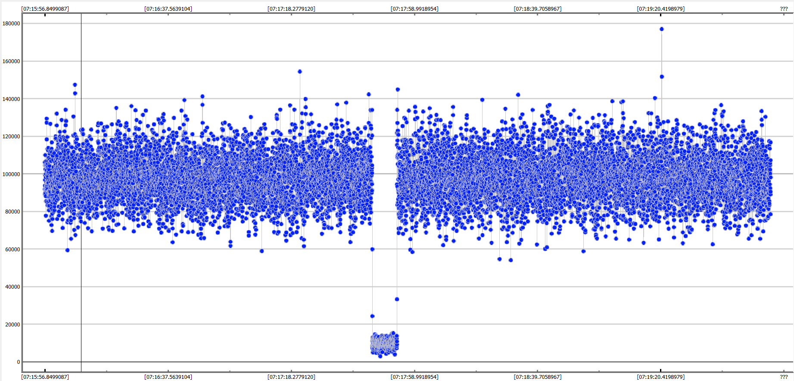
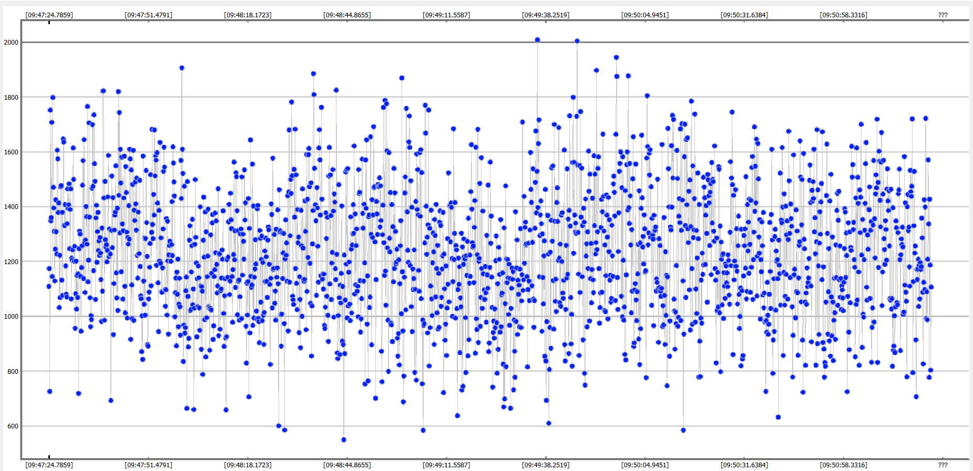
Help Us (your review team) Help You…
Files to submit – File Names
For a NEGATIVE (MISS) report…
XLS/XLSX Report Spreadsheet
For a POSITIVE report…
XLS/XLSX Report Spreadsheet
CSV “raw” unbinned from PyMovie/Tangra/LiMovie
PyOTE Log File
QHY Users
GPS Log File
Camera Settings
Note: png image of light curve not required but appreciated

Slide 10
Help Us (your review team) Help You !!!
File Naming: EVERYTHING
DATE(YYYYMMDD)_AstNum_ASTName_Oberver_POS/NEG
Example – MISS Report
20220721_1_Ceres_Moore_NEG.XLS
Example – POS Report
20220721_1_Ceres_Moore_POS.XLS(X) – report spreadsheet
20220721_1_Ceres_Moore_POS.CSV – PyMovie/Tangra/LiMovie CSV
20220721_1_Ceres_Moore_POS.txt – PyOTE log file
20220721_1_Moore_POS_GPS.txt
20220721_1_Moore_POS_Camera_Settings.txt

Slide 11
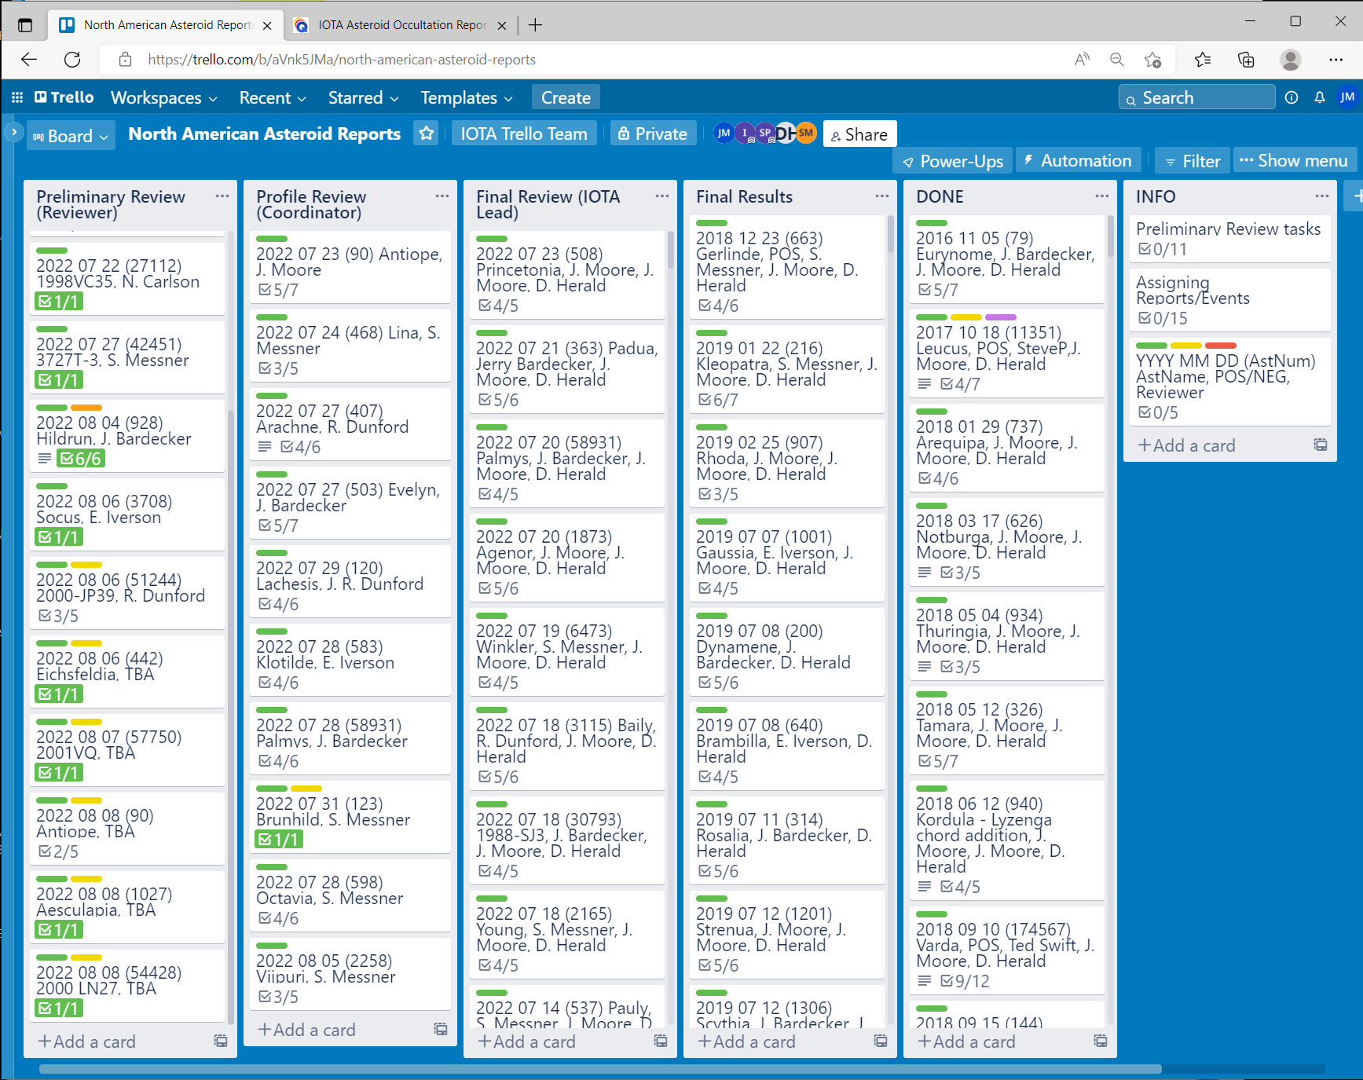
Help Us (your review team) Help You !!!
Register planned observations in OW – Tracked using Trello

Slide 12
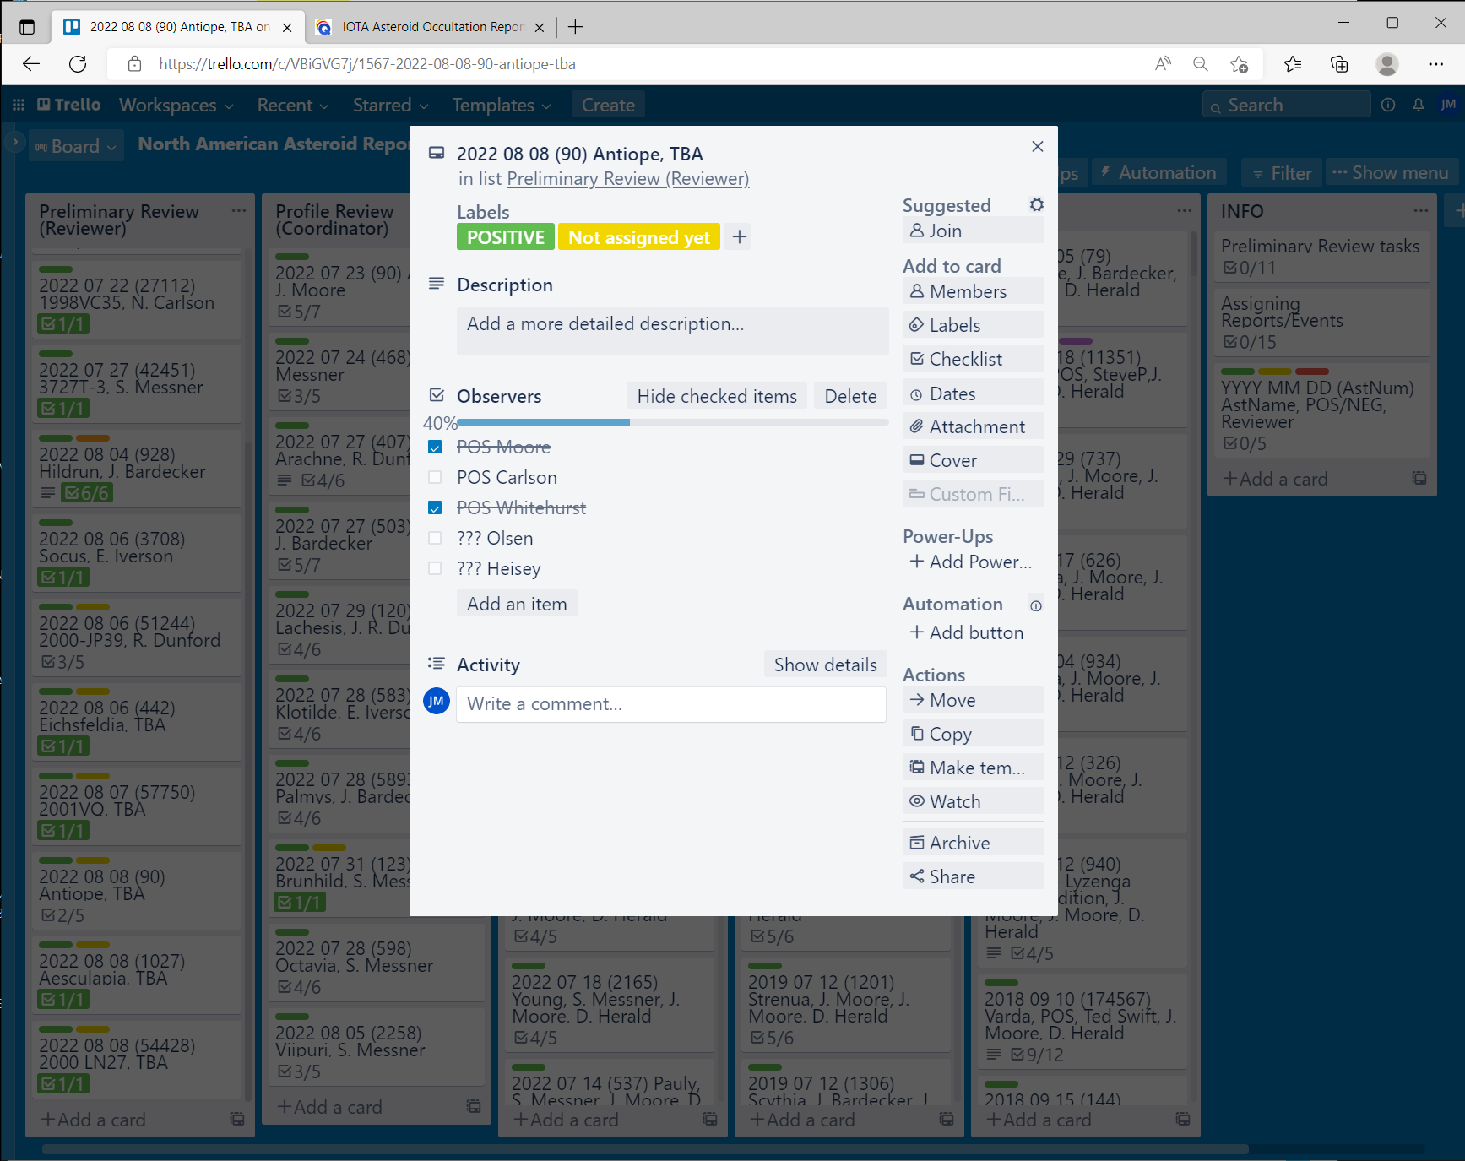
Help Us (your review team) Help You !!!
Register planned observations in OW – Tracked using Trello

Slide 13
Help Us (your review team) Help You !!!
Register planned observations in OW
Update OW ASAP after the event
Timely Reporting – Please try to report within one week (7 days) of the event. If delayed, please at least let the coordinator know so a notation can be entered into the tracking record.
Whenever Possible - Finalize report before submitting

Slide 14
IOTA North America – Conclusions
IOTA N/A is Healthy and Growing
Report Volumes/Workload Growing
Applications and Organizational Structure Evolving
Exciting Time to Chase Shadows – Good Luck in 2023!
Norm Carlson - Introduction

Slide 15
Thank You

