Slide 1
Reducing Heat Buildup and Noise in the RunCam Night Eagle Cameras
Ted Blank
tedblank@gmail.com
IOTA NA Annual Conference
August 13, 2022

Slide 2
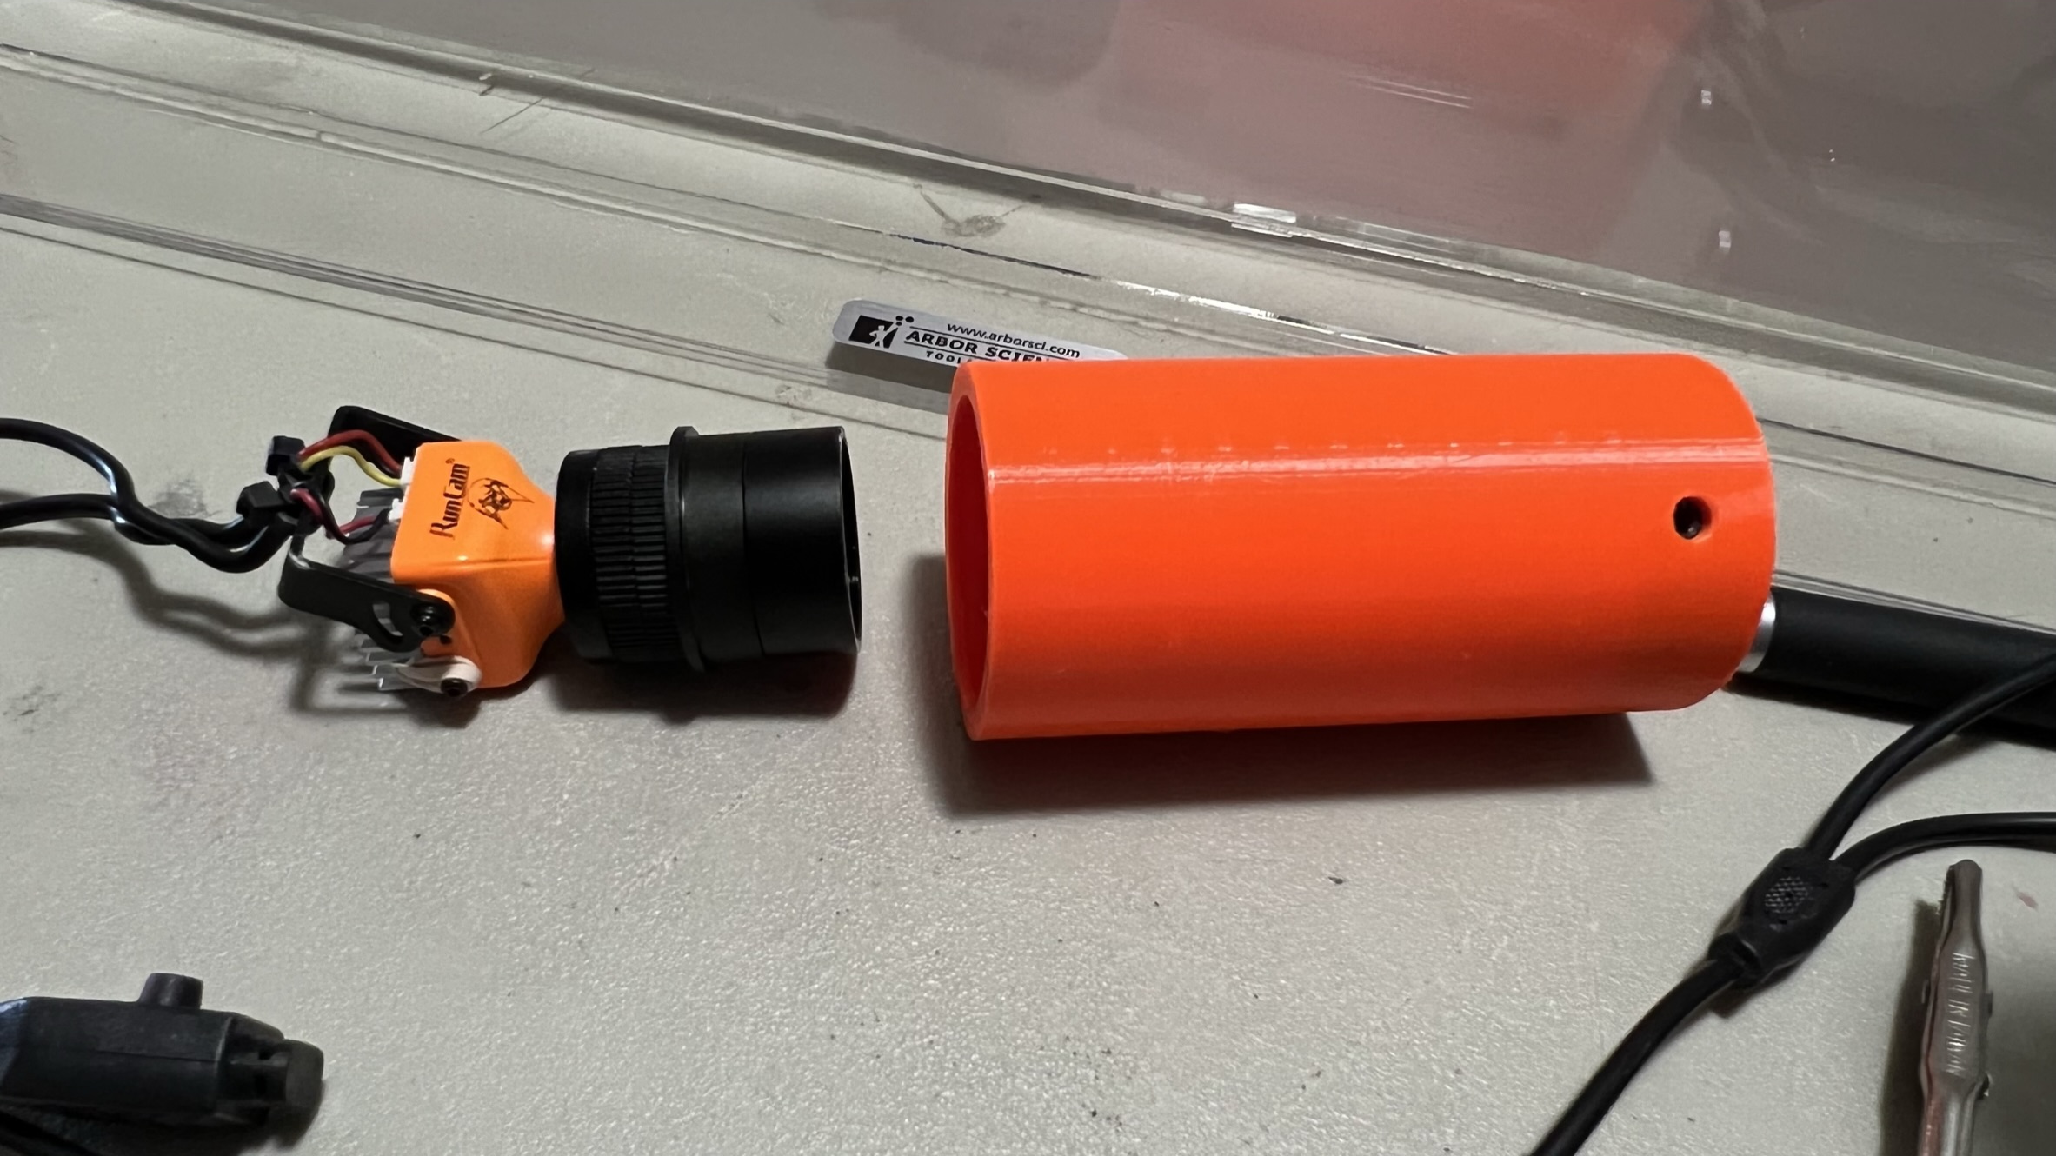
3D-printed carrier allows use of Night Eagle cameras with focal reducer in strut-based scopes with 2” focusers without shortening the struts
Contact Ted Blank (tedblank@gmail.com) if you would like the slice file to print your own

Slide 3
Problem: Heat buildup in the camera inside the carrier significantly increases its background noise
Background Noise After 30 Minutes in Carrier
running on 12V power

Slide 4
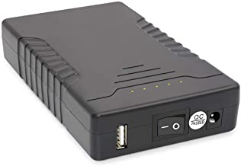
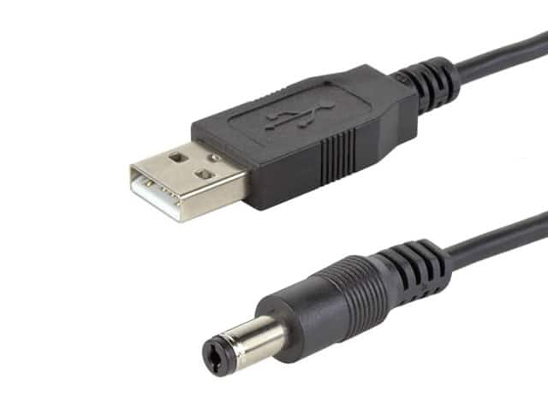
Running Camera on 12V Power Also Increases Noise
Night Eagle series require only 5V DC, but can run on 5-35V DC
Any supply voltage over 5V is converted to heat inside the camera during the process of voltage reduction
Recommendation #1: power the camera with only 5V DC
Talentcell
Rechargeable
Lithium battery
with 12V and 5V
outputs
USB to DC
power supply
cable
(5.5x2.1 mm)
12V
5V

Slide 5
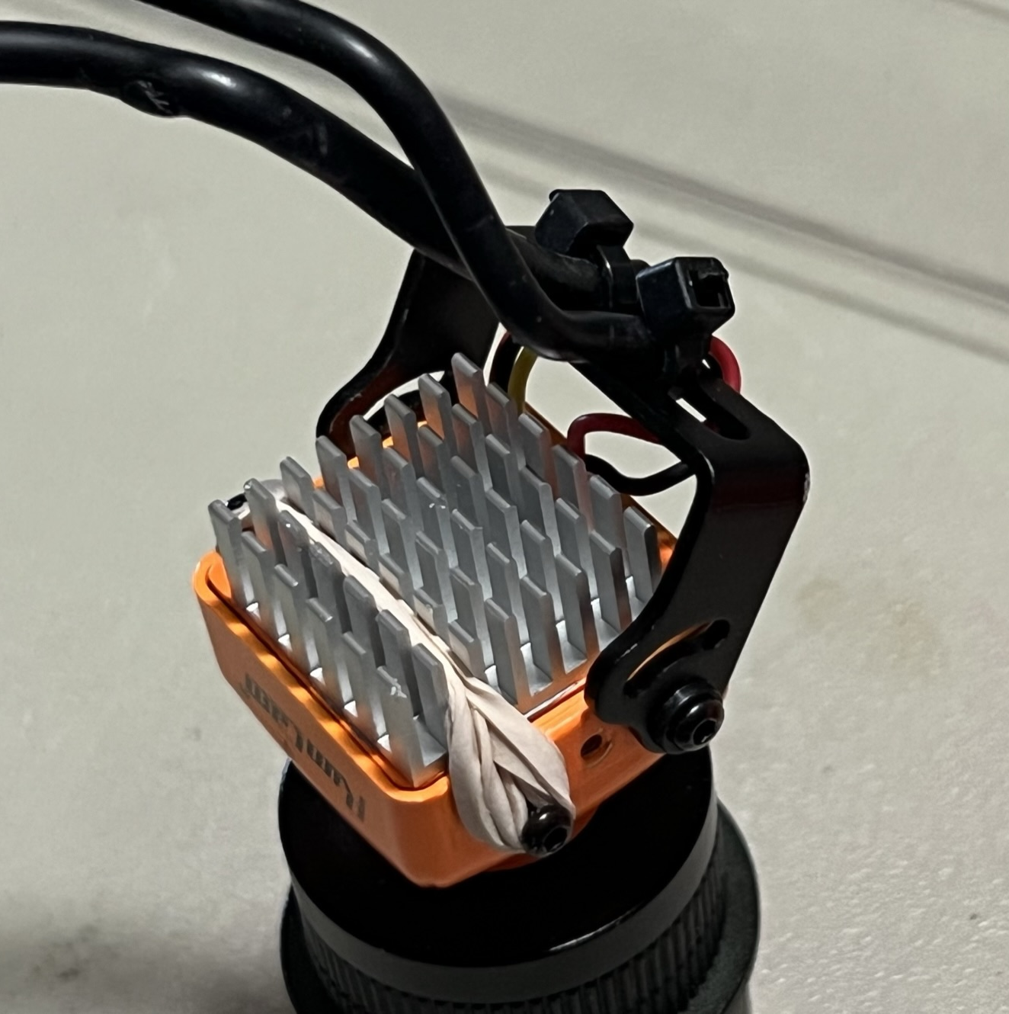
Recommendation #2: Adding a passive heat sink will reduce heat and background noise (credit & thanks to Bob Anderson for this discovery)
Digi-Key
1168-TGH-0200-03-ND
20mm x 20mm
Aluminum Heat Sink
2mm
screws,
rubber band and
a drop of
Noctua NT-H1
thermal
paste

Slide 6
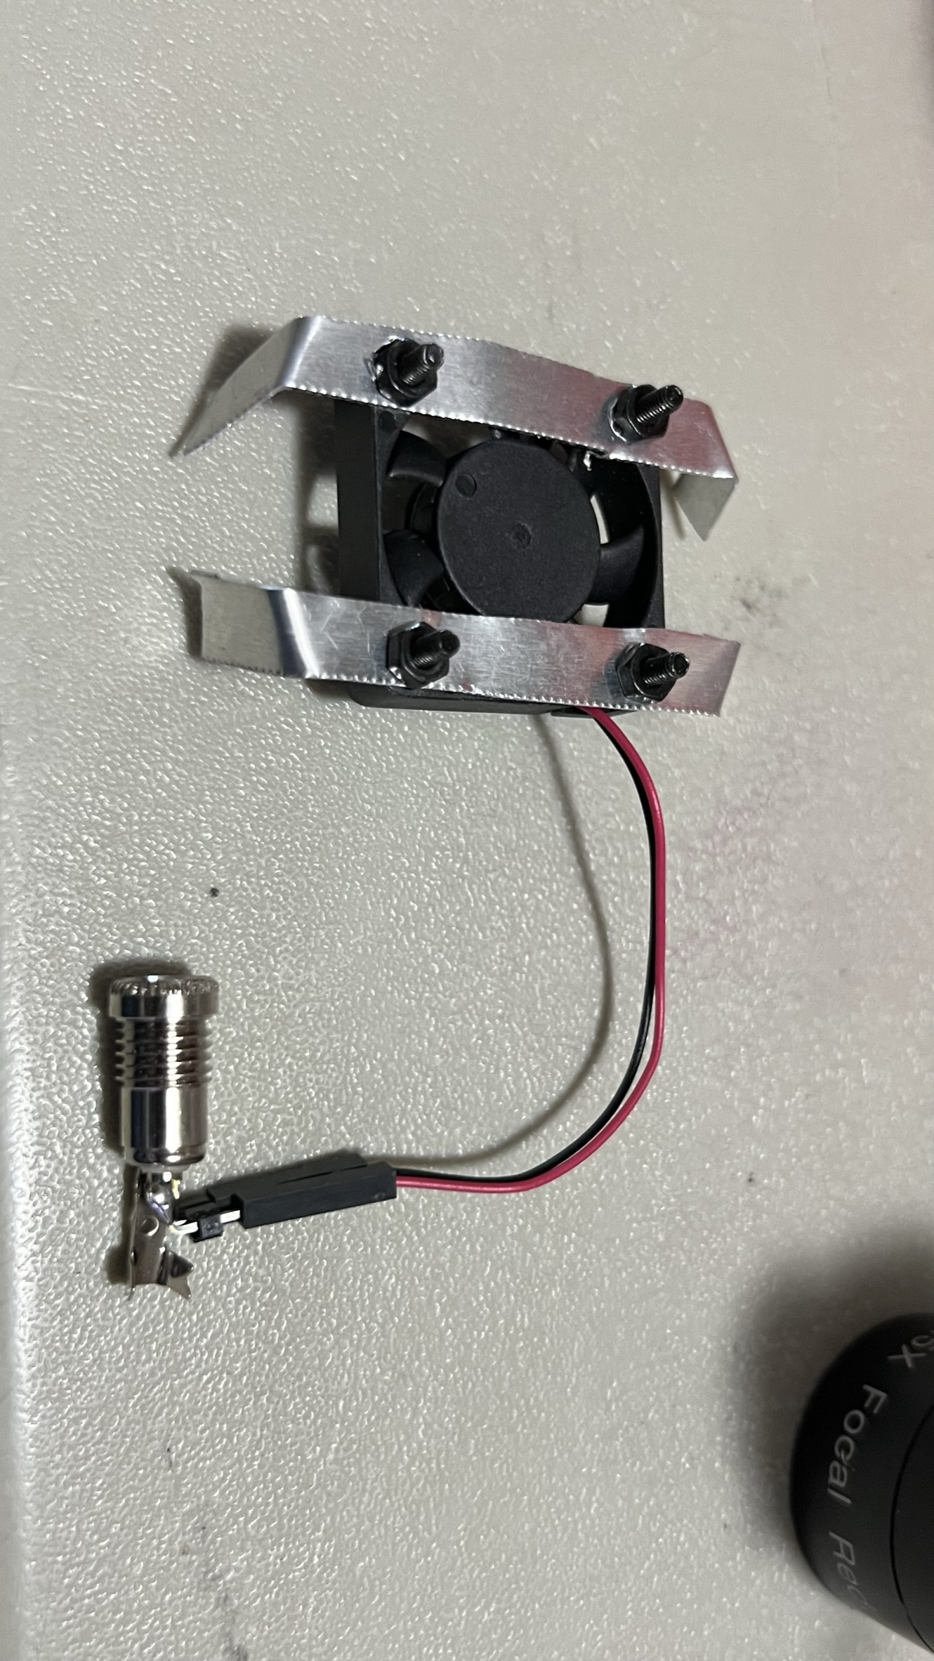
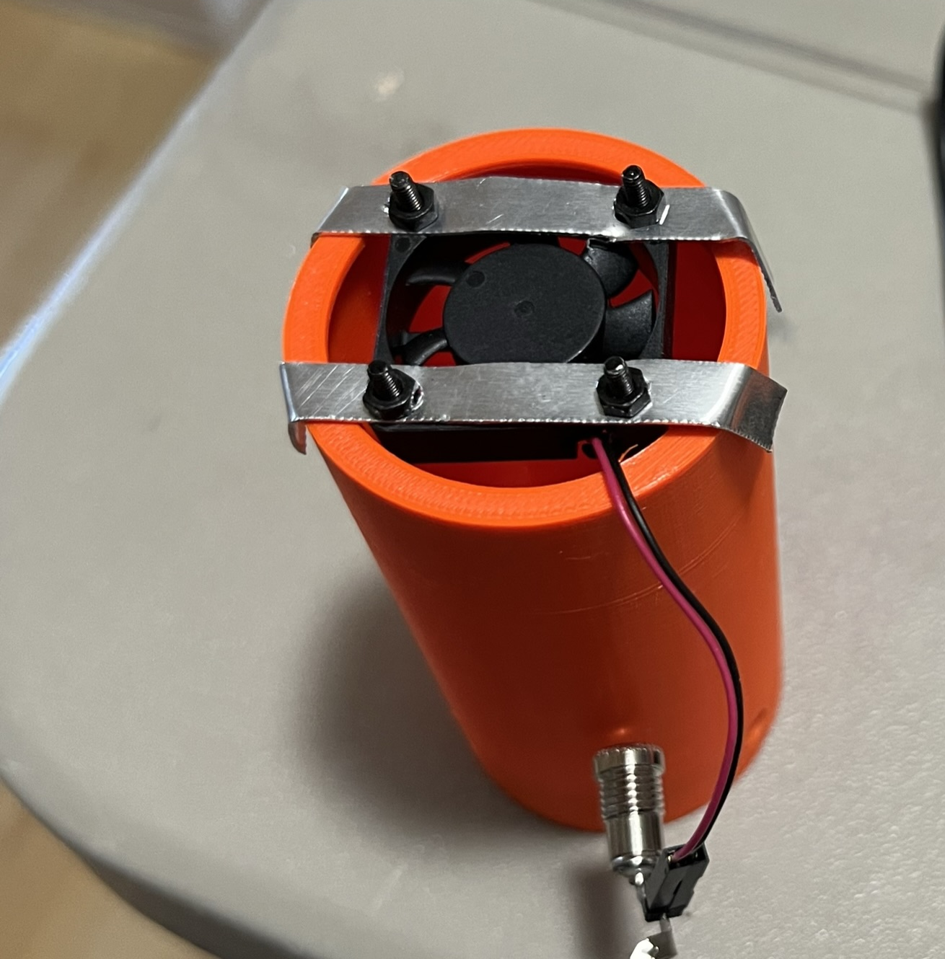
Recommendation #3: Adding a small fan will further reduce heat buildup
Easycargo Raspberry Pi 4 Fan 30x30x7mm, Raspberry Pi Cooling Fan Brushless 3.3V 5V DC Quiet Fan

Slide 7
Conclusions: Heat sink provides most benefit. Fan provides a small additional benefit. Recommend always using the heat sink even when using camera in open air.
Background Noise After 30 Minutes in Carrier
running on 12V power, no heat sink, no fan
Background Noise After 30 Minutes in Carrier
running on 5V power with heat sink & fan
(white flashes are just me removing the
lens cap for a moment)

