Slide 1
Double star processing
Dave Herald

Slide 2
Initial step – match the events to the components
Usually very straight forward
Sometimes it takes quite an effort
Treat the observers’ identification of brighter/fainter star with great skepticism if the magnitude differences are not great. This is the greatest cause of trouble in matching events to components. Don’t treat magnitudes from light curve analysis tools as always being right

Slide 3
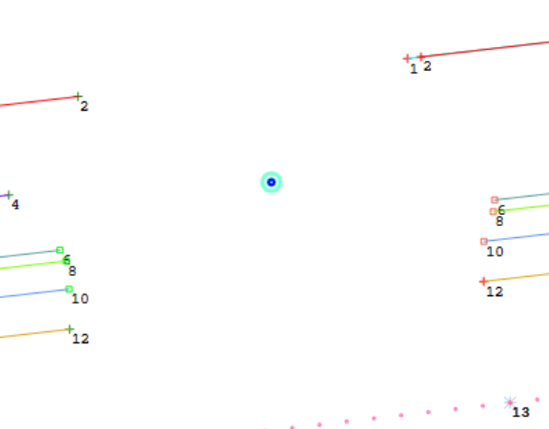
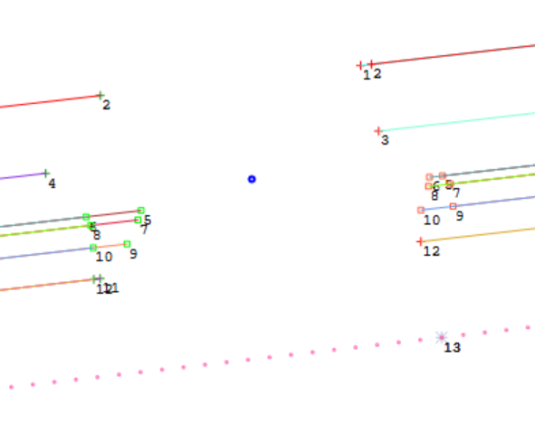
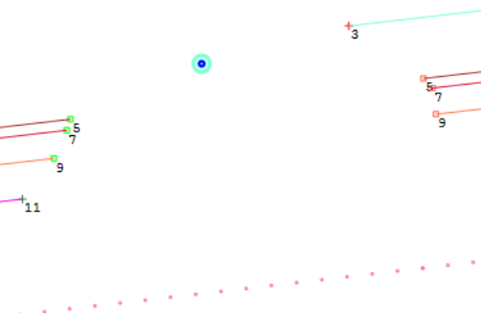
Matching events - 1
Can help to plot events for each component to find possible relationships

Slide 4
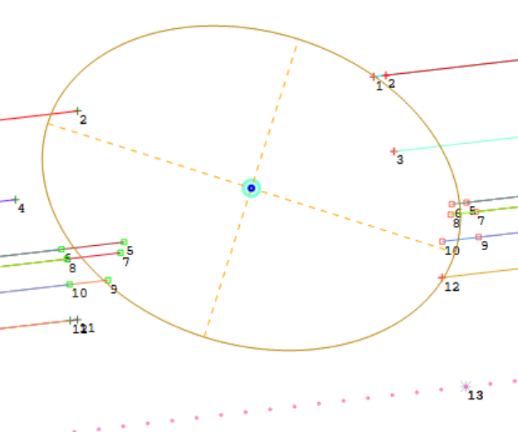
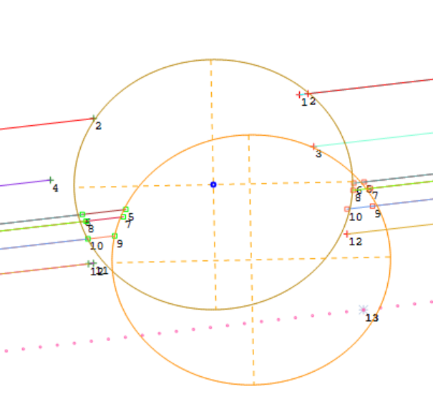
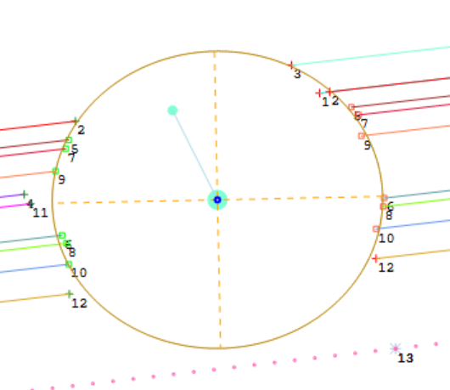
Matching events - 2

Slide 5
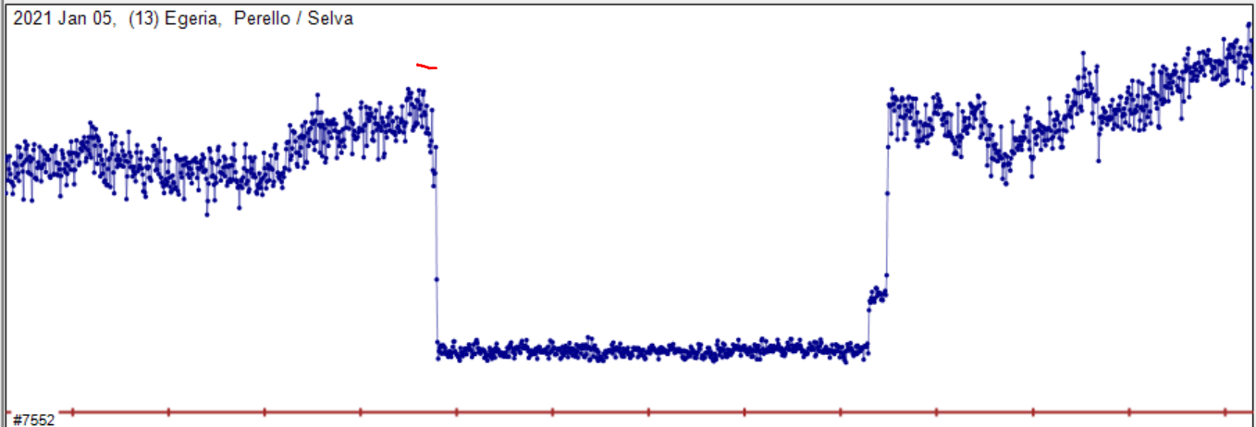
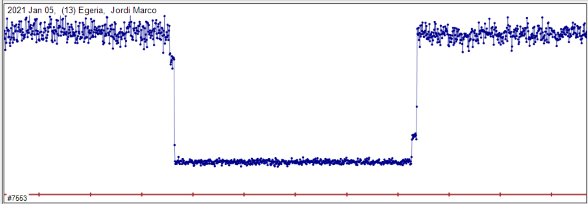
Light curves can require close inspection

Slide 6
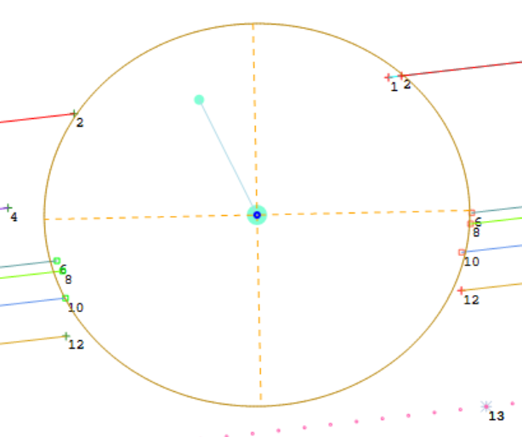
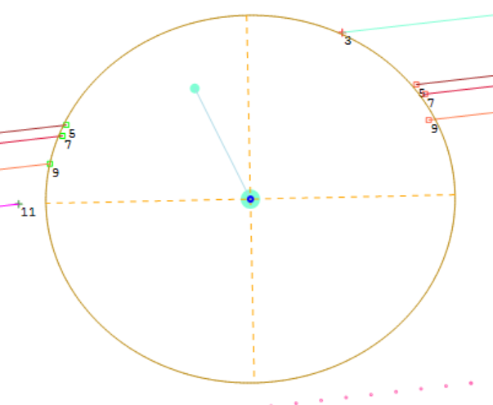
3 types of solution - #1
Unique solution. For both components, you know where the asteroid is relative to both stars

Slide 7
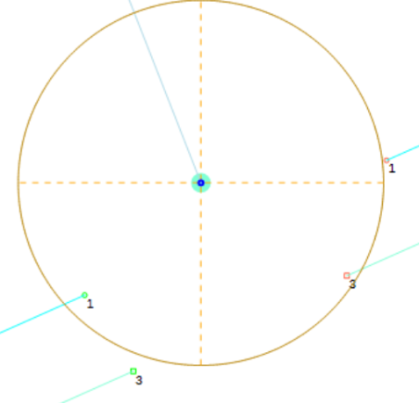
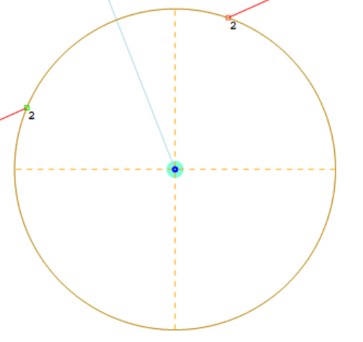
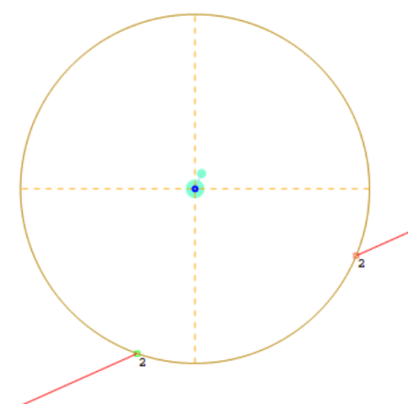
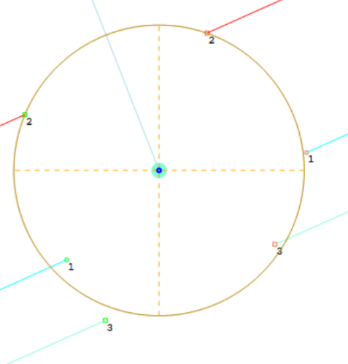
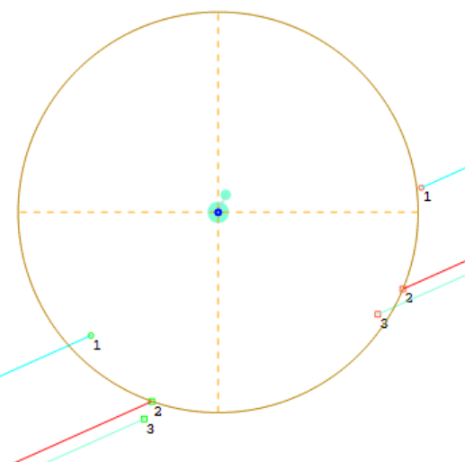
3 types of solution - #2
Double solution. You know where the asteroid is relative to one star, but the fit is ambiguous for the other star

Slide 8
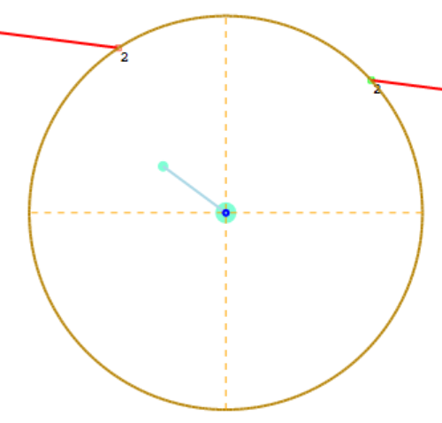
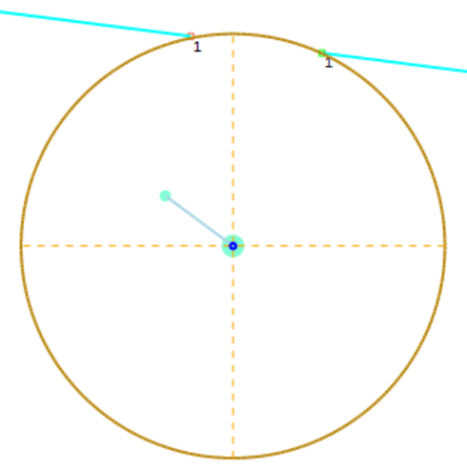
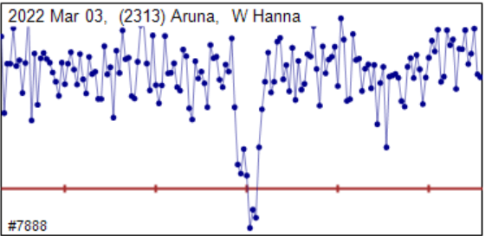
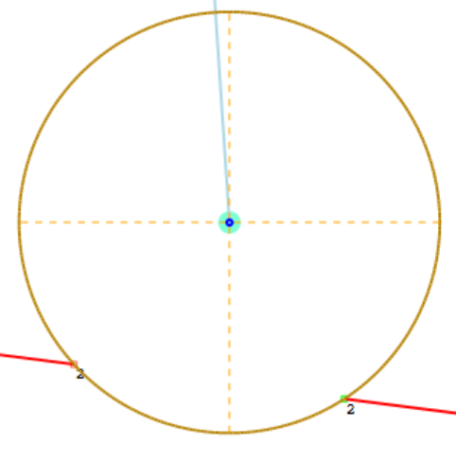
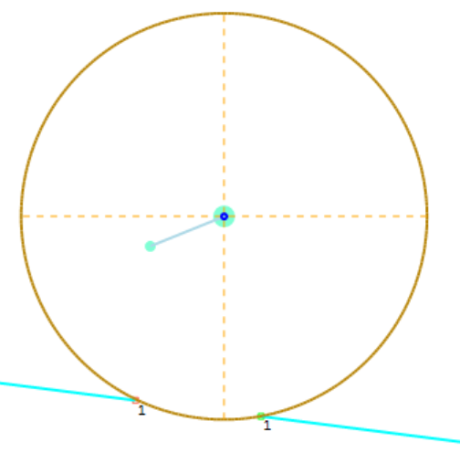
3 types of solution - #3
Four solutions. The asteroid location is ambiguous for both stars

Slide 9
Astrometry issues
In almost all cases, our doubles are not resolved in Gaia. So need to match the photo-center to the Gaia star position
Specify relative brightness of the stars
For Unique solutions, and 4-solutions, use the brighter component
For Double solutions, use the component where the star path is known

Slide 10
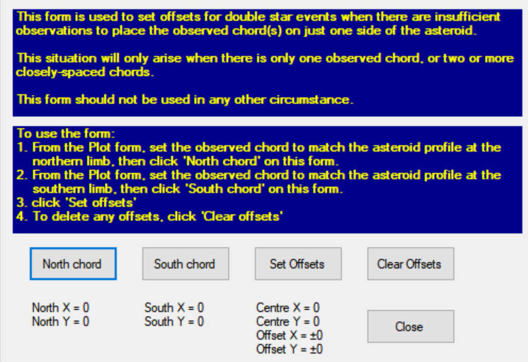
Astrometry issues – 4 solutions
Need the ‘average’ position of the main component. That is, the average of the two possible chords.
Click:
Follow instructions
After you click ‘Set Offsets’ close the form.

Slide 11
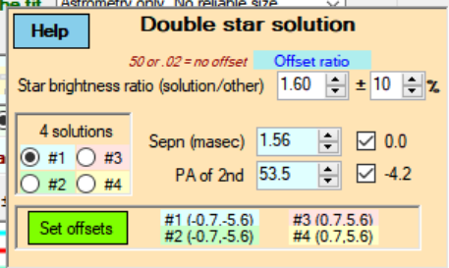
Setting solutions
For each solution, set the solution number
Fit the chords using Sepn and PA
For Unique and Double solutions, you can use the usual automatic fitting button – just check the boxes for Sepn & PA

Slide 12
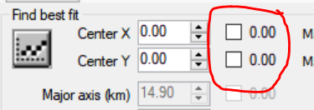
Setting solutions - 2
For four solution events – as you select a new solution number, the location of the primary star will be automatically placed. The task is to fit the other chord.
You can use the Automatic fitting button. However you MUST uncheck the fitting checks for the X and Y coordinates

Slide 13
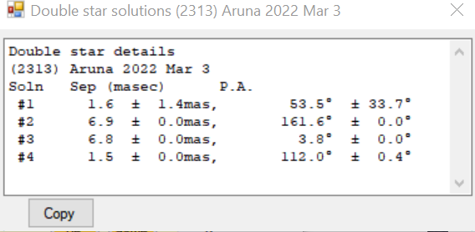
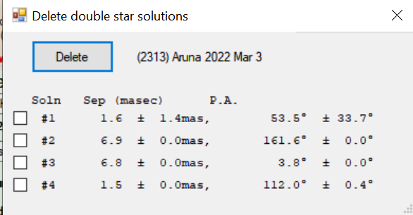
Viewing & deleting solutions
Click Solutions on the Editor
Click List current… and get
Click Delete… and get To delete, check the relevant solution(s), and click Delete.
Close the form when done

Slide 14
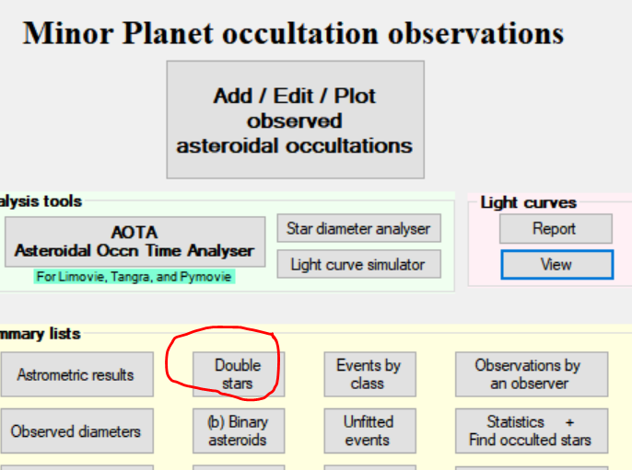
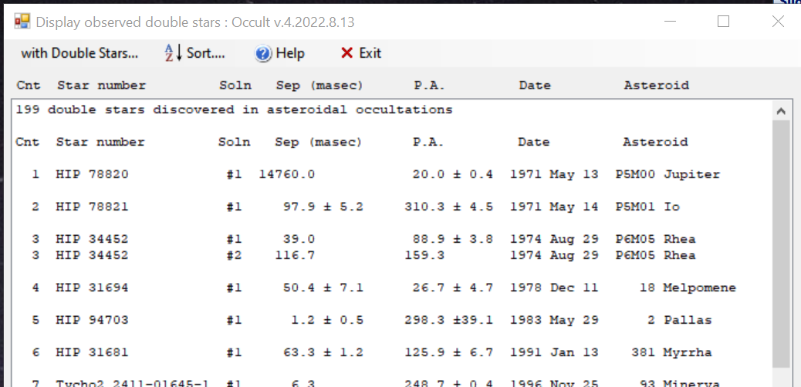
View all double stars
From Main form, click Double stars, and get:
With the exception of the first event on this list (β Sco), all are discoveries

Slide 15
Getting official recognition for a discovery
Official recognition = Entry in WDS
Need to write a short paper for the Journal of Double Star Observations. USNO will use that to create an entry in the WDS
Include all solutions. Only one will be listed in the public catalogue, but all will be included in their database
Samples of past papers are readily available… using a sample, its easy. And JDSO will assist you

