Slide 1
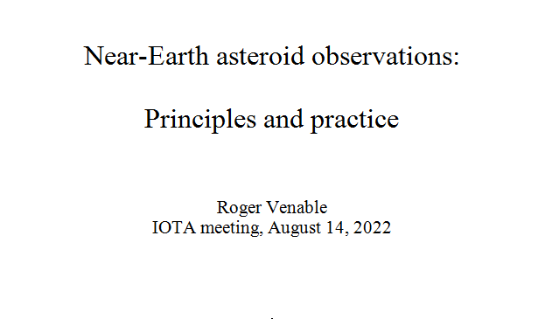

Slide 2
Notes:
2. This is the occultation path of a high rank event: 2483 Guinevere's rank 99 event of August 6th of this year. The bold yellow line is the predicted centerline, the blue lines are the path edges, and the red lines are the 1-sigma and 3-sigma uncertainty lines. The map distance key at the bottom right of the image shows that the 1-sigma uncertainty zones are about 20 km in width.

Slide 3
Notes:
3. This Google map is at the same scale as the last one, but shifted to the northwest somewhat. The path here is that of the near-Earth asteroid Didymos for an occultation on June 25th of this year. Ignore the green lines -- they are for observers' chord assignments. The red lines narrowly seen amid the green lines are the 1-sigma path limits. The path edges may be difficult to see at this resolution. They are the blue line between the two red 1-sigma lines. The blue lines appear as one line in this view due to the limitation of the map's resolution. The point here is that the path is very narrow. But strikingly, the 1-sigma uncertainty zone is very narrow in comparison to that of the main belt asteroid Guinevere on the previous slide, despite the fact that the Guinevere event is of quite high rank.

Slide 4
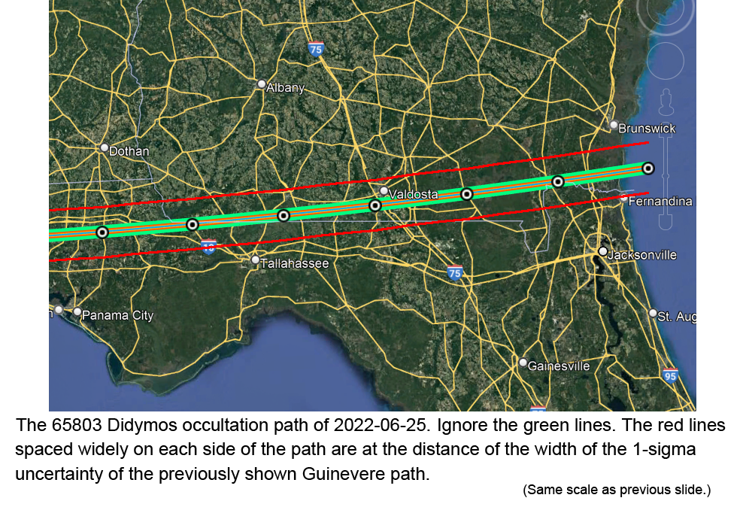
Notes:
4. Here I have superimposed a couple of red lines that are 20 km from the path edges of the Didymos event. That is, these red lines are spaced the same distance they are spaced for the Guinevere event shown previously. This is to display how greatly the path error for a main belt asteroid like Guinevere is likely to exceed that of a near-Earth asteroid like Didymos.

Slide 6
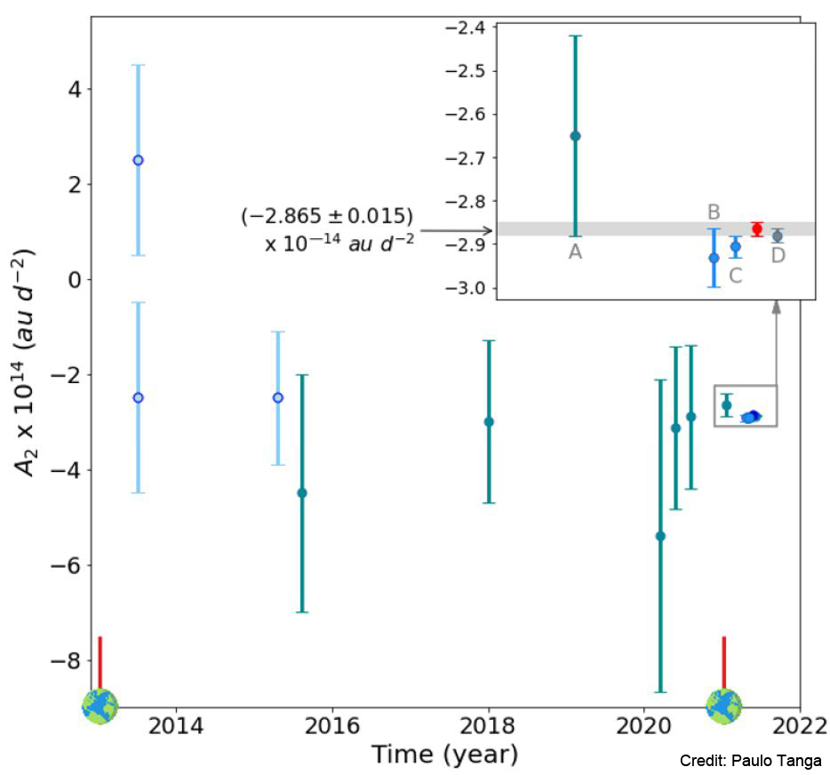
Notes:
6. This slide can be confusing. It shows the improvement in the uncertainty of the Yarkovsky effect estimate for asteroid 99942 Apophis over the last 8 years. Time is on the abscissa, and the estimate of the Yarkovsky effect is on the ordinate. Although this graph does not show the orbital model's error, that error is roughly proportional to that of the Yarkovsky effect, so I am using the Yarkovsky effect as a proxy for the accuracy of the orbital model. Note that the refinement in 2021 was so great that it had to be enlarged in the box at upper right. Along the abscissa there are two Earth symbols. These indicate times of close approaches to Earth. Apophis makes such close approaches every 8 or 9 years. This occurred in late 2012 and in early 2021, as shown on the abscissa here, and many of you will recall that the next close approach will be in 2029 when it will pass closer to Earth than our geosynchronous satellites.
This slide was created by Paulo Tanga.

Slide 7
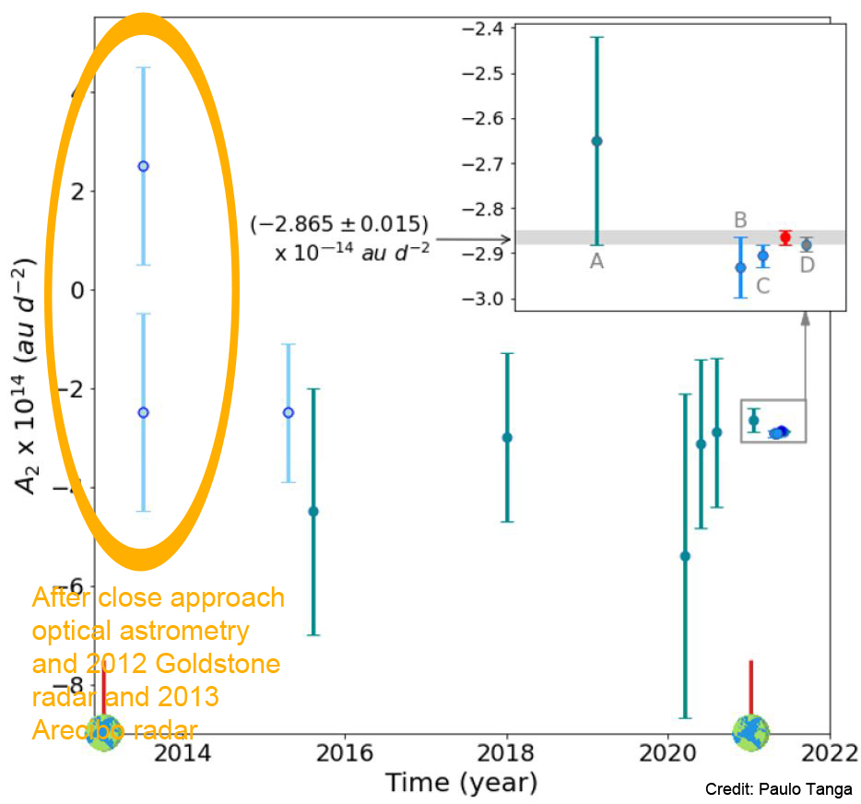
Notes:
7. Apophis was discovered in 2004 and was immediately identified as a near-Earth asteroid. Its first radar astrometry was done at Arecibo in 2005. As I said, it comes close to Earth approximately every 8 to 9 years, and for most of the rest of the time it is too close to the Sun to observe. The circled data show the large uncertainties, which do not overlap on two measurements, and which disagree on whether the effect is positive versus negative. This was the state of this measure in 2013 after a close approach to Earth. This includes radar astrometry by Goldstone radar in late 2012 and by Arecibo radar in January of 2013.

Slide 8
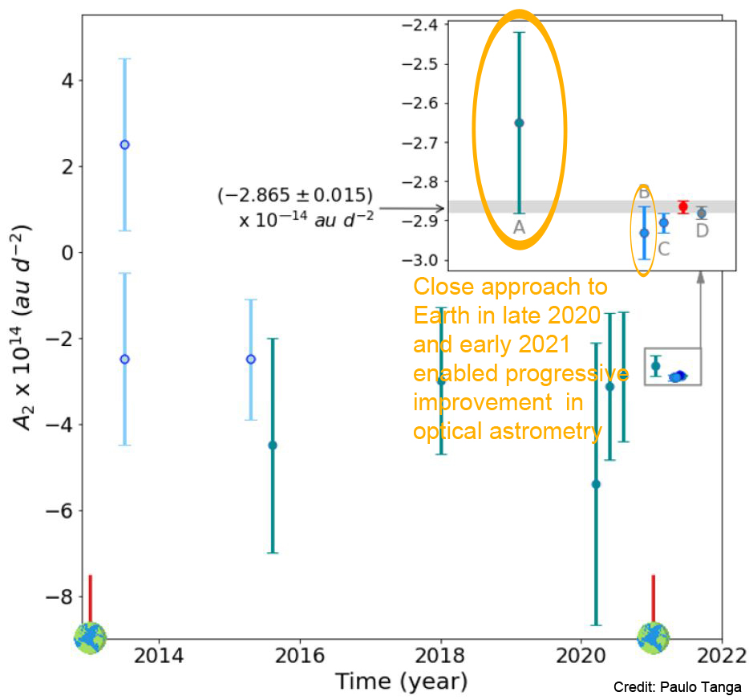
Notes:
8. The next close approach to Earth was in late 2020 and early 2021. During this time the orbital accuracy measured by optical astrometry rapidly improved, as shown by the data in the two ovals. This improvement was by virtue of the close approach plus the advent of the GAIA astrometry data.

Slide 9
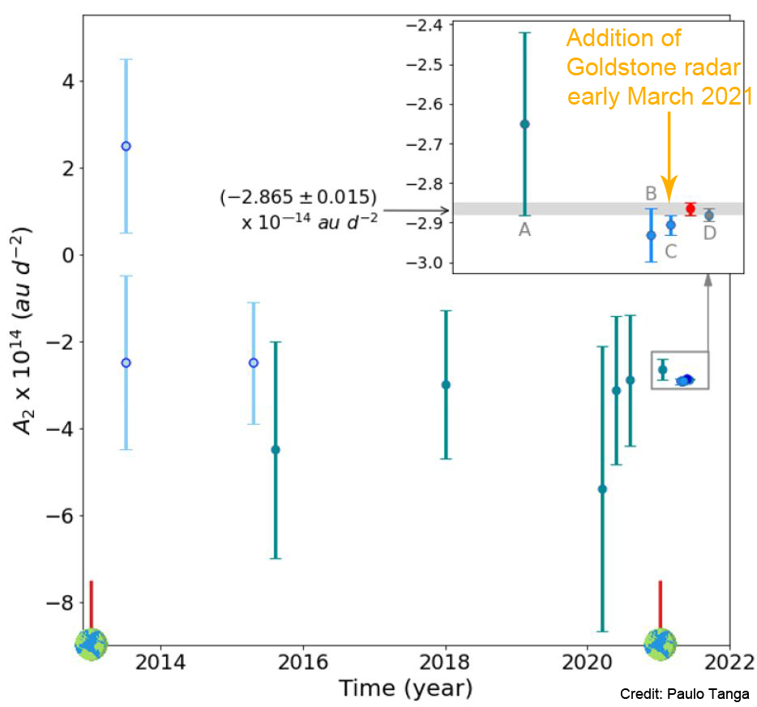
Notes:
9. The asteroid was sufficiently close for Goldstone radar astrometry in the first few days of March 2021, and this resulted in a 60% reduction in uncertainty in the measure of the Yarkovsky effect. It also brought the orbit uncertainty down to a level that suggested that a campaign of IOTA observers assembling in Louisiana had a good chance of recording an occultation.

Slide 10
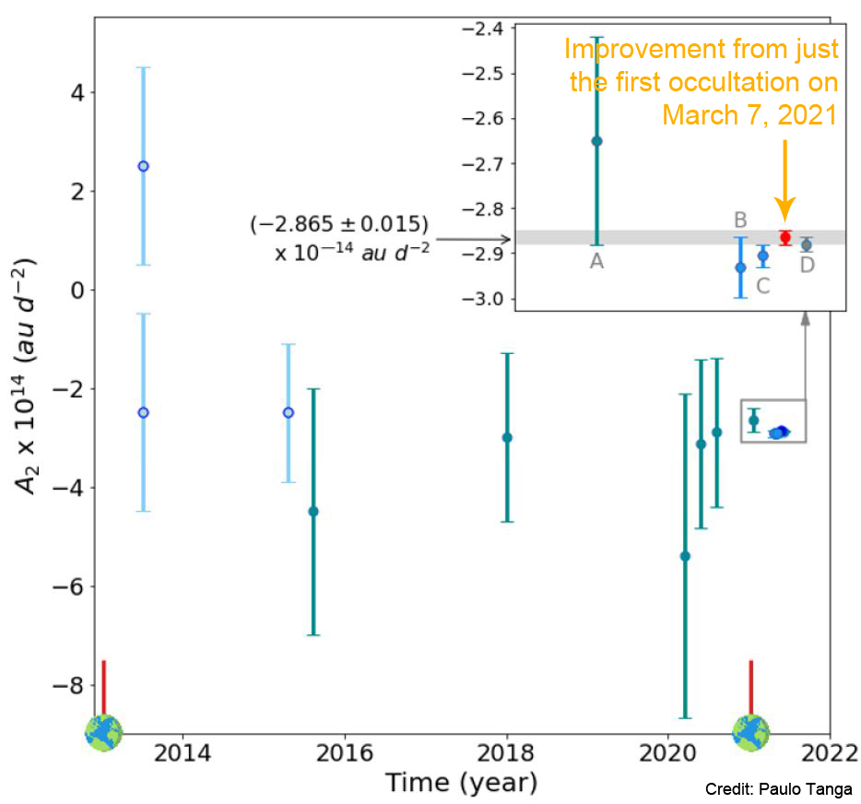
Notes:
10. This shows the improvement after a single positive occultation event, that in Louisisana on March 7th of 2021. This one occultation observation decreased the uncertainty by about 50%. (Following this, a number of subsequent positive occultation observations were made, further refining and verifying the orbit, but the data from these observations is not shown here.)

Slide 11
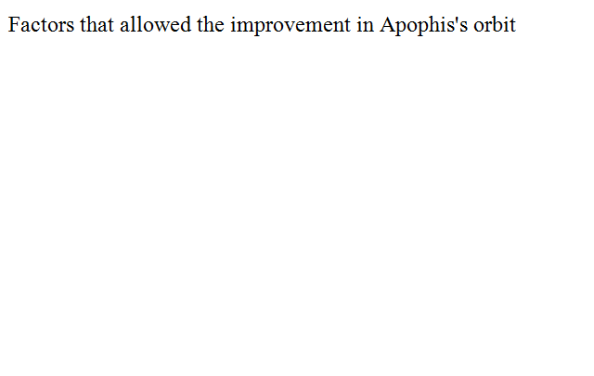

Slide 12
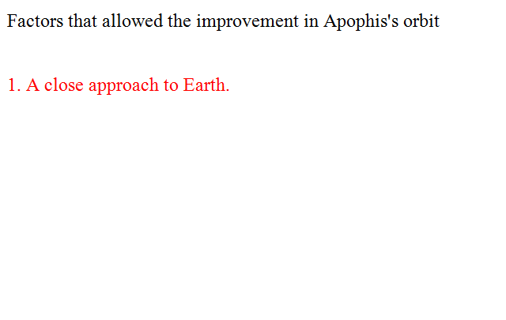

Slide 13
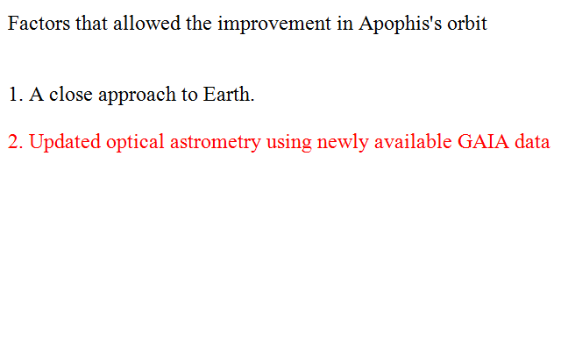

Slide 14
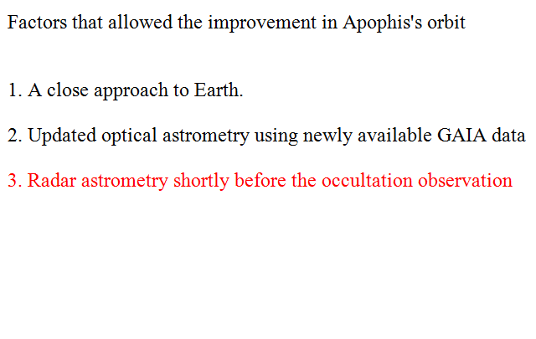

Slide 15
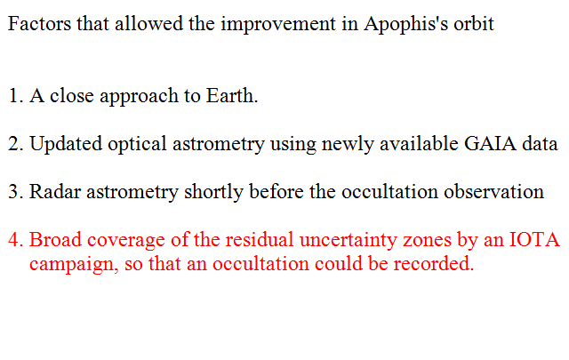

Slide 16
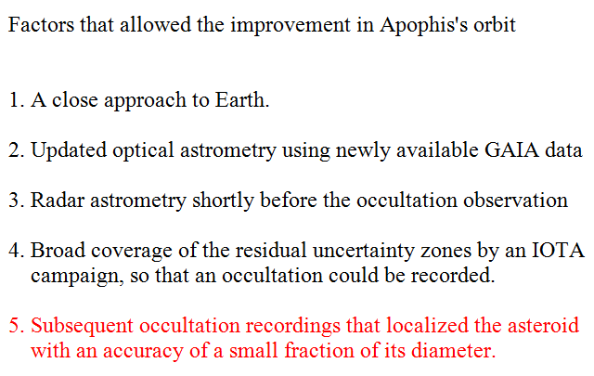

Slide 17
Notes:
17. A similar multistep process had previously led to positive occultation observations with 3200 Phaethon. Astrometry by the Arecibo instrument had already been done, and its orbit was well known in part due to a 35 year observation period. A joint occultation campaign by IOTA and the Southwest Research Institute in the western United States in 2019 is described in the caption of this diagram. There were 66 chord lines, most of them filled, and the green ones in the diagram are those manned by the SwRI observers. There were 6 positive chords.

Slide 18
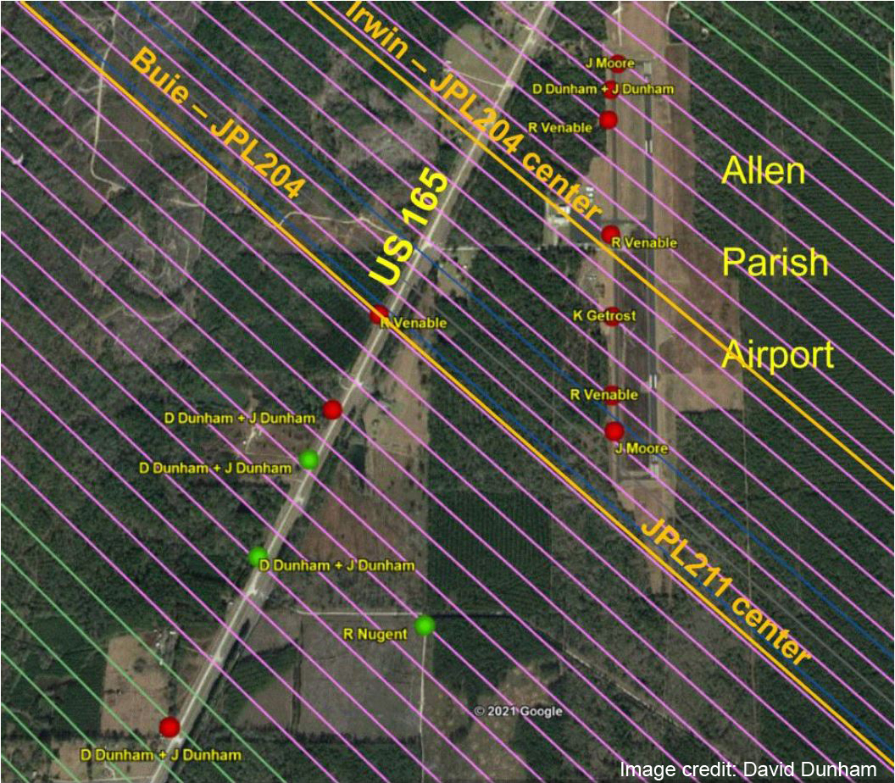
Notes:
18. The first occultation campaign by IOTA for an event by Apophis was on March 7, 2021, in Oakdale, Louisiana. The observers' chords are shown here. Note that there are three different paths drawn on the map, revealing some uncertainty of where the highest probability across-path position was located. Fortunately, the number of observers was enough to result in three positive recordings. The positions of the three positive recordings are indicated in green, while the negatives are in red. Note that the positives were not on any of the centerlines drawn.

Slide 19
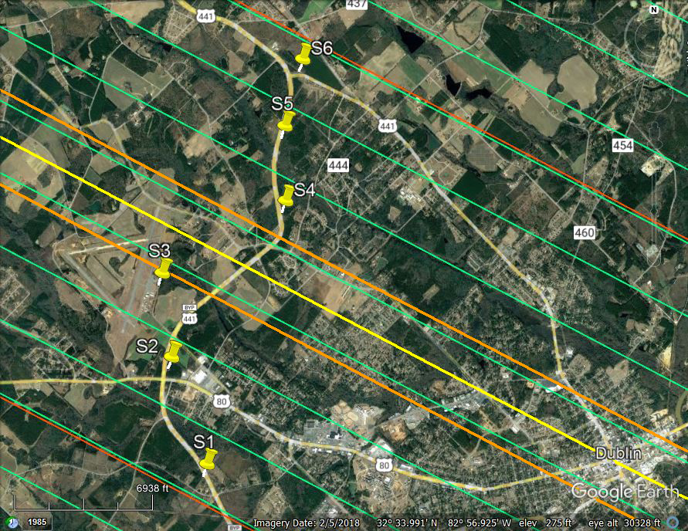
Notes:
19. Similarly, we have attempted to have large campaigns for the Didymos occultations so far this year (2022). This picture shows the sites of my 6 telescopes along U.S. Route 441 Bypass around Dublin, Georgia, for the Didymos event of July 24, 2022. The centerline is the bright yellow line, the path edges are orange, and the green lines are chord guidelines spaced at 600 meter intervals. Jack Jewell observed from the centerline in southeastern Montana, while I placed three telescopes on each side of his central station at 600 meter intervals, as shown. The yellow pins on the map are my 6 sites. Unfortunately all of the seven recordings were negative for an occultation.

Slide 20
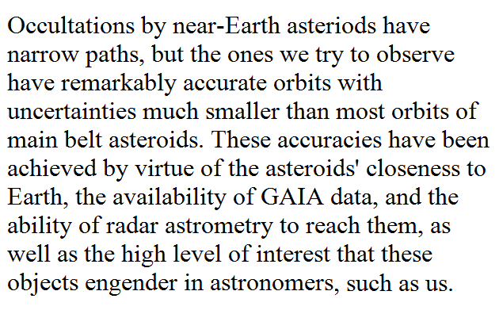

Slide 21
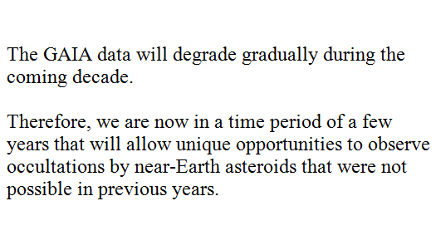

Slide 22
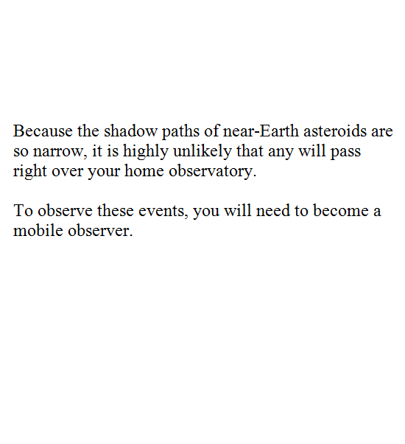

Slide 23
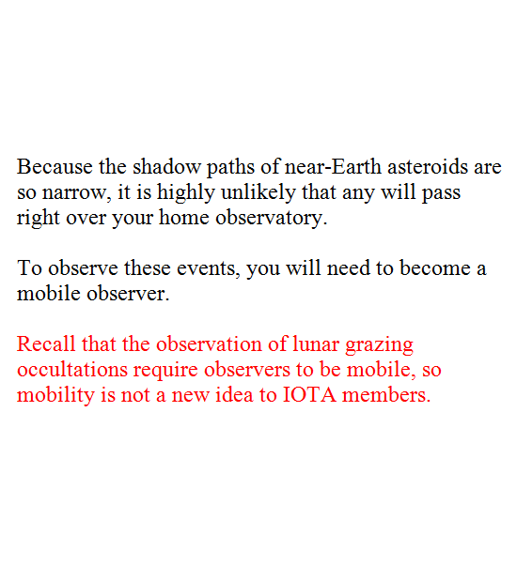

Slide 24
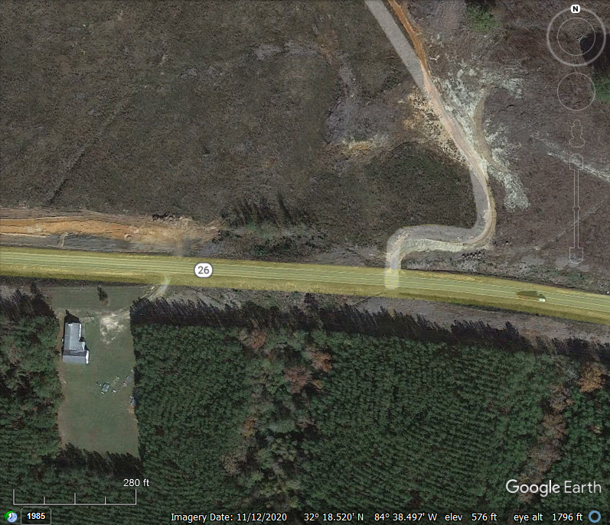
Notes:
24. Now I want to change the focus of this presentation to a discussion about mobile stations. I want to give you an idea of how I select mobile observing sites.
This is a Google Earth overhead view of an area of paved road that has a couple of good sites along it at which you might set up a telescope. On the left there is a building, and if you look carefully you will notice that it has a steeple. The street view shows that there is only a small security light in the right front (northeast) corner, and no gate on the driveway. The best site at this church is not in the driveway but around the back of the church, which involves a carry of equipment of fewer than 100 feet. I usually do not plan on using a church site on Sunday nights because many churches have meetings on those nights. On the right side of the picture there is a dirt road that curves sharply right and then sharply left. A close look far along the dirt road above what is visible in this view revealed that there are no homes along it, and it peters out in a tree farm. I stopped along this road about 200 feet in and set up right on it.

Slide 25
Notes:
25. The point here is that there are two good sites in this view, and they are exemplary of the type of site that you should look for when you set up a mobile observing station.

Slide 26
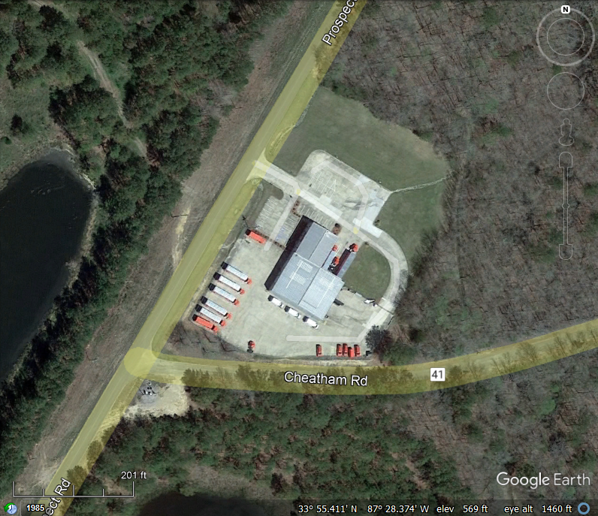
Notes:
26. This is a Google Earth overhead view of a Coca Cola bottling plant. Remarkably, its security lights are only in certain areas, and the parking lot to its north has no lights. Because trucks sometimes pull into distribution centers at night, I prefer in this case to set up in the grass just to the north of the parking lot. If you need to look over trees from such a site, you can often tell how tall the trees are from an overhead view such as this. Along the road side there are telephone lines. In this locale, the telephone poles are 30 feet tall. Their shadows are visible, and you can compare their shadow lengths to the shadow lengths of the trees to ascertain the heights of the trees.
There are two other good sites in this view. One is at the right edge of the roadside dirt-surfaced clearing in the lower left. There is a recess amid the trees here, and if your sky target is in the west or northwest this would be a very good site. The other good site is along a 2-rut path into the woods at the upper left. The street view may show you whether this path is gated. The overhead view shows that there are no structures (that is, no possible homes) along it. If your sky target is to the southwest, you will be able to see it through a gap in the trees along this path.

Slide 27
Notes:
27. So, there are three good sites here. Keep in mind that you must not set up near homes. I usually use 300 feet as an absolute limit, but I prefer to stay 600 feet from homes, and if my site would be in clear view from a home across a field I would require more than 600 feet separation.

Slide 28
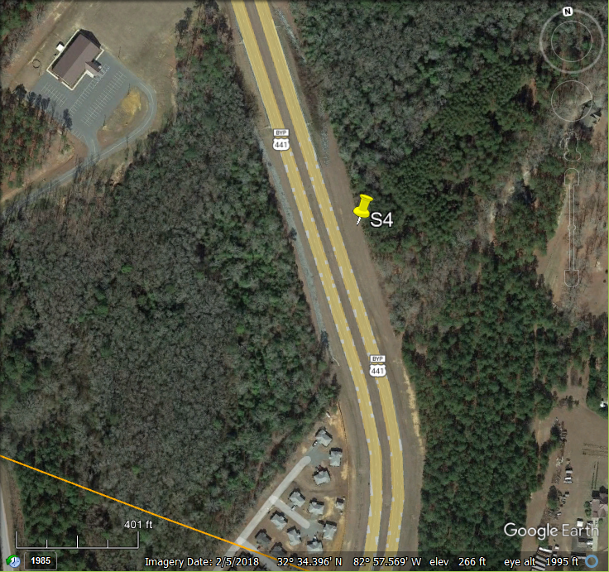
Notes:
28. The potential observing sites that I just showed you are typical of those that I use for main belt asteroid observations. Such main belt events allow substantial leeway in the spacing of stations-- generally a few miles -- even when there are other claimed chords, due to the width of the path and uncertainty zones.
However, such sites are unlikely to be useful for near-Earth asteroid observations. The reason is that, due to the very narrow pathwidth and uncertainty zone, you will be constrained to set up within a small distance of your assigned chord. Indeed, for some of our Apophis observations, chord assignments were separated by only 80 meters in the sky plane, so observers were behooved to set up accurately on their assigned chords. For near-Earth asteroids, I have been using a particular type of highway. Certain highways provide excellent, wide shoulders for the setup of telescopes. These are federal divided highways (not including any highways of the Interstate system, as it is not legal to set up along the Interstates.) Most federal divided highways have shoulders about 70 feet wide.
This Google Earth picture is a closeup of the 6-station view that I showed several slides ago. U.S. Route 441 includes a divided "bypass" highway around Dublin, Georgia. The shoulders along the bypass are 70 feet or more wide. The yellow lines drawn by Google Earth over the road's pavement are actually wider than the pavement. By looking at the distance key at the bottom left, you can see that the telescope position is nearly 100 feet from the pavement. This is typical for this stretch of road. A shoulder of approximately 70 feet width is typical of major federal highways that are divided highways like this one, though some are narrower.

Slide 29
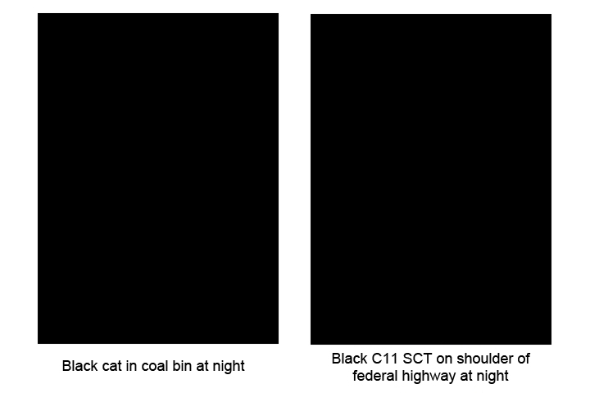
Notes:
29. These two photographs are self-explanatory. I wish you to notice the remarkable resemblance of a black cat to a black telescope. For those of you who have never set up a roadside telescope and are afraid that passing headlights will illuminate your equipment, I encourage you to actually try this: After painting your equipment a very dark color, set it up at night in a field about 70 feet from a road, and drive past it to see whether your headlights enable you to discern it in the dark. Under such circumstances, I cannot see mine. . . and I have never suffered the theft of equipment by passers by.

Slide 30
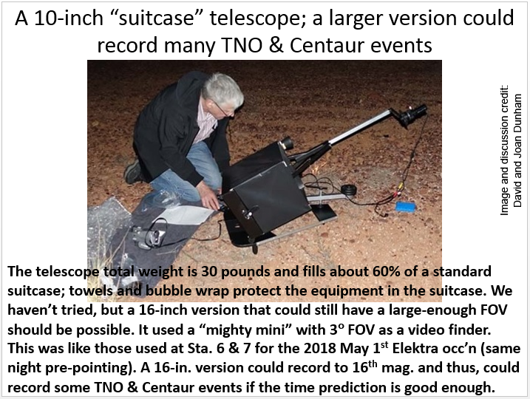
Notes:
30. Because the path is so narrow, the shadow will miss you if you try to observe it from home. You need to go mobile. This slide shows David Dunham setting up a suitcase telescope of 250 mm aperture. Except for the optical components, it is homemade. The altitude and azimuth pointings are controlled by hand screws, but also allow fast sliding for the making of the larger prepointing movements. Telescopes such as this can be transported in ordinary baggage and used for observations anywhere in the world. John Broughton originated this particular design.

Slide 31
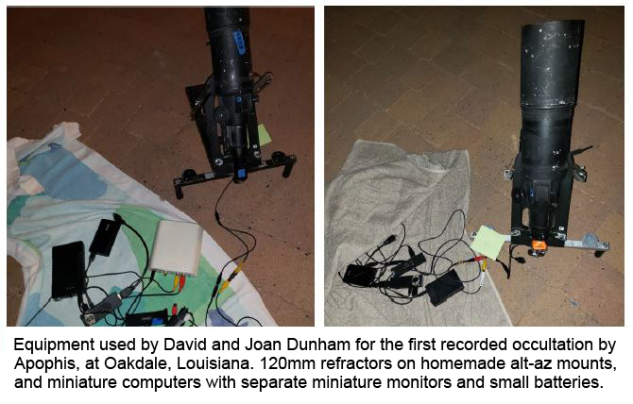
Notes:
31. The Dunhams also use these 120 mm refractors mounted on homemade altazimuth mountings scaled down from the one on the previous slide. The miniature computers, miniature monitors, miniature batteries, and video time inserter are also shown. These electronic components are scaled down, making it easy to travel with them.

Slide 32
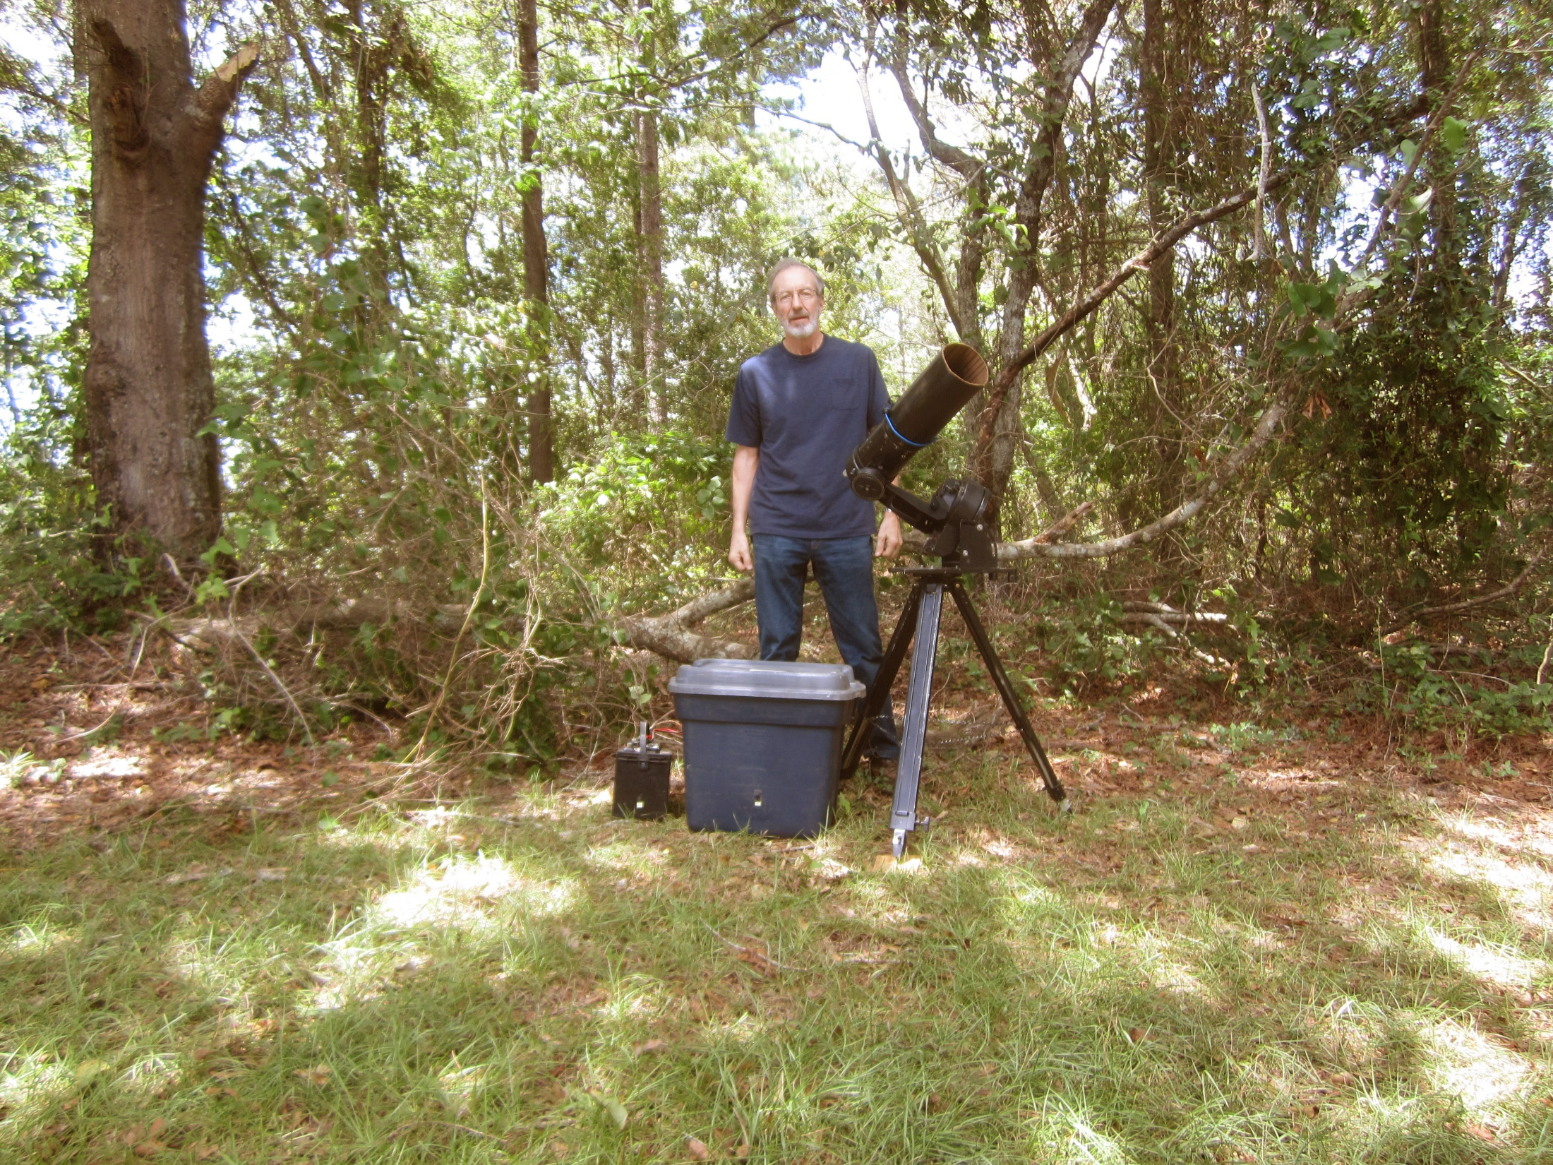
Notes:
32. I use a different approach. This is an ordinary Celestron C5 on an ordinary C5 equatorial mounting. It is easily transported, but requires a moderately large box, and note that I use an ordinary laptop computer for recording. It's in the blue box in front of me. Also, I use heavy but inexpensive boat or recreational vehicle batteries of the "deep discharge" type, seen here to the left of the blue laptop box. A gap in the trees along a roadside, such as that behind me, can be used to hide a telescope. (I call this telescope my "John Westfall C5", as I purchased it from his wife Elizabeth after his death.)

Slide 33
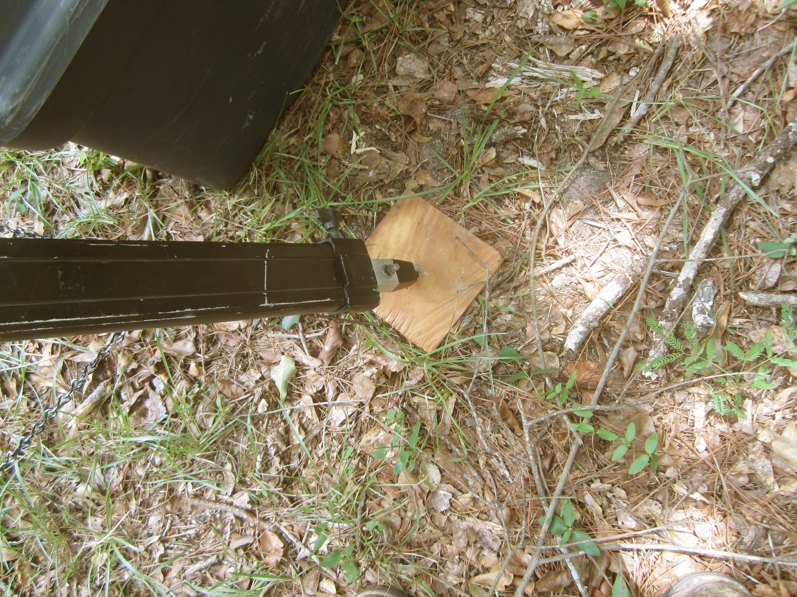
Notes:
33. When a telescope is to be set up using the prepointed method and left unattended, always place boards under the tripod feet to prevent them from sinking slightly into the ground over time, and thereby ruining the accuracy of your prepoint.

Slide 34
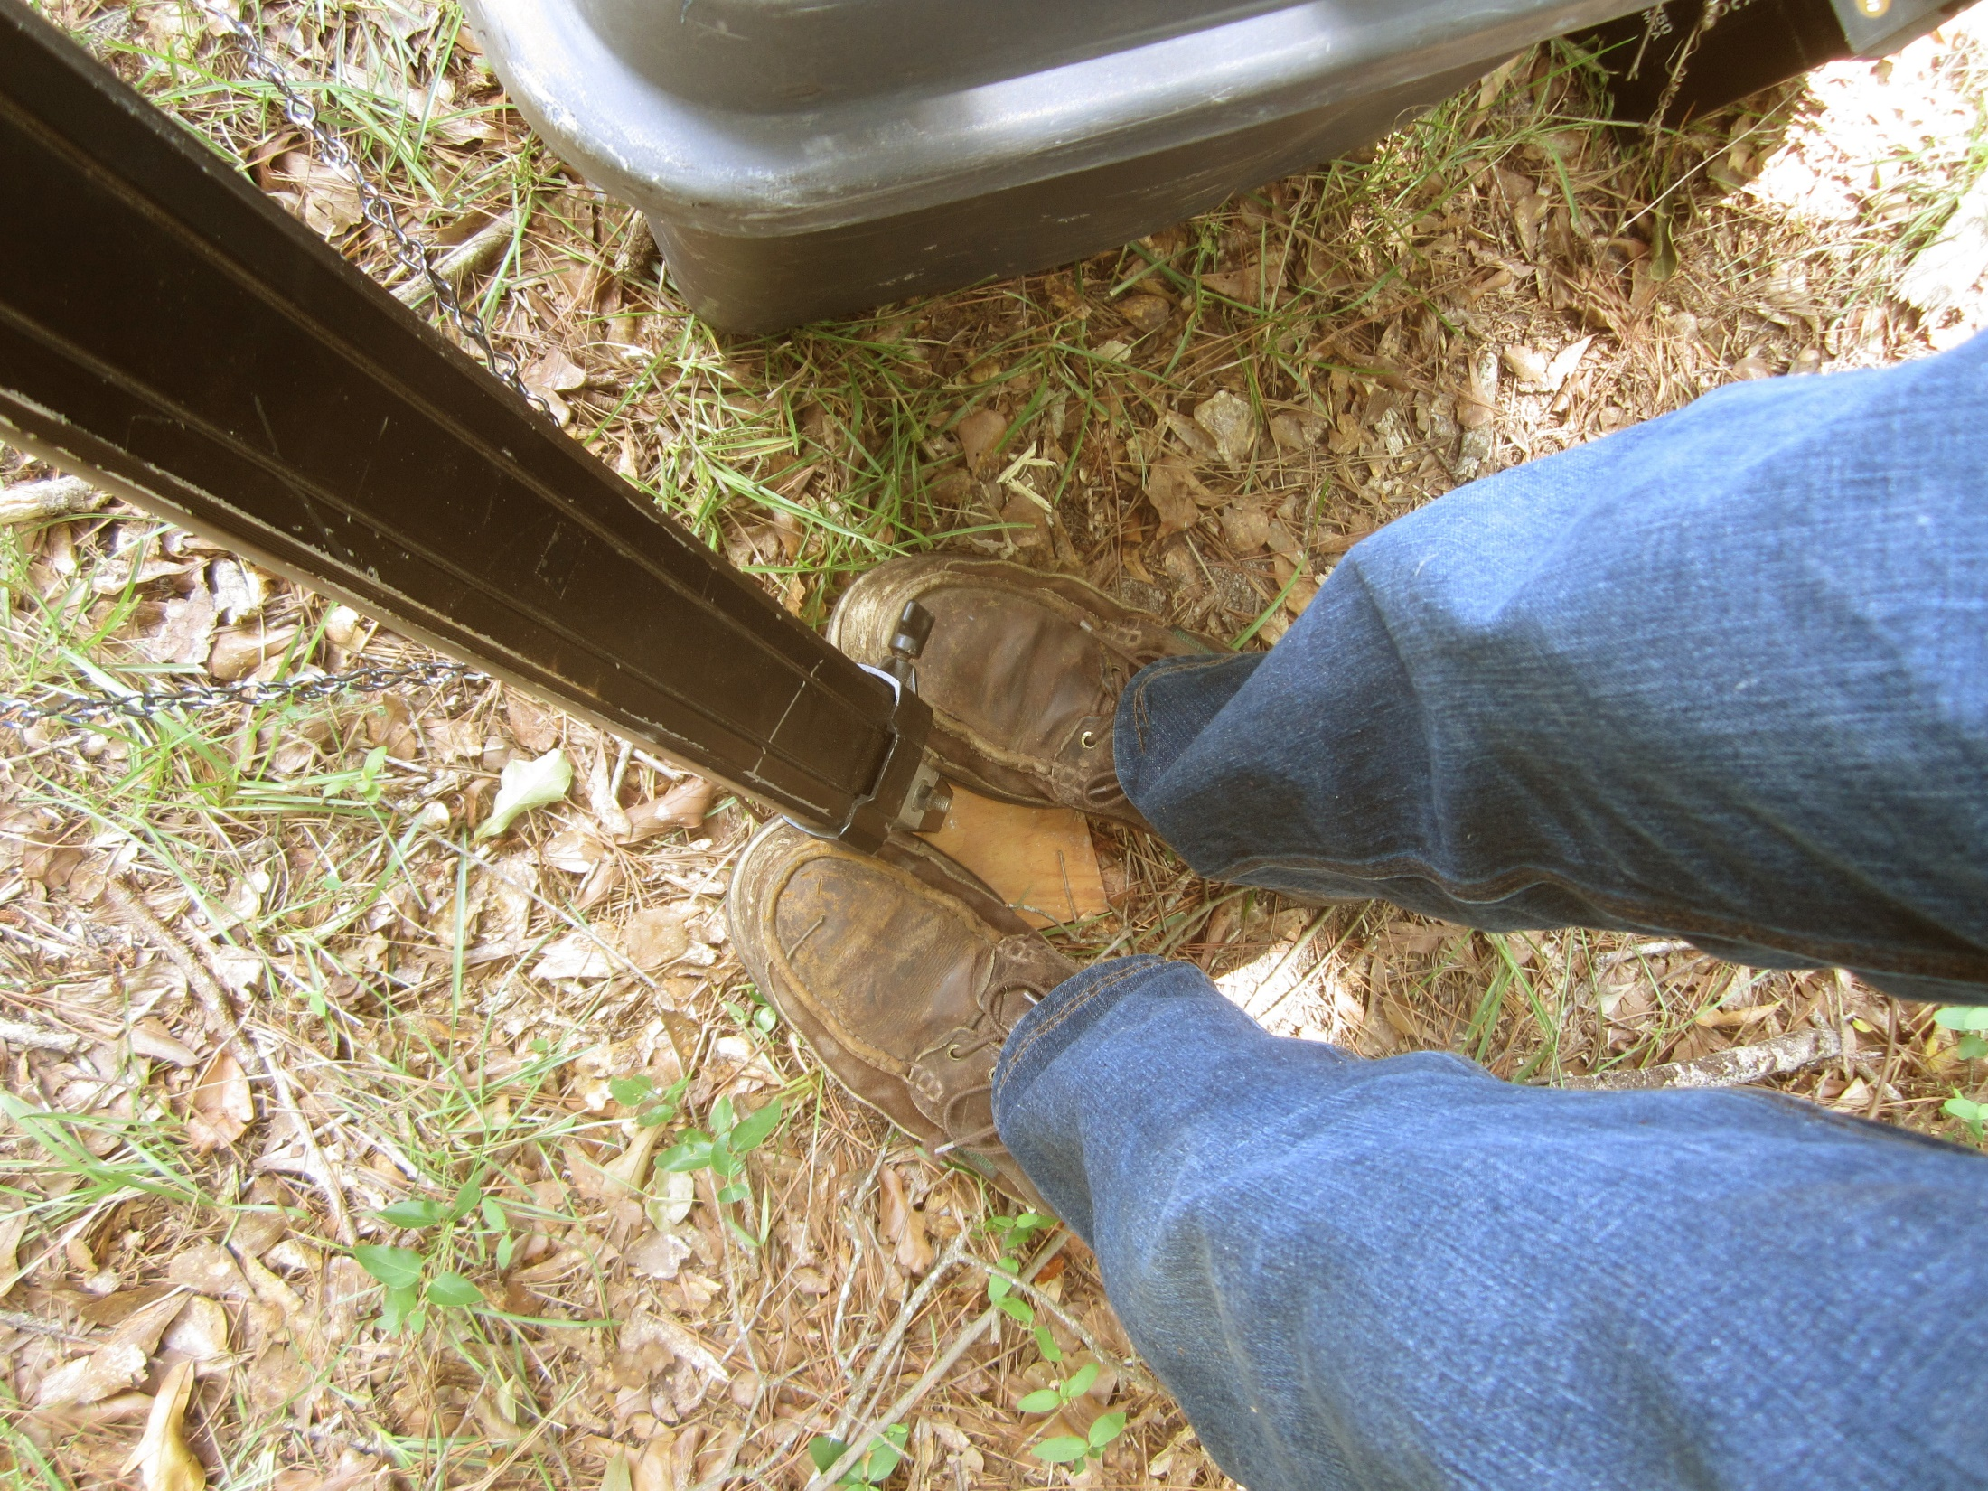
Notes:
34. After placing them, I step on the boards with my whole weight, in an attempt to complete the settling of the tripod before prepointing.

Slide 35
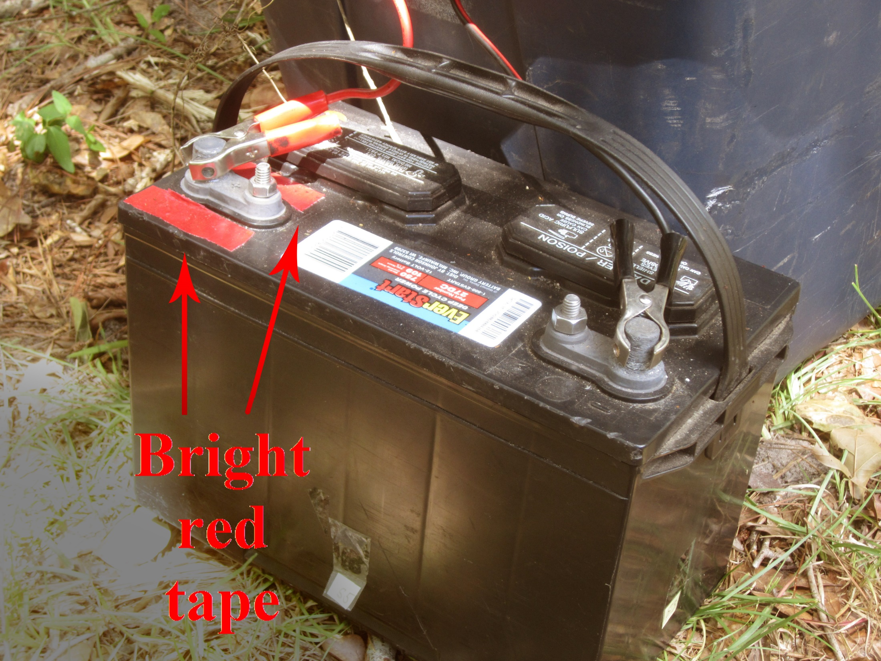
Notes:
35. I have lost many a station by misconnecting the battery terminals in the dark. I cannot see the blue smoke in the dark, but I can smell it. Now all my batteries are prominently marked by red tape around the positive terminals, so I can more readily see which terminal is positive.

Slide 36
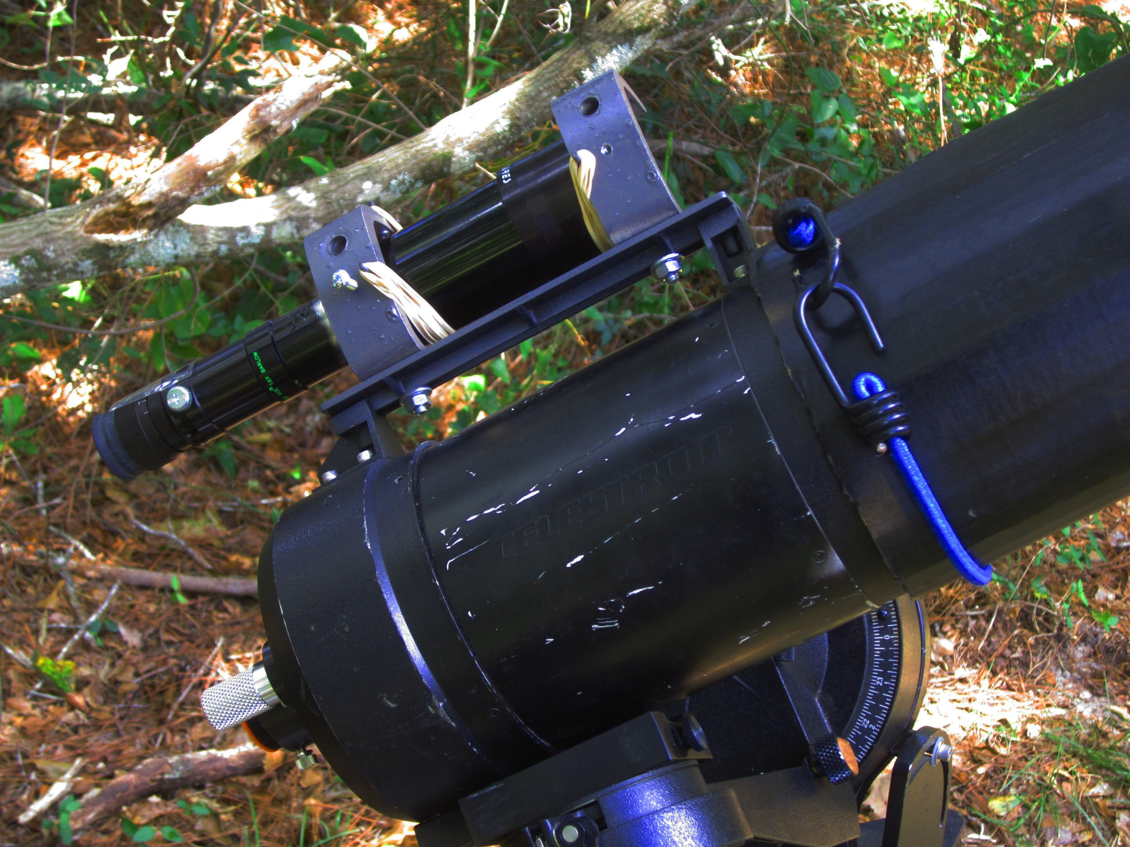
Notes:
36. The C5 came from the factory with a small finder scope of only 25 mm aperture, enabling me to see stars down to about magnitude 7.5. I highly recommend replacing a small finder with a finder of 50 or 60 mm aperture, enabling the detection of stars of magnitude 9.0. This 50 mm finder was made by cobbling together a bunch of spare parts, and building its on-scope mounting. The use of a large finder such as this will prevent the telescope from fitting into its factory-supplied case, so you will have to make a padded box in which to carry it.
The dew shield is always needed in the southeastern United States. A dew heater in addition to a dew shield is often needed for SCT's larger than 250 mm aperture, but the heater is generally unnecessary for smaller SCT's. The dew shield here is homemade -- a roll of cardboard.

Slide 37
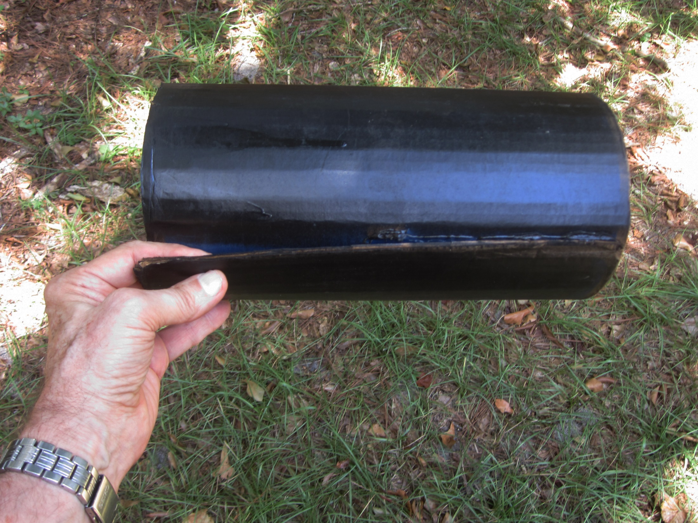
Notes:
37. The dew shield is glued into a roll on only one end of the roll. This allows the other end to expand a bit, shown here by the admission of my index finger, so as to slip over the end of the telescope snugly. The use of a bungee cord may be optional when the dew shield is new, but after repeatedly getting wet with dew the shield will be have only a weak grip on the telescope and the bungee cord will be necessary.

Slide 38
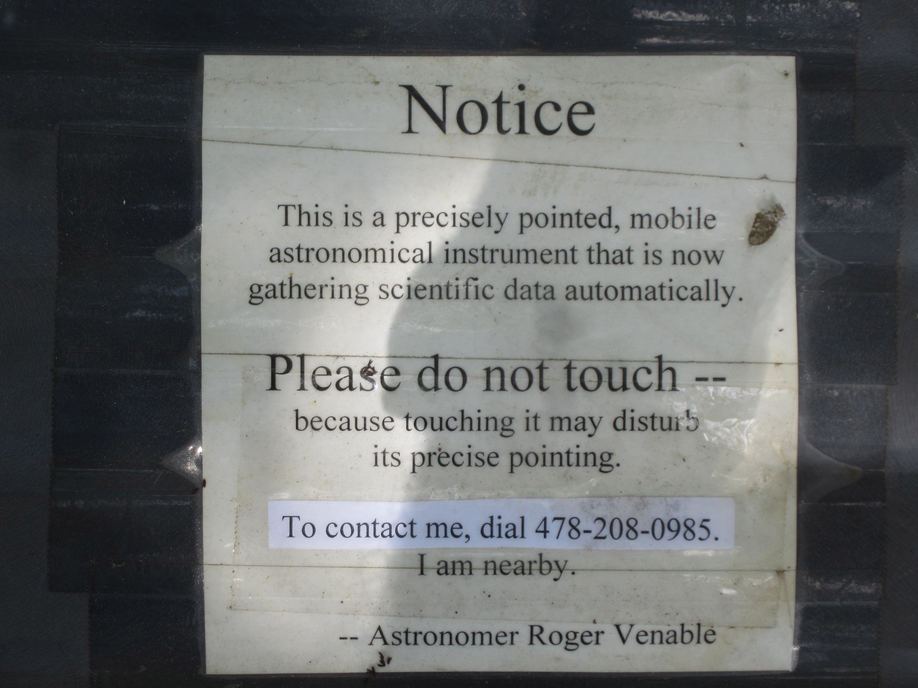
Notes:
38. It seems to be a good idea to leave a message somewhere on your unattended equipment. In preparation for this talk I counted approximately 425 unattended telescope setups that I have made. Of these, two that I know of have been discovered and left untouched; two were molested by policemen who mistakenly thought their touches were too light to disturb the pointing; and none were bothered by anyone else. (Perhaps a lot of them were discovered and this sign was read and the equipment was left alone, but I'll never know about such cases that did not call me.)

Slide 39
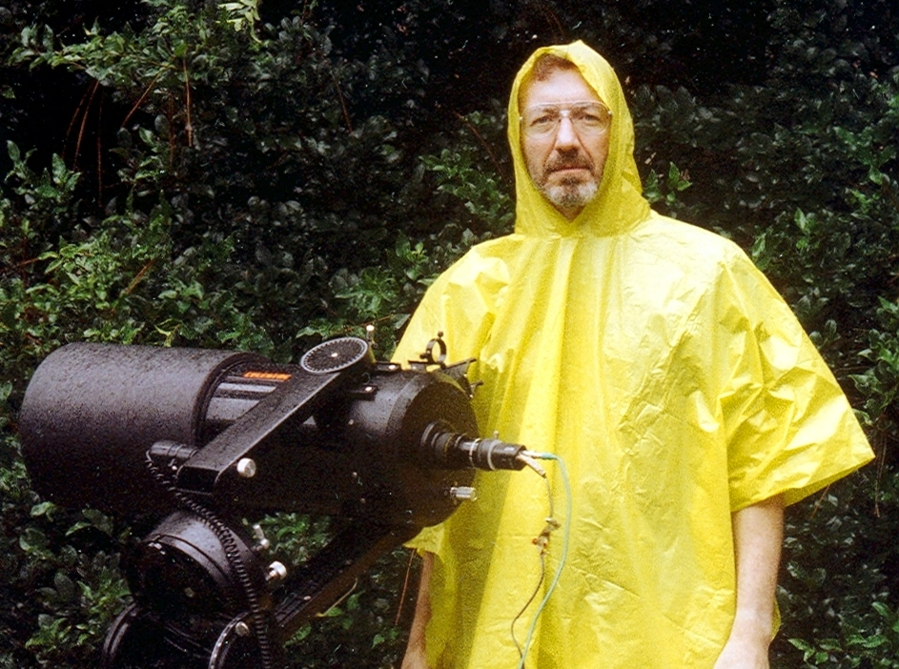
Notes:
39. In the state of Georgia, be ready for rain when the forecast is for a clear sky.

Slide 40
Notes:
40. As an example of an occultation by a near-Earth asteroid, this slide presents the light curves of the three positive occultation chords of the first Apophis occultation, observed in the IOTA campaign in Oakdale, Louisiana. Notice that the occultation was very brief, of 3.5 frame durations at one site (left panel, Dunhams observation), 3 frames at another site (middle panel, Richard Nugent's observation), and only 1 frame at one site (right panel, Dunhams' observation). The brief duration of this event will lead us into my next presentation.

Slide 41
