Slide 1
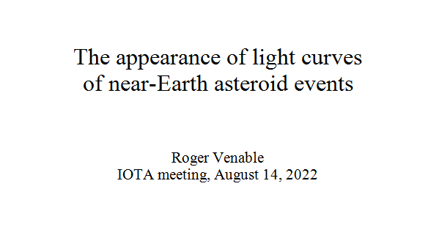

Slide 2
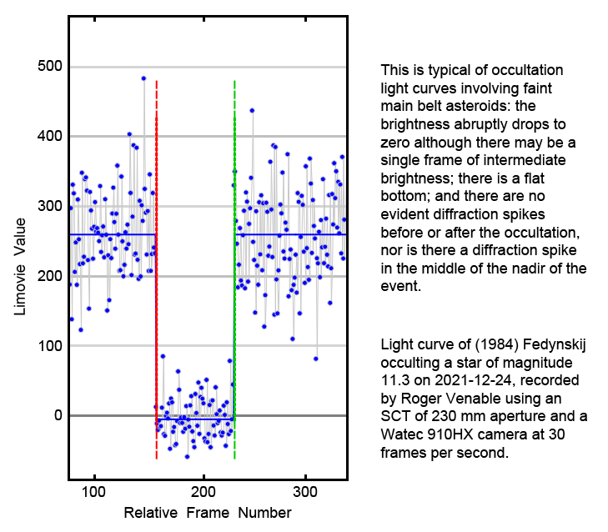
Notes:
2. This occultation light curve is typical of those involving faint main belt asteroids. There are several salient features of it.
First, the disappearance and reappearance are abrupt. (As you know, any instantaneous change in brightness may involve a single frame of intermediate brightness if the change occurs during the exposure of that single frame. Thus, a single frame of intermediate brightness does not mean that the disappearance or reappearance is gradual.)
Second, the brightness during the occultation is at the same brightness as the background sky -- that is, zero brightness.
Third, the bottom of the event is flat.

Slide 3
Notes:
3. Here we see the three light curves of the first successfully recorded occultation by asteroid 99942 Apophis on March 7th of 2021. The Dunham's chord on the left shows a non-zero event bottom and a peculiar single-frame brightening in the middle of the occultation. There happens to be a single frame of intermediate brightness during the reappearance, so it can be estimated that the occultation at this location lasted 3.5 frames. Richard Nugent's chord in the middle lasted 3 frames and shows no brightening in the middle frame of the occultation. The Dunham's chord on the right shows an occultation of only one frame duration, with a remarkably incomplete disappearance.
The point here is that these light curves appear different from that of a typical occultation by a main belt asteroid.

Slide 4
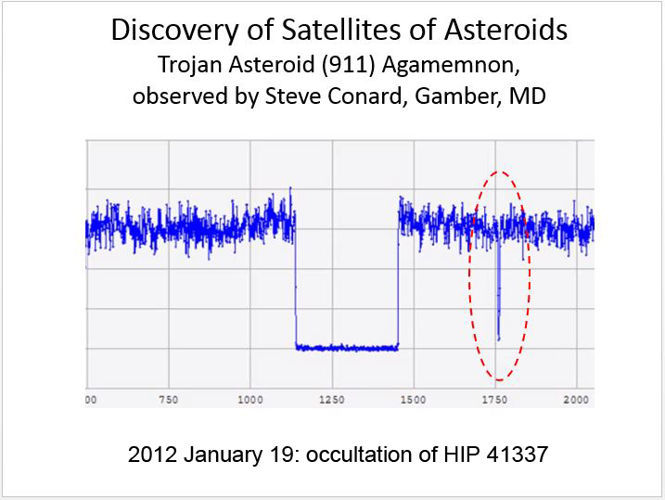
Notes:
4. About 10 years ago, Steve Conard recorded this light curve of an occultation by the Jupiter Trojan 911 Agamemnon. It shows a secondary event consistent with a small asteroidal moonlet. Note that the brightness of this secondary event does not drop to zero, and note also that there are three frames of intermediate brightness. The primary event clearly shows a drop to zero brightness and shows only 1 frame of intermediate brightness.

Slide 5
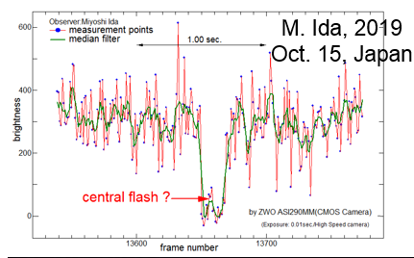
Notes:
5. This light curve of an occultation by 3200 Phaethon was made by Myoshi Ida on October 15th, 2019, from a site near the predicted centerline. The points along the red lines are the raw data, while the green lines are medians of unspecified sample length. The recording was made at 100 frames per second. It shows a spike in brightness in the middle of the event bottom.

Slide 6
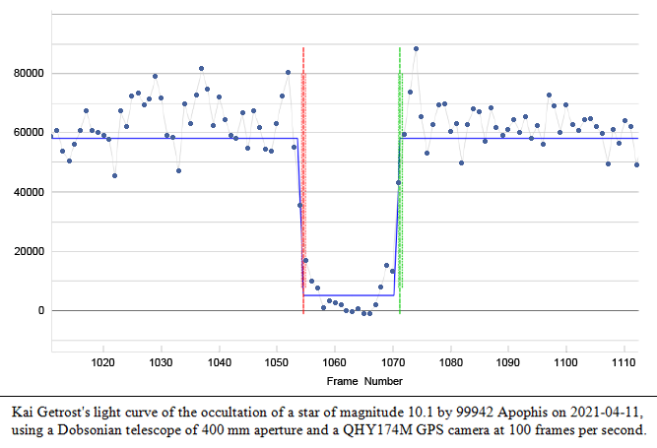
Notes:
6. This light curve of an occultation by 99942 Apophis was made by Kai Getrost on April 11th of 2021. It shows spikes in brightness immediately before and after the occultation. Note that these spikes are separated from the occultation by 1 or 2 frames. This light curve also shows a peculiar rounding of the event bottom. Like Myoshi Ida's light curve of the previous slide, this recording was made at 100 frames per second.

Slide 7
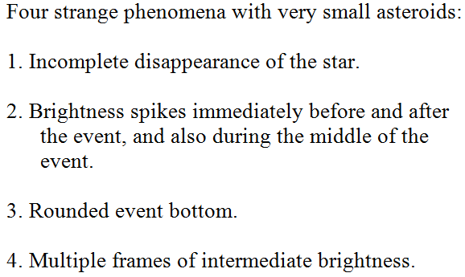

Slide 8
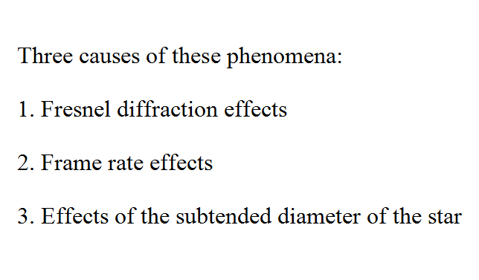

Slide 10
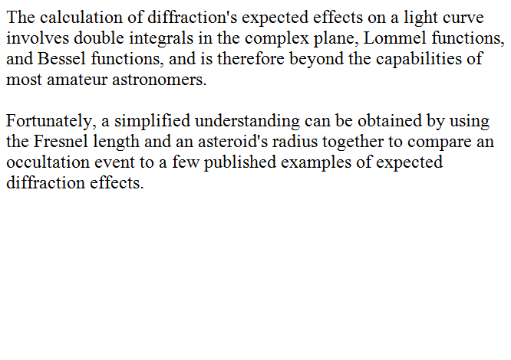

Slide 11
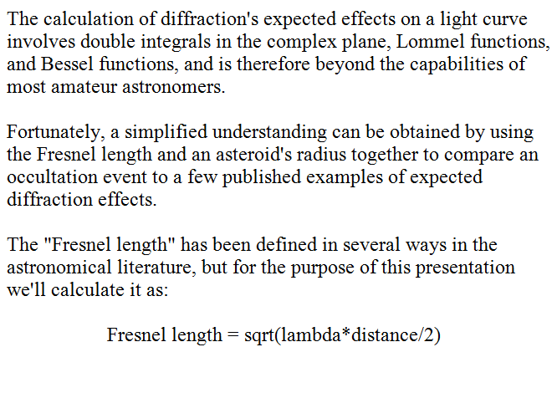

Slide 12
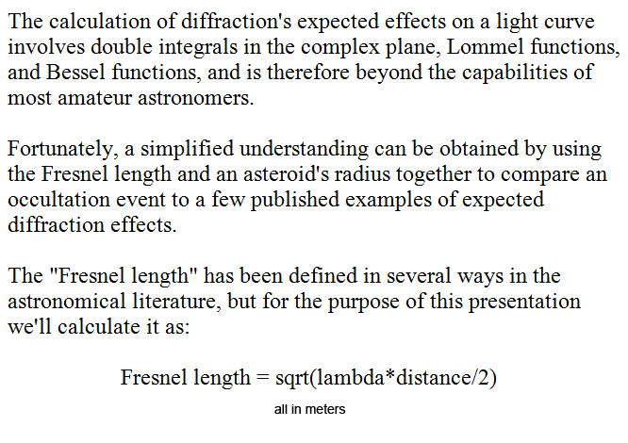
Notes:
12. In making such a calculation be careful with the units. It's easiest to calculate if you convert both the wavelength and the asteroid's distance to meters, and then the resulting Fresnel length will also be in meters.

Slide 16
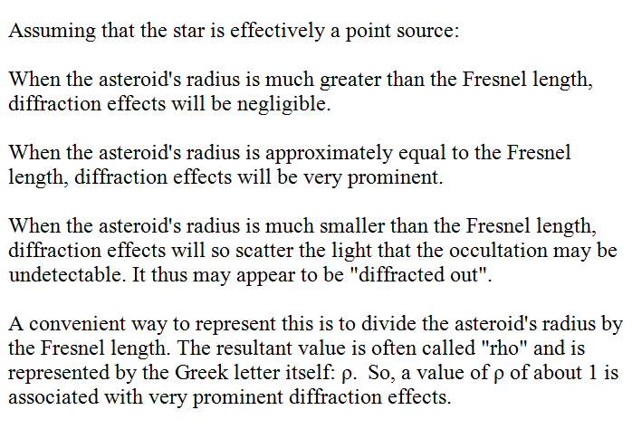

Slide 17
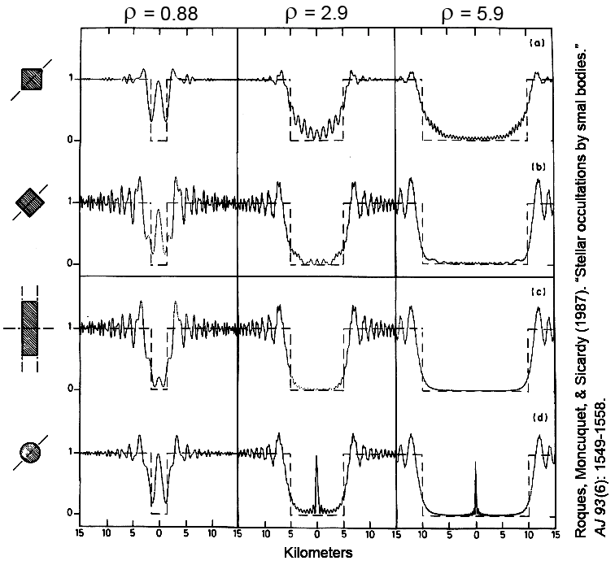
Notes:
17. This slide is very busy, but I'd like to walk you through some of it because it is central to understanding the effects of diffraction in occultations. Notice that this figure is from a 1987 article about diffraction effects in occultations, written by Roques, Moncuquet, and our associate Bruno Sicardy. I have added the rho values at the top of each column. The diagrams will apply to any occultation that has the same value of rho, which depends on wavelength, distance, and asteroidal radius. The diagrams are idealized by having been computed using a single wavelength and a star that is a point source.
Notice the four drawings at the left edge of the diagram. These indicate the shape of the asteroid and the occultation path across it in the sky plane.
In each of the twelve diagrams, the dotted lines indicate the geometrical occultation. The solid lines indicate the brightness as affected by diffraction.
For the purpose of understanding the diffraction diagrams, it is helpful to think of the wavelength and distance as constant, so that the different columns show only the effect of asteroidal diameter. (Although this diameter is indicated in kilometers at the bottom of the slide, that radial distance is related to the specific wavelength and the distance of the asteroid from the observer, so the kilometer measure is the part of the diagram that cannot be exported to other cases.) The different rho values in the three columns differ only by virtue of the asteroid's diameter.
Please direct your attention to the left column, showing diffraction when rho is 0.88. Notice that, for this rho value of 0.88, there is a strong central spike in brightness regardless of the asteroid's shape, except that it is attenuated greatly by an occultation across the short dimension of an elongated body. This central spike is a Poisson's spot caused by diffraction, and it must not be confused with the central spike seen in occultations by large bodies with atmospheres such as Titan, Triton, and Pluto. These atmospheric central spikes are caused by refraction, not by diffraction.
While looking at the patterns in the left column with rho of 0.88, imagine that you were observing an occultation by a small, elongated object like Apophis, with a rho value of 0.88. You might expect to record a strong central diffraction spike. If the central spike fails to show up, its absence strongly suggests that you have recorded an occultation across the asteroid's short dimension, as in the third row from the top.
Notice that, for any occultation with a rho of 0.88, the brightness does not decline to zero at any point during the occultation.
Now please direct your attention to the top two rows together. These show occultation paths crossing a square occulting body in two different configurations. The point of comparing these two rows is to see that asteroids of very different shapes can have very similar diffraction patterns at all values of rho.
Now please direct your attention to the bottom row, which shows a diametric occultation by a circular body. Note that this is the only configuration in which a strong central diffraction spike is present at any diameter. The diffraction spike become progressively narrower at larger diameters, so that it in actual practice it becomes more difficult to detect. The bottom right diagram shows that the detection of a Poisson's spot can require good luck. I'd like you to imagine an observer's chord that passes near the centerline but not exactly through the center. Notice that even the base of the Poisson's spot is pretty narrow. Consequently, one must be right on the centerline to detect the Poisson's spot.
Incidentally, for a perfectly spherical occulting body and a perfectly diametric occultation path, the Poisson's spot's peak brightness at any wavelength is always equal to the unocculted brightness.
I haven't mentioned the diffraction brightness peaks that are immediately before and after the geometric occultation. Note that they are present in every one of the twelve diagrams. Notice that they all peak at approximately the same distance outside the geometrical occultation.
Now please direct your attention to the two columns on the right. Notice that in every one of these eight diagrams, the occultations have rounded bottoms, for rho values of 2.9 and 5.9.
Finally, I want to point out something that you may not have noticed yet. In all twelve diagrams, the disappearances and reappearances are not abrupt, but are gradual. This is despite the computation of the diagrams in which the star was considered to be a point source. Of course, your ability to record the gradual nature of the dimming and brightening depends on the frame rate you use. Clearly, a high frame rate may assist in recording some diffraction features.

Slide 18
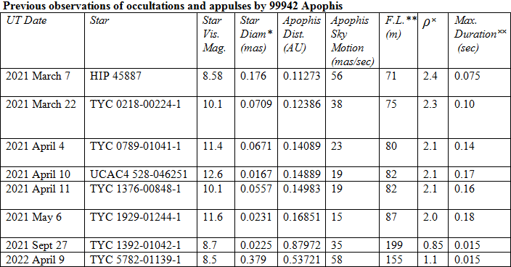
Notes:
18. This slide shows a compilation of some data about most of the observed occultations and appulses by Apophis in 2021. If you look at the second column from the right, you will find the value of rho for each of these events. Notice that for the first six events, the rho value was intermediate between that of the first two columns of the previous slide. For the final two events of this slide, the rho values were similar to that of the first column in the previous slide.

Slide 19
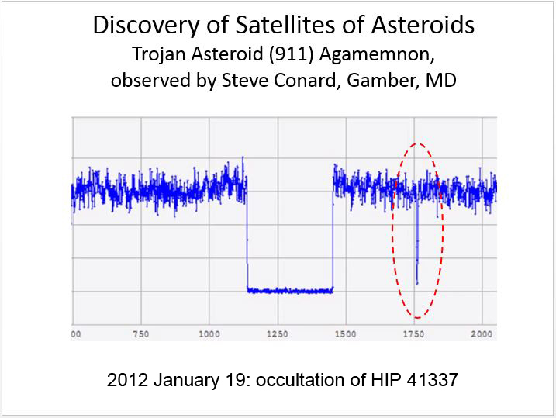
Notes:
19. Diffraction explains the nonzero event bottom of Steve Conard's observation of an asteroidal moon. The rho value of the main event on this slide is about 290, while that of the moon is only about 3.0. Diffraction also is a possible cause of the multiple points of intermediate brightness in the secondary event.

Slide 20
Notes:
20. Diffraction appears unlikely to be the explanation of the central peak in Ida's near-centerline recording of a Phaethon occultation. The rho value was 22, so any diffraction spike should be very narrow. As I pointed out when displaying the diffraction diagrams 3 slides previously, even a grazing pass through the bottom of the central spike will be quite narrow, not wide as the central spike is here. Note that Phaethon's diameter is about 15 times as great as that of Apophis, so if the two are at the same distance Phaethon's mid-occultation spike will be much narrower than that of Apophis. This central spike recorded by Ida is a puzzle to me.

Slide 21
Notes:
21. Diffraction explains the nonzero event bottoms of these Apophis occultations. Moreover, in the Dunhams' light curve on the left, which was made from near the center of the actual path, diffraction is a good candidate to explain the small brightness spike in the middle of the event. Rho was 2.4.

Slide 22
Notes:
22. With Kai Getrost's recording of an Apophis event, diffraction explains the rounded bottom, as well as the brightness spikes immediately before and after the event. Rho was 2.1.

Slide 23
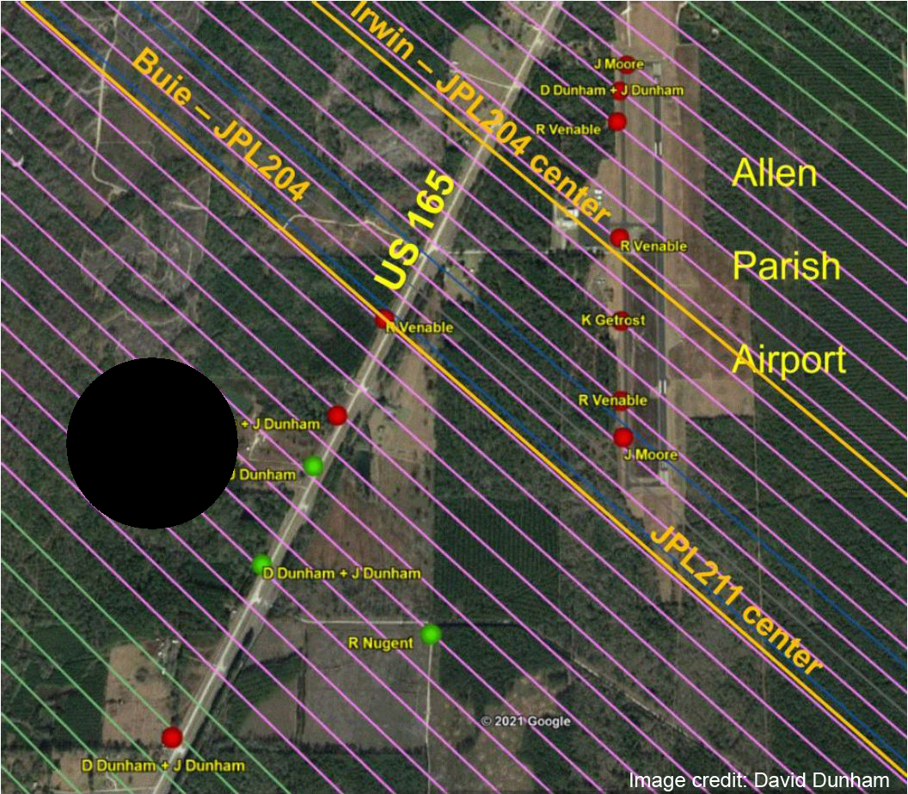
Notes:
23. We have long thought of an asteroidal shadow as something like that diagrammed here. This shows it about to move toward the lower right and pass over the telescope sites of the Dunhams and Richard Nugent on March 7, 2021.

Slide 24
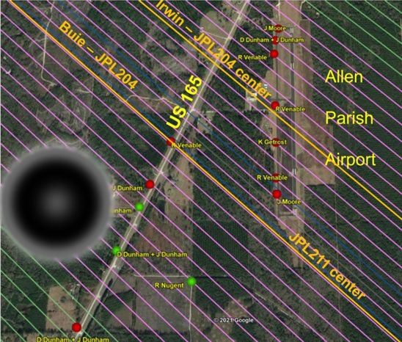
Notes:
24. Actually, the shadow was something like this, with a bright center that appears to have been detected by the Dunhams near the centerline, and a bright external ring that causes the brightness peaks immediately before and after the geometrical occultation. These brightness peaks before and after the event were obscured by the low SNR's associated with the small telescopes used for the observations.

Slide 25
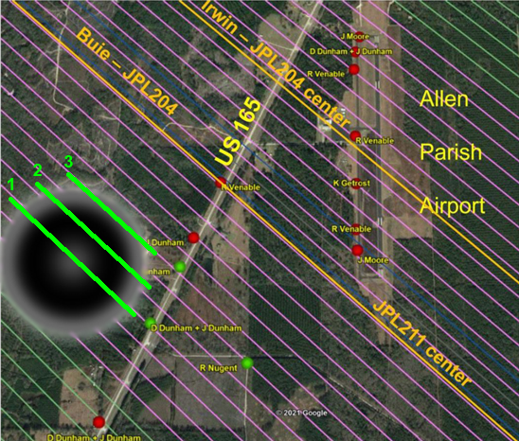
Notes:
25. With this slide I have drawn three bright green lines across the shadow in order to emphasize the difference in the light curves that three observers might see due to diffraction effects.
The observer at the southwestern site would observe a brightness pattern along line 1. It would first show an increase in brightness just before the geometrical occultation, followed by a dimming, followed by a brightening as the Poisson's spot crosses his site, followed by another dimming, and finally another brightening just after the end of the geometrical occultation.
The observer at the middle site would observe a brightness pattern along line 2. He too would see two brightenings just before and after the geometrical occultation, but he would not detect a Poisson's spot.
The observer at the northeastern site would observe a brightness pattern along line 3. He might detect a relatively protracted brightening, and no dimming at all, and due to the absence of a dimming he might fail to interpret his light curve as an occultation event!

Slide 26
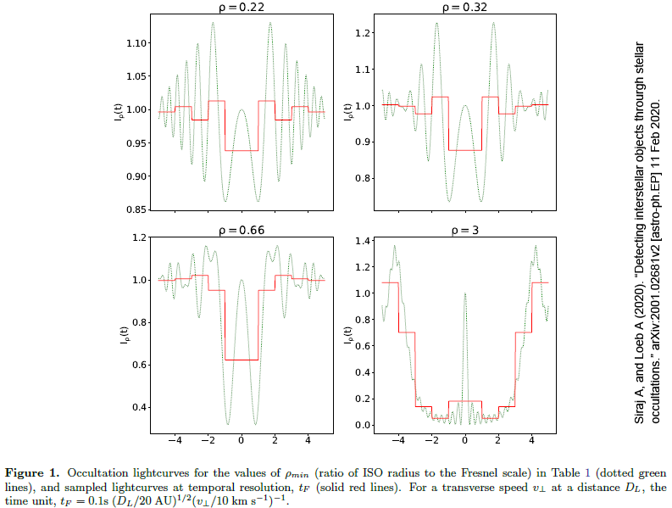
Notes:
26. Now for a look at diffraction effects from a different point of view. This slide is copied from a 2020 article by Siraj and Loeb in which they discuss the possibility of detecting free interstellar planets by the occultation of faint stars. They note that the rho values of such occultations are likely to be quite small, similar to those seen in occultations by near-Earth asteroids.
Accordingly, the slide shows very prominent diffraction effects as the faint gray lines, not the red lines. The numbers on the abscissa at the bottom are units of camera frame duration, not time per se, and not distance. The red lines show the brightness that the camera would record as its exposure spans the part of the diffraction pattern that occurs during the exposure. In every camera frame, this brightness amounts to the area under the part of the diffraction curve exposed during that frame.
The key point here is that, for a rapidly changing diffraction pattern, a camera frame rate may be too slow to detect the finer diffraction-related features of the occultation because of its averaging effect. For example, if you look at the lower left panel that has a rho value of 0.66, the dimmest point of the occultation is at about 30% of the baseline brightness, as shown by the diffraction pattern. However, the dimmest frame recorded by the camera is twice as bright, at about 60% of the baseline brightness.
Furthermore, if you look at the lower right panel that has a rho value of 3, you can see that the detectability of the central Poisson's spot is severely suppressed by the effect of the camera's frame rate.
It thus appears that fast frame rates are beneficial in occultation recordings.

Slide 27
Notes:
27. This again is the table of most of the occultations by 99942 Apophis in 2021, and notice that the last item in the table is in 2022. The subtended diameters of each star is given in the fourth column. Notice that, for the last event listed, the star diameter was considerably larger than the stars in all of the other events. The final factor that I want to discuss is the effect of the star's diameter on the appearance of the light curve of an occultation by a near-Earth asteroid.

Slide 28
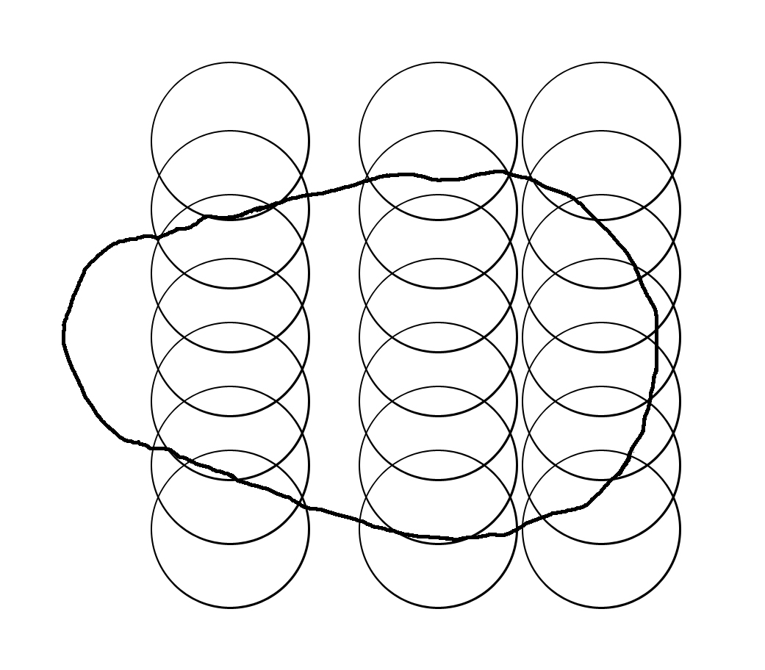
Notes:
28. This diagram represents star diameters superimposed on Apophis's approximate size, for the purpose of explanation. It illustrates three possible vertical paths along which the asteroid might cross the star. The actual shape of the asteroid is not well known but it is thought to be elongated in roughly this proportion. (The particular presentation of the asteroid's contour at the time of the appulse is unknown.)
The sizes of star and asteroid here represent the actual dimensions given in standard source material. The greatest top to bottom distance across the asteroid is 0.873 milli-arc seconds as specified by the Horizons ephemeris in the appulse of April 9, 2022. The star diameter is 0.379 milli-arc seconds, as specified by GAIA DR3. The spacing of the star figures in each of the vertical rows is the distance of a single camera frame, at the frame rate that I used in that observation. The frame rate was 380 frames per second.
The central row of stars shows a scenario in which there would be 4 frames in which the star is completely occulted, with at least one additional frame of intermediate brightness at the beginning and the end of the occultation. Note that there will always be 1 or 2 frames of intermediate brightness, and note that this is not due to an abrupt D or R during a single frame's exposure. Rather it is due to a truly gradual D and R associated with a large star size.
The left row shows a scenario of 3 frames of complete occultation, also with at least one frame of intermediate brightness at the beginning and end. Note that this left scenario increases the durations of intermediate brightness only slightly as compared to the central scenario, due to the shape of the asteroid.
In contrast, the right row shows an incomplete occultation due to the large star size, and in this event there are at least three frames of intermediate brightness both before and after the central event.
One of the important aspects of these scenarios is the effect that the large stellar size has upon the diffraction pattern that an observer would record. Notice that, when one part of the star is at a point at which it should be contributing to a central brightness spike, another part of the star is at a point at which it will contribute to a nadir in the diffraction pattern. Because of this, the central flash probably would be eliminated. The same phenomenon will depress the detectability of the diffraction peaks that would occur immediately before and after the event were the star a point source. I think that the overall effect here of the large stellar size is similar to that of the relatively slow frame rate illustrated two slides ago.
At the risk of being very redundant, I want to say that the significance of the effect of star diameter as illustrated here is related to the very small size of the asteroid. For large asteroids, the effect is generally considered to be miniscule.

Slide 29
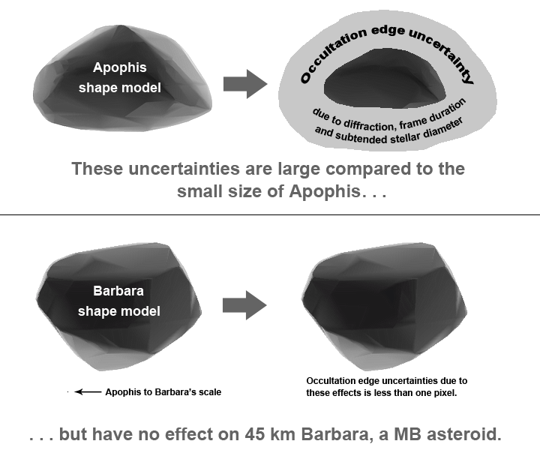
Notes:
29. The top half of this slide shows the likely timing uncertainties an observer might experience due to the combined effects of diffraction, frame duration, and stellar size. For Apophis, they may add together to make up a significant fraction of a path width.
The bottom half of this slide shows the same effects as they relate to an ordinary main belt asteroid, Barbara, which is of about 45 kilometers in diameter. Notice a tiny dot in the lower left, showing Apophis at the same scale.
The effect of star diameter that I have been describing is of the same magnitude for all occultation observations. That is, star diameter effects are not related to asteroid size. The effects of frame duration are also unrelated to asteroid size except insofar as they affect the recording of diffraction features. Diffraction effects actually decrease with large asteroid size. So, the summed effect of all three of these phenomena is slightly less for large asteroids than it is for small ones. I don't mean proportionally less. I mean absolutely less. The uncertainty zone that they cause around a main belt asteroid like Barbara is too small to be drawn around its shape model here, as its thickness is less than one pixel in the diagram.
That is why I have been speaking about these effects in regard to near-Earth asteroids.

Slide 30
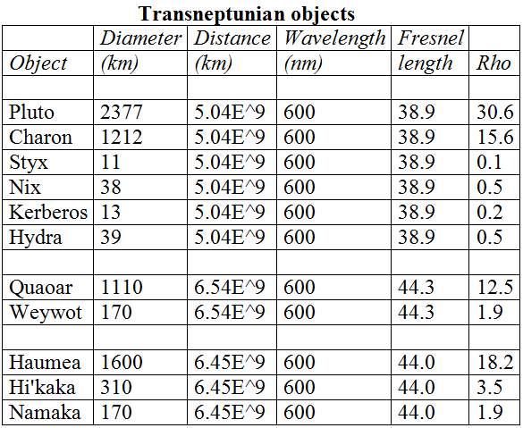
Notes:
30. The effects of diffraction, and probably the effects of star diameter and frame rate, will affect occultation light curves of some transneptunian objects in the same manner by which they affect near-Earth asteroids. This is because their distances are great and the diameters of many of them are small. This table lists three large TNO's and their respective moons, with their rho values in the last column on the right. Notice that the large TNO's Pluto, Charon, Quaoar, and Haumea all have fairly large rho values. However, their small moons have small rho values.
In 2009, a prediction was made that Pluto's moon Hydra would occult a star. I set up a 14" telescope in my backyard and had no difficulty imaging the star, which was a lot brighter than Pluto. I interpreted my observation as a "miss" observation. However, in looking at the rho value of 0.5, I now wonder whether I could have identified a positive observation even if an occultation occurred.
Notice that Weywot's rho value is 1.9. This object is a good candidate for the display of prominent diffraction effects, as well as star diameter effects and frame rate effects.

Slide 31
