Slide 1
Reflections
Five issues to think about
Dave Herald
Dave Gault

Slide 2
Event time accuracy
Should I aim for the highest time precision I can achieve?
When is sub-frame timing desirable?
Most residuals reported in our astrometry > 1 mas.
Spatial resolution – usually larger than 1km

Slide 3
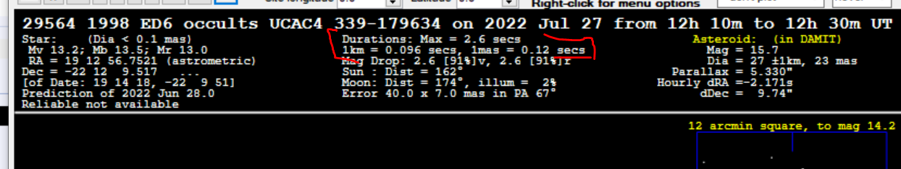
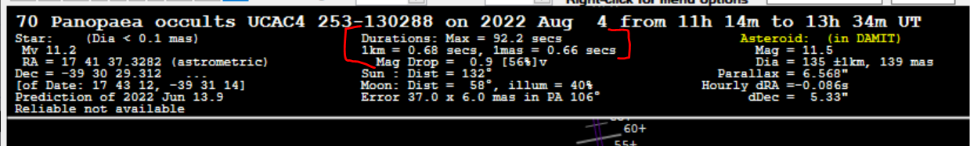
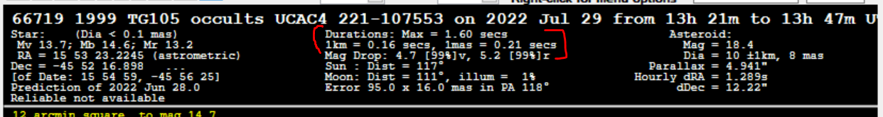
95+% occultation astrometry has uncertainty >1.0 mas. 0.1 mas unachievable
Shape resolution - depends on number of chords. Single chords – irrelevant. If many chords - 20% of separation between chords? 5% of diameter?
Examples of typical values relating to spatial and time resolution

Slide 4
Background subtraction to do, or not to do – that is the question
Purpose of background subtraction – to set the zero level of the light curve to zero light
Makes no adjustments in time direction
When you add two light curves, or subtract a light curve from another: noise of the two light curves is added (i.e. made worse).
σ _{combined} = √ (σ₁ * σ ₁ + σ ₂ * σ ₂)
Can avoid adding noise if you subtract a constant mean value of the background (σ ₂= 0)

Slide 5
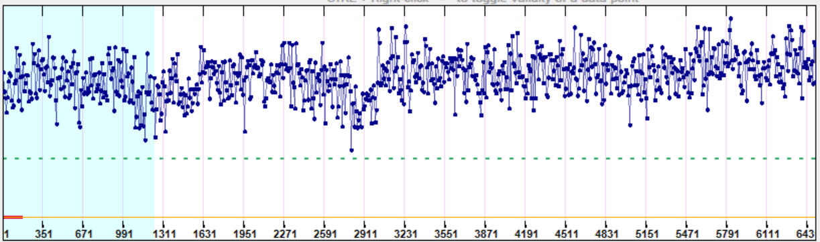
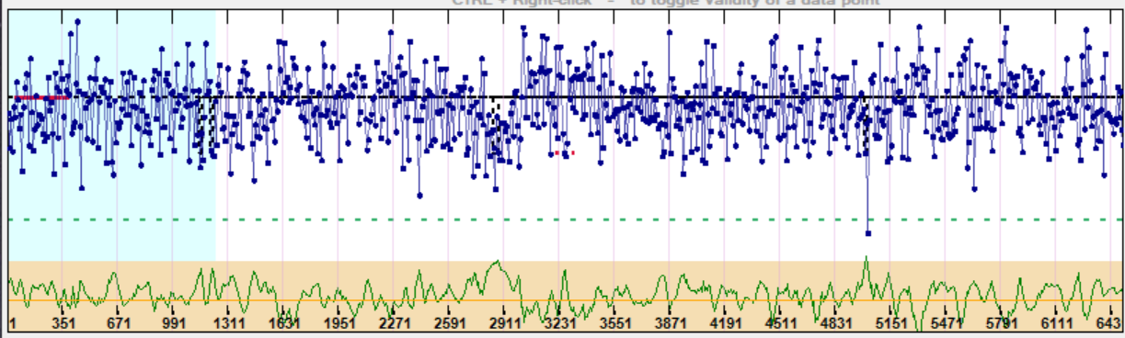
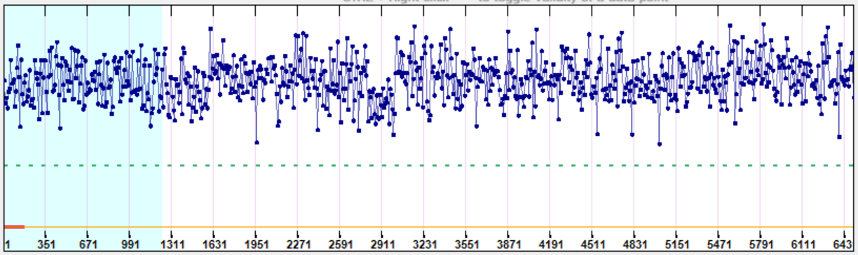
Erida (R. Nolthenius, 2022 Jun 24)
PyMovie light curve, with usual background subtraction
Tangra light curve, with usual background subtraction in AOTA
Tangra light curve, with average background subtraction in AOTA

Slide 6
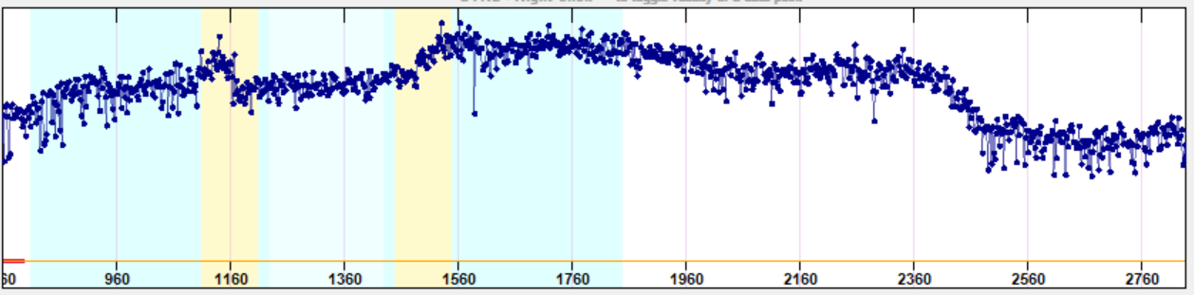
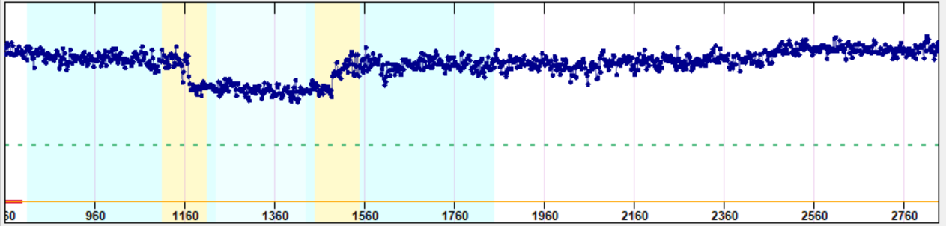
2021 Aug 18 Eleonora (Herald)
An extreme example. Very thin cirrus cloud with bright moon
Tangra light curve, with usual background subtraction in AOTA
Tangra light curve, with average background subtraction in AOTA

Slide 7
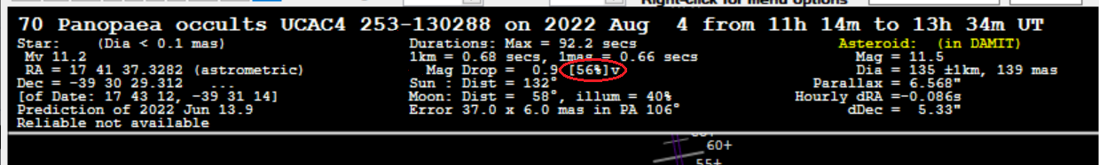
Reporting Magnitude drops
I am regularly seeing comments in reports about the mag drop, specifying mags to 0.001 (ie 1 milli-mag)
Eg. mag drop = 3.685 +/- 2.146 (0.95 ci) ( a range of 5.8 mags! or drop to 0.5%! )
mag drop = 0.997 +/- 0.256 (0.95 ci)
With a high quality cooled 16-bit CCD camera and 1-minute exposures, milli-mag precision rarely achieved.
A photometrist would be contemptuous at the suggestion this was plausible with 8-bit non-cooled camera at sub-second exposures
Realistic values. 0.1 mag precision for mag drops of up to about 2, 1 mag for drops up to about 3. If >3, the limiting magnitude is far more relevant.
If significant digits were applied, the above examples would become 4 ±2, and 1.0 ±0.3
Why are mag drops being given to 0.001 mag? = 1 part in 1000 ! Does this create a public embarrassment re our understanding of photometric accuracy? Does this lead to reduced credibility of our observations generally?
Would it better to report the occultation drop as a percentage of full light?

Slide 8
Gamma – to use, or not to use
Traditional mantra: Do not adjust gamma. ALWAYS set it to 1.
Gamma changes the vertical response in a non-linear manner.
For events that are instantaneous, non-linear vertical response is of minimal consequence to event time
Gamma less than 1 will affect magnitude changes. How much does this matter? Magnitude changes are poorly determined from our 8-bit light curves. And if really necessary, gamma can be undone with PyOTE?
If changing gamma enables you to record an event, or record an event with higher time resolution – why not forget the mantra, and adjust gamma?

Slide 9
Computer time stamping delays within the computer
VTI time stamp – applied as signal leaves the camera.
QHY174GPS – built in GPS receiver.
ADVS – Numbered frames time tagged.
Flash-Tagging – reference frames tagged in video stream.
  All, subsequent PC processing time irrelevant.
Computer processing time stamping is significant.
  And is in addition to camera delays

Slide 10
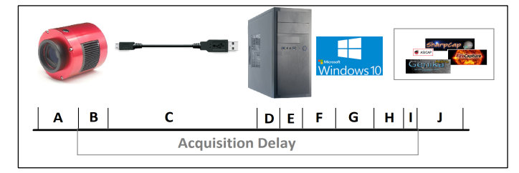
Acquisition Delay
Chip readout
Camera processing
  (A+B is Instrument Delay of Integrating CBVS cameras)
Cable
Port Hardware Type - USB2, USB3, FireWire…
Port Driver
Camera Driver
Windows Interrupts
Recording Software
Associate time with image frame
Images saved.

Slide 11
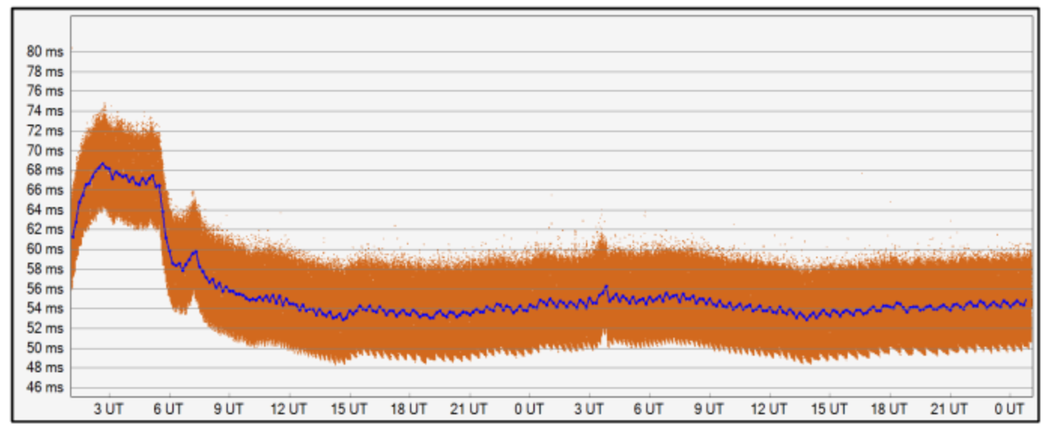
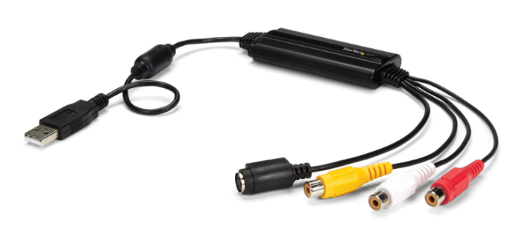
Practical illustration
Startech SVIDUSB Frame Grabber
Acquisition delay over a 24hr period from start-up
Minimum delay – 53 msec. But more than 68 msec 2hrs after start-up
Pavlov and Gault, JOA 2020-2
WAT-902+Startech SVID2USB23
Does anyone test their system for this delay?
Does anyone correct their times for this delay?
Is the answer No to both these questions?

