Slide 1
An introduction to Shape models In Occult
Dave Herald

Slide 2
Value of shape models
Shape models provide the shape, but not the size, of an asteroid
Fitting a shape model to occultation chords provides a scale for the shape model. This allows the Volume-equivalent diameter to be measured
For a well-observed event with a good shape model, the fit to the chords can identify the location of the center of mass – rather than center-of-figure
IAU standards for astrometric reports updated to accommodate center-of-mass astrometry

Slide 3
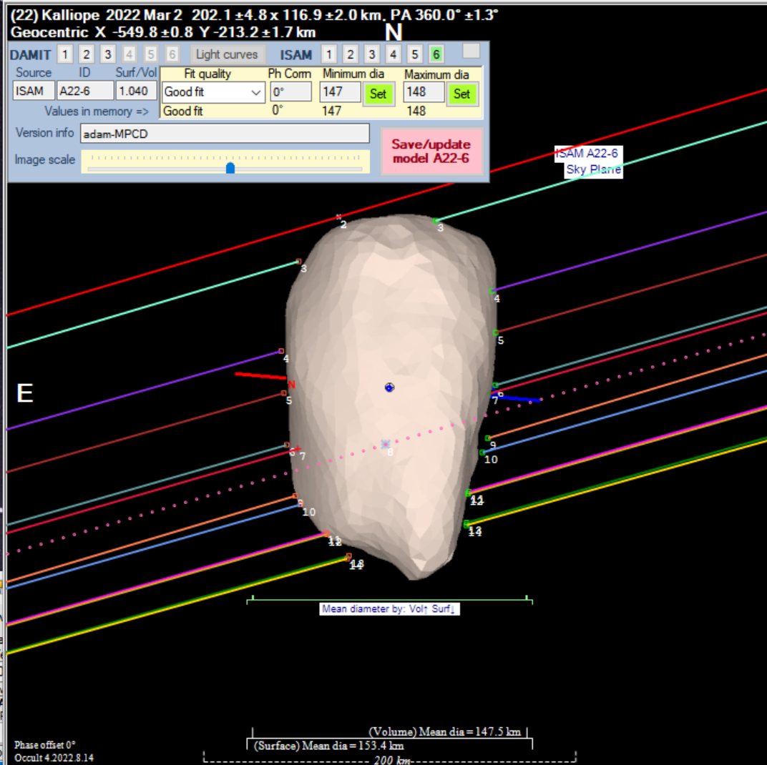

Slide 4
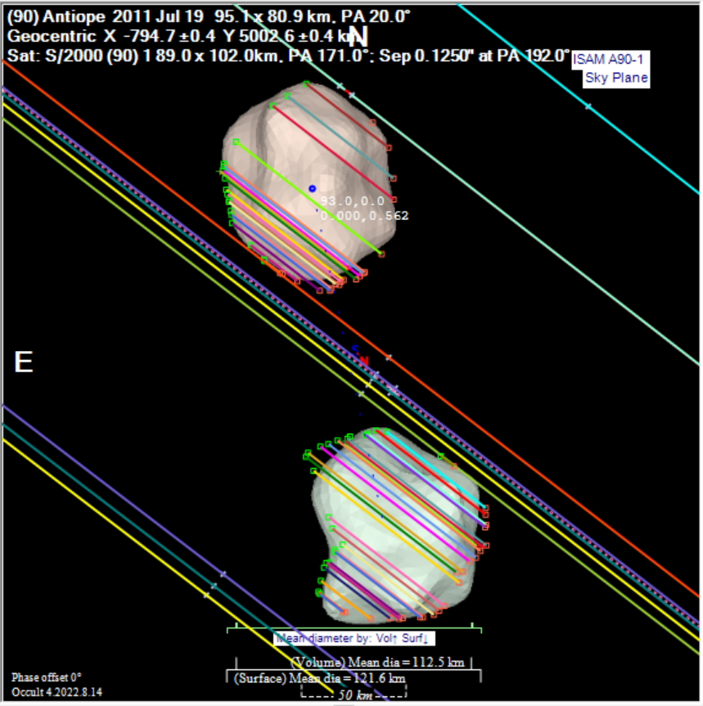
High resolution, good fit with differences in detail

Slide 5
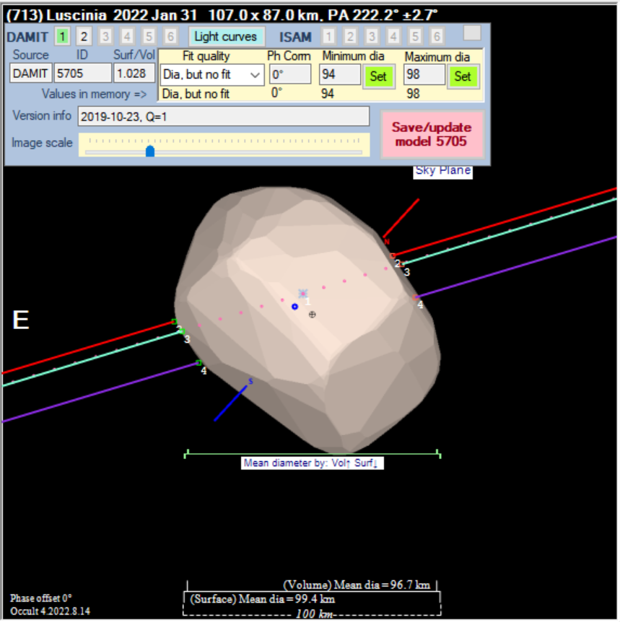
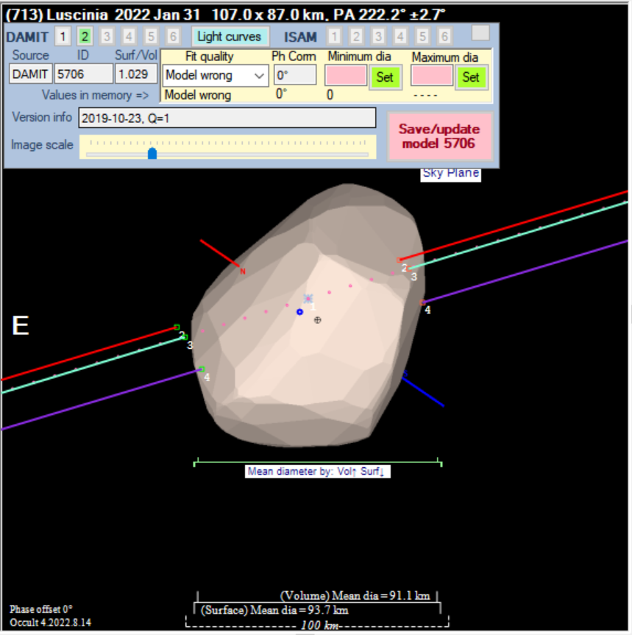
Two shape models, one right

Slide 6
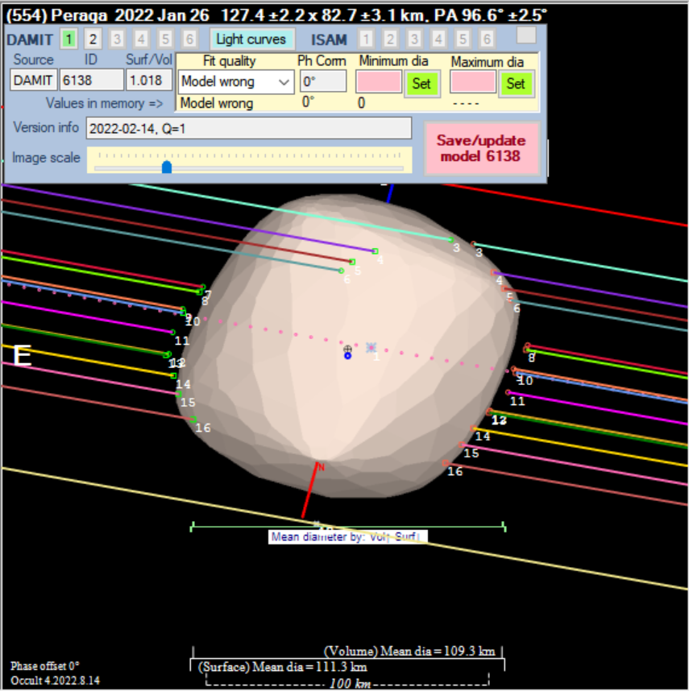
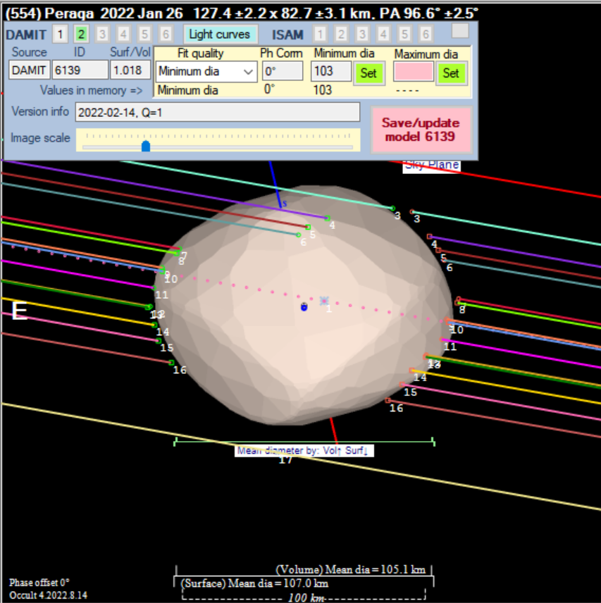
Two shape models – both wrong

Slide 7
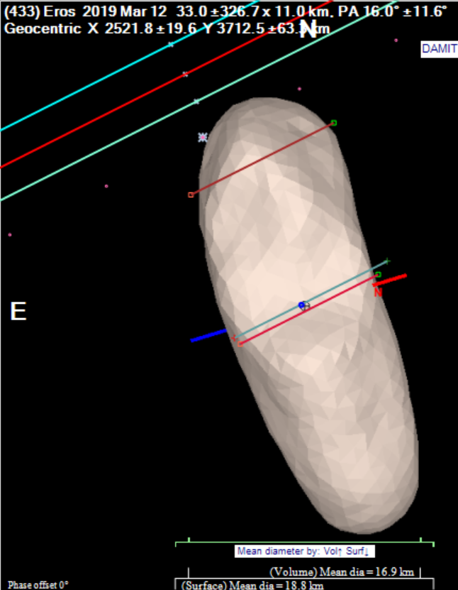
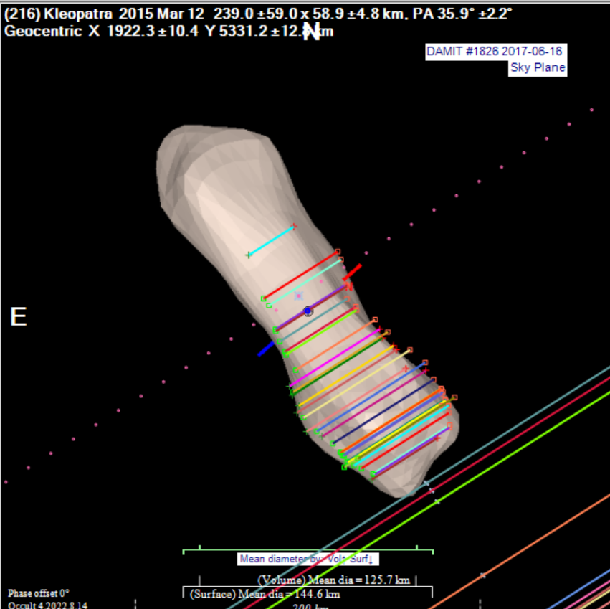
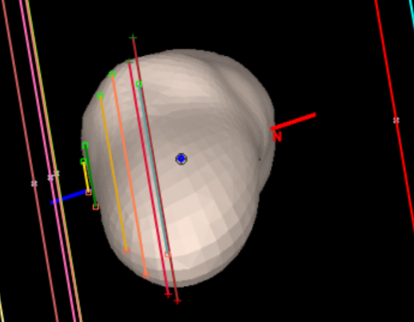
Irregular asteroids

Slide 8
Issues
Usually an ambiguity in orientation of axis
=> typically two shape models, one right, the other wrong
Axes shown on plot. Red = north pole
Some details of shape model given at:

Slide 9
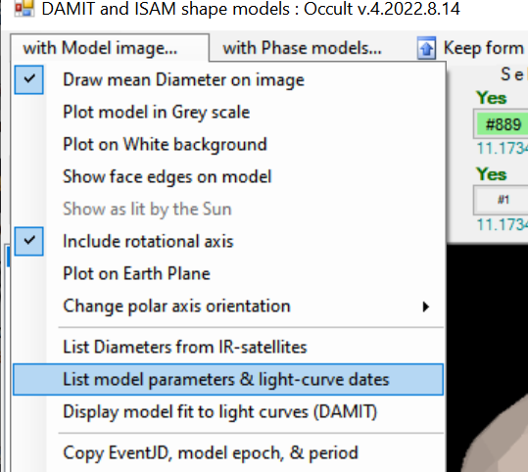
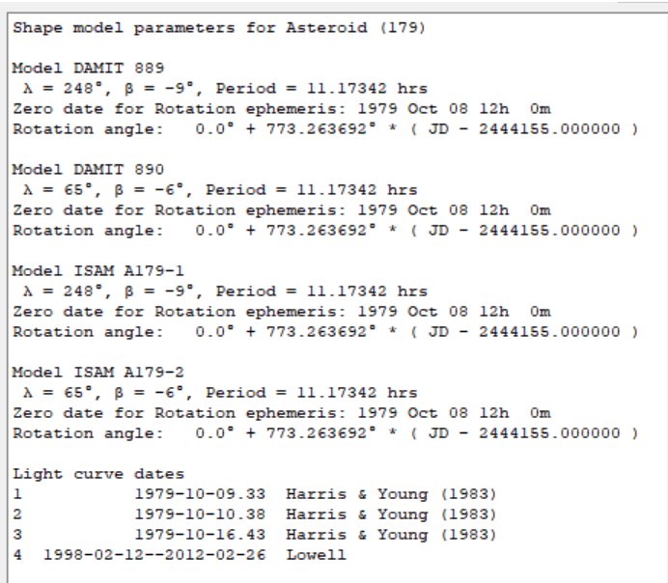
View Basic details of shape model

Slide 10
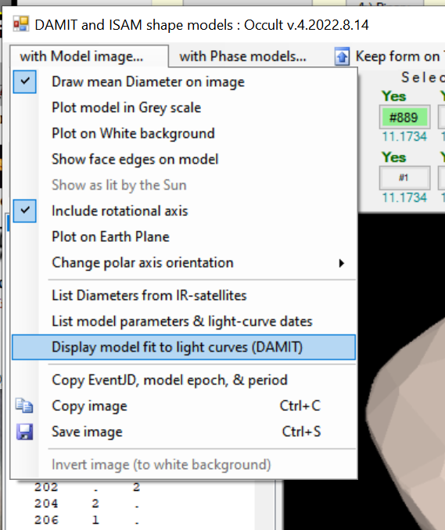
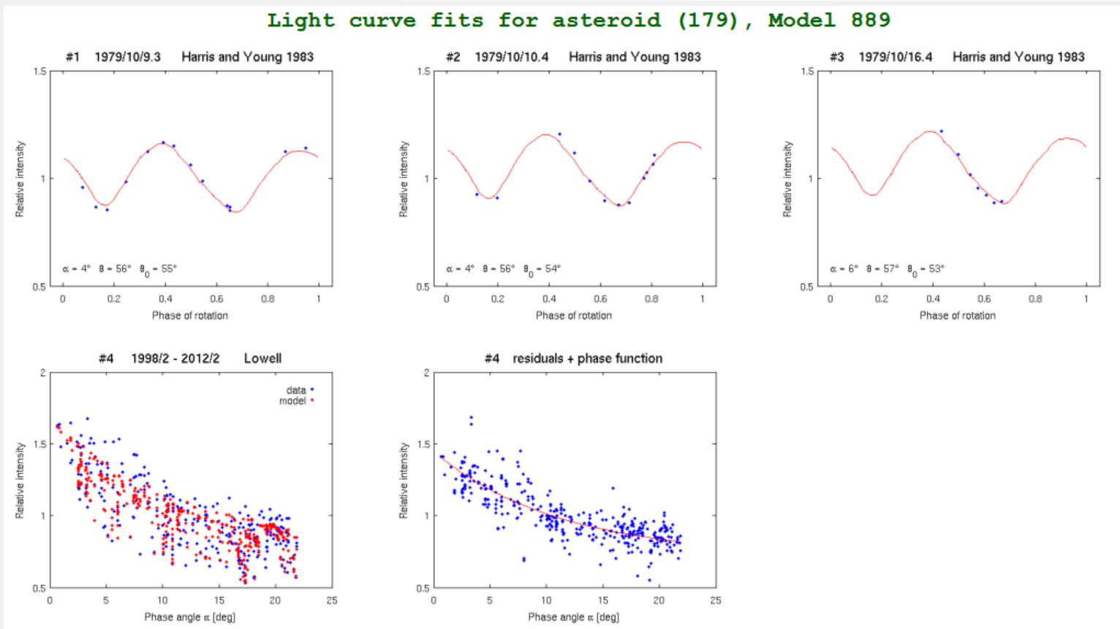
For DAMIT, view fit to light curves
Assess reliability of shape models from
the number of dedicated light curves,
the time span covered by the light curves,
the number of different shaped light curves (the more the better),
the quality of the fit

Slide 11
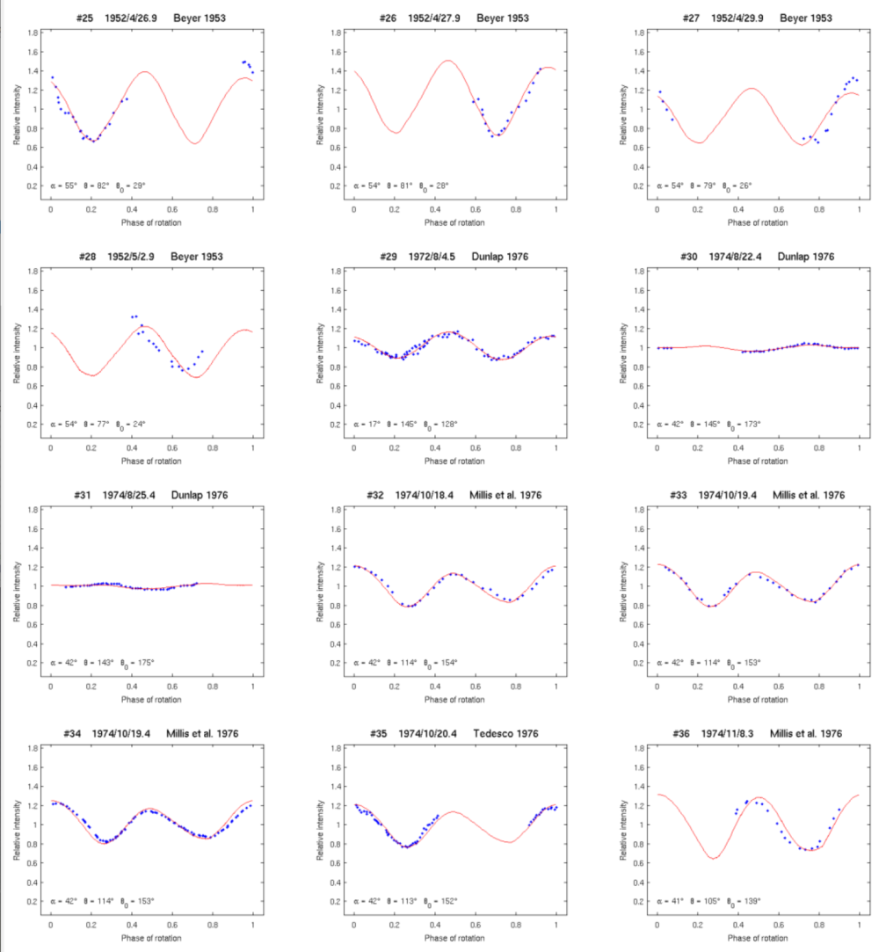
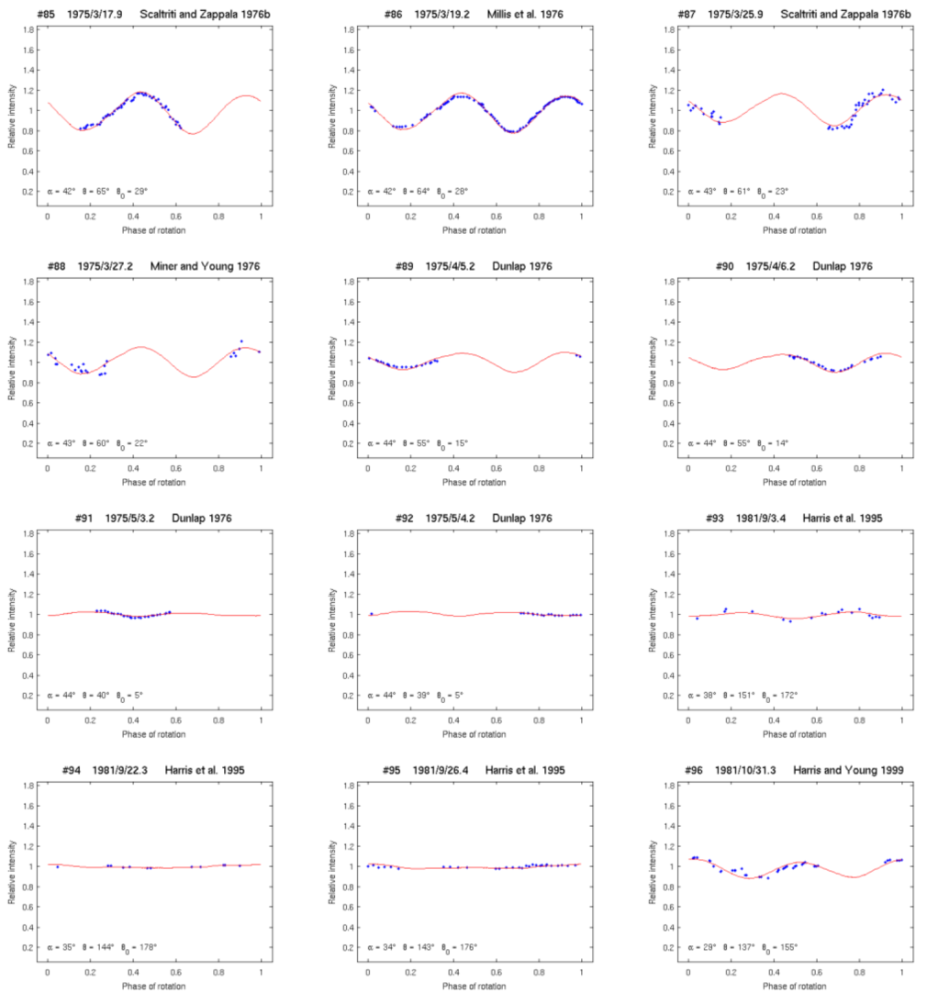
Light curve fits for Eros

Slide 12
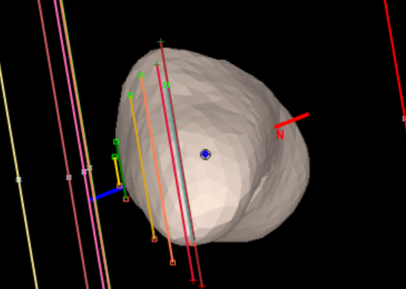
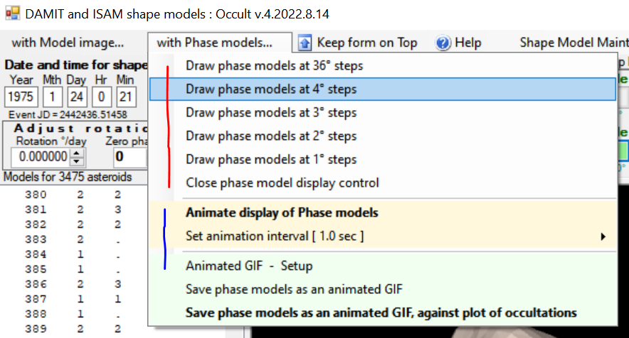
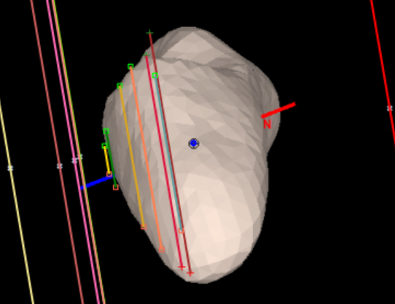
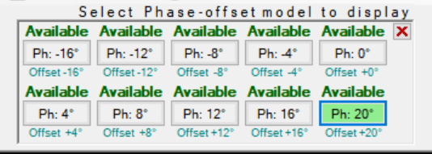
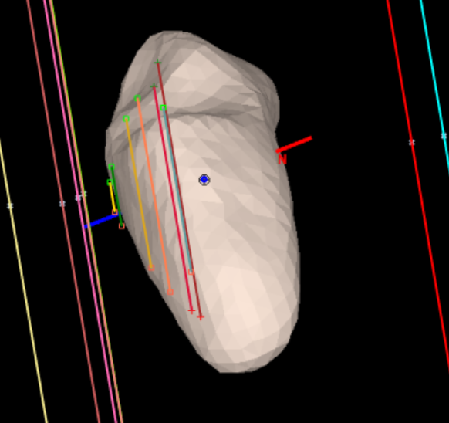
Can rotate and animate

Slide 13
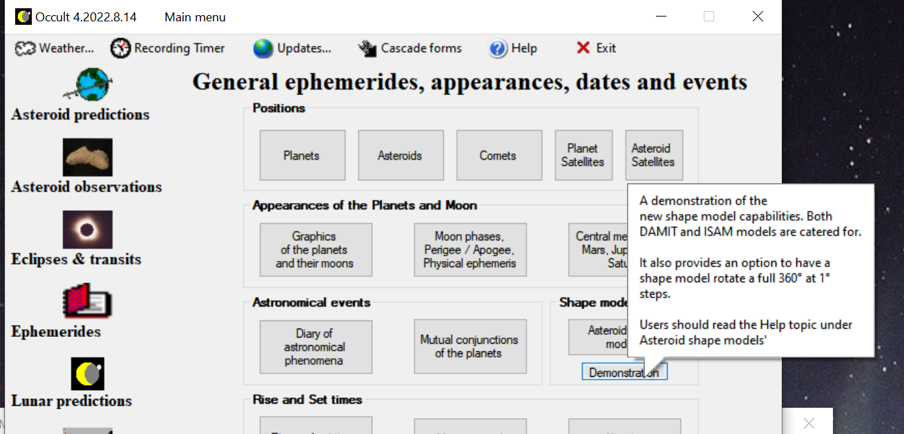
Can ‘play around with’ models

Slide 14
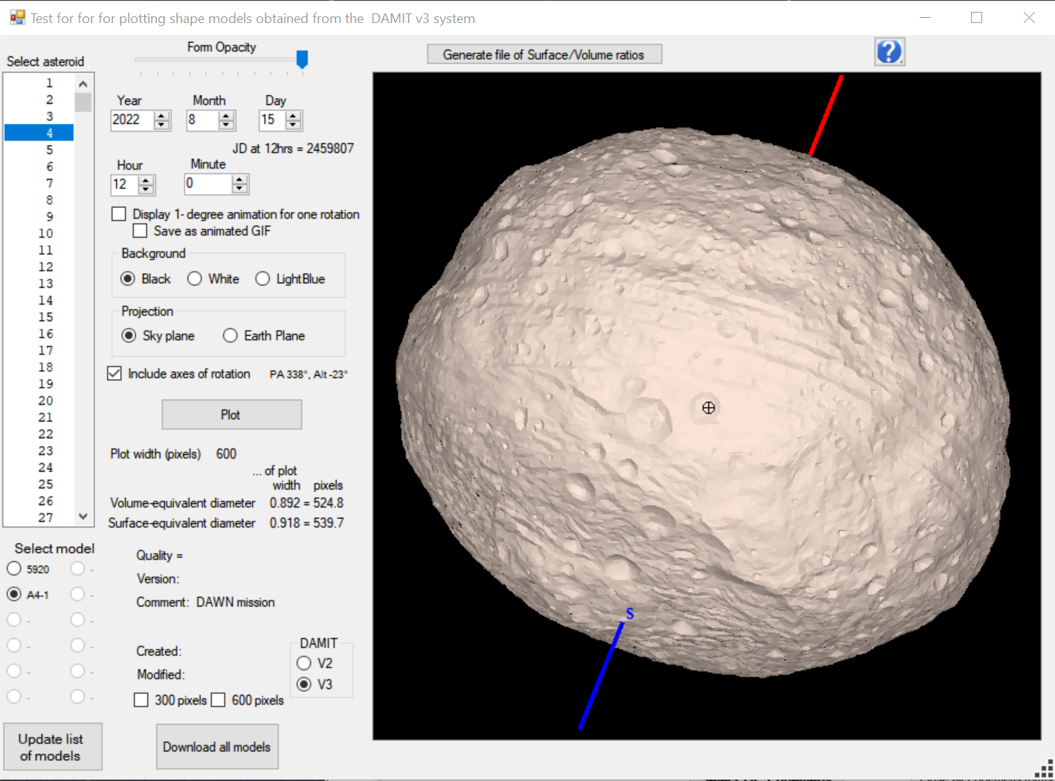

Slide 15
Demo - Eros

Slide 16
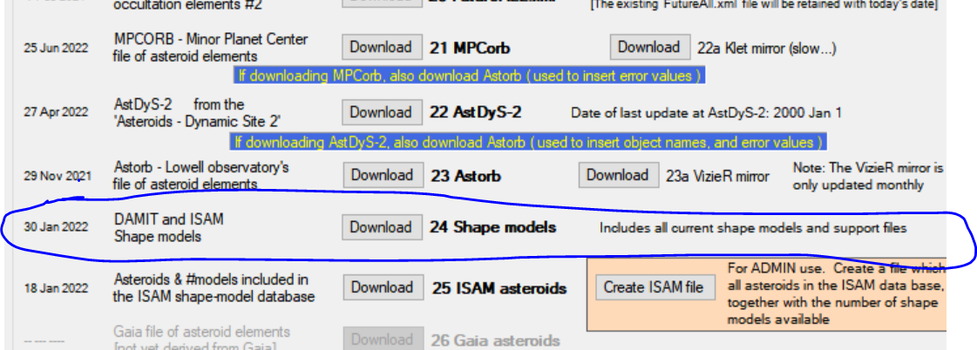
Maintenance
Download #24

