Slide 1
Preparing a Windows Computer for Occultation Recording
Notes:
Show the short video of the computer

Slide 2
Accompanying Document
This is extracted from “Preparing a Windows 10/11 Computer for Occultation Recording”
Available on occultations.org at
https://occultations.org/documents/Preparing a Win10 computer for occultation recording-Win 11 updates.pdf

Slide 3
Video
Prior to turning on the computer the VTI was turned on and its output video connected via a SidVid avi digitizer
The computer logs on and starts IOTA Video Capture automatically
Computer displayed is a Windows 11 Lenovo
With one important flaw: it turns on when the lid is lifted even the slightest
The user has no control of the on button

Slide 4
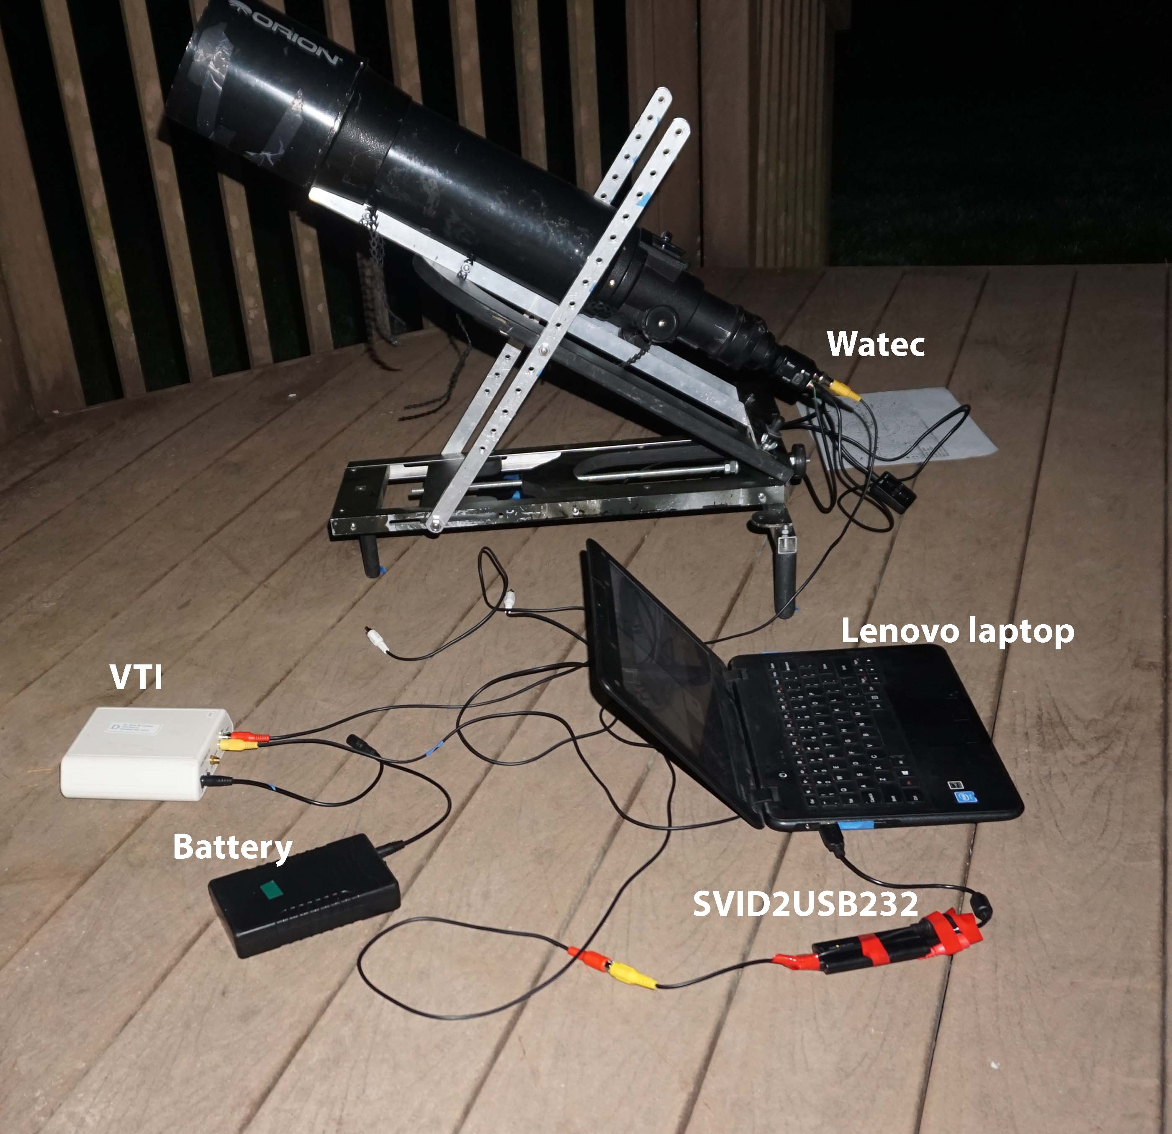
Notes:
Describe the components of this standard recording setup for a pre-pointed manual alt-az scope. Mount built by John Broughton

Slide 5
Setup Basics
Computer is only for occultation recording, has minimal other software and, once prepared, is disconnected from the Internet forever
You need Administrator status
First steps
Perform all the waiting updates
Download the software needed for recording: IOTA Video Capture, SVID2USB driver, lagarith
Ascertain that all of the updates have been completed, which can take a long time
Disconnect the computer from the internet

Slide 6
Remove Distracting Software and Services
All software that does not support occultation recording: games, communications, mail and phone support, stubs for Microsoft Office
All software and services that use the internet. This can be a very long list of things
Disable sharing and notifications
Manufacturers updating and monitoring services
Windows 11 – remove OneDrive, widgets, chat (not on all Win 11’s)
This can be a very long list and it is different for every provider and every model of computer.

Slide 7
Services Requiring External Connections
Turn then all off. The list of possibilities is endless and varies with every computer
Notifications, sharing, syncing
Set time to UTC and manual updates

Slide 8
Time
Change these settings to manual time and date setting, do not synchronize the clock.
Set the time zone to UTC

Slide 9
Power Settings
Desirable settings:
Operate forever with no user interaction
Set power options to Never or Do Nothing
Set Sleep to Never
Laptop - Continue operation with the lid closed – set to Do Nothing
Browse options the computer might offer under Advanced Options or other possible relevant options
If Remote Desktop is offered, turn that off

Slide 10
Install Software
Instructions are given with the software and on Occultations.org.

Slide 11
Run Without Requiring Log-On
A convenience, not a requirement
Run>netplwiz
or
command prompt>netplwiz
Notes:
You may need to enter your password once or twice to complete this process. It will not accept PIN codes.

Slide 12
Set IOTA Video Capture to Turn On Automatically
Not a requirement, a convenience
Need to see hidden folders, requires an additional step in some Win10 computers
Put a copy of the IOTA Video Capture shortcut in
Users\<name>\AppData\Roaming\Microsoft\Windows\Start Menu\Programs\Startup
Notes:
See the accompanying document for information on how to find the hidden folder control

Slide 13
Operation of the Recording Computer
Preparation
Bring up IOTA Video Capture and enter the event in the schedule
Manually set the computer clock to within a few seconds of GPS time
Check that there is sufficient space available for the video capture
At the observing site
Start the VTI first, give it time to lock onto the GPS signals
Plug the SVID2USB into the computer before turning on the computer
Turn on the computer
If it is working properly, the display will show the VTI time display and the time remaining until the event recording begins
If it is not working properly, check all the cable and battery connections, the Video Capture video options and properties, the computer clock time and date
Notes:
Note that the computer clock is only used to start the recording. Timing is done using the VTI GPS data encoded onto the video

