Slide 1
NEA AND OTHER OCCULTATION RESULTS FROM RECORDINGS BY IOTA OBSERVERS For IOTA meeting by zoom, July 15, 2023; adopted from a presentation given to the ChesMont Astronomical Society, July 9
David W. Dunham¹, Fumi Yoshida^{2,4}, T. Hayamizu³, T. Arai^{4,} Hiroyki Watanabe⁵, Hayato Watanabe⁵, J. Dunham¹, R. Venable⁶, S. Chesley⁷, J. Irwin⁸, D. Herald⁹, R. Nolthenius¹⁰, N. Carlson¹¹, K. Getrost¹², S. Messner¹³, R. Jones¹⁴, R. Anderson¹⁵, T. Blank¹⁶, P. Maley¹⁷, and S. Preston¹⁸
¹International Occultation Timing Assoc. (IOTA), 16348 E Glenbrook Blvd, Fountain Hills, AZ 85268, USA, dunham@starpower.net, ²S School of Medicine, Univ. of Occupational and Environmental Health, Yahata, Kitakyusyu, Japan, ³Saga Hoshizora Astronomy Center, Nishiyoka, Saga, Japan, ⁴Planetary Exploration Research Center (PERC), Chiba Inst. of Tech., Japan, ⁵Japan Occultation Information Network (JOIN), ⁶IOTA, Chester, GA, USA, ⁷Jet Propulsion Lab., Pasadena, CA, USA, ⁸IOTA, Bramley, Guilford, UK, ⁹Trans Tasman Occultation Alliance, Murrumbateman, NSW, Australia, ¹⁰Cabrillo College & IOTA, Aptos, CA, USA, ¹¹IOTA, Tucson, AZ, USA, ¹²IOTA, Cleveland, OH, USA, ¹³IOTA, Northfield, MN, USA, ¹⁴IOTA, Running Springs, CA, USA, ¹⁵IOTA, Lake Oswego, OR, USA, ¹⁶IOTA, Fountain Hills, AZ, USA, ¹⁷IOTA, Carefree, AZ, USA, and ¹⁸IOTA, Medina, WA, USA
(Japan)

Slide 2
Good Occultation Article in the September issue of Sky and Telescope
Be sure to read this good article, on pages 34-40; in it, Marc Buie describes the motivation for, and execution of, large occultation campaigns for exploring objects throughout the solar system, especially for the Trojan asteroids that are targets of NASA’s Lucy mission.
I will talk mostly about occultations by Near-Earth Asteroids (NEAs) but will also show other results, and how IOTA observers make the observations.

Slide 3
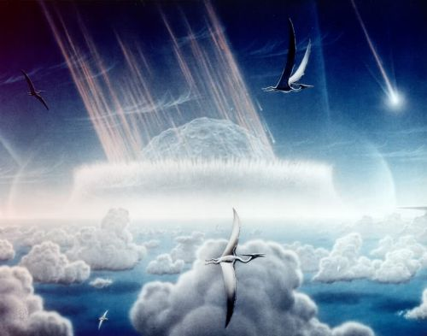
The Chicxulub Impact
10km NEA (or 6km comet) hit shore of Yucatan 65 million years ago.
Over 70% of plant and animal species perished from the blast, worldwide
wide fires (from impact debris re-entering the atmosphere), and the collapse
of photosynthesis in the cold dark years that followed. The dinosaurs died, and now humans rule, because dinosaurs didn’t have a space program and didn’t know about planetary defense.

Slide 4
IOTA and Asteroidal Occultations Introduction
The observer network that became IOTA formed in 1960’s
to visually observe lunar grazing occultations with mobile efforts
1975 January 24 occultation of κ Gem by (433) Eros, a first event
The mobile techniques to observe lunar grazes, were used effectively to observe asteroidal occultations in the late 1970’s
Starting in the 1980’s, IOTA began recording occultations with video equipment, improving the observations
Using stars and the Earth’s rotation to pre-point stationary telescopes at multiple unattended locations with timed recording became possible
Working with the NASA PDS Small Bodies Node and the Minor Planet Center, IOTA archives all asteroidal occultation observations
ESA’s Hipparcos and Gaia missions have greatly improved prediction accuracy, resulting in a large increase in observed occultations
The sizes, shapes, and accurate positions of several hundred asteroids have been determined
Dozens of close double stars have been discovered, the diameters of several stars have been measured, and some asteroidal satellites have been discovered, and several characterized.

Slide 5
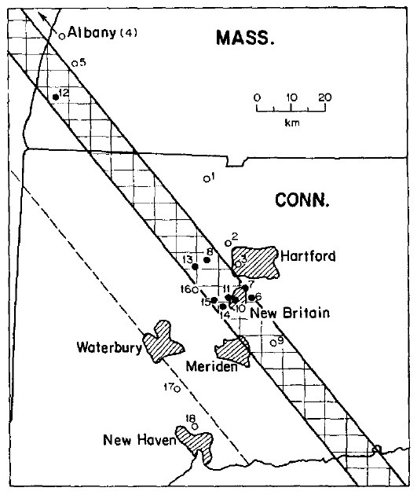
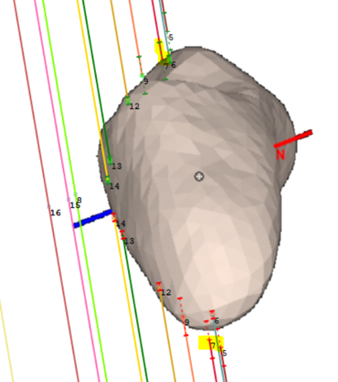
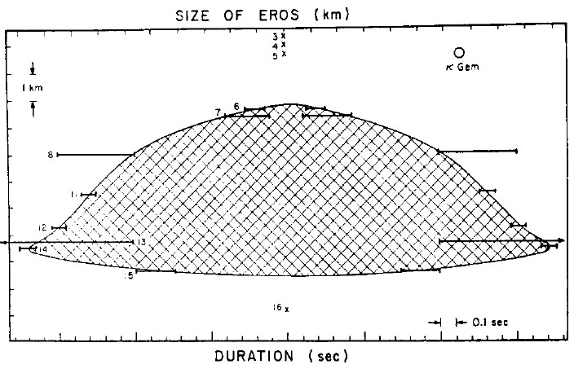
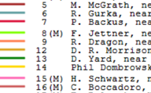
First observed occultation by a NEA, 1975 Jan. 24, κ Gem occulted by Eros
from O’Leary et al.,
Icarus, Vol. 28, pp.
133-146 (1976)
Left, map of observers & sky plane plot from the 1976 Icarus paper. Right, modern sky plane plot of the chords fitted to Eros’ shape model derived from NEAR-Shoemaker data. This was the first occultation by ANY asteroid that was observed from multiple stations. Especially, the stations deployed by the Pioneer Valley Colleges led by Brian O’Leary was the first successful coordinated effort to observe such an event by mobile observers. A crucial observation, now known to be a false negative, resulted in the wrong squashed shape shown by O’Leary et al. It would be 44 years before an occultation by another NEO would be observed.

Slide 6
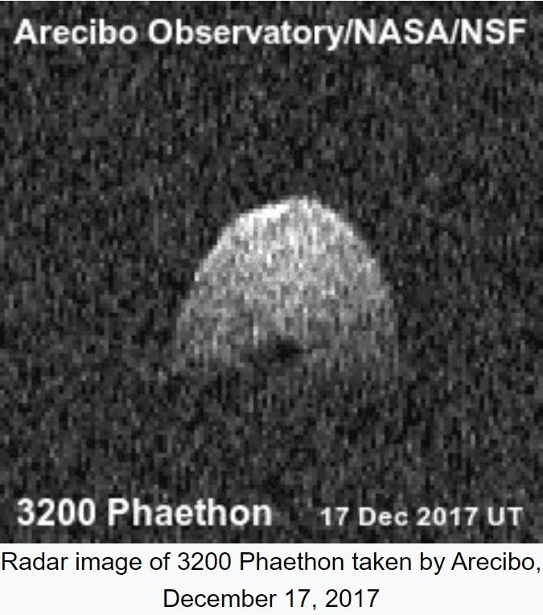
(3200) Phaethon
(3200) Phaethon was the first asteroid to be discovered by a spacecraft (IRAS).
Phaethon is the parent body of the Geminids meteor stream that puts on one of the largest annual meteor displays
This mysterious object may be a (nearly) dead comet nucleus, or a very active asteroid, throwing off boulders like has been observed on Bennu by OSIRIS-REx
Phaethon is an Apollo asteroid with a perihelion of only 0.14 AU, <half Mercury’s, with aphelion 2.4 AU in the Main Belt. The extreme thermal changes near perihelion likely drive its shedding of pebbles and dust, creating the trail imaged by the Parker Solar Probe. Small non-gravitational forces on its orbit have been detected.
● JAXA’s DESTINY+ spacecraft plans to launch in 2024 and fly by Phaethon in 2025 -see https://en.wikipedia.org/wiki/DESTINY+
● Radar observations show Phaethon to be nearly spherical with a diameter of nearly 6 km
● Thermal IR data give a diameter of ~4.5km

Slide 7
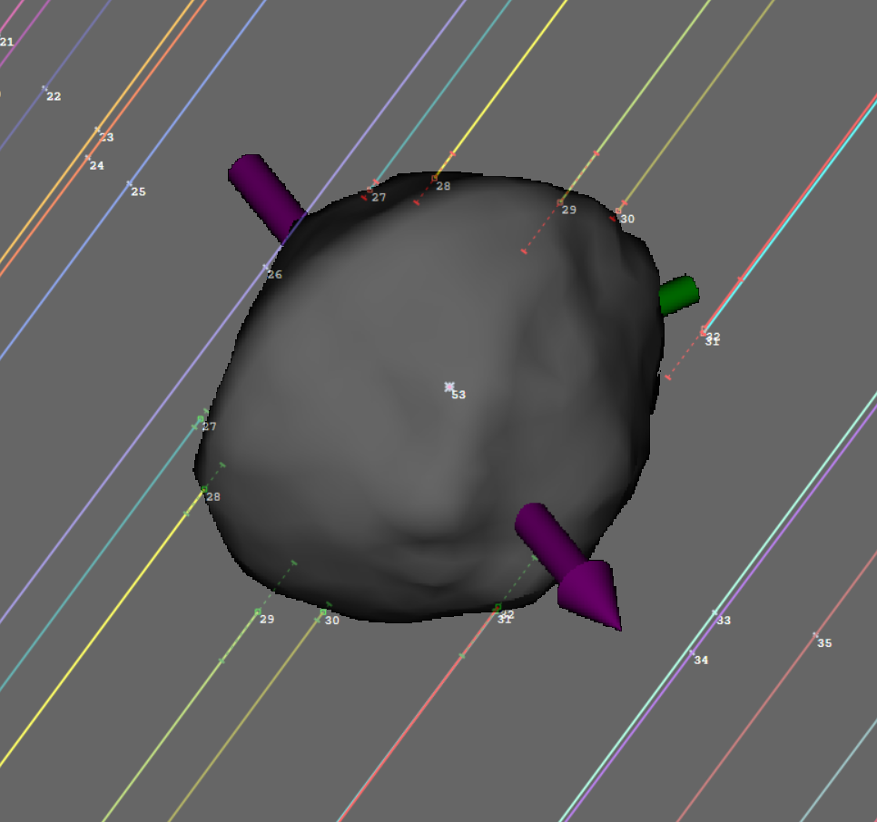
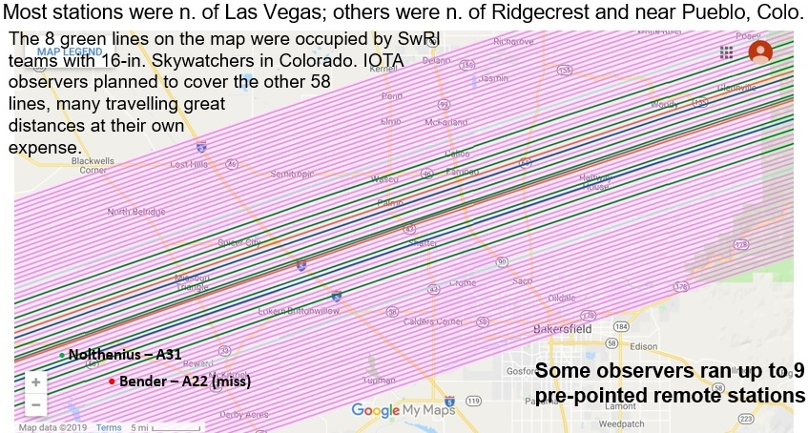
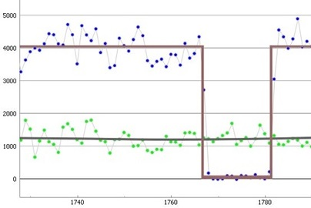
First Occultations by (3200) Phaethon described at PDC 2021
2019 July 29
Left: Sky-Plane plot of
central timings fitted to Sean Marshall’s Phaethon shape model.
Right: Map showing planned observer lines,
central California.
2019 July 29
The 1st occultation, of 7.3-mag. SAO 40261 whose path crossed the southwestern USA on 2019 July 29, was found by Isao Sato in Japan. The orbit was refined by the planetary ephemeris team at JPL that provided a prediction that was much more accurate than expected. Almost 70 telescopes were set up, 8 by SwRI and the rest by IOTA, to record the event from a span of 45 km, with the 6 central stations recording the event. The scopes at ∼20 unattended stations were pre-pointed to the alt/az of the occultation using Guide star charts with the “pre-point line of declination” plotted. We hope that new plate-solving techniques will enable more to make these multi-station deployments; we seek help in finding solutions that work with simple video systems in the field. Five more Phaethon occultations were observed in late 2019 and one in 2020 that resulted in a 3-times reduction of the error of the determination of the A2 non-gravitational parameter of Phaethon’s orbit, with a table of the observed events on the lower left.
R. Nolthenius
Light-curve
Of the 2019 July 29 occ’n

Slide 8
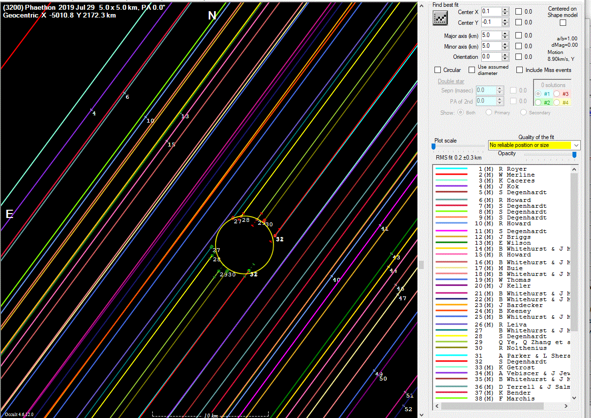
2019 July 29 Phaethon occ’n, all successful chords

Slide 9
Phaethon Orbit A2 Determinations (units au/d^2 x10⁻¹⁵)
The A2 term for most NEO’s is caused by the Yarkovsky effect,
but for Phaethon, mass loss due to strong thermal heating near
perihelion is likely the main driver, as evidenced by the Geminids
& the Phaethon dust trail imaged by the Parker Solar Probe.

Slide 10
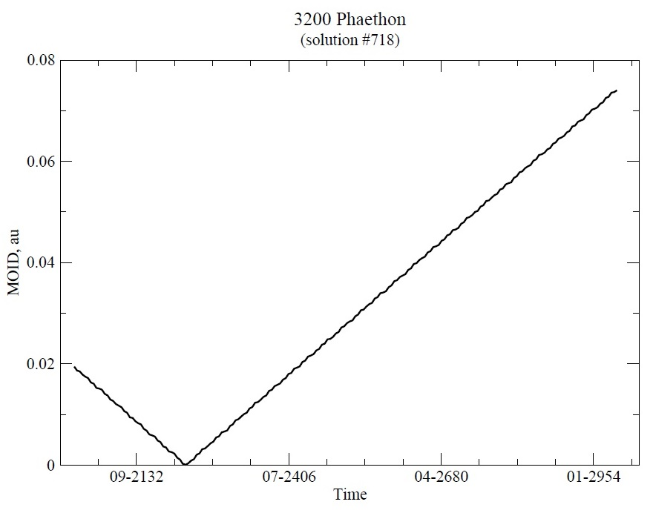
MOID = Mean Orbit Intersection Distance
Although Phaethon’s MOID with Earth
goes to zero ∼2217, there is no risk
of impact then since the period in
the orbit is known well enough
that the Earth and Phaethon
will not arrive at the MOID
point at the same time.
In any case, there
should be some great
Geminid showers in the
early 23rd century. At ∼6km across, Phaethon is almost as large as the object that wiped out the dinosaurs.
We should keep close tabs on Phaethon since its A2 term could change; its rubble pile structure could change with the severe thermal shocks it suffers, so such a change might alter the orbit period enough to be a concern in 200 years.

Slide 12
Best-observed
Phaethon occultation

Slide 13
This well-observed occultation
had an unexpected large path shift

Slide 15
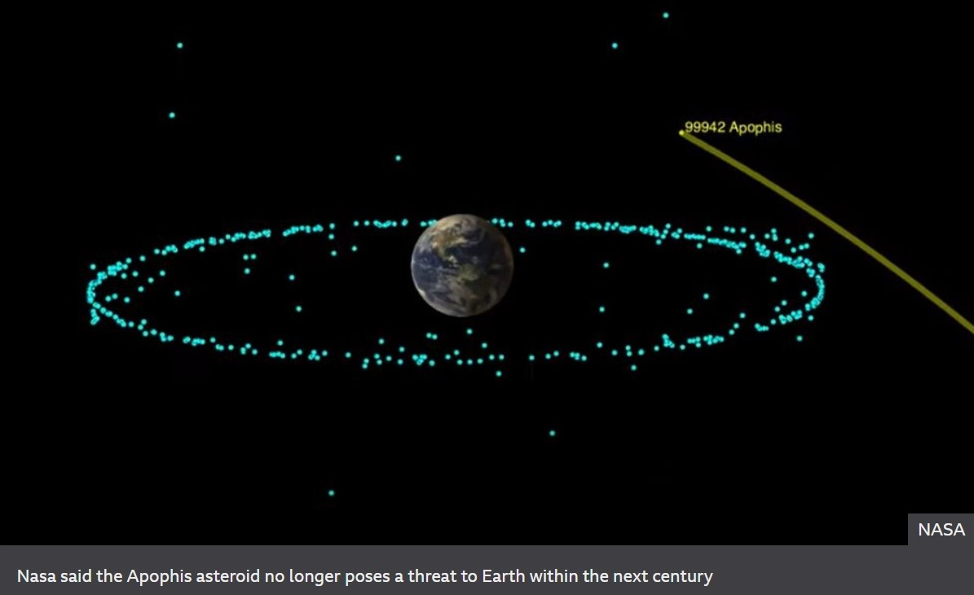
Apophis will pass near the geosat ring on 2029 April 13
It will be about 3rd mag. as seen from Europe and Africa
The approach will be about 0.1 lunar distance,
It’s the closest approach by an asteroid this large in 1000 years
2013 radar observations showed Apophis to be ∼340m across
An impact would destroy everything within 25 km, and produce severe damage out to 300 km from the impact point

Slide 17
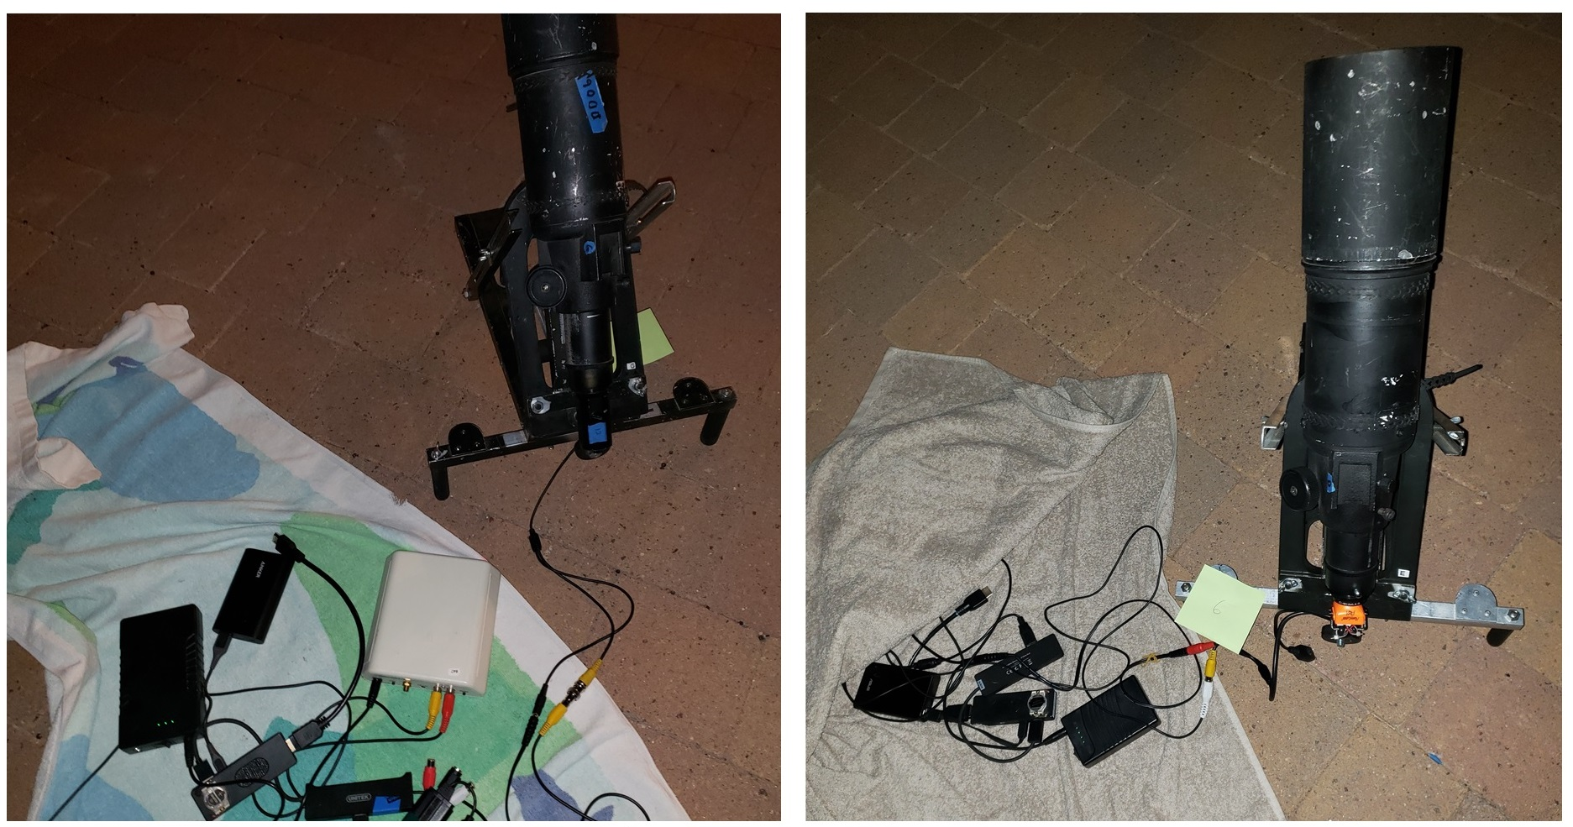
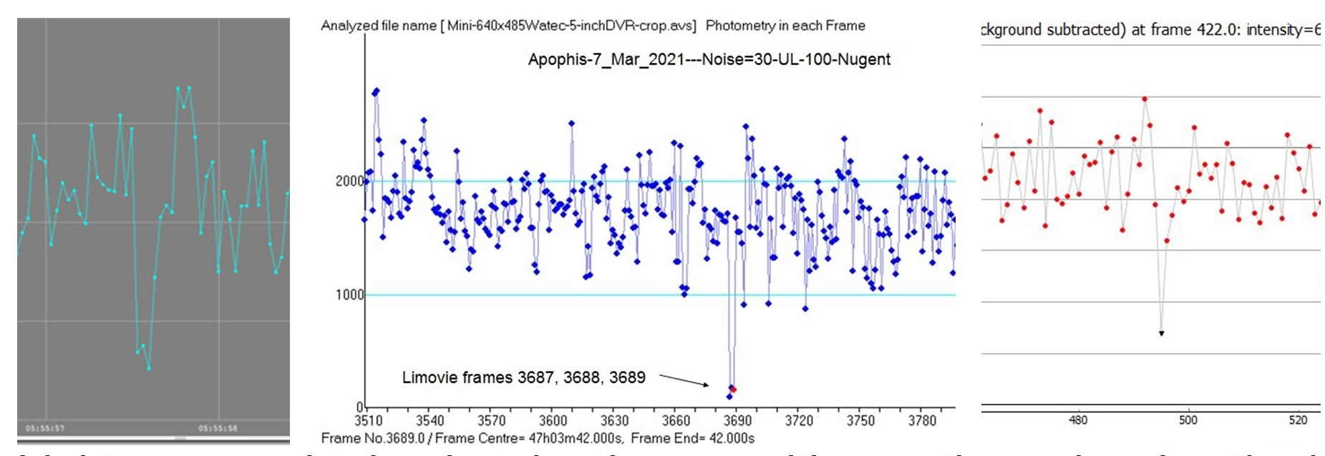
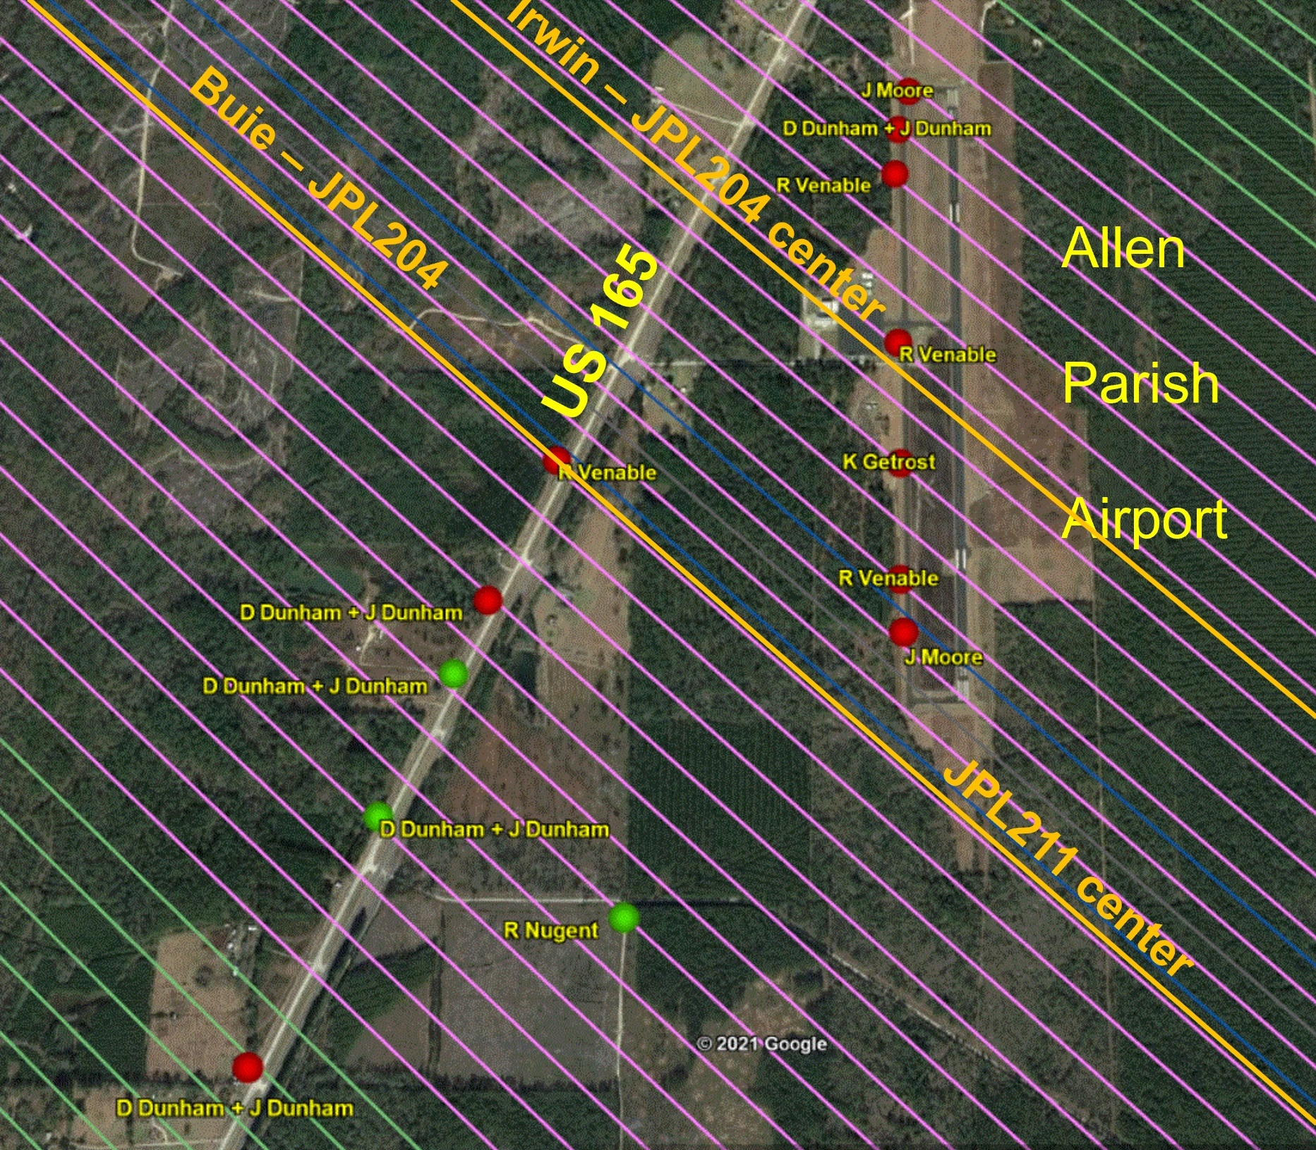
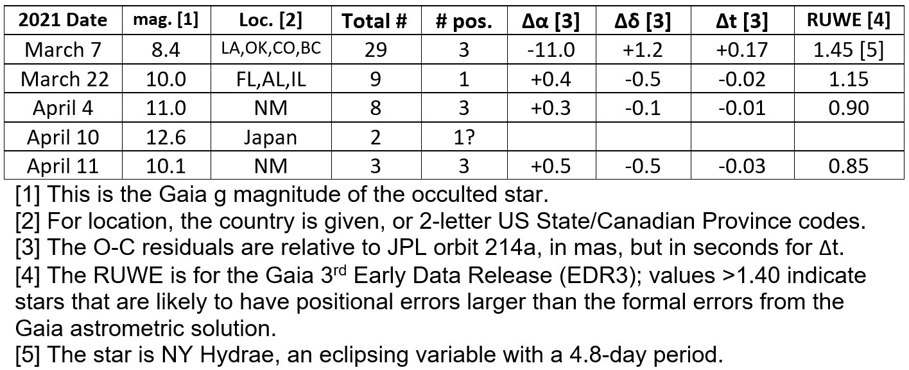
2021 Occultations by (99942) Apophis from PDC 2021-1
The 1st observed event on March 7th benefitted from a JPL prediction based on radar data from Mar. 4-6; the star was 8.4-mag. NY Hydrae, an
eclipsing binary with high Gaia RUWE.
Above, the 2 pre-pointed 8cm Dunham Above, the 3 positive light curves for the March 7th .
unattended systems that recorded occultation.
positives; 3 others they deployed had misses.
Left: Stations near Oakdale, Louisiana with the planned lines; Green dots mark positive sites, red dots mark sites that had no occultation (negatives).
Right: Residuals from the
first 5 Apophis occultations
from the JPL 214a orbit that
gave 0 weight to Mar. 7 since
the star’s Gaia RUWE was
high. The high-precision orbit,
with radar & occultations,
retired the risk of impact with
Earth for at least a century.
marginal detection, not used
Much information about past observed Apophis occultations ia at http://iota.jhuapl.edu/Apophis2021.htm.

Slide 18
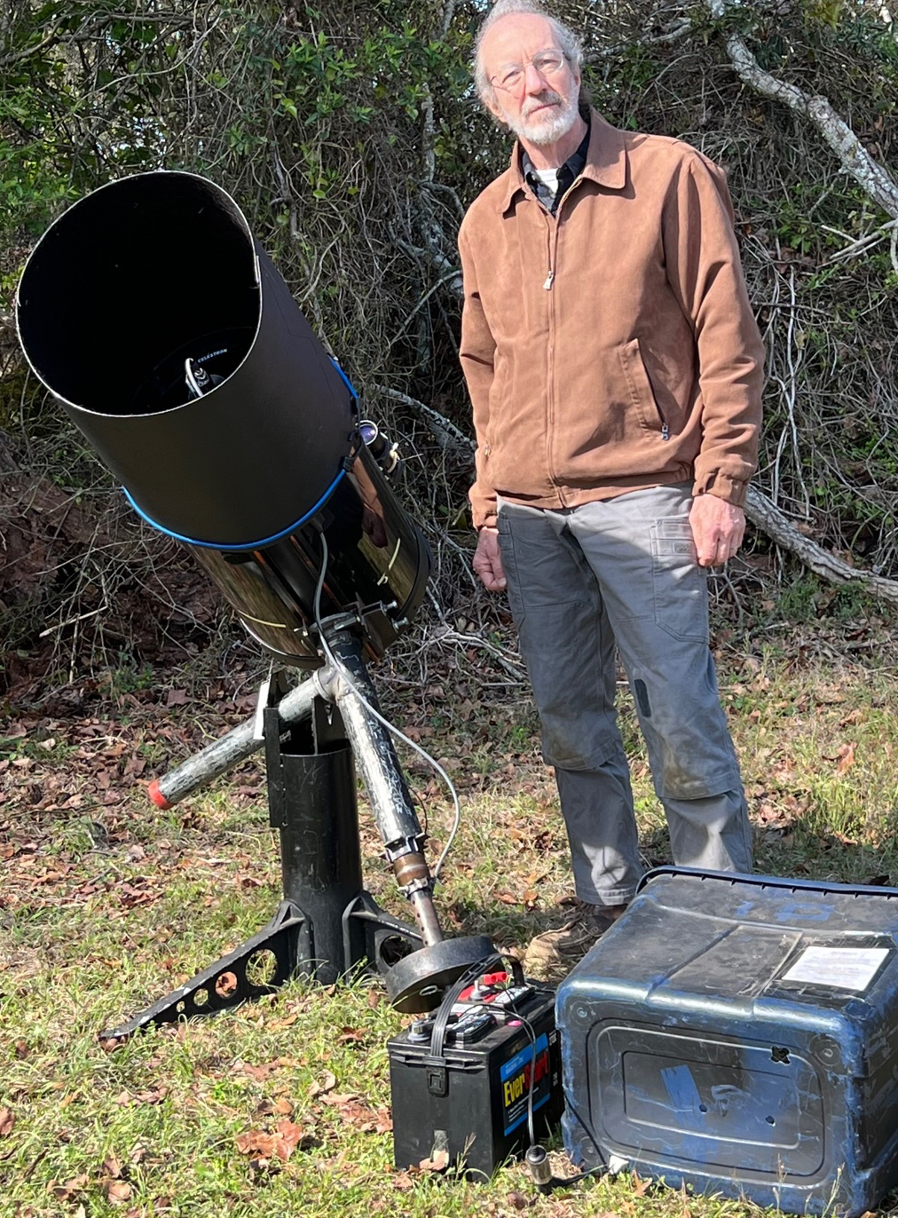
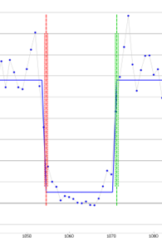
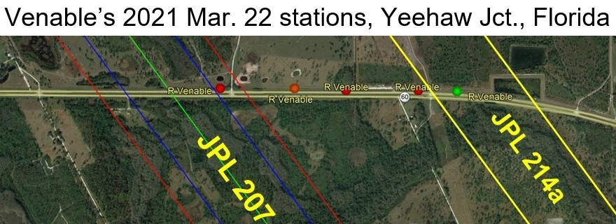
2021 Occultations by (99942) Apophis from PDC 2021-2
The 1st observed event on March 7th benefitted from a JPL prediction based on radar data from Mar. 4-6; the star was NY Hydrae, Hydrae, an eclipsing binary with high Gaia RUWE. On 2021 Mar. 22,
R. Venable recorded the occultation of a 10.0-mag. star from 5 loca-
tions with large pre-pointed telescopes in Florida (below); he covered
the east side of the predicted (JPL207) path while others covered the
west side. To the right is Venable with one of his 14-in. Fastar (f/2.1)
SCT’s with specially-built low mount that adds stability and facilitates
quick set-up. His fence of telescopes extended just far enough east to
catch the critical occultation observation (green dot, positive) while the
others were negative (red dots). With this effort, Venable saved
Apophis’ accurate orbit that helped retire its risk of impact; the subse-
quent events listed on the previous slide secured the orbit. Venable’s
subsequent deployments of his systems have led to other NEA occul-
tation successes, especially for Didymos and Dimorphos, see later
Slides.
Above right, April 11 near Farmington, NM, light curve of the
the occultation of a 10.1-mag. star by Apophis, by
Kai Getrost, recorded with 100 frames per second with a
QHY 174M GPS camera attached to a 20-inch Dobsonian
telescope. Effects of Fresnel diffraction are evident.
See the next talk by Damya Souami for the remarkable
Reduction of Apophis’ orbital errors from the addition of
IOTA’s asteroidal occultation observations.
Path after moree
Observed events
were added
Predicted path, before
the occultation

Slide 19
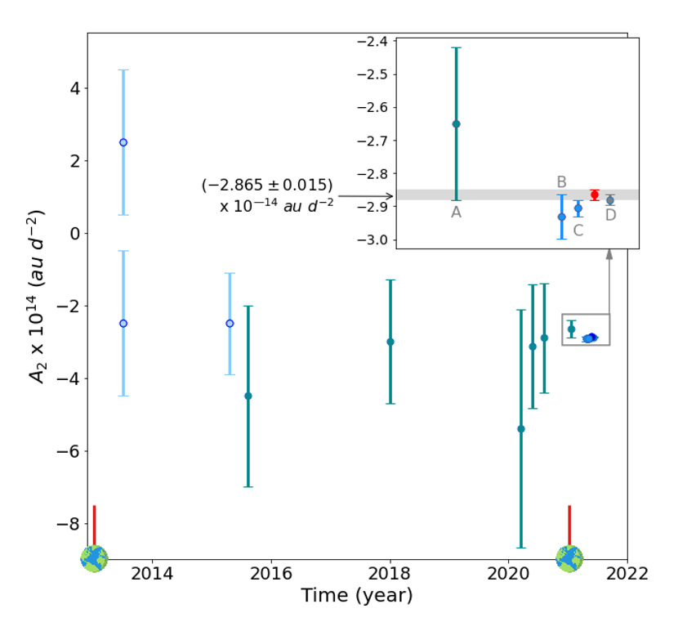
Occultations helped retire the risk of Apophis
Gaia Image of the week,
2021 Mar. 29. “Apophis’
Yarkovsky acceleration
improved through stellar
occultation” – D is the solution that adds the occultation results.
Evolution in time of our knowledge of the average Yarkovsky acceleration for 99942
Apophis. The light blue data represent the early theoretical estimates from approximate
models of the physical properties of Apophis1. The other data are measurements
enabled by the collection of more optical and radar astrometry. On the horizontal axis,
close encounters with the Earth (enabling collection of accurate astrometry) are marked.
The inset shows the last estimates compared to our value, in red, obtained from all the
observations available on March 15, including the occultation observed on March 7, 2021.
For more, see https://www.cosmos.esa.int/web/gaia/iow_20210329.

Slide 20
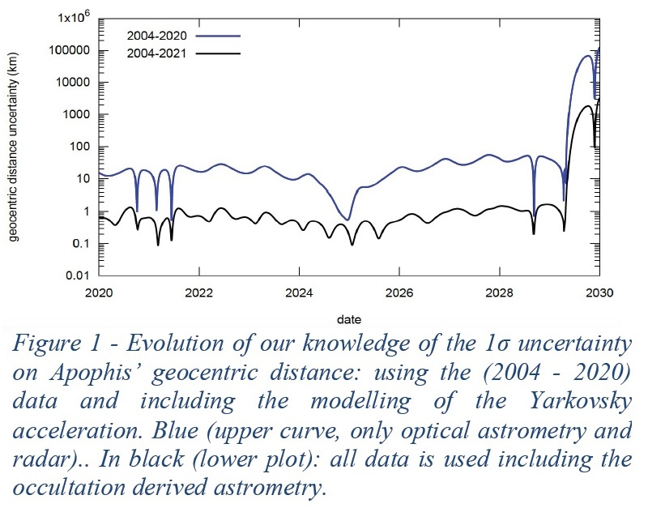
Improvement of Apophis Ephemeris from Occultations
Unpublished; don’t distribute
(D. Souami, ACM2023)

Slide 21
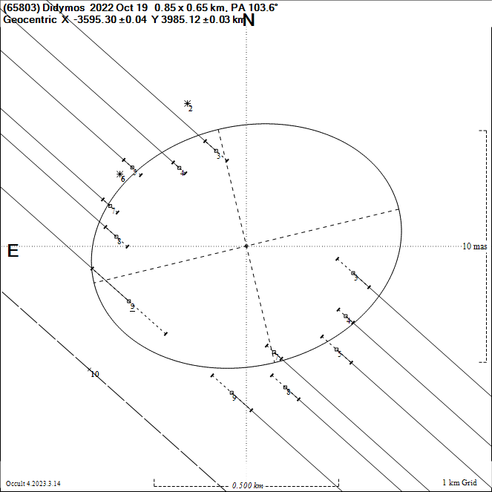
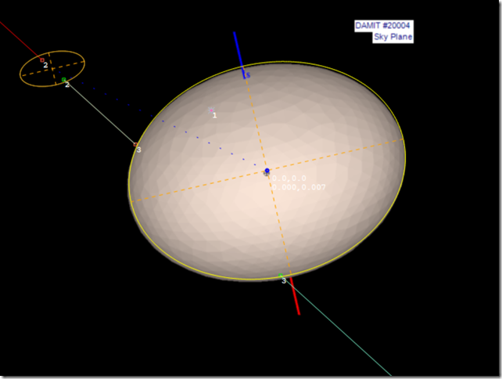
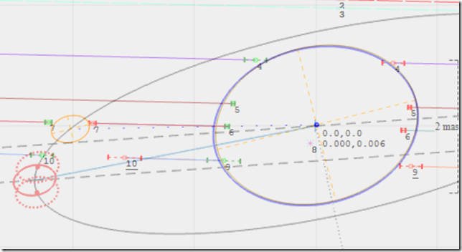
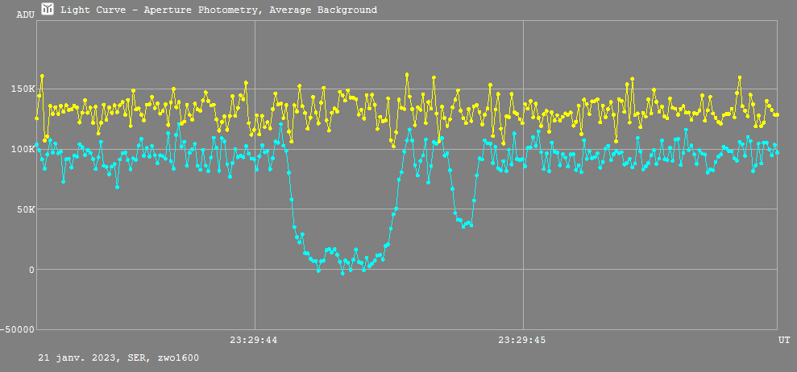
Occultations by the Didymos/Dimorphos System, 2022-2023
Sky plane plot of the Didymos occultation of an 11.2-mag. star in Japan, 2022 Oct. 18, one of the better-
observed Didymos occultations.
Sky-plane plot of the first observed occultation by
Dimorphos, upper left, shortly before the occultation by Didymos, R. Venable, Crawford, FL, 2022 Oct. 19.
Far right: Lionel Rousselot’s
light curve of the 2023 Jan 21
Occ’n by Didymos and Dimor-
phos near Perigueux, France
Sky plane plot of the occultation of a 9th-mag. star by Dimorphos and Didymos, observations organized by ACROSS in France by P. Tanga et al., 2023 Jan. 21.
Several other Didymos occ’ns have been observed around the world;
for more about results from them, especially on the orbits, see papers by Chesley (PDC 2023; ACM 2023); and about ACROSS by Souami et al. (ACM 2023).
More Didymos/Dimorphos occultations can be observed in 2024.

Slide 22
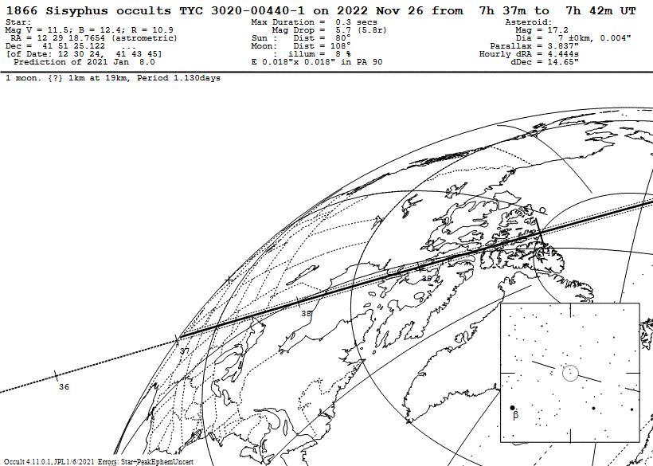
This NEA occultation late last year was
successfully recorded by Steve Messner
from a site on the predicted
central line in Minnesota.
Fortunately, the actual
path error was much
smaller than expected,
allowing this
single-station
success.

Slide 23
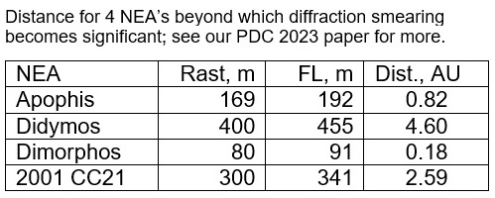
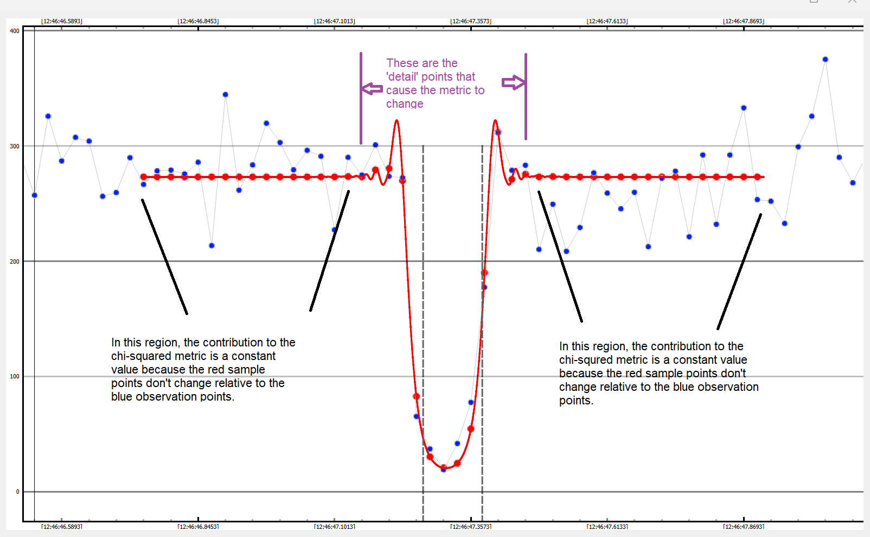
1st Observed Occultation by 2001 CC21, NEA flyby target of Hayabusa2
Below: Fresnel
Diffraction
Model fitted
To Ida’s Light
Curve with PyOTE

Slide 24
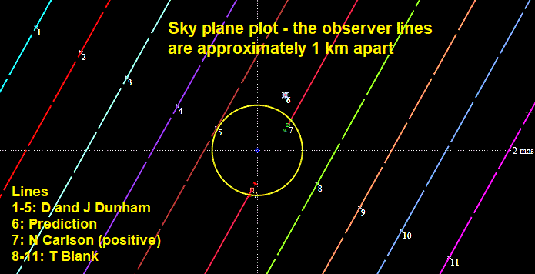
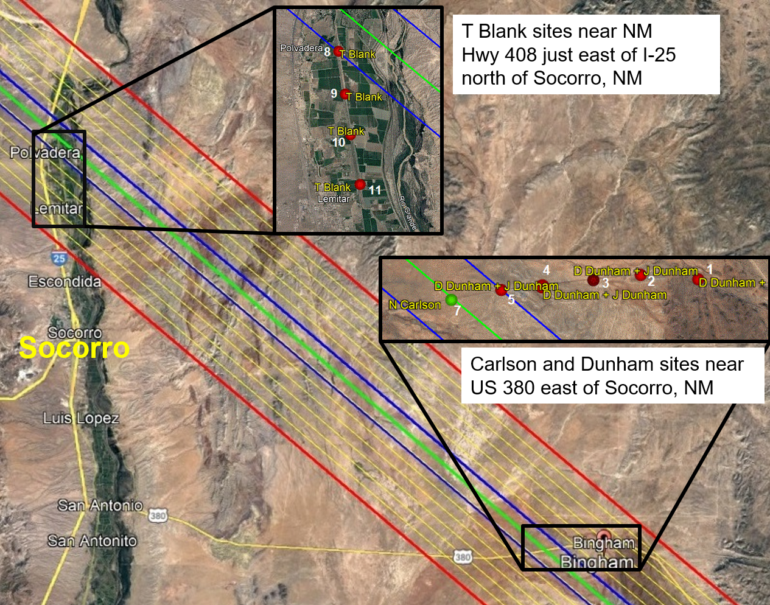
Occultation of 8.4-mag. SAO 164452 (= HIP 106281) by (2102) Tantalus, 2023 May 7
(2102) Tantalus is a 1.4-km PHA in a highly
inclined (64° to the ecliptic) orbit that won’t be
in radar range again until 2038. This bright event
provided a chance to record an occultation with
easily-transported 8cm systems, like those we used
for Apophis in 2021 March. IOTA members Ted Blank,
and David and Joan Dunham, deployed and pre-
pointed 10 of these systems near Socorro, N. Mex.,
to cover most of the 1-σ path error zone while Norm Carlson set up his larger (20cm) scope on the predicted center.
We used a predicted 2-km diameter for our planning but later we found a better recently-published radar diameter of
1.4 km; also, the real error was much less than 1-σ. Next time, we’ll have more concentration near the center.
On 2022 Nov. 26, IOTA member Steve Messner recorded the 1st occultation by 7-km NEA (1866) Sisyphus in Minn.

Slide 25
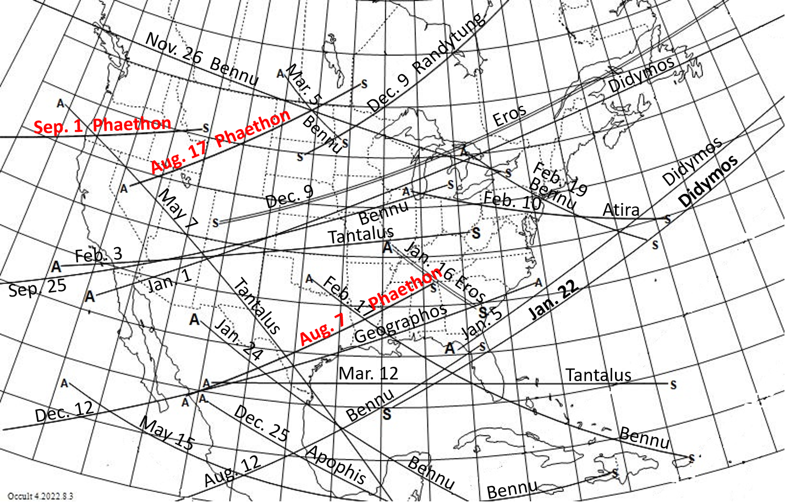
Occultations by NEAs in North America during 2023 to mag. 12.0 (to mag. 13.0 for Phaethon; 3 chances for it highlighted)
This map is adopted from one that we published in the Royal Astronomical Society of Canada’s Ob-server’s Handbook for 2023. It is also available on IOTA’s NEA occultations page at https://occultations.org/publications/rasc/2023/nam23NEAoccs.htm along with much more about NEA events worldwide. For more predictions, see
https://occultations.org/publications/rasc/2023/ACM2023.htm . IOTA will prioritize the NEAs with uncertain futures given in ACM2023 #2312 presen-ted on Monday in the NEO I session, & mission targets

Slide 26
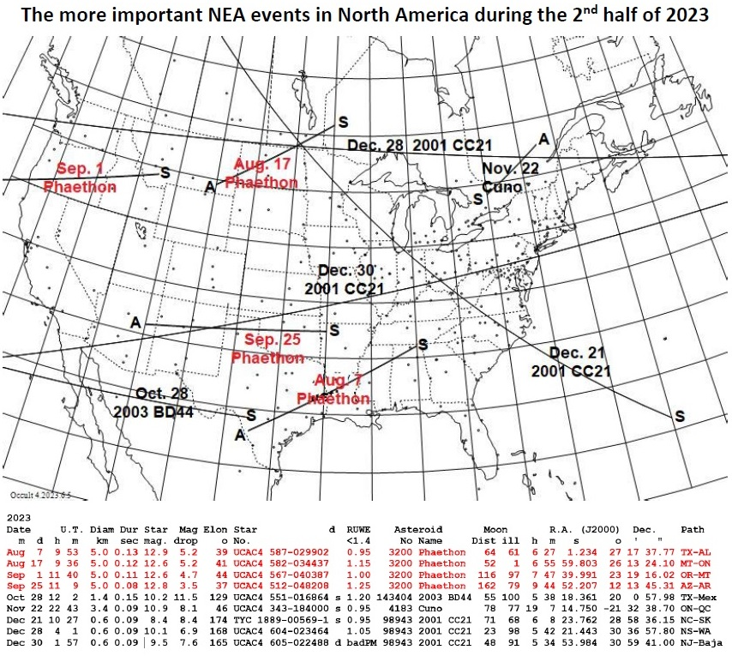

Slide 27
Occultations by NEAs in North America during 2023 to mag. 12.0 (to mag. 13.0 for Phaethon; 3 chances for it highlighted)
This map is adopted from one that we published in the Royal Astronomical Society of Canada’s Ob-server’s Handbook for 2023. It is also available on IOTA’s NEA occultations page at https://occultations.org/publications/rasc/2023/nam23NEAoccs.htm along with much more about NEA events worldwide. For more predictions, see
https://occultations.org/publications/rasc/2023/ACM2023.htm . IOTA will prioritize the NEAs with uncertain futures given in ACM2023 #2312 presen-ted on Monday in the NEO I session, & mission targets

Slide 29
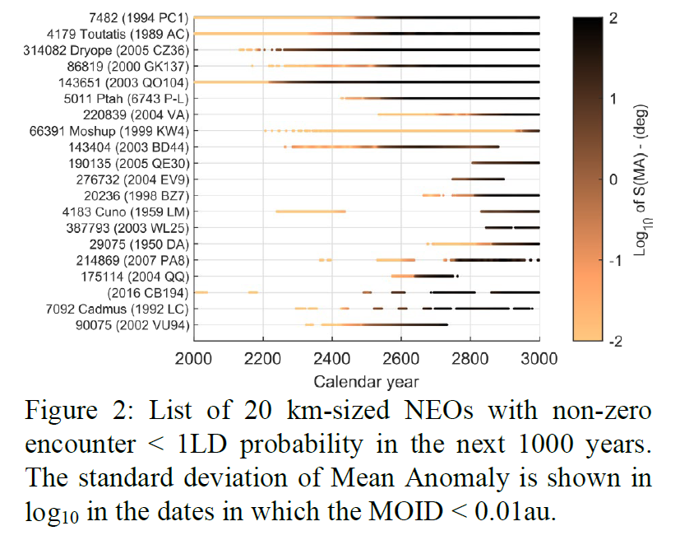
THE HAZARDOUS KM-SIZED NEOs OF THE NEXT THOUSANDS OF YEARS by O. Fuentes-Muñoz, D. J. Scheeres, D. Farnocchia, and R.S. Park at ACM 2023 in Flagstaff

Slide 30
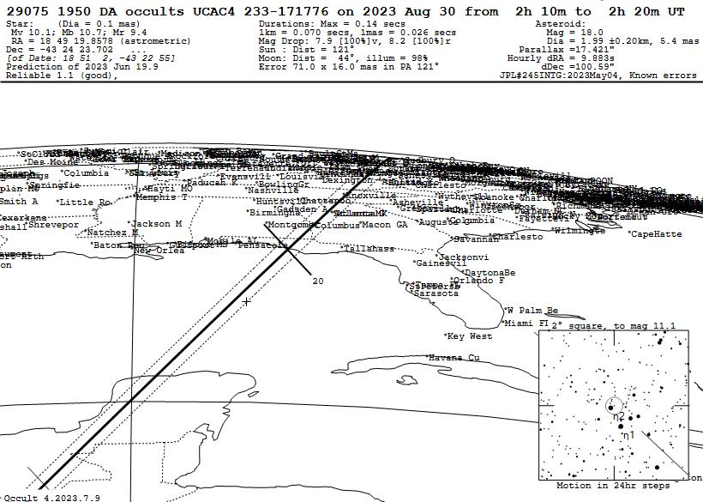

Slide 31
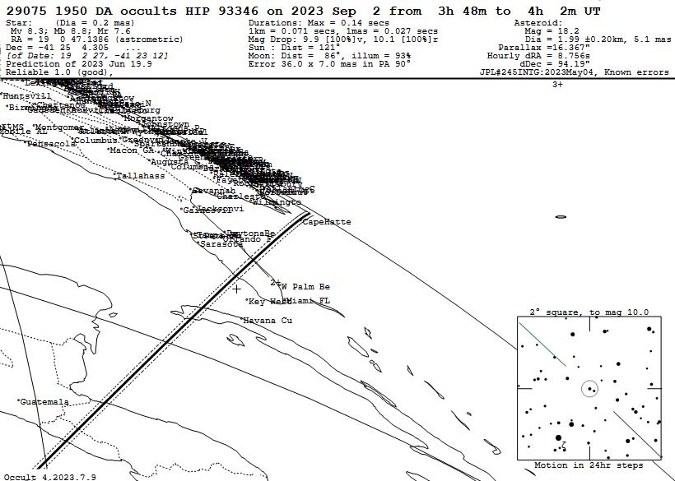

Slide 33
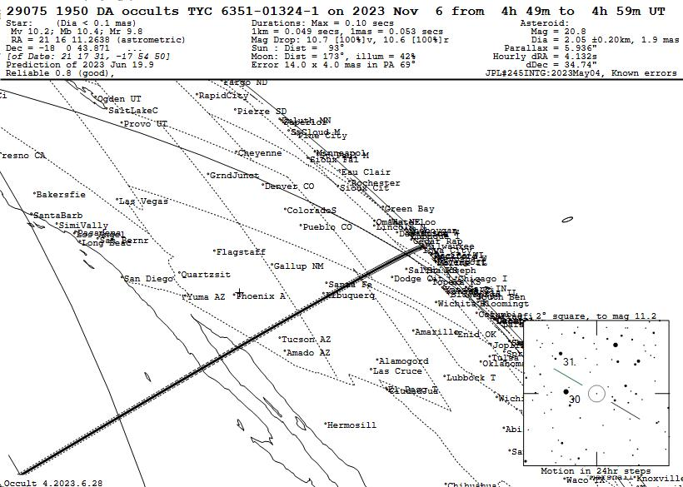

Slide 34
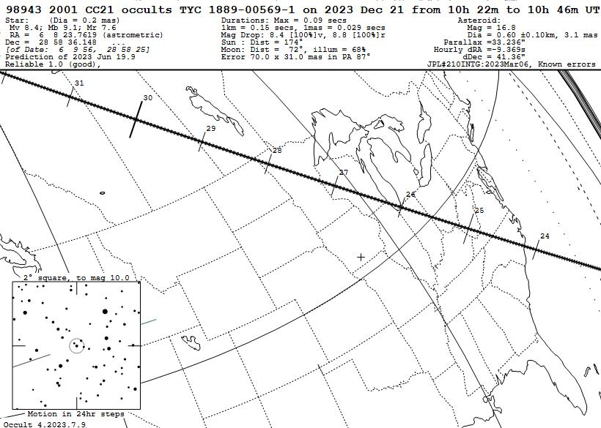

Slide 35
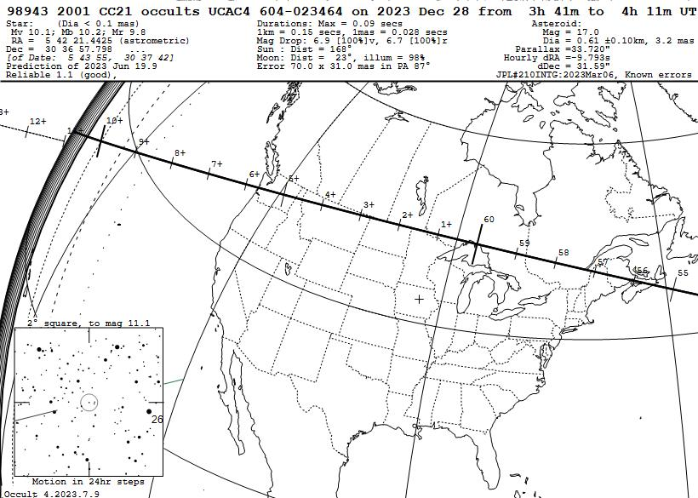

Slide 36
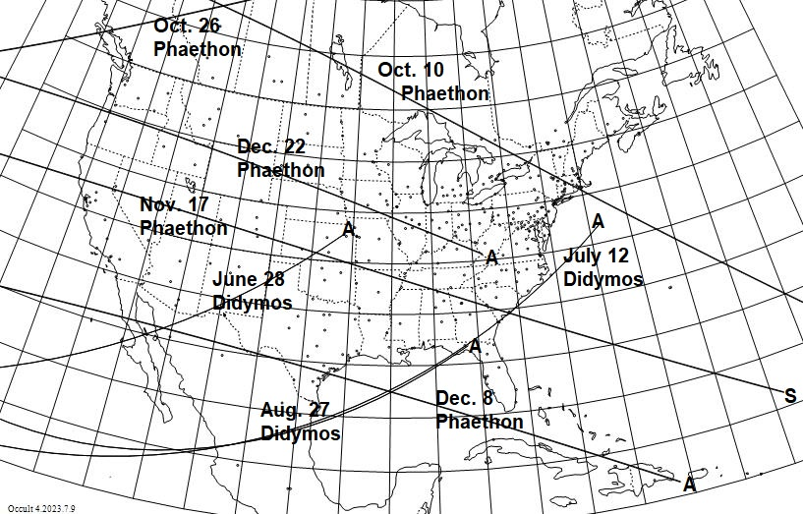
Best 2024 NEA Occultations

Slide 37
Conclusions
The rare bright 2019 July 29th occultation was the first successful campaign for a small NEO; until Apophis in 2021, it was the smallest asteroid with multiple timed chords during an occultation. A large collaboration of amateur and professional astronomers enabled that success.
The radar size and shape were verified, and the improved orbit allowed a good prediction for the next occultation, then subsequent events, and an improvement of Phaethon’s A2 non-gravitational parameter by a factor of 3.
But recent observations show that sudden changes might occur to Phaethon’s orbit near perihelion, so more observations by this enigmatic object are needed.
The occultation technique was successfully applied to Apophis, which is more than 10 times smaller than Phaethon, and also Didymos, further demonstrating the astrometric power of observations of NEO occultations for planetary defense;
Information about the sizes, shapes, rings, satellites, and even atmospheres of Kuiper Belt objects, Centaurs, Trojans, and other asteroids is proportional to the number of stations that can be deployed for occultations by them
We encourage as many others as possible to time occultations by NEA’s, TNO’s and by other asteroids (and sometimes comets) from their observatories
We want others to learn to make the necessary mobile observations, including the multi-station techniques pioneered by IOTA, to observe NEA and other occultations, to support planetary defense and asteroid science.
Please visit https://occultations.org/publications/rasc/2023/ACM2023.htm to get this presentation, and for links to IOTA’s, and other’s, Web sites that have predictions and much other information that will allow you, and others at your institution, to take part in this exciting field of astronomy.
Contact: dunham@starpower.net; cell +1-301-526-5590 and
local IOTA member Bruce Hohenstein, BHolenstein@gravic.com .

