Slide 1
OCCULTATIONS BY CENTAURS, TNOs, AND SPECIAL MAIN-BELT ASTEROIDS DURING THE REST OF 2023 AND BY TROJAN ASTEROIDS IN 2023 & EARLY 2024 For the IOTA meeting by zoom, July 15, 2023
David W. Dunham

Slide 2
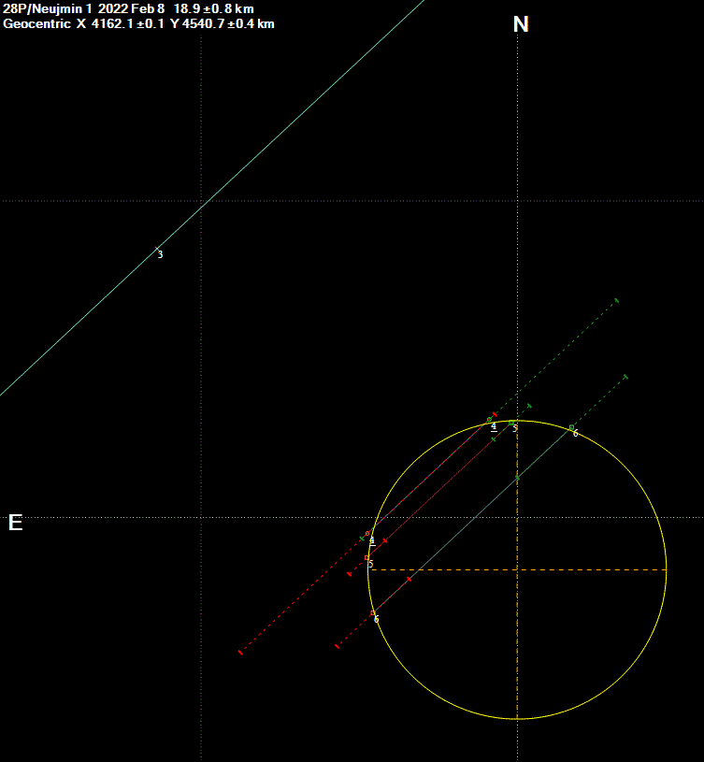
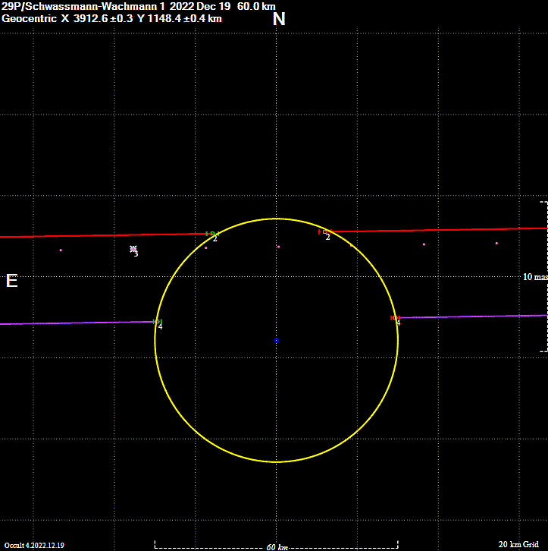
IOTA Observations of Occultations by Comets
On 2022 February 8, 3 amateur observers in Europe working with IOTA obtained what we believe to be the first unambiguous observations of an occultation by the nucleus of a comet, 28P/Neujmin 1.
On 2022 Dec. 4, a first occ’n of a 15th-mag. star by SW-1 was observed at SOAR in Chile, allowing Lucky Star to update the orbit accurately. On 2022 Dec. 19, IOTA observers worked with Lucky Star & others to record the 1st multi-chord occultation by 29P/Schwassman-Wachmann 1 (SW1). IOTA observed at least 2 more SW1 events, on 2022 Dec 29 in NM and 2023 May 7 in the UK. But for the best info. about SW1 occultations, see Buie et al.’s ACM 2023 E-Poster #2445.

Slide 3
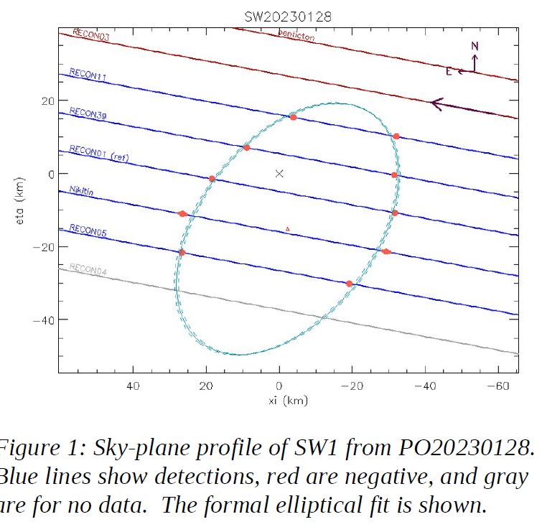
Other observed occultations by SW-1
Vadim Nikitin recorded the 2022 Dec. 29th Event near Roswell, NM and Richard Nugent saw it in cen. Texas, but wasn’t able to record it.
The earlier successful events
allowed Marc Buie at SwRI to
mount a multi-station mobile effort with RECON systems in eastern Washington for the
2023 Jan. 28th event, left,
from his ACM 2023 abstract,
but it was not included in his
ePoster so this should not be
shared until it is published. Note that this was just a week before the huge Polymele effort in Kansas on 2023 Feb. 4 UT.

Slide 4
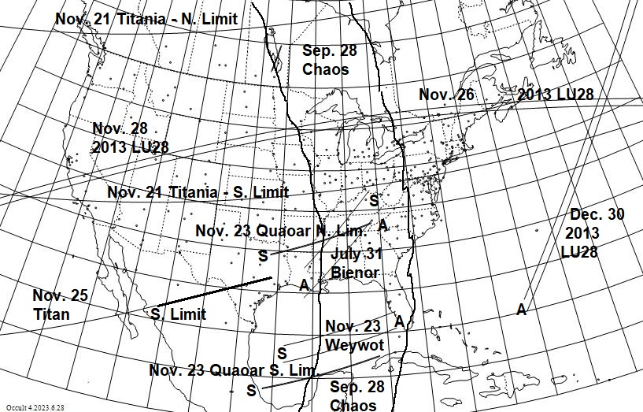
Occultations by Distant Objects, rest of 2023 in North America
A

Slide 5
Occultations by Distant Objects, rest of 2023 in North America
Date U.T. Diam Dur. Star Mag Eln Star d Path Planet Moon R.A. (J2000) Dec.
m d h m km sec mag Drop o No Name Dist ill h m s o ' "
Jul 31 9 25 188 5.5s 14.6 4.6 34 UCAC4 653-044855 LA-KY 54598 Bienor 164 97 6 42 17.421 40 26 37.59
Sep 28 7 11 364 63.5s 13.5 7.5 92 UCAC4 607-028826 FL-ON 19521 Chaos 103 98 6 9 56.940 31 21 23.25
Nov 21 5 18 1577 72.8s 11.8 2.2 172 TYC 1236-00841-1 NL-CA Titania 72 59 3 12 17.324 17 32 27.04
Nov 23 0 25 139 4.9s 14.8 4.2 38 UCAC4 373-131780 s FL-low Weywot 87 78 18 29 5.730 -15 24 54.02
Nov 23 0 32 1095 37.9s 14.8 4.2 38 UCAC4 373-131780 s TX-GA 50000 Quaoar 87 78 18 29 5.730 -15 24 54.02
Nov 25 3 55 5150 367s 14.4 0.01 88 UCAC4 386-150960 wNAm Titan 64 94 22 12 47.559 -12 50 56.62
Nov 26 7 43 76 3.2s 14.7 3.5 112 UCAC4 695-050057 CA-NS 468861 2013 LU28 78 99 9 24 15.663 48 54 52.09
Dec 30 0 9 76 2.0s 15.8 2.3 141 UCAC4 703-049020 Berm 468861 2013 LU28 29 91 8 59 57.152 50 30 12.43

Slide 6
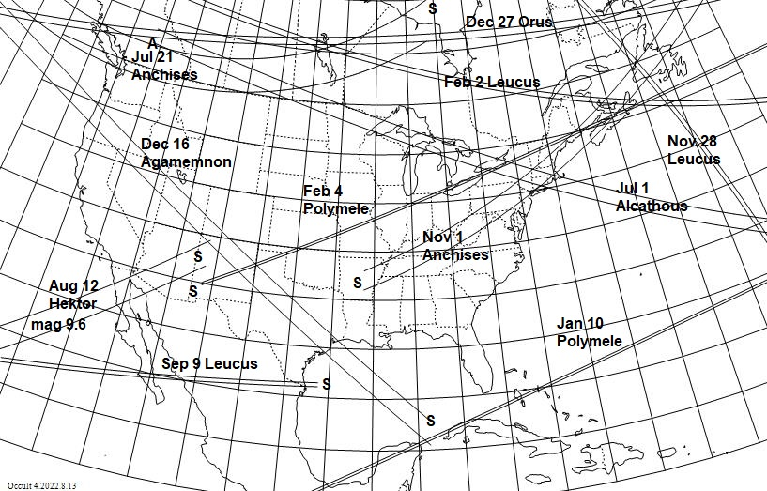
Occultations by Trojan Asteroids during 2023 in North America Upcoming Lucy events underlined in red, bright Hektor event in green

Slide 7
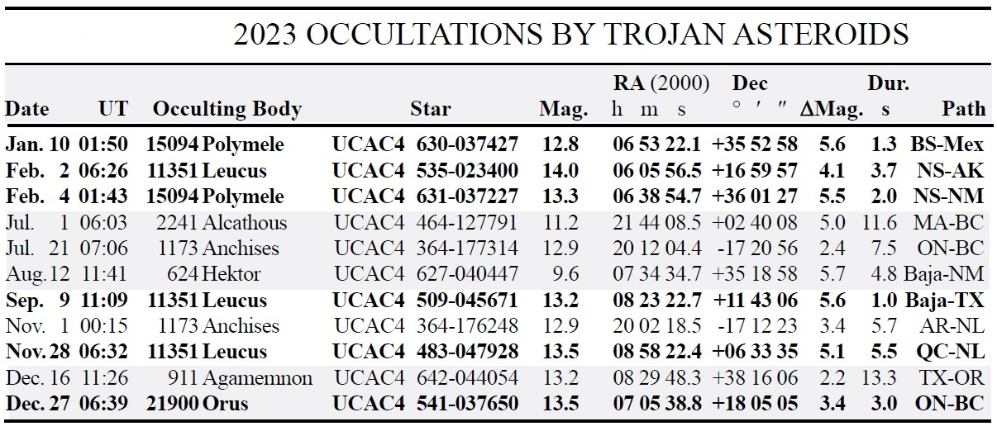
Occultations by Trojan Asteroids during 2023 in North America

Slide 8
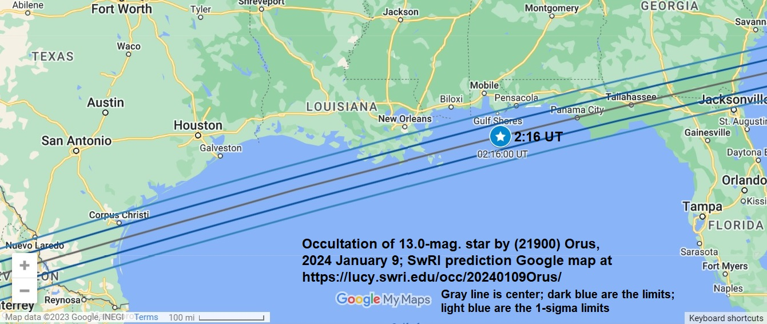
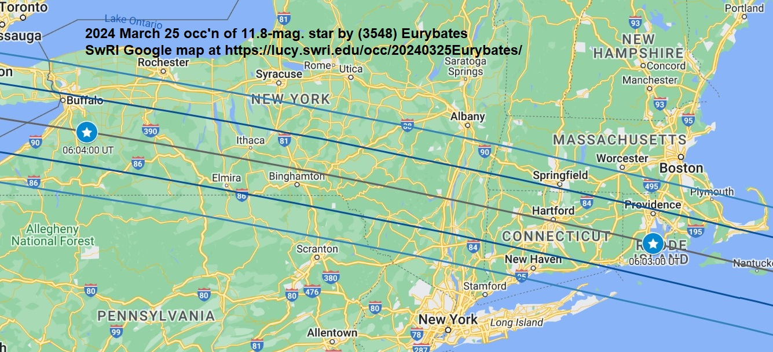
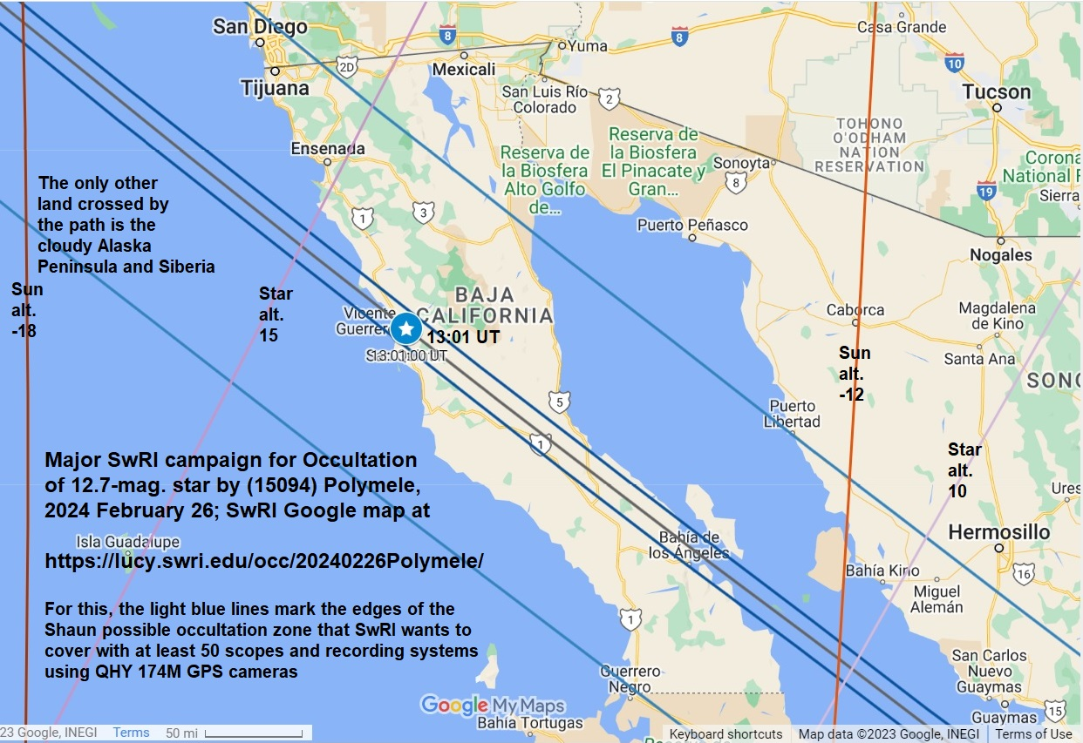
Lucy Target Occultations, Early 2024 from https://lucy.swri.edu/occ/predictions.html
The Southwest Research Institute (SwRI) is also interested in occultations by other Jupiter Trojan asteroids, to extend the science that will be obtained by NASA’s Lucy mission.

Slide 9
Diagram by Dave Herald using the Occult4 program. For more, including the videos, please visit
https://www.youtube.com/watch?v=w_Cc5Or1FFw . Gaia confirmed the duplicity from the small wobble of the center of figure, finding a period of 1.3 days. On 2022 May 16, Nosworthy and Gault found from another occultation that (172376) 2002 YE25 is likely a binary with ∼3-km objects about 15 km apart; see http://hazelbrookobservatory.com/ye25/#:~:text=Introduction,is%20probably%20two%20smaller%20objects.

Slide 10
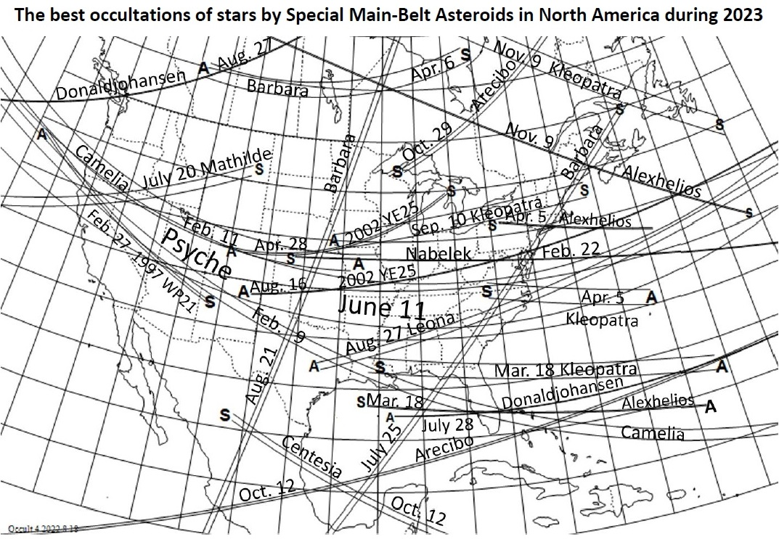
From the RASC Observer’s Handbook and
https://occultations.org/publications/rasc/2023/nam23MBspecialoccs.pdf.

Slide 11
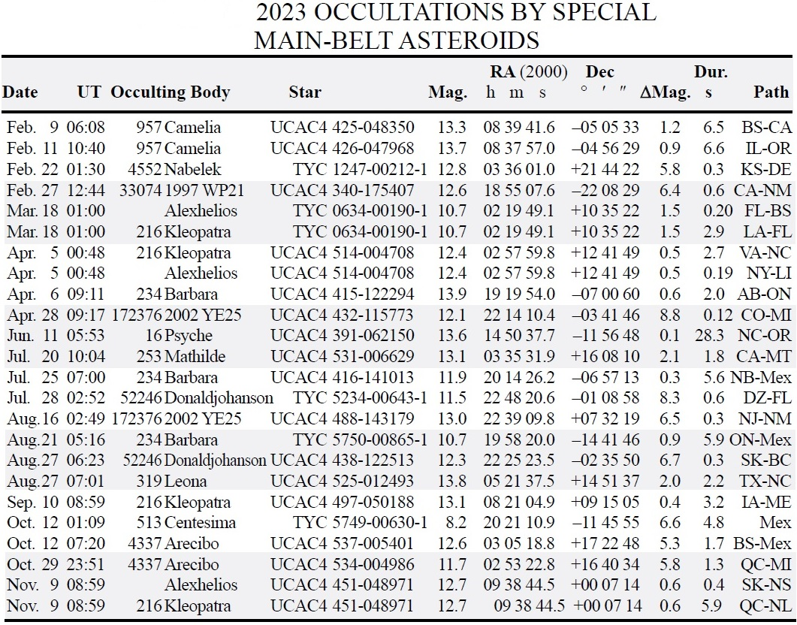
Table of information for events on the map on the previous slide.

Slide 12
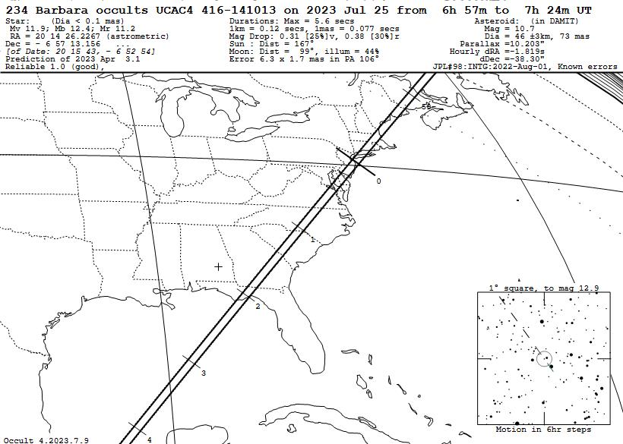
If clear enough, we
plan to observe this from 3 stations on Maryland’s Eastern Shore.

Slide 13
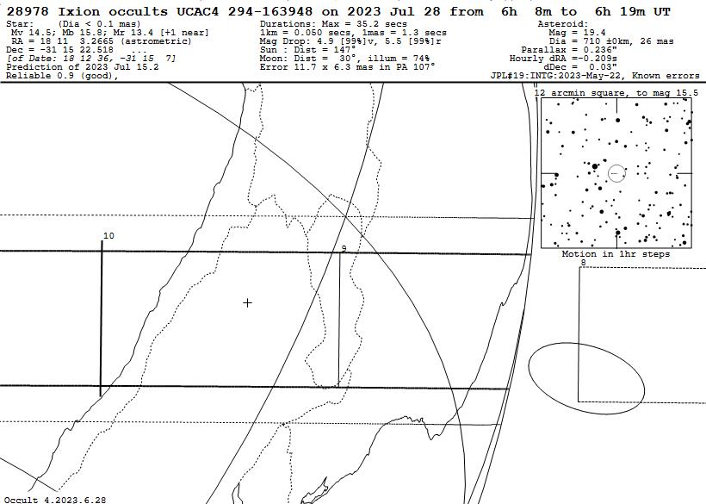

Slide 14
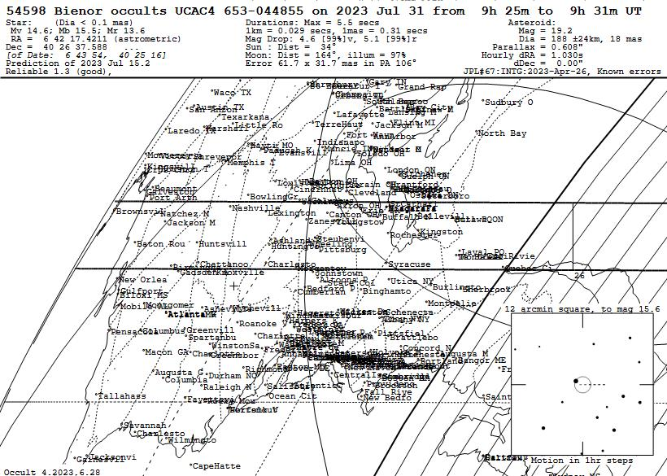

Slide 15
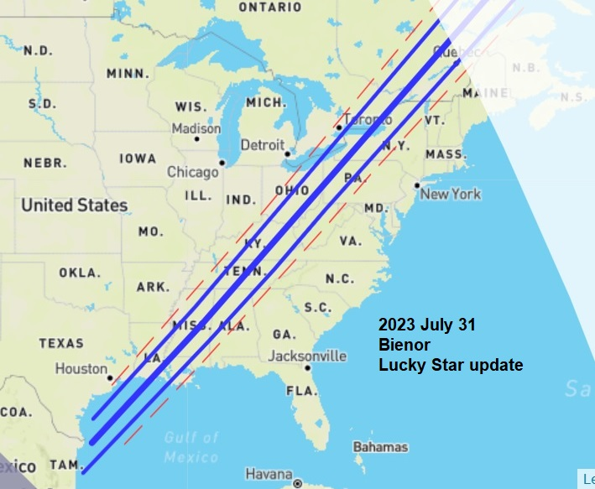
https://lesia.obspm.fr/lucky-star/occ.php?p=122624
Similar to my
Horizons-based prediction

Slide 16
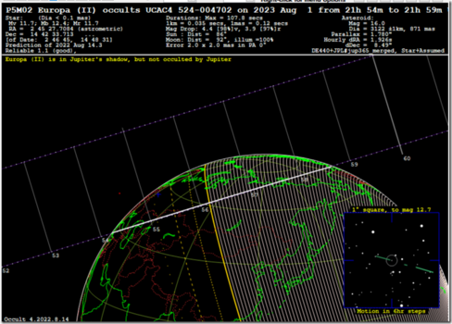
During eclipse by Jupiter

Slide 17
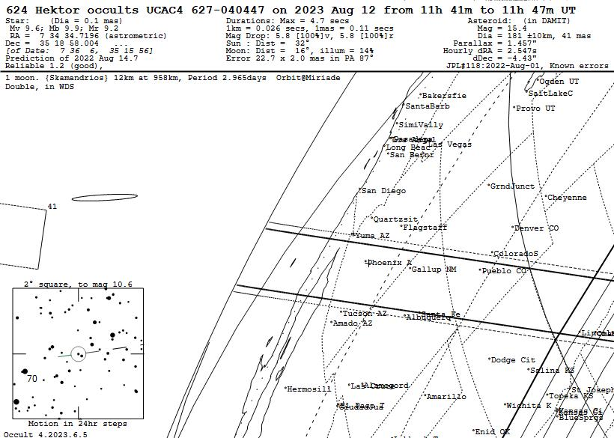

Slide 18
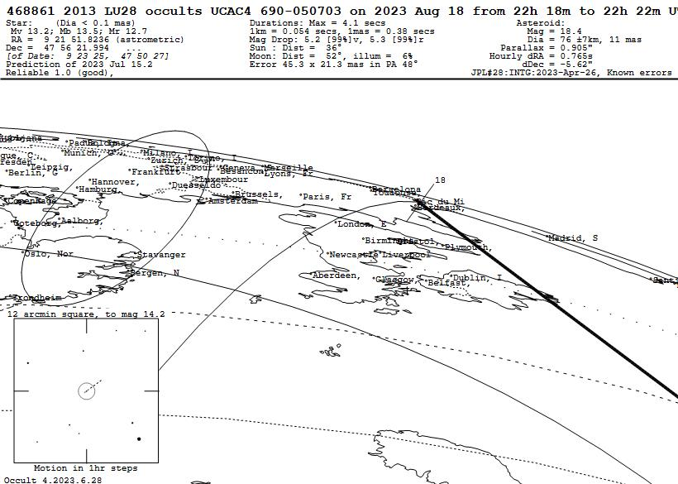

Slide 19
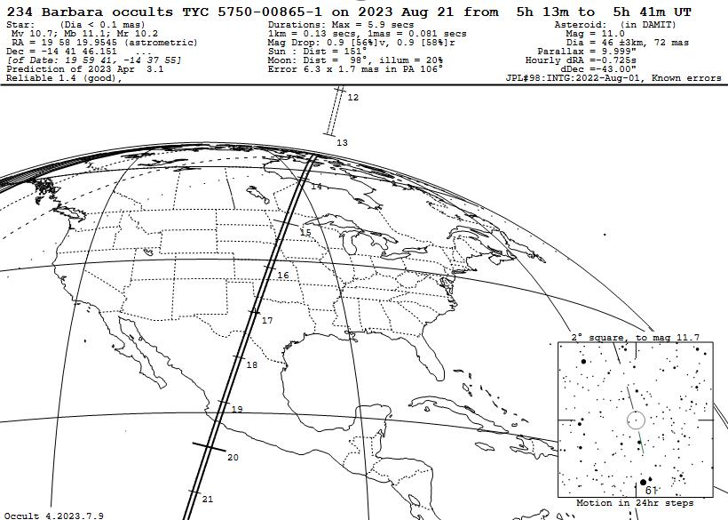

Slide 20
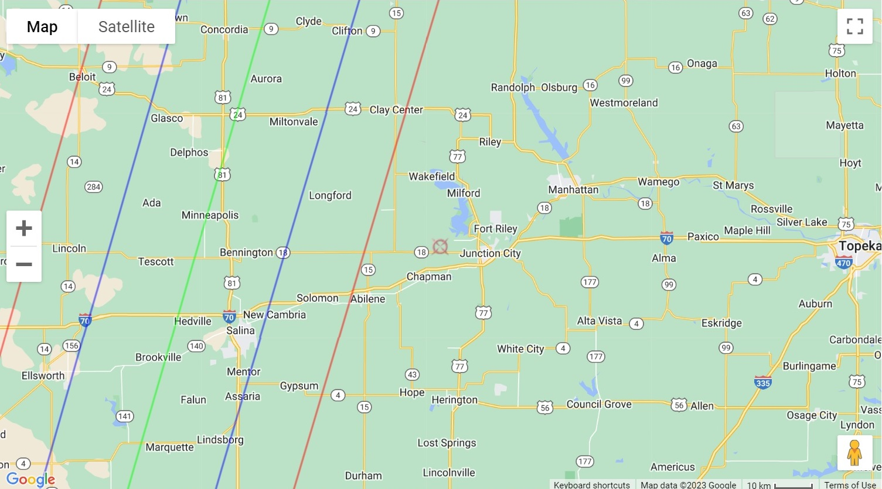
2023 Aug. 21, back to Salina, KS for the Barbara Occultation?

Slide 21
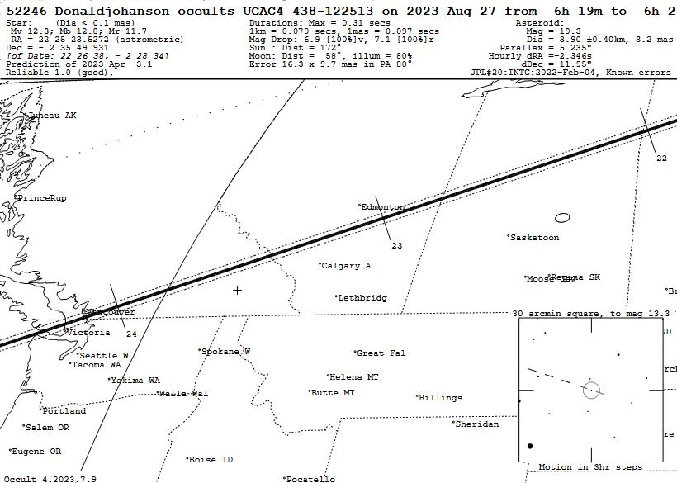
Lucy mission main-belt target

Slide 22
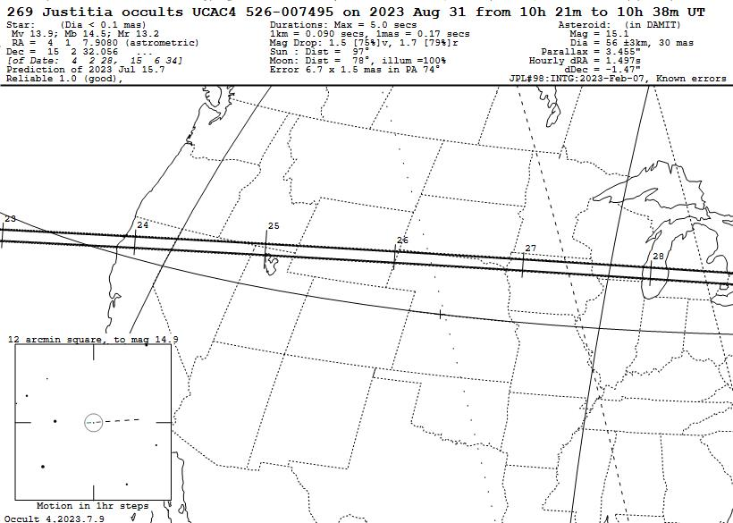
Justitia is a red main-belt asteroid
similar to KBO’s which it might
have been. It is the final flyby target
of a United Arab Emirates main-belt
tour mission so observations are
desired. SwRI may organize a
campaign for it.

Slide 23
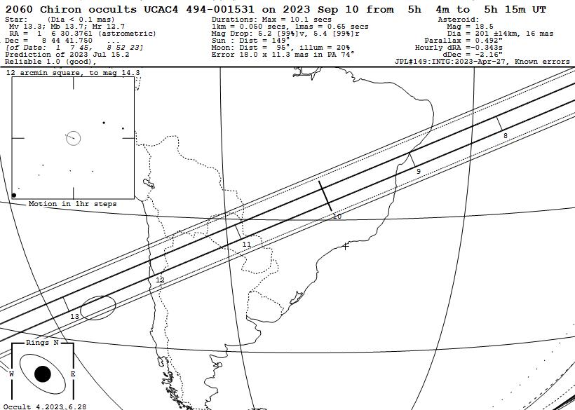

Slide 24
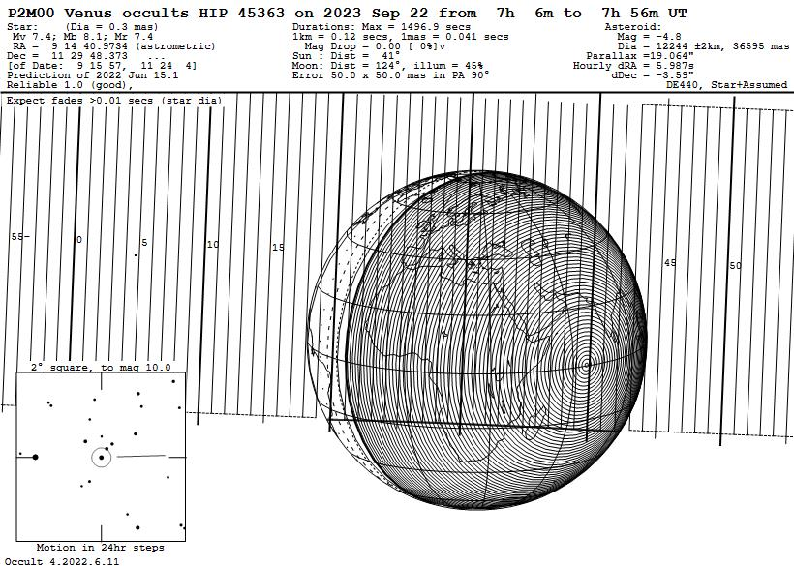

Slide 25
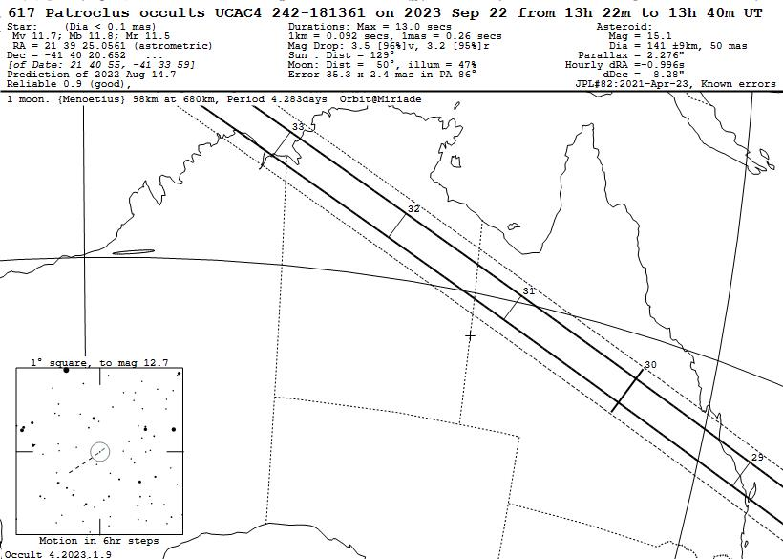

Slide 26
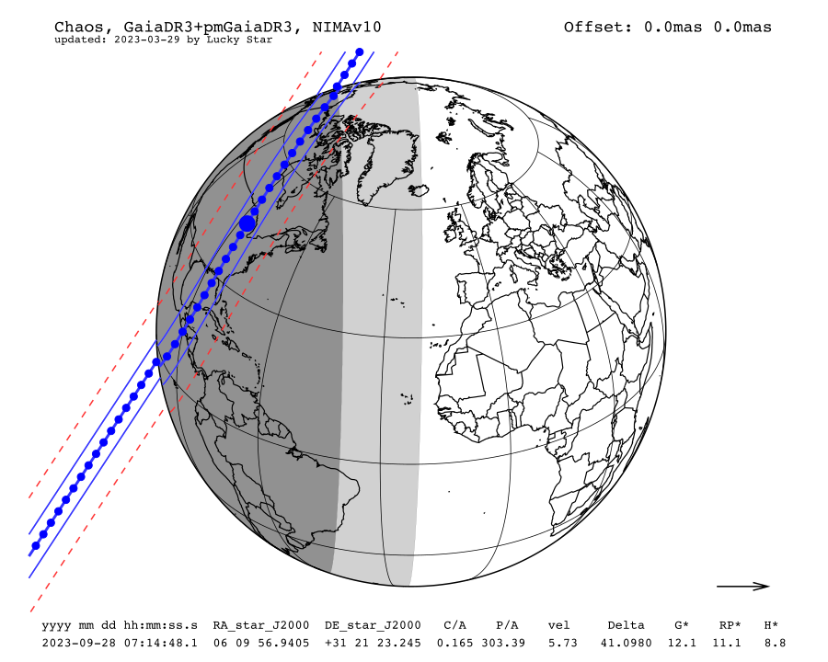
From https://lesia.obspm.fr/lucky-star/occ.php?p=124402
2023 Sept. 28
Chaos
My path for this is wrong; here’s the correct one from Lucky Star

Slide 27
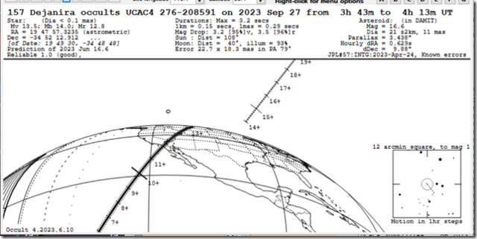
One of the lowest-numbered unobserved (by occultations) asteroids

Slide 28
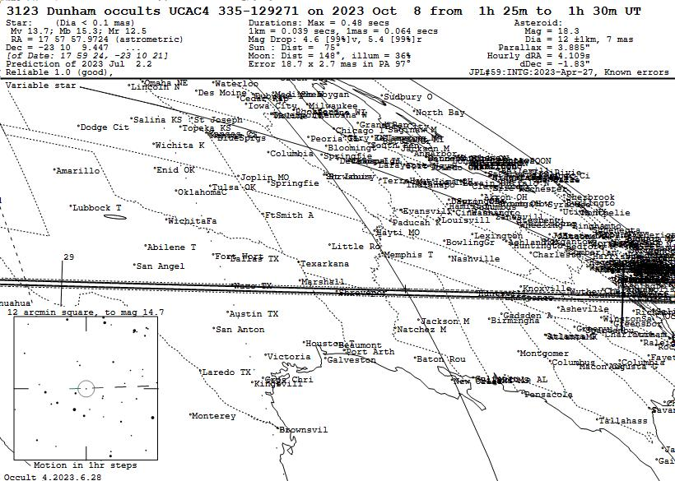

Slide 29
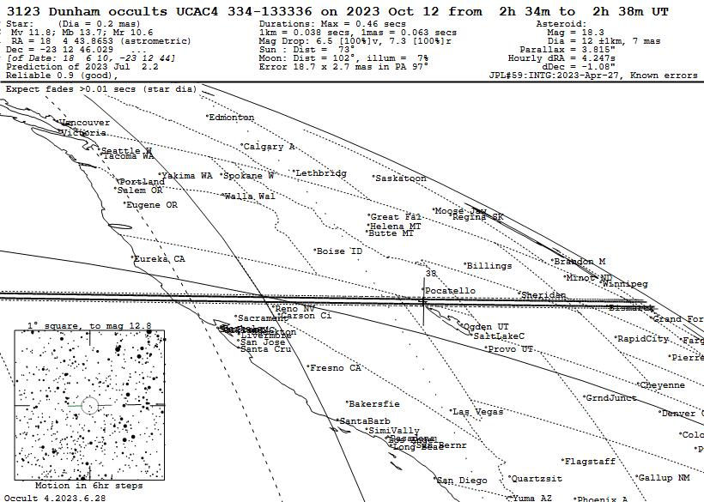

Slide 30
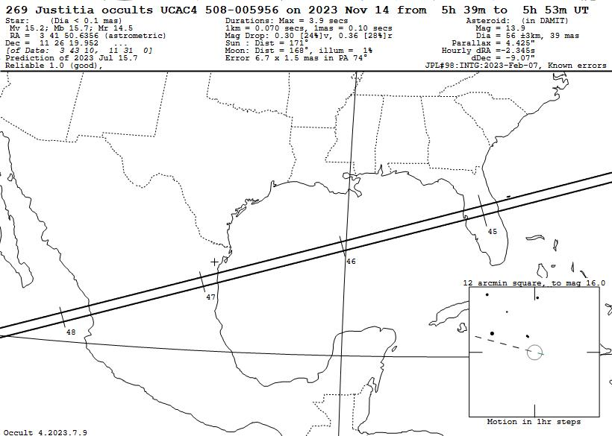

Slide 31
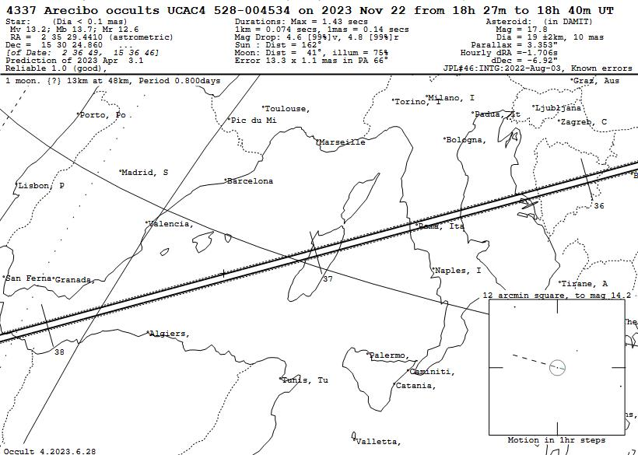

Slide 32
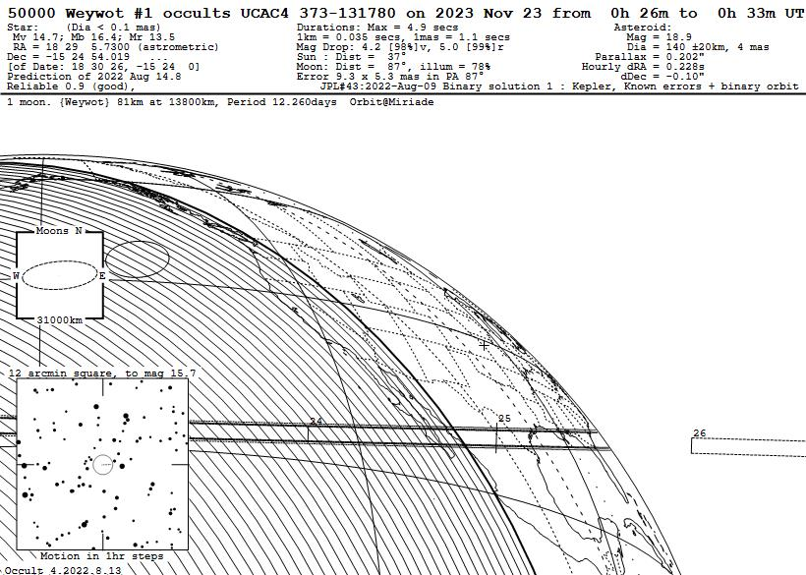

Slide 33
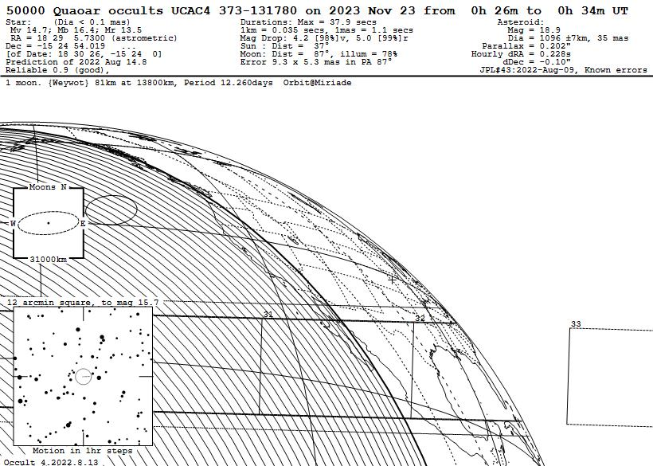

Slide 34
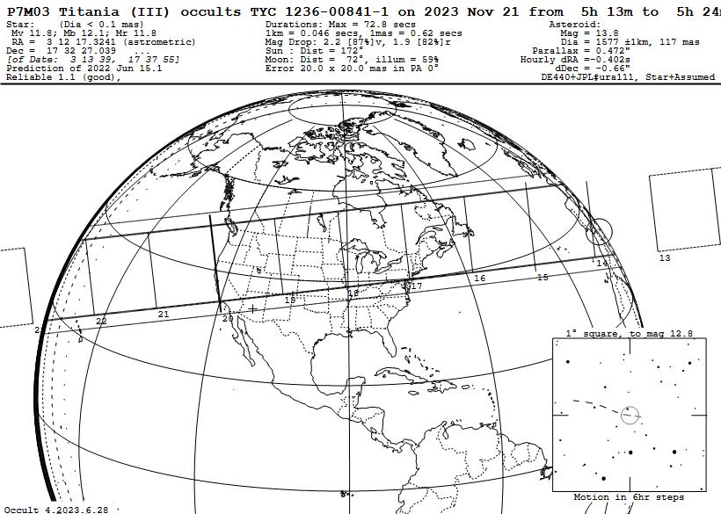

Slide 35
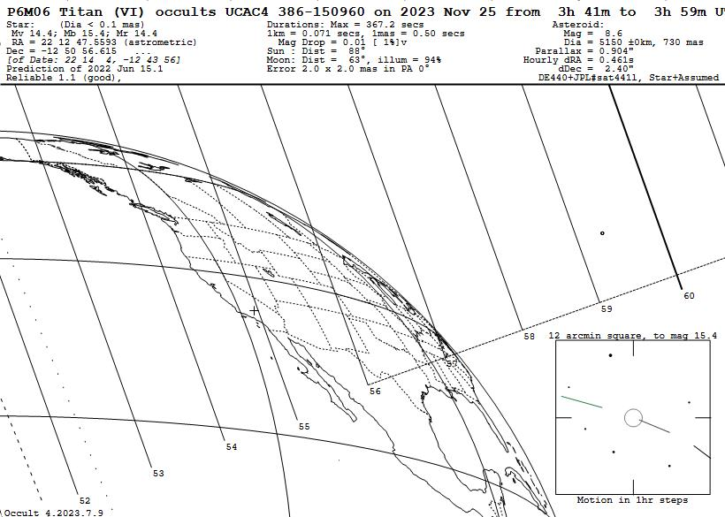

Slide 36
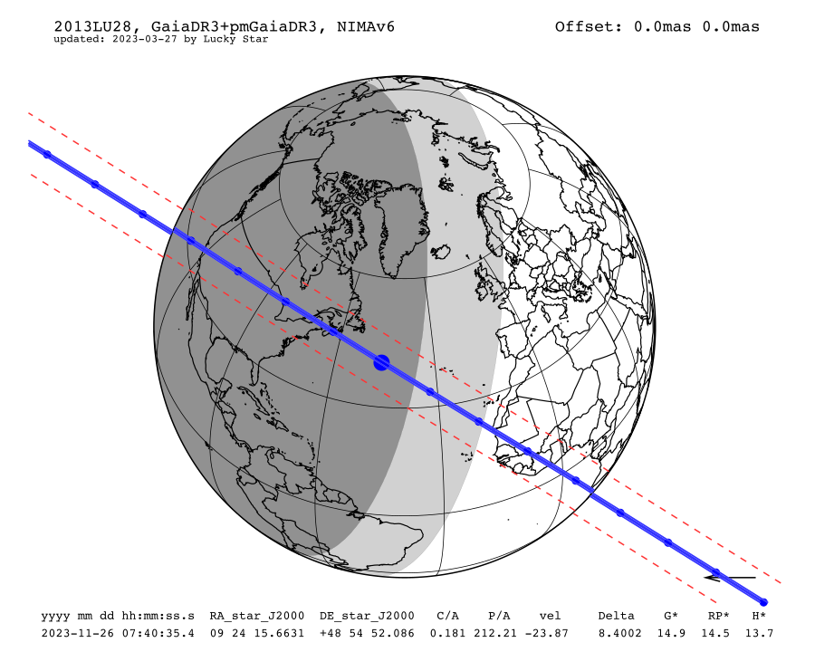
From Lucky Star (errors better), but my path for this is similar

Slide 37
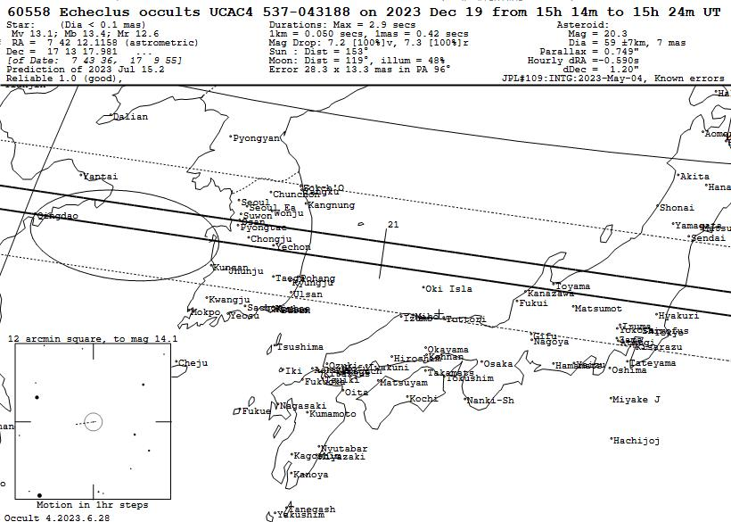

Slide 38
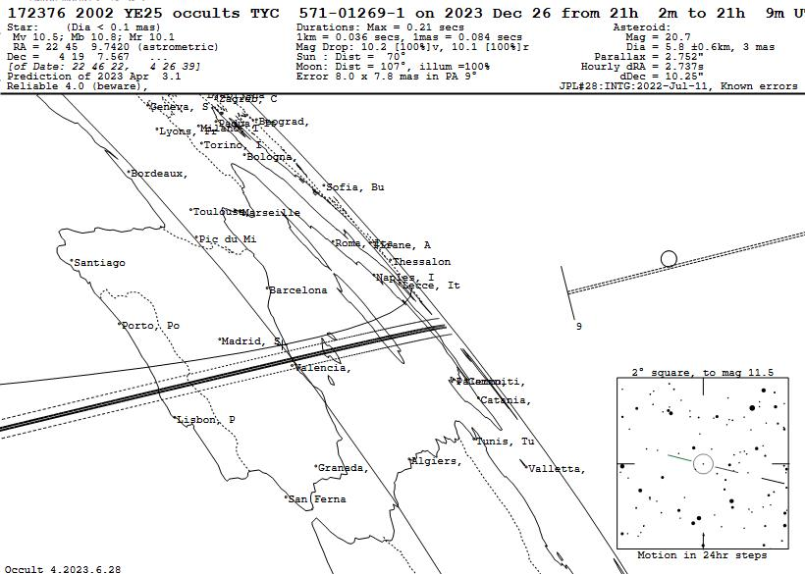

Slide 39
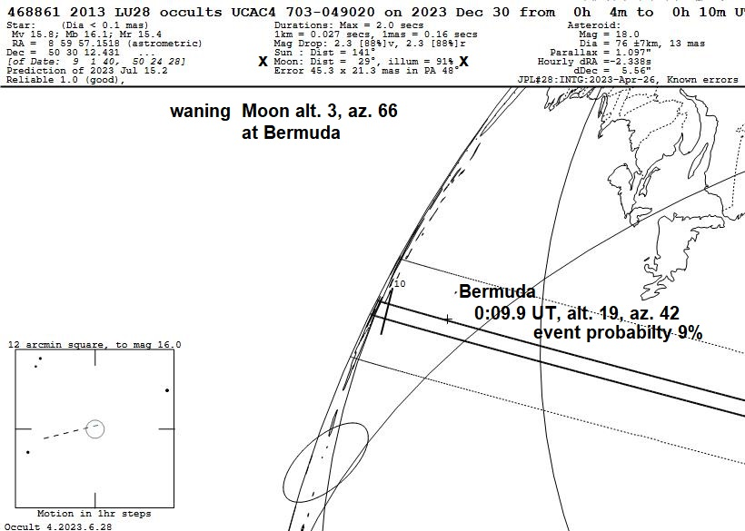

Slide 40
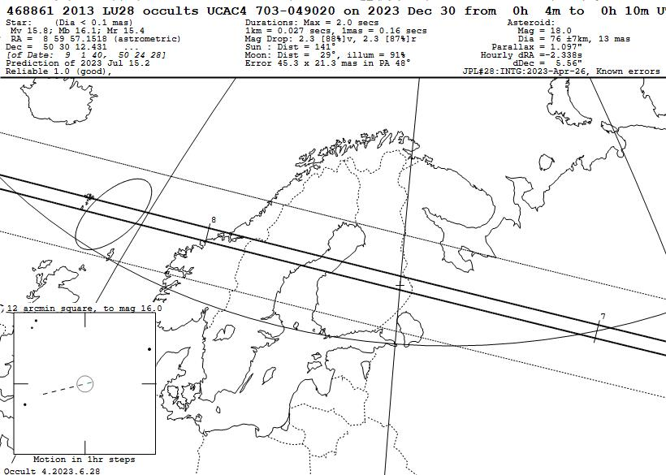

Slide 41
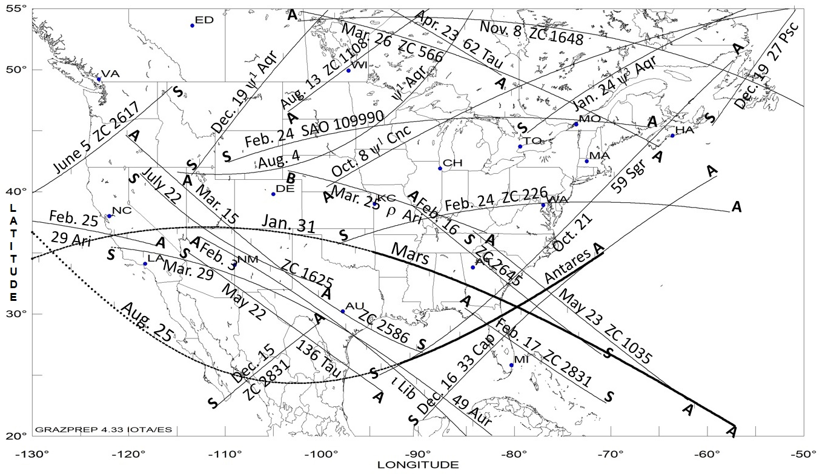
Best 2023 Lunar Grazing Occultations, from RASC Handbook and
https://occultations.org/publications/rasc/2023/nam23grazes.pdf (E. Riedel and D. Dunham)
Also, remember the annular solar eclipse of 2023 October 14

Slide 42
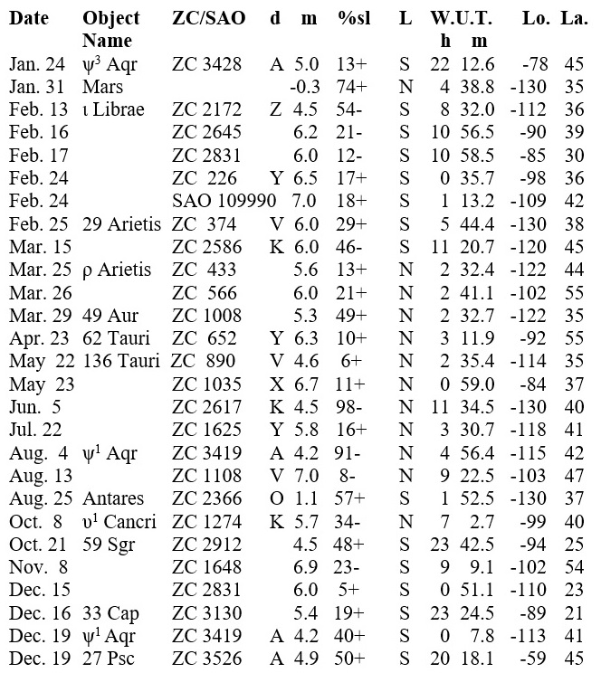
Best 2023 Lunar Grazing Occultations, from RASC Handbook and
https://occultations.org/publications/rasc/2023/nam23grazes.pdf (E. Riedel and D. Dunham)

Slide 43
Conclusions
Information about the sizes, shapes, rings, satellites, and even atmospheres of Kuiper Belt objects, Centaurs, Trojans, and other asteroids is proportional to the number of stations that can be deployed for occultations by them
We encourage as many others as possible to time occultations by NEA’s, TNO’s and by other asteroids (and sometimes comets) from their observatories
We want others to learn to make the necessary mobile observations, including the multi-station techniques pioneered by IOTA, to observe NEA and other occultations, to support planetary defense and asteroid science.
Please visit https://occultations.org/publications/rasc/2023/ACM2023.htm to get this presentation, and for links to IOTA’s, and other’s, Web sites that have predictions and much other information that will allow you, and others at your institution, to take part in this exciting field of astronomy.
Contact: dunham@starpower.net; cell +1-301-526-5590 and
local IOTA member Bruce Hohenstein, BHolenstein@gravic.com .

