Slide 1

OCCULTATION OF BETELGEUSE
BY (319) LEONA ON 2023 DECEMBER 12 U.T.
For the IOTA meeting by zoom, July 15, 2023
David W. Dunham, Dave Herald and Ted Blank

Slide 2
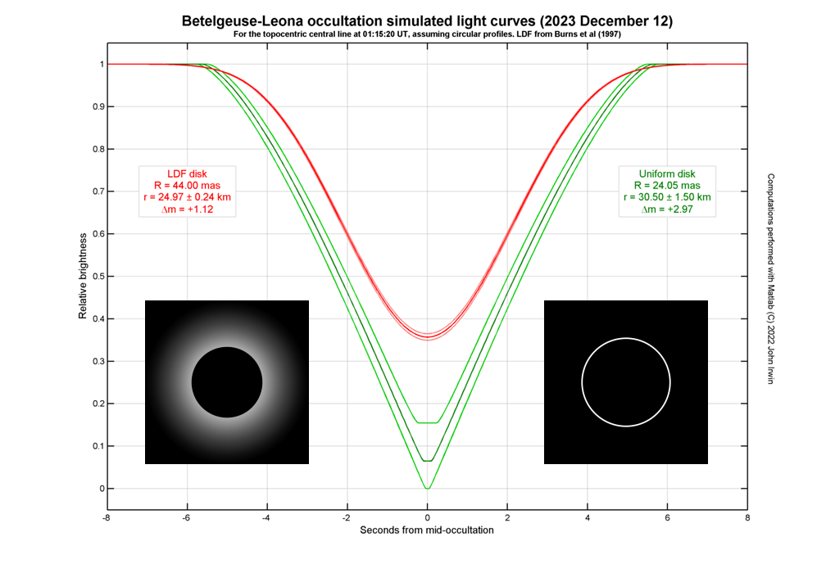
Important Question, what will be seen?
Possible occultation light curves

Slide 3
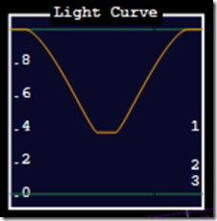
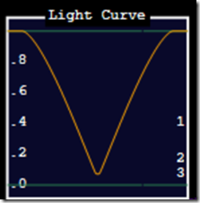
Important Question, what will be seen?
Leona diameter 50 km Leona diameter 61 km
Possible occultation light curves

Slide 4
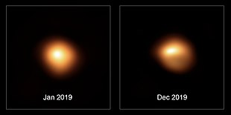
The Size and Shape of both Betelgeuse
(variable star) and Leona are uncertain
Above, SPHERE images of Betelgeuse (Wikipedia).
Special observations of Betelgeuse with large telescopes
and interferometers are planned to determine its size and
possible irregularities or obscuring dust clouds in December.

Slide 5
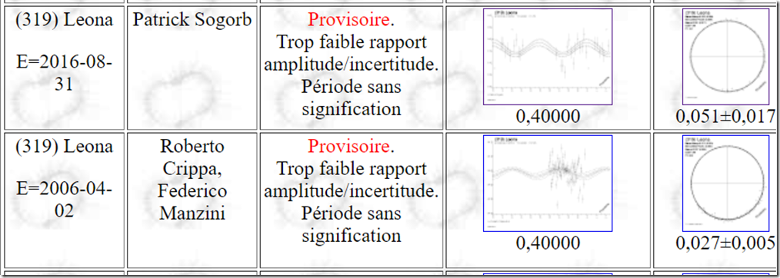
Leona’s Long Rotation Period (430h)
complicates determination
of its size and shape.
So it is VERY IMPORTANT that some OTHER occultations by
Leona be observed from multiple stations BEFORE December 12,
to take best advantage of this unique opportunity.

Slide 6
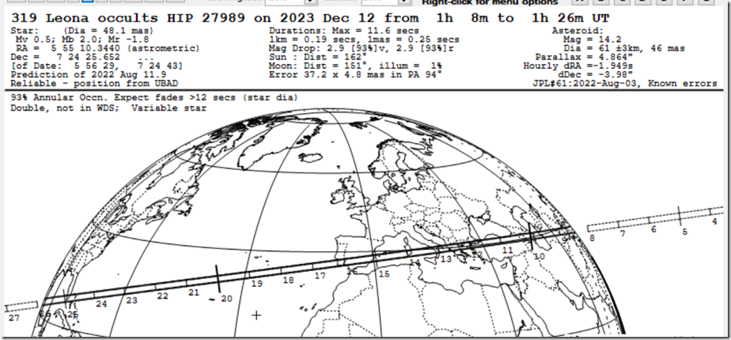
The best (currently used) path uses UBSC positional data for Betelgeuse and the latest (#60) Horizons orbit of Leona.
This path shown assumes a point source for Betelgeuse.

Slide 7
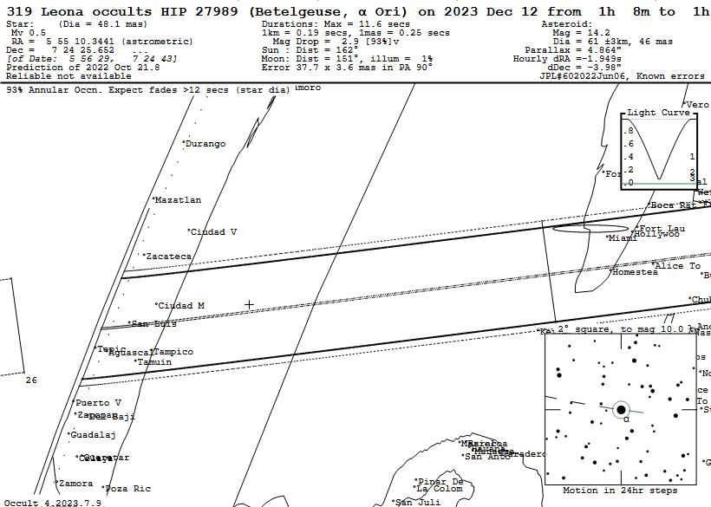
Mexico and Florida

Slide 8
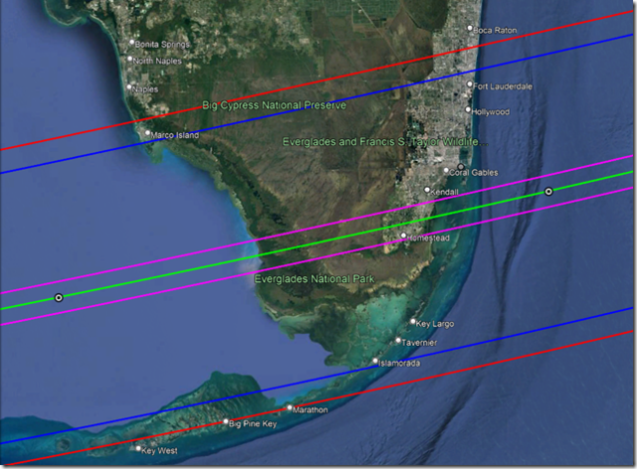

Slide 9
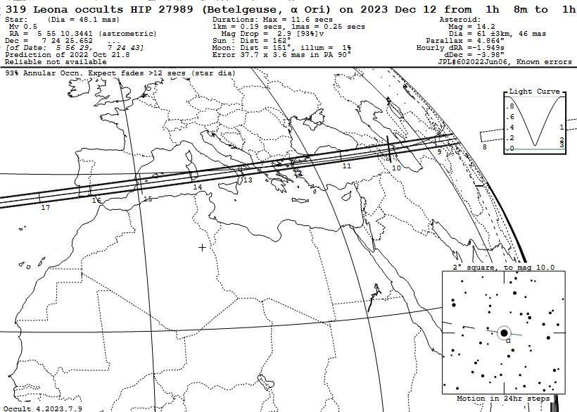

Slide 10
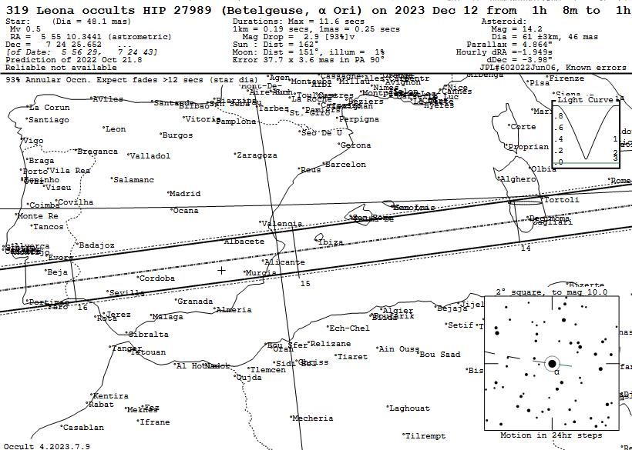
Iberia and Sardinia

Slide 11
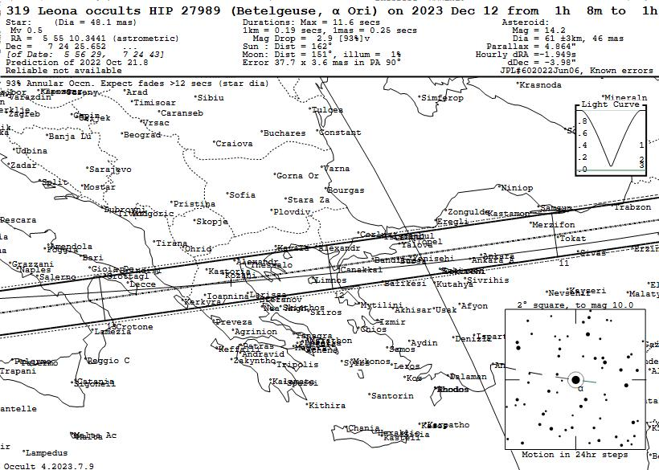
Italy to Turkey

Slide 12
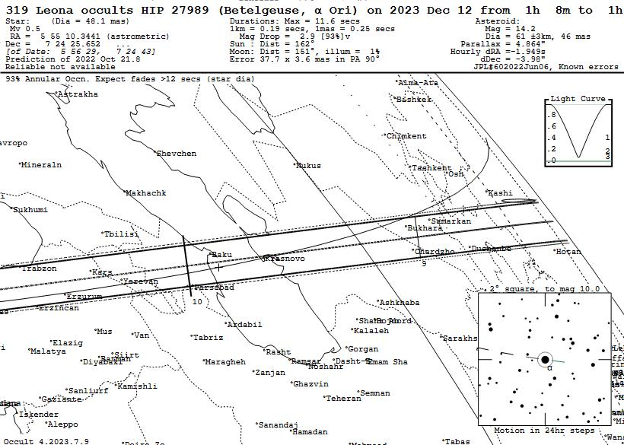
Central Asia
The path is over Baku, Azerbaijan; the International Astronautical
Society (large aerospace mtg.) will meet there 2023 Oct. 2-6

Slide 13
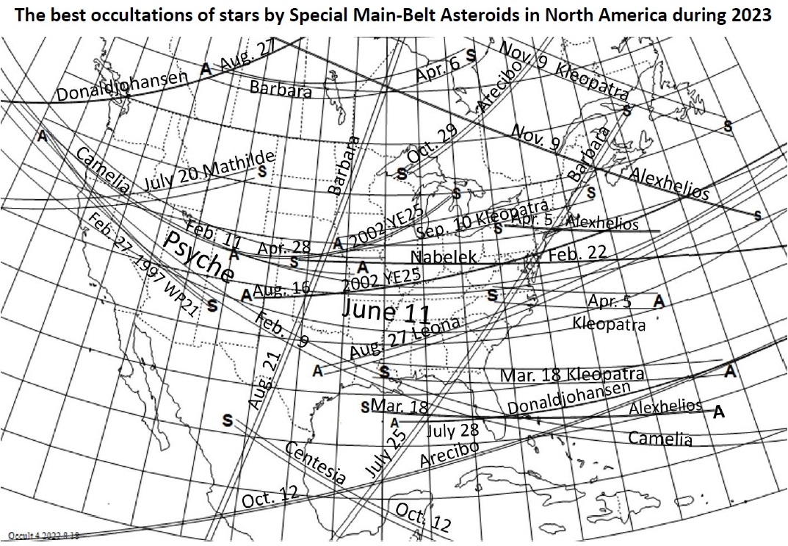
From the RASC Observer’s Handbook and
https://occultations.org/publications/rasc/2023/nam23MBspecialoccs.pdf.

Slide 14
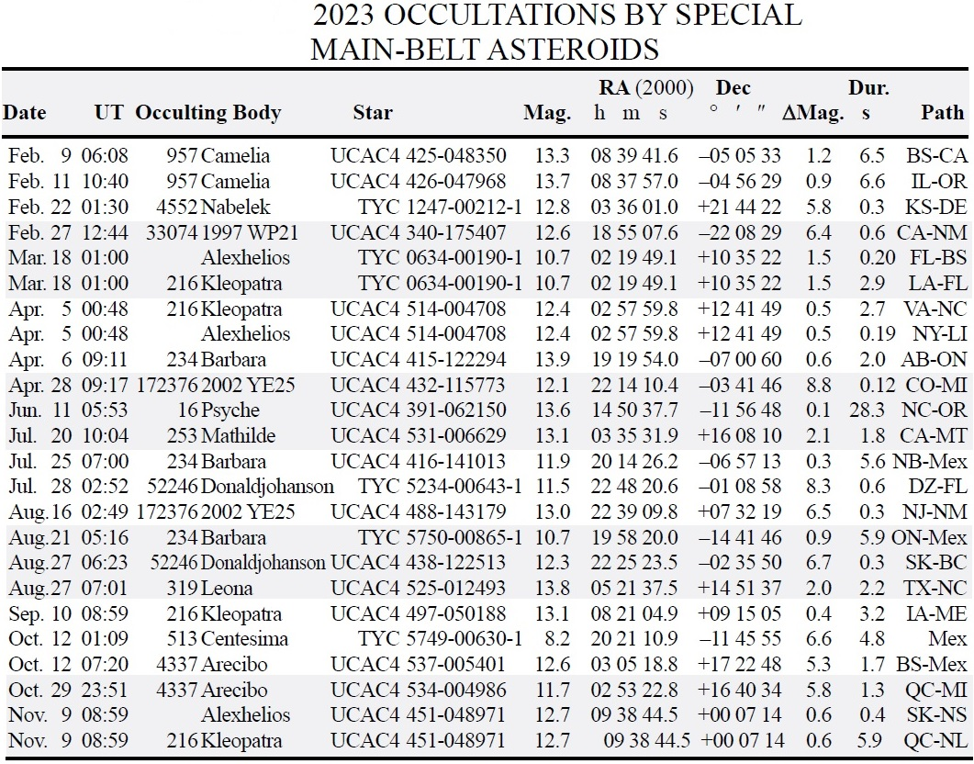
Table of information for events on the map on the previous slide.

Slide 15
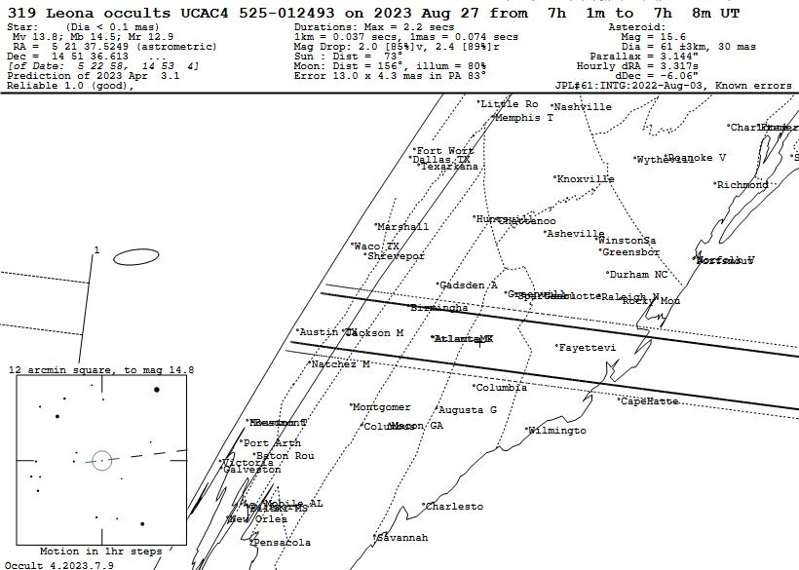

Slide 16
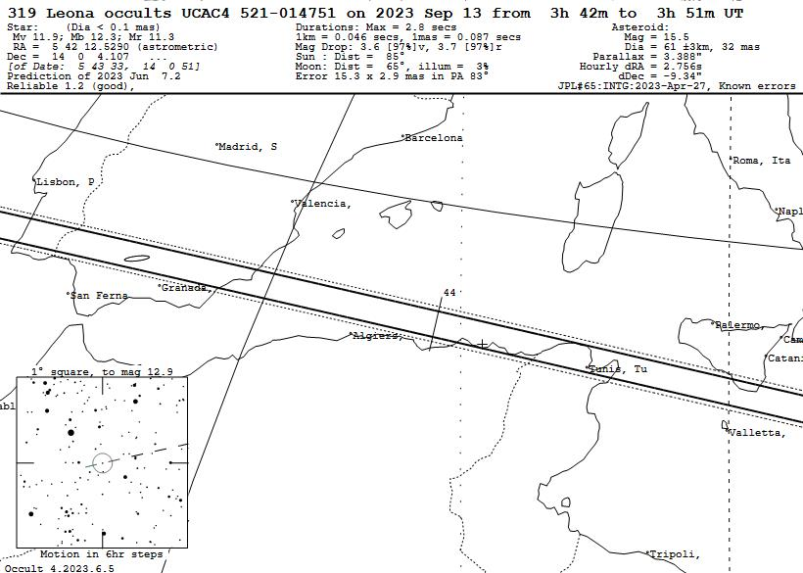
Good opportunity in Europe - Iberia
Path over Iberia is similar to the Dec. 12th Betelgeuse event

Slide 17
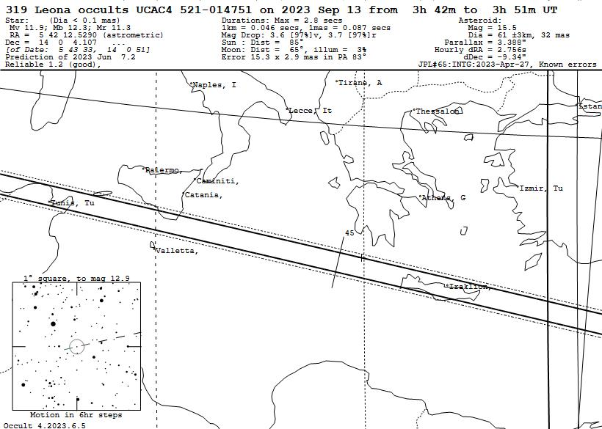
Good opportunity in Europe – farther east
Maybe Tunisia or s. Sicily, but twilight likely too strong in Crete

Slide 18
Conclusions
The occultation might be recorded with DSLR cameras (video mode), recording a smart phone timing app before and after for good time calibration; Ted Blank can say more about this.
With gradual events, “on-off” timings like with Erigone – Regulus in 2014 won’t work, so not suitable for a large public campaign.
But good for advanced high school and college students and astronomy clubs.
You should visit https://occultations.org/publications/rasc/2023/nam23MBspecialoccs.htm and near the end, click on “Worldwide special main-belt events to mag. 14” to download the file 2023worldMBspecial.xml to use with Occult to calculate Leona occultation possibilities for YOUR
observatory and region.
Can discuss further at IOTA/ES-IOTA Round Table on Aug. 6 at 18h UT (2pm EDT in US); see JOA 2023_3, p. 18-19
Please visit https://occultations.org meetings section to get
this presentation.
Contact: dunham@starpower.net; cell +1-301-526-5590 and

