Slide 1
OccuWeather
A tool to aid occultation weather planning
Kai Getrost
Cleveland OH
16 July 2023 IOTA North America Annual Meeting
Notes:
I’d like to talk today about a website I’m working on to help with weather planning for occultations. It’s still under development, but I think there’s enough so far to warrant some discussion and feedback.

Slide 2
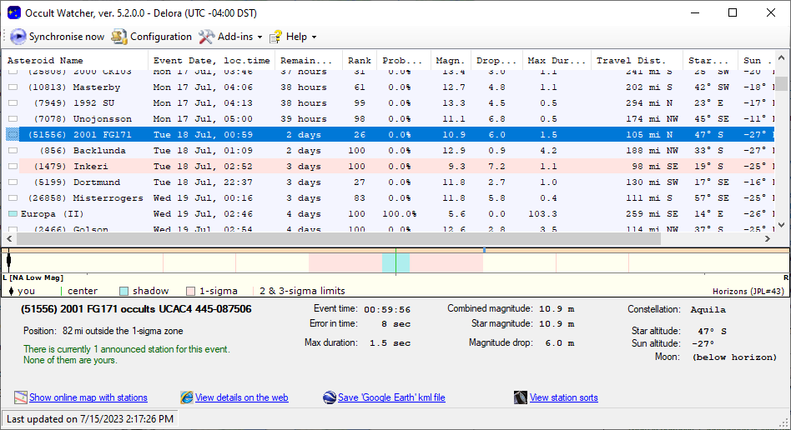
Notes:
To illustrate where this tool fits in, let me start with my typical workflow for an event. I find an event, maybe on OccultWatcher, maybe elsewhere.

Slide 3
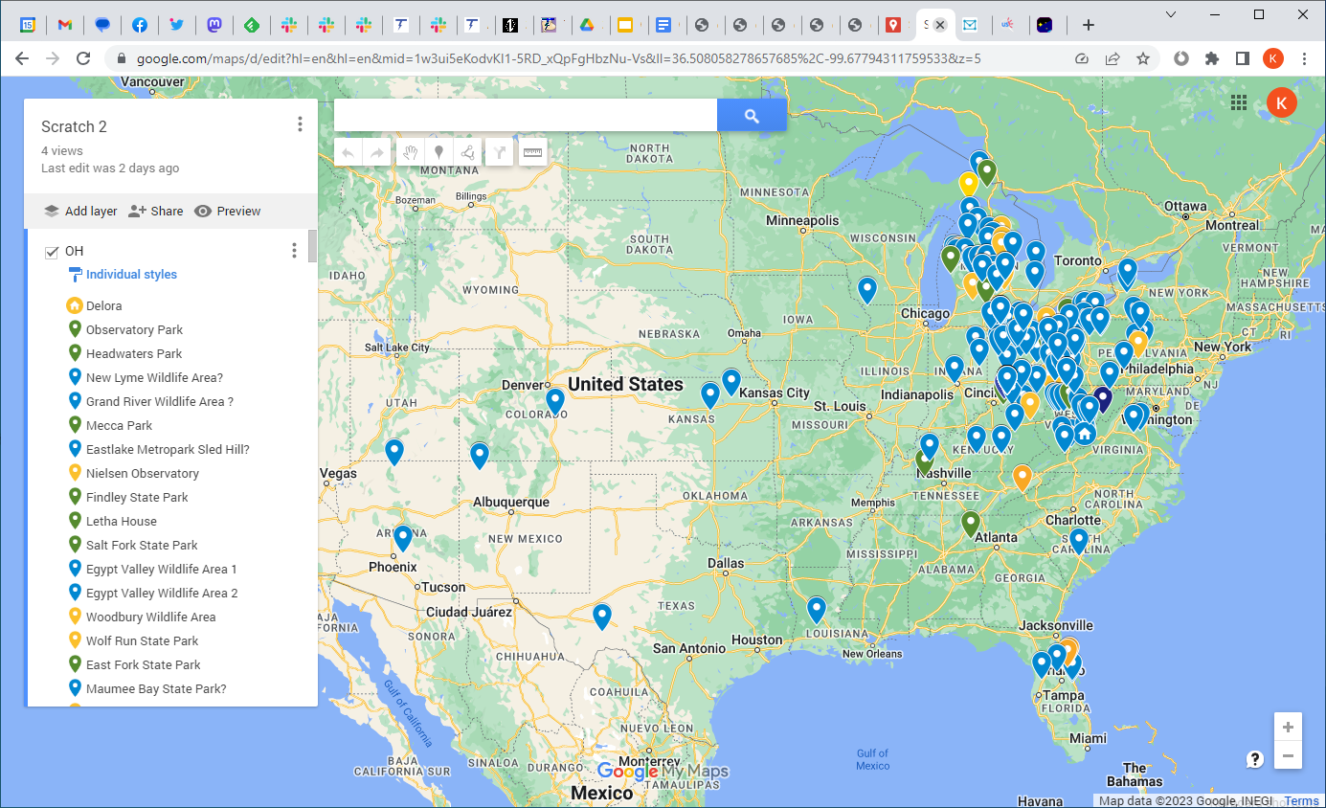
Notes:
I almost always go mobile, sometimes quite far. So site scouting is part of the flow.

Slide 4
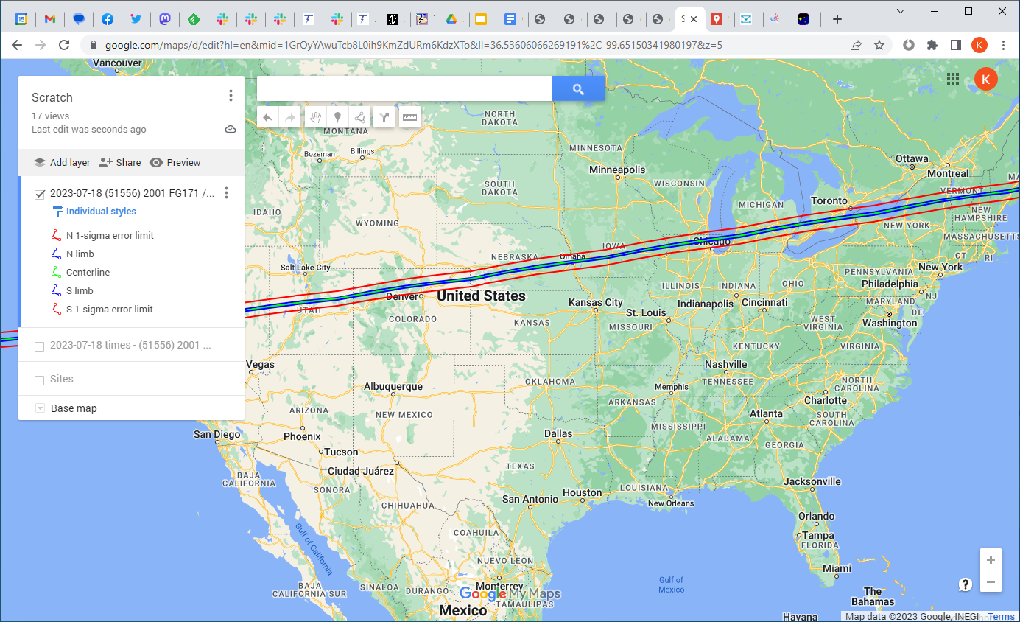
Notes:
So I load the event KML into Google Maps…

Slide 5
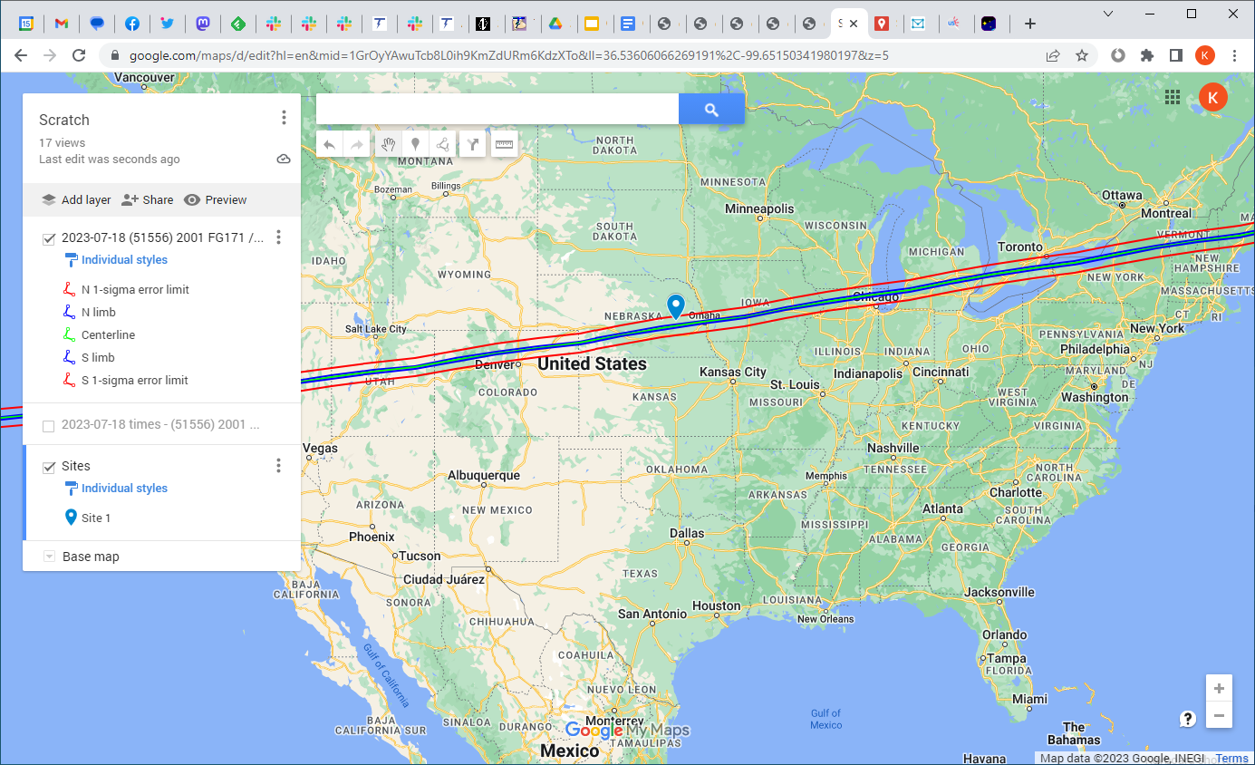
Notes:
…and eventually settle on a site or two, let’s say Nebraska for this one.

Slide 6
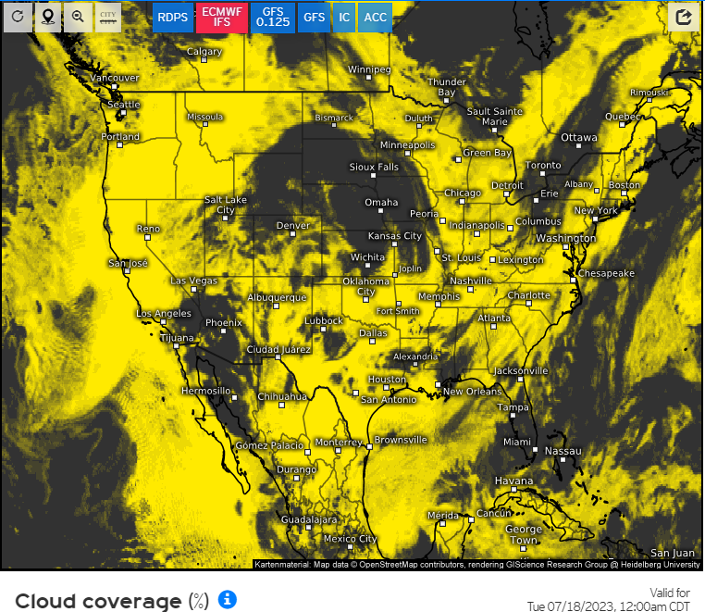
Notes:
But of course I check the weather beforehand. So now I switch to a completely different site, with a different map that has none of the path marked, nor my site. In this case – weather.us – the map projection is similar, and they’ve labelled some cities, so mentally transferring “my site was in eastern Nebraska” is fairly straightforward.

Slide 7
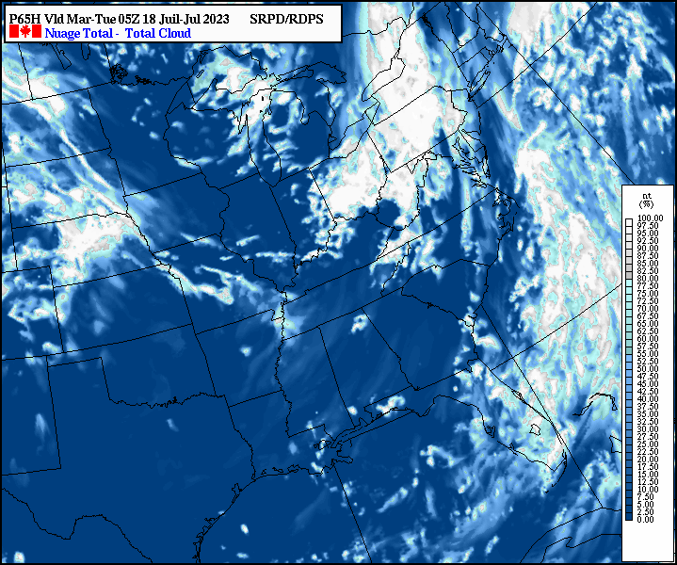
Notes:
But sometimes it’s harder. The Canadian model – which I often use – has yet another map projection, and no cities marked. So now I’ve got to do more mental coordinate transformation to guess where my site is. And of course, the weather never cooperates – Nebraska looks cloudy. So now I’ve got to find another clear site on the path – but where is the rest of the path? I’ve forgotten exactly, since I’d focused just on my site.

Slide 8
Notes:
So it’s back to Google Maps to try to memorize the entire path – or most of it – not just a single point….

Slide 9
Notes:
…so when I go back to the weather site, I can mentally plot the path and try to find an opening. Looks like Illinois might be clear. But did the path go through Illinois? Or was it Indiana? Back to Google yet again to double-check. It’s the 21st century: Why can’t we just plot an occultation’s path directly over a weather map?

Slide 10
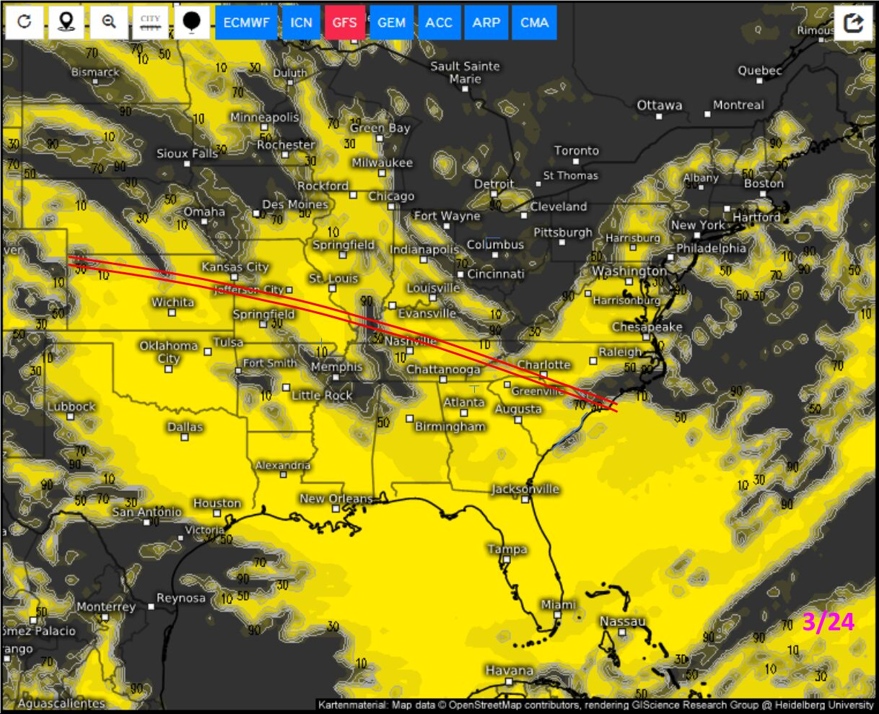
Notes:
I’ve thought about doing it manually, as some folks have done, for example by saving images in PowerPoint and hand-tracing the path overtop (this example is for a different event). But it’s tedious, needs constant manual updating with each new forecast, and certainly doesn’t scale across many events. I haven’t seen any site automatically plot occultation paths – or any KML – directly over live weather maps. If you have, please let me know, so I can stop duplicating effort. So I decided to give it a shot…

Slide 11
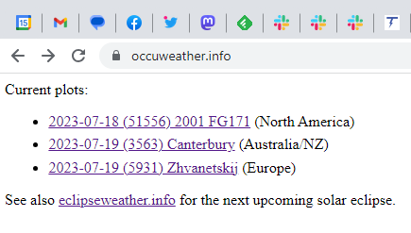
occuweather.info
Notes:
…I call it OccuWeather (a great suggestion I can’t take credit for). It’s still under development, so the interface is changing and few events are listed. But at the top of the site, you pick an event link (let’s say the 2001 FG171 event here)…

Slide 12
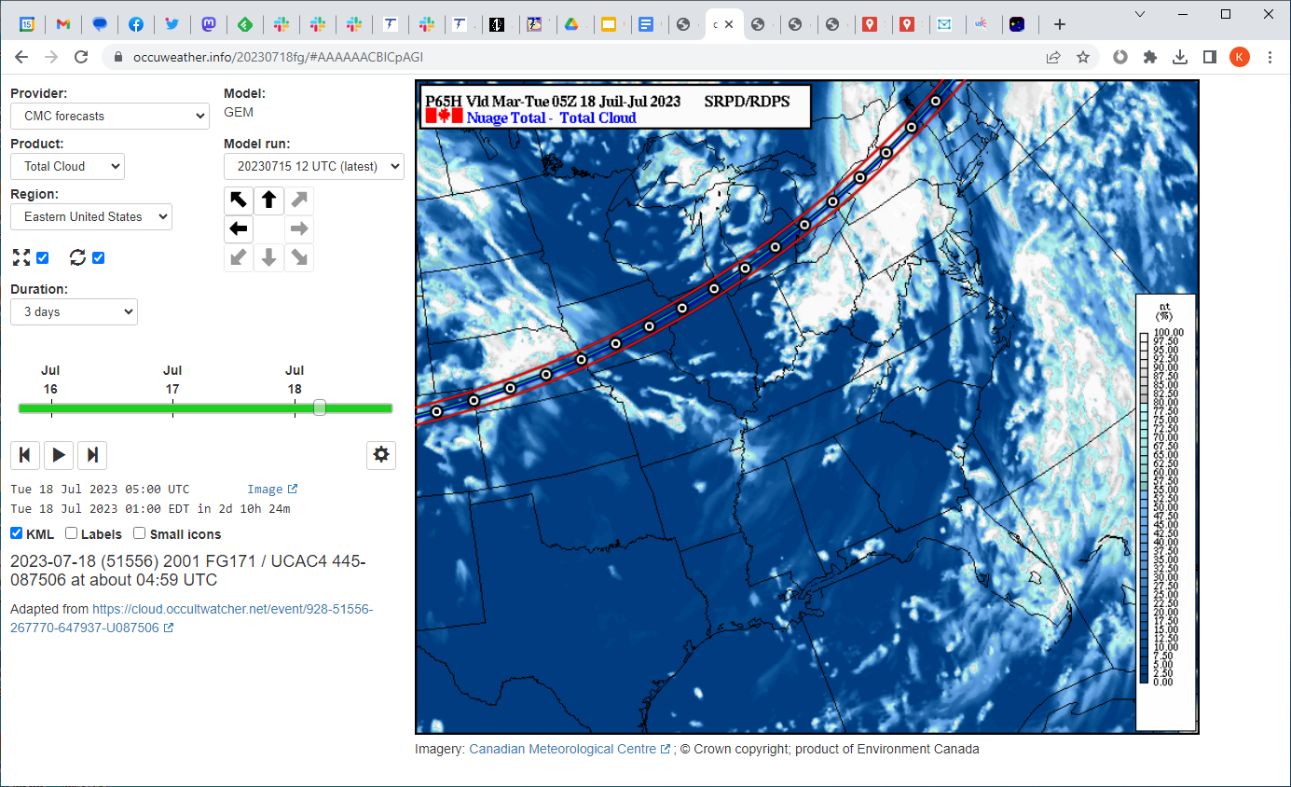
Notes:
…and you get an event page that plots a live weather map, with the event path overlaid atop. You can compare the path with Google Maps, and see that it does follow the map accurately…

Slide 13
Notes:
…despite the projection difference.

Slide 14
Notes:
The map can be animated or jogged, of course…

Slide 15
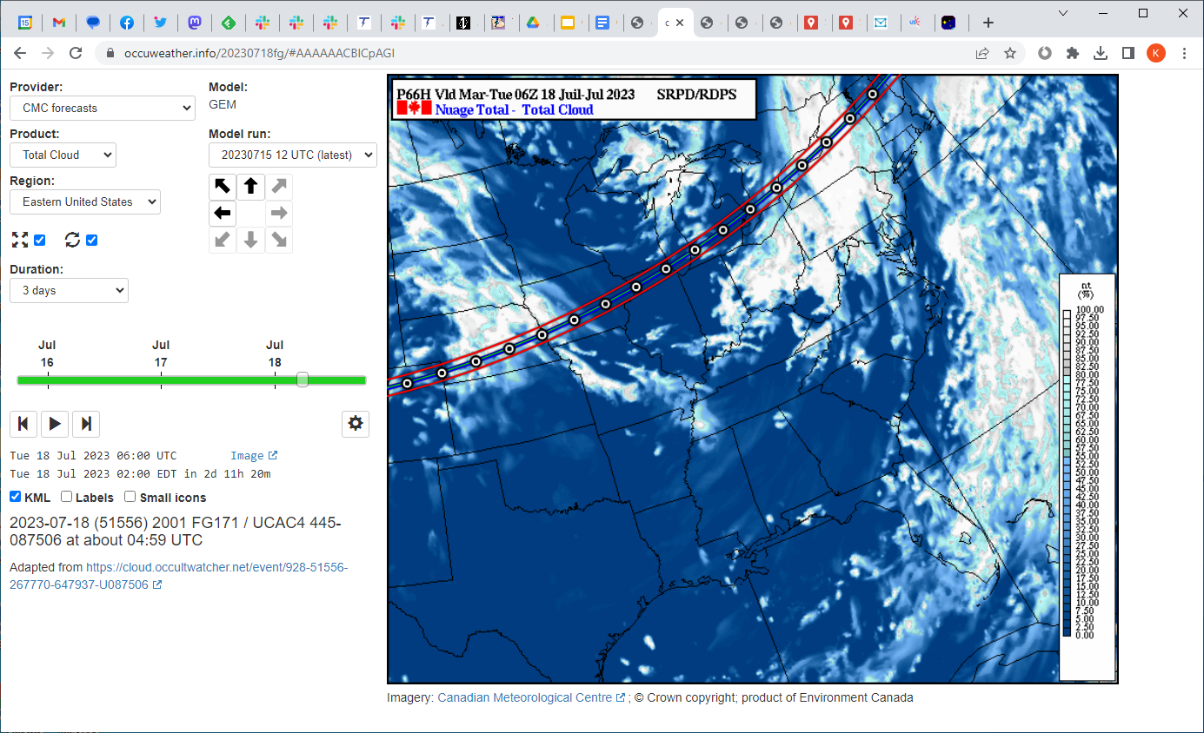
Notes:
…to show weather evolution over time.

Slide 16
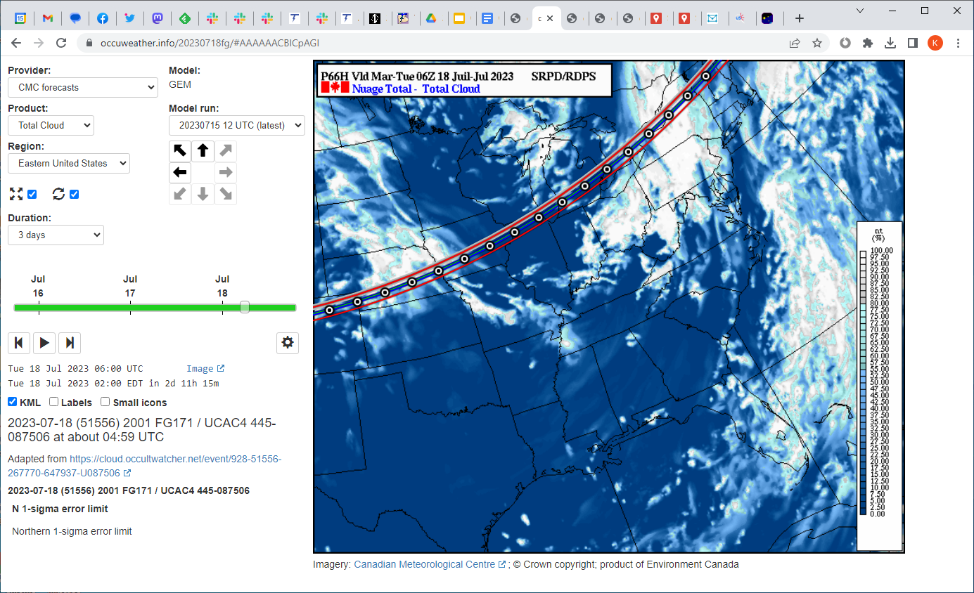
Notes:
The KML elements are somewhat active, and will show their details when hovered over or clicked on, such as when I click on the green central line here.

Slide 17
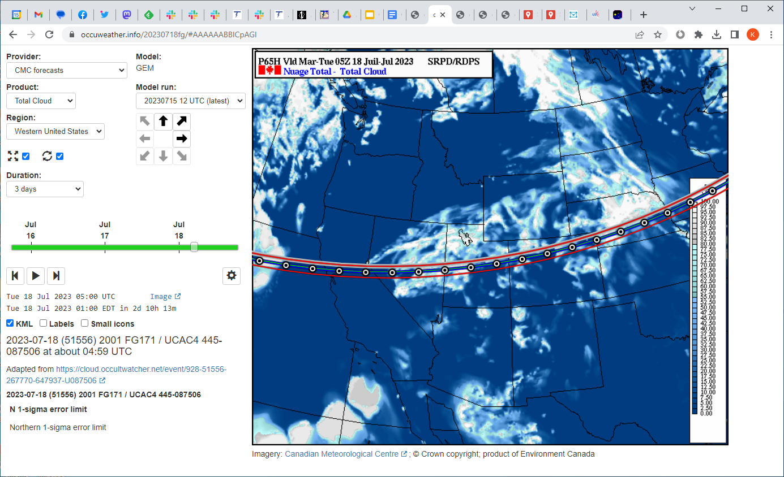
Notes:
We can of course pan to different regions, with the arrows or the Region: select box; so I can pan west here.

Slide 18
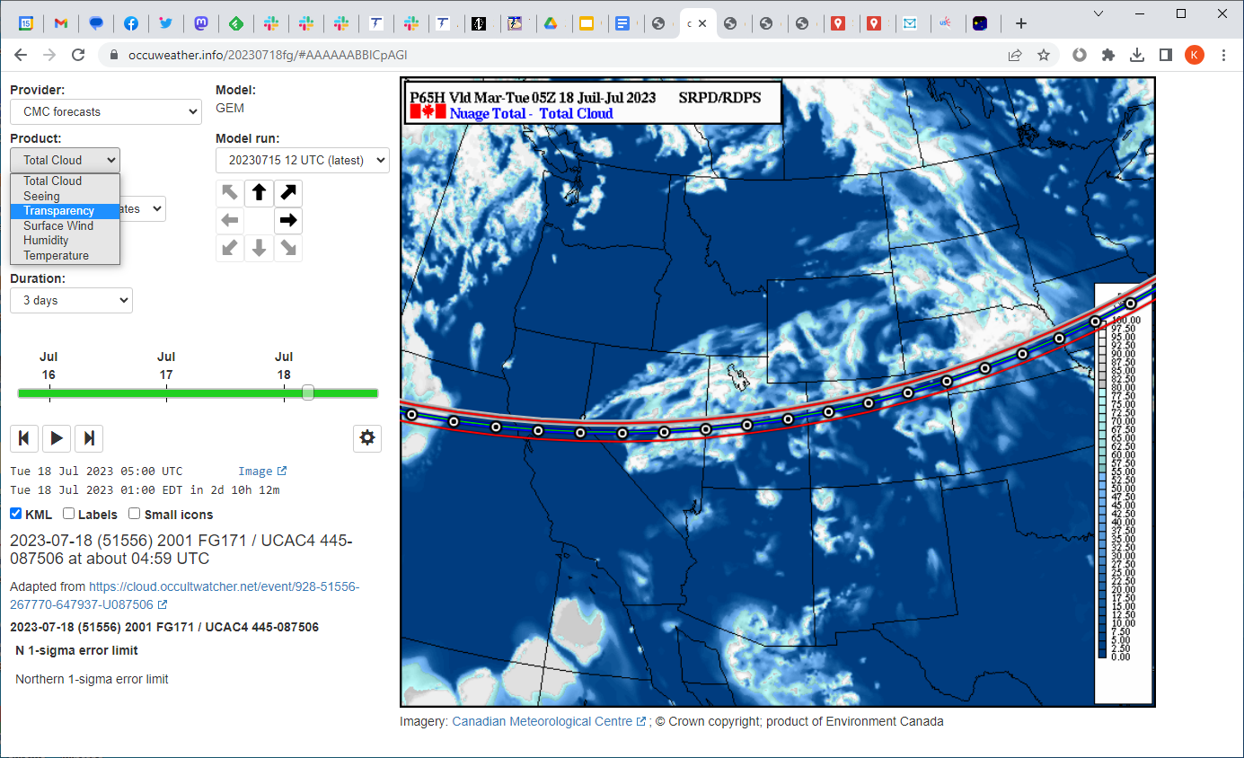
Notes:
Different products are available besides cloud cover, depending on the provider…

Slide 19
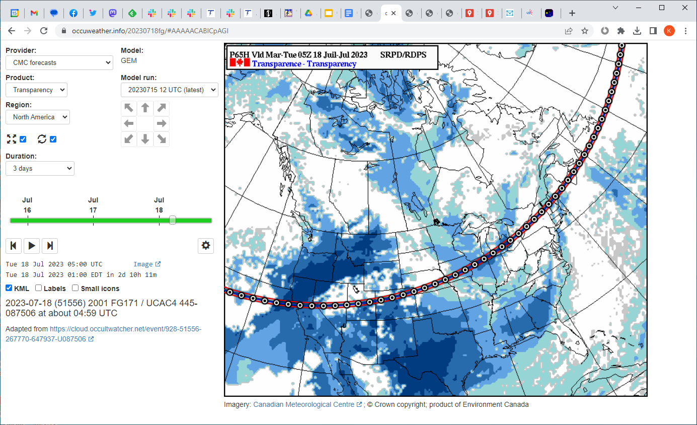
Notes:
…such as Transparency for the Canadian forecasts.

Slide 20
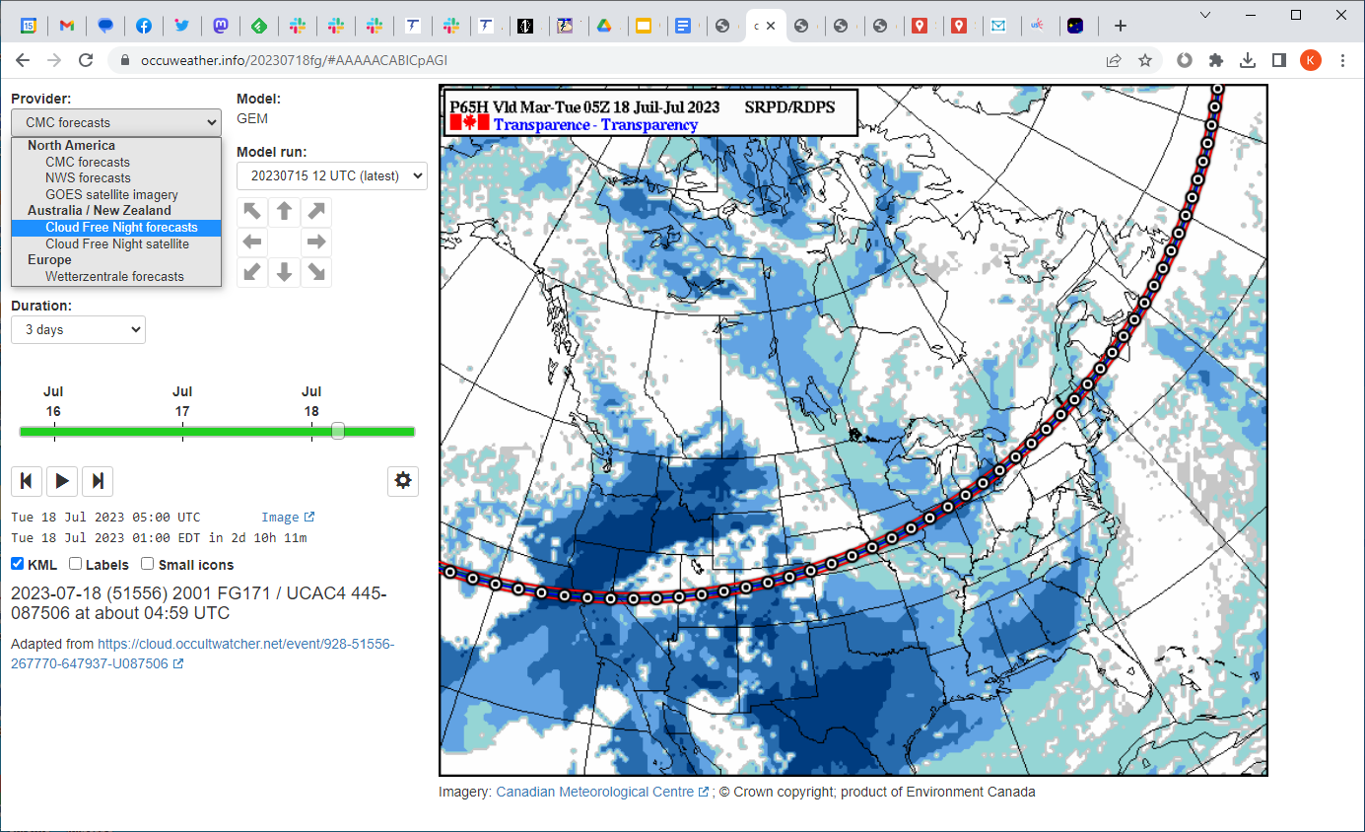
Notes:
Some other parts of the world are covered via other providers…

Slide 21
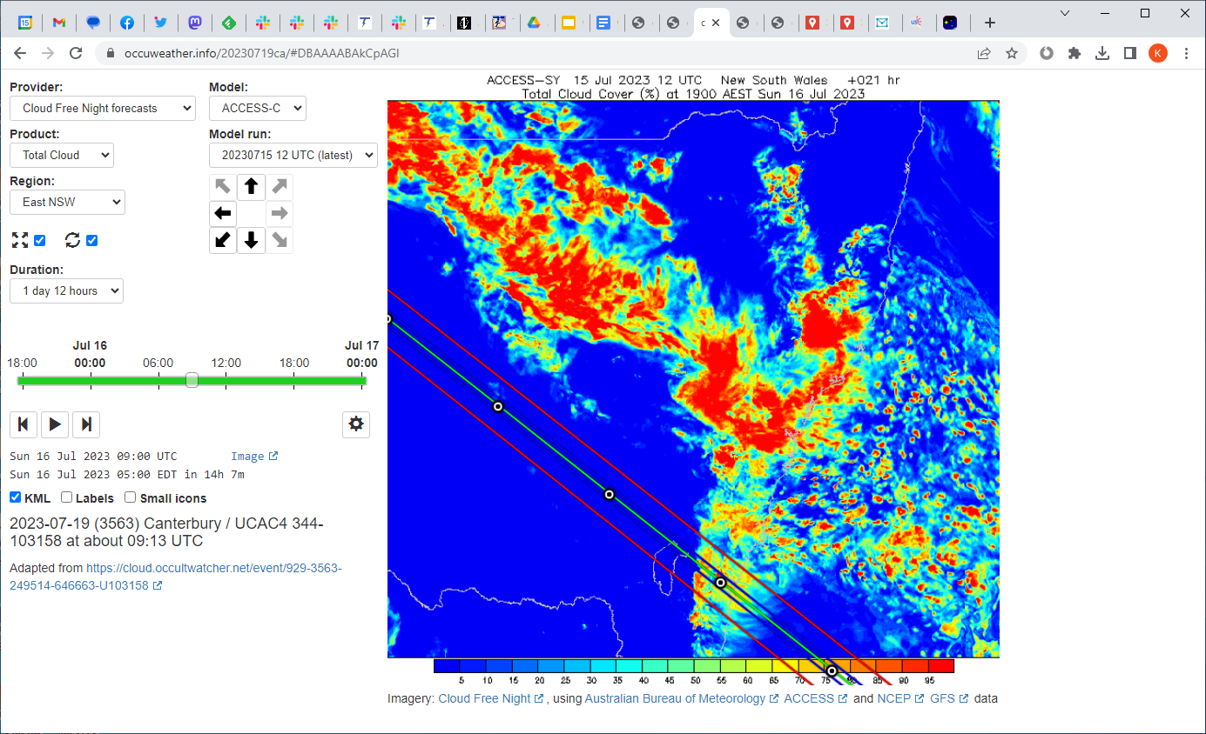
Notes:
…Australia/New Zealand is covered via Cloud Free Nights, the creator of which has generously allowed me to use his imagery…

Slide 22
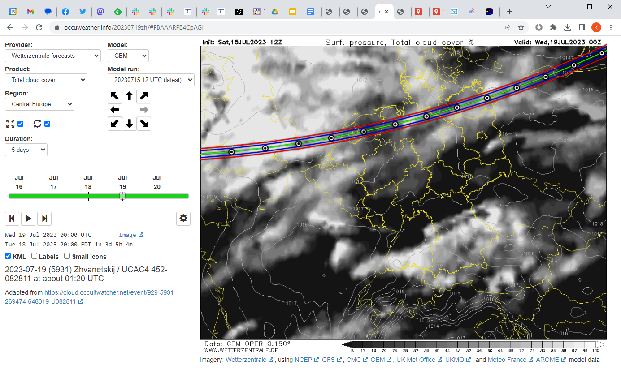
Notes:
…and Europe is covered via Wetterzentrale. Each provider has its own products, regions, and models, so there are differences amongst them.

Slide 23
Pros
Event path mapped on live weather forecast
Full-browser scale imagery
Same interface across providers
Shows UTC, and your local time
Notes:
So, what are the benefits to occuweather? Of course the main one is being able to see an event’s path directly on a weather forecast. But also, the interface shows the weather imagery at full browser scale; I find it easier to use that way. And the interface is the same across providers, so selecting the correct time is consistent. I also show UTC – since we work in that – and the user’s local time, not an arbitrary timezone of the website.

Slide 24
Cons
Same interface across providers
Missing features on providers’ original websites
Limited events for now (manually added)
Limited providers
Suggestions welcome
But technical and legal requirements must be met
Full-frame static images
Predictable image URLs
Permissible to show live images on third-party websites, with acknowledgement/link
GUI and everything else needs work
Notes:
Downsides? Well – the interface is the same across providers: some bells and whistles that might be available on some providers’ websites aren’t available here. There are also very limited events available for now, as I have to manually add each one. Limited providers – I’d love to add more, and suggestions are welcome. But there are some tech and legal requirements. And of course, the GUI and most everything else needs work.

Slide 25
Future work
Automatically set event time
Click on map to get lat/lon of any point
Mobile support
Integration with OccultWatcher Cloud?
Notes:
Speaking of work, I have a todo list a mile long. But here are some of the major items I’m considering. I’d like to make pages automatically set the display to event time – if it is known, chances are that’s the time you’re interested in. The ability to click anywhere – not just on a predefined KML point – to get a point’s lat/lon would be useful. This could help when you find a clear area on the event path, and want to transfer that to Google Maps for more site scouting. Mobile support would also be nice – the site is nearly unusable on a phone currently. And finally, in the long term I’d like to explore integrating with OccultWatcher Cloud, so that when you find an event there, a link would take you straight to an occuweather page for that event, without having to touch KML at all.

Slide 26
Feedback and event suggestions welcome
occuweather.info (occuwx.me for shorter URL)
kaigetrost@gmail.com
Notes:
That’s about it. Feedback is welcome, the site is occuweather.info. Feel free to suggest events to add; as I said, everything’s manual at this stage so I only add events I’m interested in. But it’s easy to add more, so if there’s one coming up you want a page for, just email me. Thanks.

