Slide 1
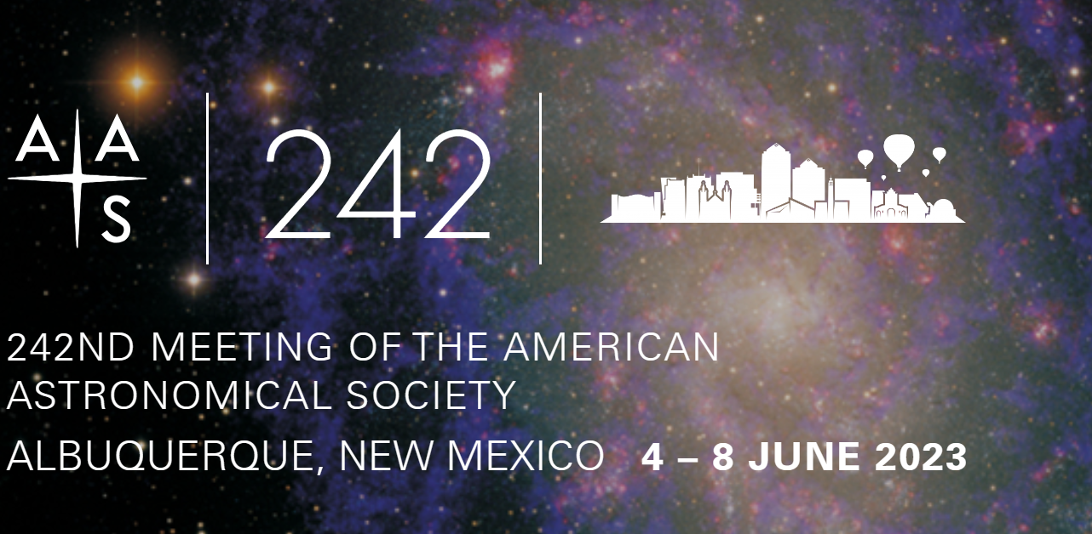
Outreach at NEAF and Other Meetings
IOTA Meeting July 15 2023
Joan Dunham

Slide 2
Outreach
Actions we take to present astronomy in an interesting way
The most common technique: Set out telescopes for public viewing
Often quite enjoyable for both the outreacher and the outreached
Not an effective way to attract occultation observers
How CAN we find new observers?
How can we measure the effectiveness of our outreach efforts?

Slide 3
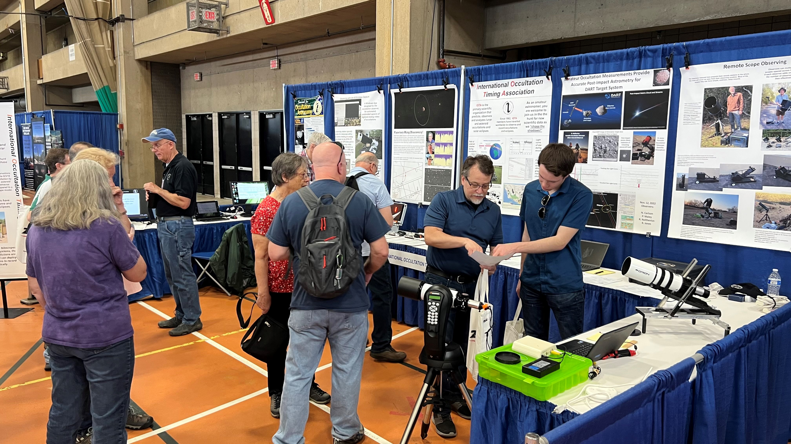
NEAF
IOTA had a booth and gave a lecture at the 32nd North East Astronomy Forum and Space Expo (NEAF 2023, www.neafexpo.com), hosted this year by the Rockland Astronomy Club on April 15 & 16 at the SUNY Rockland Community College in Suffern, New York.
NEAF is fun, interesting talks, lots of vendors, lots of people
Roxanne Kamin was IOTA’s lecturer, gave a well-attended presentation on chasing tiny shadows cast by asteroids occulting stars
Do we gain observers or add members from these booths and lectures?
A very good question. I do not have a very good answer. New members post NEAF: 1
David gave a talk on occultation observing to ChesMont Astronomical Society which they requested after meeting us at our NEAF booth.
See the short note on this year’s IOTA NEAF activities in the most recent issue of JOA

Slide 4
Other Meetings
Presentations and papers using data obtained by citizen scientists are excellent tools for outreach, showing prospective observers their efforts are valued
Results of analysis incorporating occultation observations my not be available until long after the occultation itself has occurred, frustrating to those who want immediate confirmation of their efforts.
Observers are frequently unaware of how or when their data are used, even when they are specifically acknowledged for their efforts.
In-person meetings allowing interaction between observers and the analysts have multiple benefits for both the observer and the analyst but:
Meetings can be expensive.
Information on meetings may not be widely circulated beyond professional astronomer organizations.
Attending meetings, even virtually, can be time consuming.
Meetings I will describe were open to citizen scientists

Slide 5
AAS Workshop - Small Ground and Space Telescopes in the New Era of Big Telescope Survey*
Organized by AAVSO director Brian Kloppenborg and Russ Genet
Questions addressed:
How can small telescopes contribute to science?
Attracting students and citizen scientists to astronomical research
A meeting summary and access to the presentations is in the works
Perhaps of interest to IOTA, two AAVSO efforts we might emulate
AAVSOnet – a network of member owned and managed telescopes available to other members for specific observations
AAVSO how-to hours – member-to-member assistance
Comments
Outreach discussions focused more on teaching very motivated high school and college students than on encouraging citizen science engagement
I requested that the workshop summary include a request for more emphasis on developing cameras that can time occultations
*Held in conjunction with the 242nd American Astronomical Society Meeting in Albuquerque, NM 4-8 June 2023

Slide 6
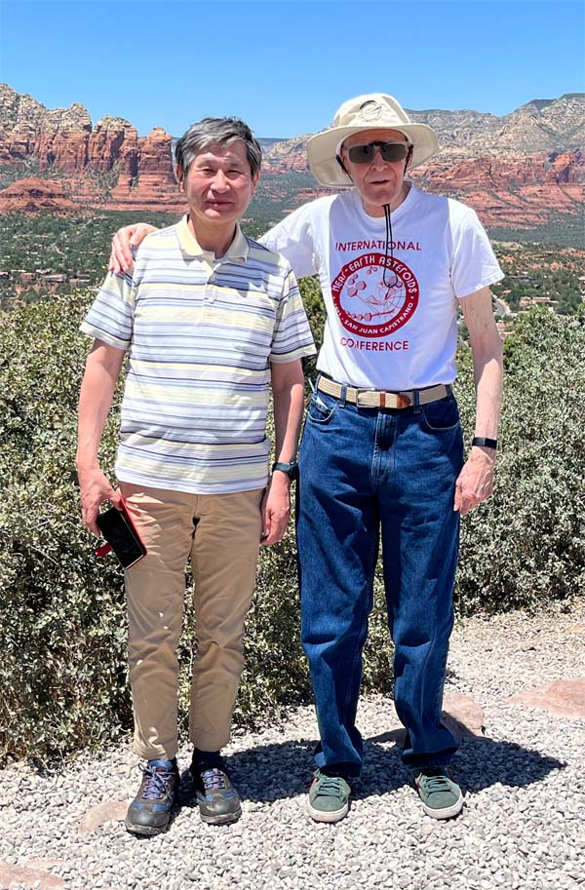
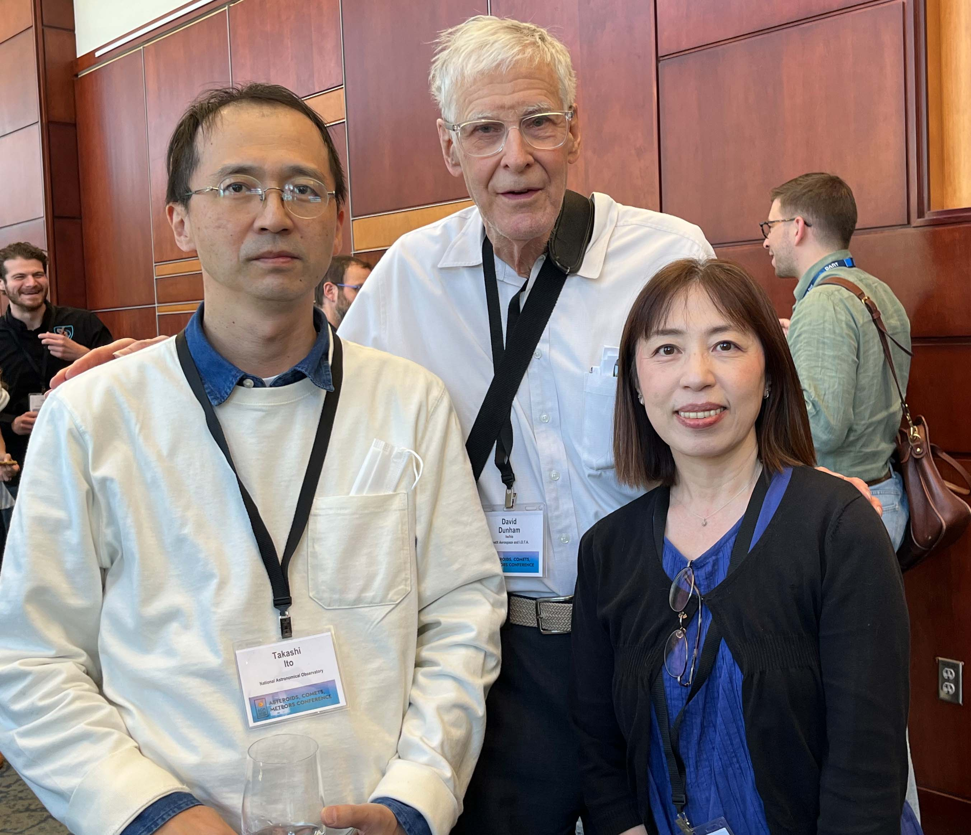
Asteroids, Comets, Meteors Conference 2023 June 18-23, Flagstaff AZ
Meeting in a series held every 3 years
Multiple presentations including or highlighting the work of occultation observers
Nice confirmation of the many hours observers have spent on observing activities
Face-to-face interactions with others a very enjoyable part of this meeting
No proceedings from this conference will be published.
Isao Sato and David Dunham
Takashi Ito, David Dunham, Fumi Yoshida

Slide 7
Gaia Team
Presented Gaia@home, providing access to tools and data, see www.gaiaathome.eu
Highlighted the Arecibo satellite discovery as the satellite discovered by the two occultations in May and June 2021 is also detectable in the Gaia data.
The 2023 Focused Release contains data for over 150,000 solar system objects, almost all of them asteroids
A special issue of Astronomy and Astrophysics was published in June on the Gaia Data Release 3. See www.aanda.org and select Volume 674 June 2023.

Slide 8
SWRI Presentations on Lucy Targets
Marc Buie - Polymele occultation observations
Very desirable to determine the orbit of Polymele’s companion, Shaun, prior to the Lucy spacecraft flyby.
Current knowledge from the two single-chord Shaun occultations obtained so far is not sufficient to determine that moon’s orbital period about Polymele
There are two good opportunities, in Feb 2024 in Mexico and in April 2025 in Australia.
See September 2023 Sky and Telescope for his article on occultations by all of the Lucy Mission targets.
Hal Levinson – analysis of Polymele occultation data suggests that it is also, like Arrokoth, a somewhat flattened “hamburger patty” shape
SWRI has searched for good occultations by the Lucy targets. Brian Keeney and others listed 16 in a poster on the subject. They are also listed on the SWRI website.

Slide 9
Presentations on Occultation Observations
Comet 29P/Schwassmann-Wachmann – SWRI presentation on 3 separate attempts, 2 in December 2022 and one in this past January.
Is SW1 a comet or is it an asteroid? Or was it once a comet but now is in a stable orbit within the Trojans and is gradually losing its volatiles?
NEA Occultations – Multiple papers on occultations by Phaethon, Apophis, and Didymos and their observations by multiple professional and non-professional scientists.
Much of this has already been described in David’s presentations

Slide 10
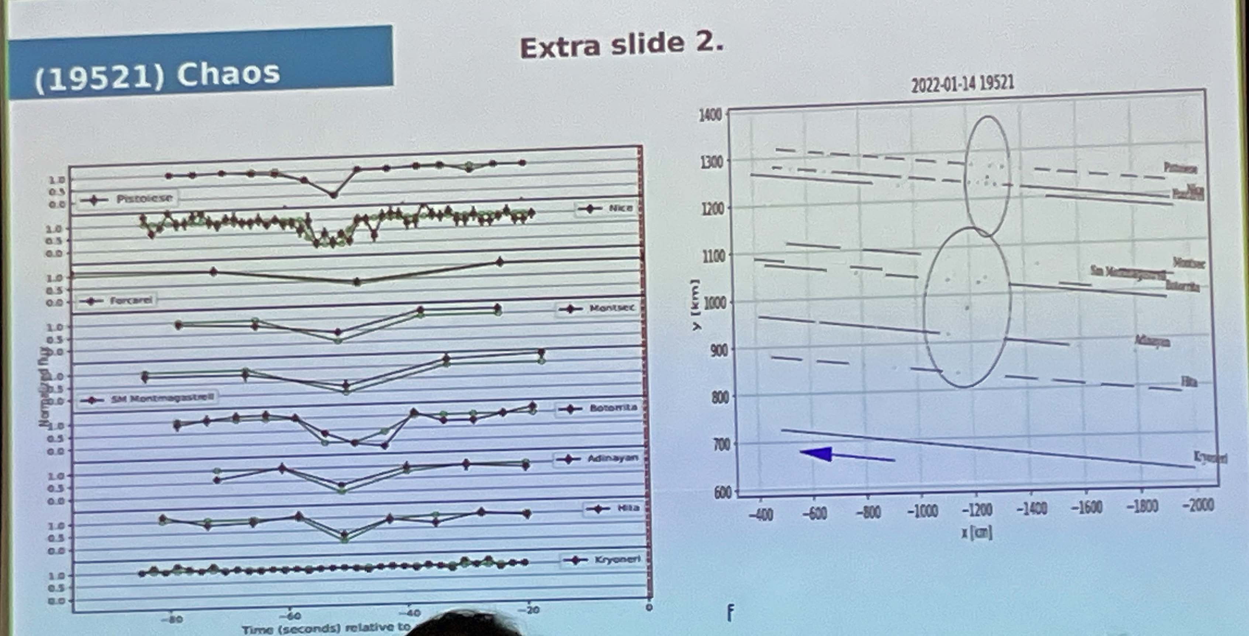
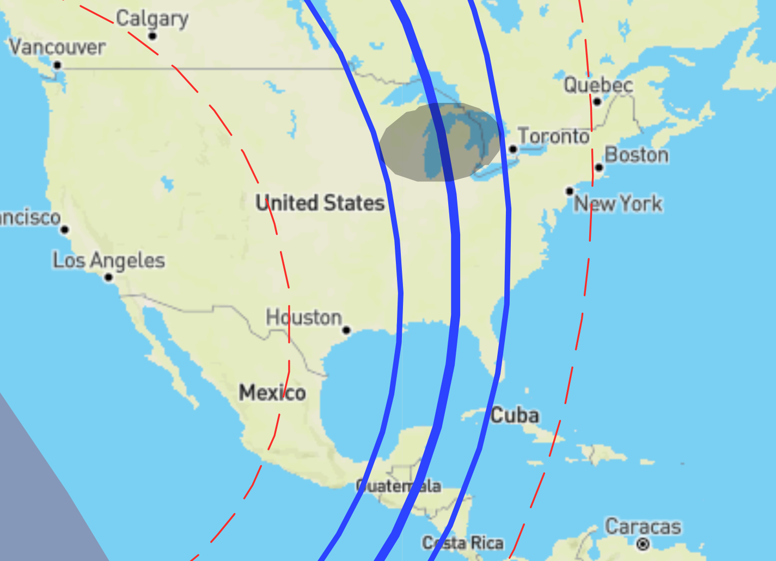
Occultation by (19521) Chaos
Rodriguez Leiva – presented on a previously unreported occultation by this interesting TNO, with an upcoming occultation through the middle of the US on 09/28/23. See https://lesia.obspm.fr/lucky-star/occ.php?p=124402
Event date
28 Sep 2023
07:15: UTC
Star G mag = 13.5

Slide 11
Other Items
Announcement by Peter Jenniskens of his new book, An annotated atlas of Earth's meteor showers, available for pre-order on Amazon and by the publisher, Elsevier.
Joel Castro, a poster on “The Mexican Network for Stellar Occultations: A Professional and Citizen Science Collaboration”
Minor Planet Center described upgrades made and expectations for future ones to manage the data volumes expected in the future. They have started a monthly newsletter to communicate with their users as well as the general public.

Slide 12
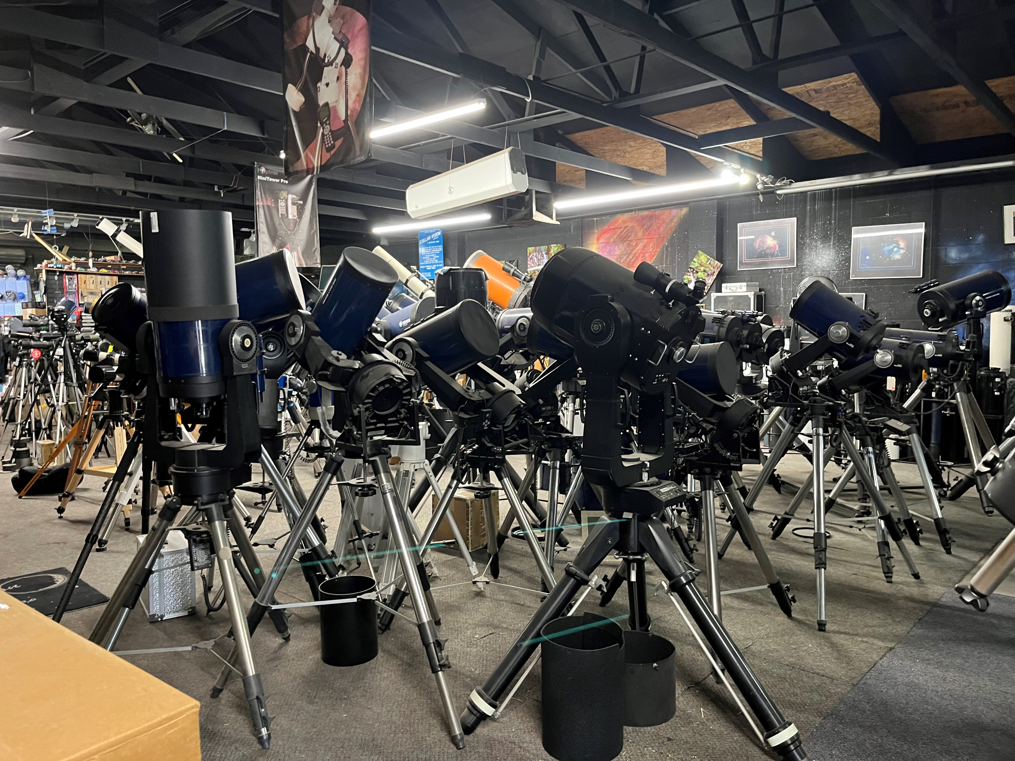
Ideas on Future Outreach Efforts
This country is awash in small, unused telescopes.
Is this an opportunity for future outreach?
Can we develop easy-to-use and inexpensive solutions so underutilized scopes could be reasonable options for occultation observations?
Would more people be interested in observing if we did do that?
Used scopes for sale at Stellar Vision

Slide 13
Derald Nye’s telescope
On display in the Stellar Vision shop in Tucson. Frank Lopez describes it as excellently machined and very well made.

