Slide 1
What happens with your observations
An outline of processing, and what happens with the results
Dave Herald

Slide 2
Step 1 - Observations
Regional coordinator
Brings observations together, and prepares an event file
Identifies any problems, and communicates with observers to resolve them
Generates and adds a ‘postdiction’
Fits ellipse to observations
Initial fit to shape models
Initial double star analysis
Initial asteroid satellite analysis
Coordinates with other coordinators when event crosses multiple regions
When OK, send to Global coordinator, in batches of 10
Time frame:
Days…

Slide 3
Stage 2 Global coordinator
Regional coordinator
Australasia
Time frame
< 2 months
Quality Assurance
Superficial overall check of the report
Closely review:
shape model fitting,
double star solutions,
possible asteroid satellite
Review chord consistency
Merge Unistellar observations
Where an observation looks like there might be a hidden problem, ask questions
When OK, add to main file
Regional coordinator
Europe
2nd level
Quality Assurance
Review events on a
Monthly basis, when events for that month are globally complete
Regional coordinator
Japan
Regional coordinator
North America
Regional coordinator
South America
Unistellar

Slide 4
What happens to the results?
Size and shape
Astrometry
Double stars
Asteroid moons
Archiving

Slide 5
Size & shape of asteroids
Original motivator for occultations
Multichord events are required
Only get a single profile – a problem since asteroids generally have significant irregularities
Combine with shape models good diameters
Shape modellers use occultation results to improve models
Occultation diameters demonstrate that diameters from satellite (eg NEOWISE) are quite reliable. Significant differences caused by albedo issues
Publication of results - almost non-existent. MNRAS paper gave an indication, but no more. The forthcoming PDS archive will have a full table of results, for those with shape models
Have been used, in combination with mass measurements from orbital perturbations, to derive densities of some asteroids.

Slide 6
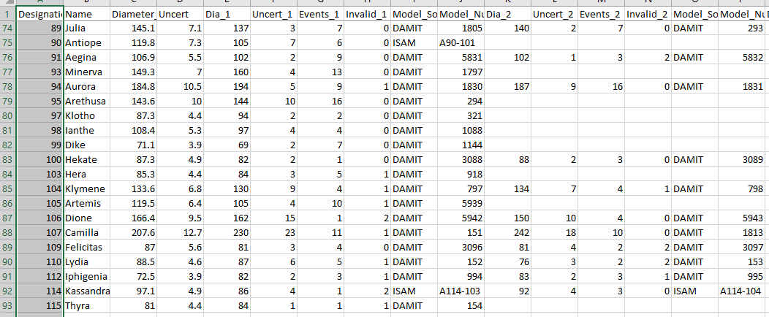
Asteroid diameters from shape model fitting
# events model invalid
Nominal
Dia & Uncert
# events used
x km ± y km
Shape model

Slide 7
Astrometry 1/4
Discussion with Director of Minor Planet Center in 2003. Essential element – ‘certainty’ that an occultation occurred
First report submitted 2007. Processing at MPC was outside of usual processes, using special dedicated software to process
2019-2023: our submissions put on hold.
Serious review of entire backfile, multiple times.
develop a detailed error model (guidance/assistance from Horizons);
MPC implementing new systems; also implementing the new IAU standard ADES (Astrometry Data Exchange Standard), with that ADES standard needing to be revised to accomodate the high accuracy available with some of our observations
New MPC Observatory code allocated 275 Non-geocentric Occultation Observations
Reporting has now recommenced. But MPC still has some implementation issues. Unlike before, processing will be main-stream
Special events – direct reporting to JPL Horizons, with rapid orbit updates

Slide 8
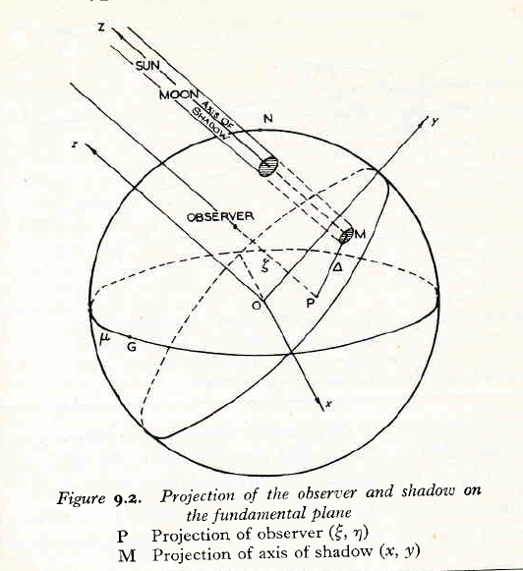
Basis of our Astrometry 2/4
In this image: Sun = Star Moon = Asteroid
Star casts shadow of asteroid on the ‘Fundamental plane’ - a plane normal to the direction of the star
As seen from the center of that shadow, the asteroid has the exact same position as the star
The astrometric report specifies the (x,y,z) coordinate of the center of the shadow on the fundamental plane. The report is exactly the same as for astrometry from orbiting satellites – except our satellite is ‘inside’ the Earth
(x,y,z)

Slide 9
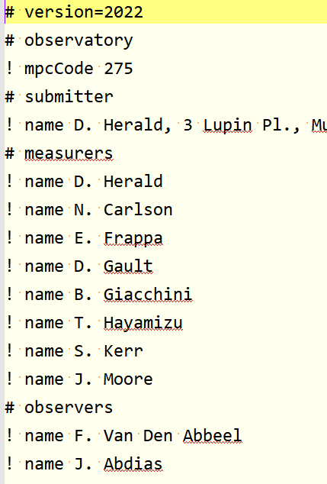
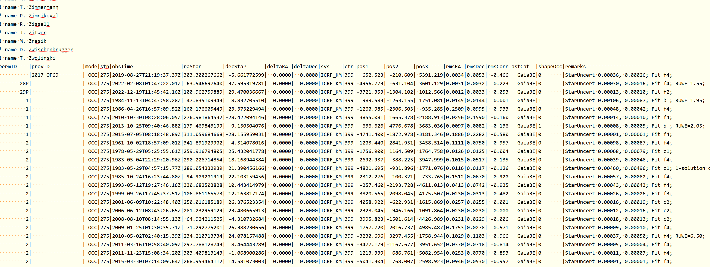
Example ADES astrometry report

Slide 10
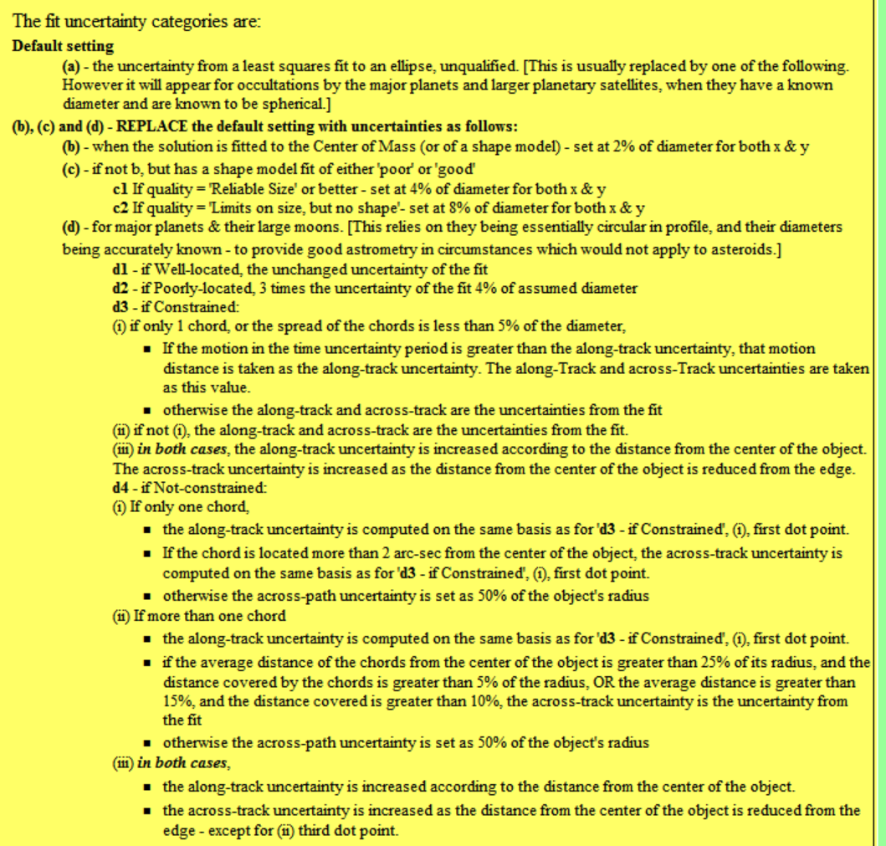
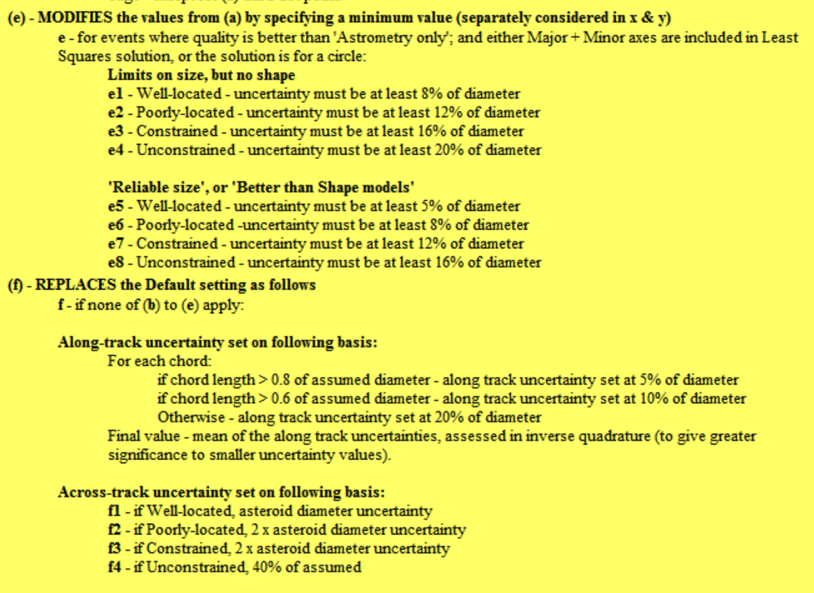

Slide 11
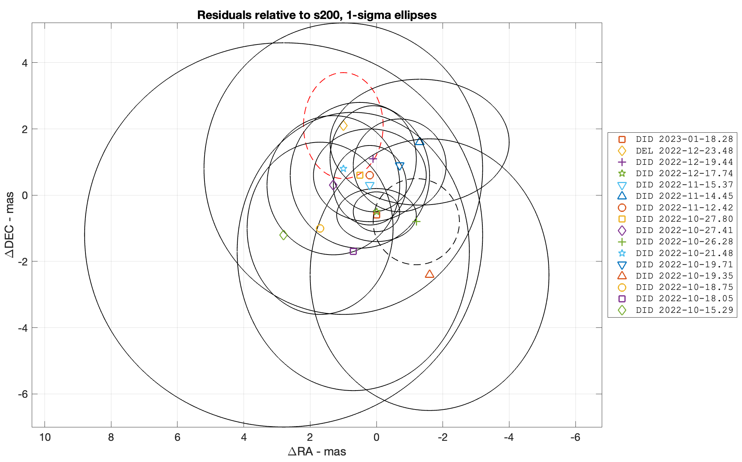
Astrometry 3/4
Didymos residuals – mas
High credibility in our observations => orbit updates at Horizons within hours of receipt of each of the occultation results

Slide 12
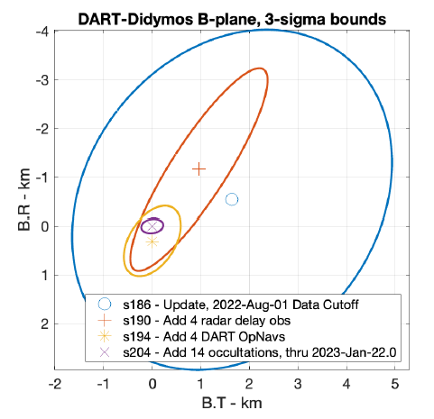
Astrometry 4/4
Occultation results better than:
DART OpNavs system (ie position from the DART satellite navigation system)
Radar observations
The best traditional astrometry before the event

Slide 13
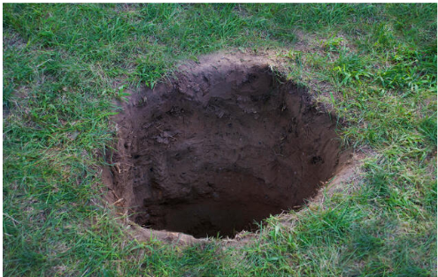
Double star discoveries – 1/3
Small number each year
Observers entitled to have their discovery formally recognised, with an entry in the Washington Double Star catalog
This requires a publication is Journal of Double Star Observations
Used to be managed by Brian Loader (New Zealand)
Current situation:

Slide 14
Double star discoveries – 2/3
Paper format quite basic.
Observed data required : light curve(s); star ID, mag & cords; asteroid ID; date
Computed data required : double star solution(s)
Observers have most of the information required. A standard pro-forma paper would enable observers to easily prepare a paper
Will need support with the double star solution
Regional coordinators don’t have the spare time

Slide 15
Double star discoveries – 3/3
Proposal
‘someone’ does the work to create a pro forma paper (probably 2 or 3 to cover several situations)
Observers involved with the discovery use their data to ‘fill in’ the paper
Coordinator(s) provide assistance with the double star solution
Paper reviewed by coordinators (or someone who takes on that role)
Paper submitted

Slide 16
Archiving – with NASA’s PDS system
Originally arranged by David Dunham
Has been paused for several years – as for astrometry
Next archive almost ready to go
A lot of work needed to describe every field. For asteroids
each event has 260 columns of data - with there being more than 8,800 rows of data (2.2 million data items)
each observer within each event has 42 columns of data – with there being more than 36,000 rows of data (1.5 million data items)
Each column is required to have a full description of its content

Slide 17
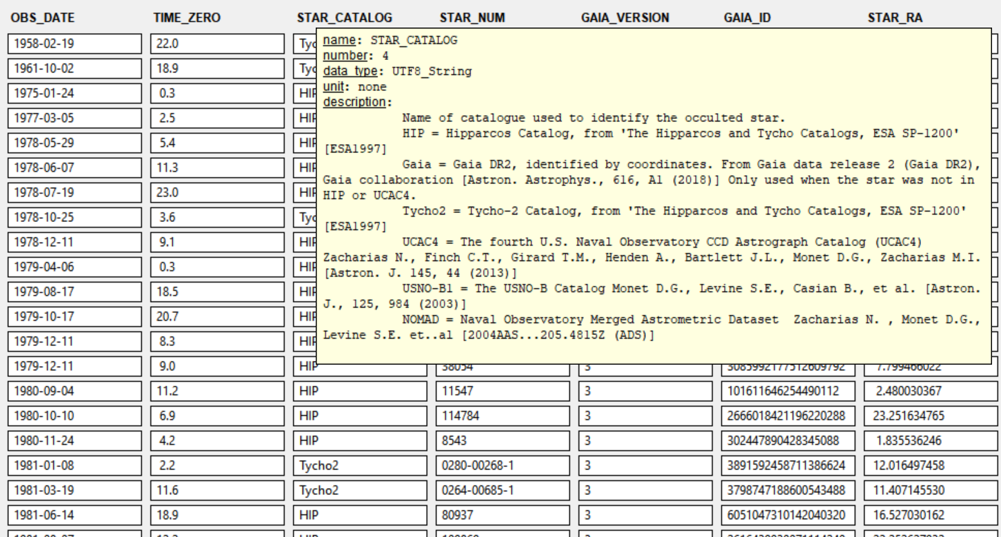
Illustration of archive data – PDS4 Viewer

Slide 18
Archive file content
Archive files give:
The observations (events, observer details)
Diameters from Shape Model fitting
Astrometry
Double Stars

Slide 19
Any Questions?

