Slide 1
Glossary of terms used in this presentation
Aperture: a square box that contains a sampling mask and moves in response to a selected tracking star. (This differs from common usage of this term)
Static (fixed) mask: a traditional circular measurement mask
Dynamic mask (shape fitting computed mask): a non-circular measurement mask that snugly encloses star images
DNR (drop to noise ratio): used in occultation astronomy when there is a positive event with a measurable drop
SNR (signal to noise ratio): with no drop present, the signal referred to in this case is the baseline value
Fit metrics: a collection of numbers that characterize the most significant parameters of a found event
Notes:
I will begin this talk by thanking Tony George for the many contributions he made to this paper.
As always, Tony diligently tested the new PyMovie features that have been added to improve light curve extractions.
And, as always, he pushed to make the new features easy to use and, hopefully, to be understood.
So --- thank you Tony.

Slide 2
Methods for improving light-curve extractions from videos
To begin with, we need to ask
What do we mean by ‘improving’ a light-curve extraction?
Some reasonable answers to what it is we’re looking for…
… more precise timing (smaller edge time error bars)
… a higher DNR (drop to noise ratio)
… a lower likelihood that the event found was due to noise
Notes:
Square wave occultations are the focus of this discussion because, unlike penumbral occultations or diffraction occultations, only D and R edge times and their associated uncertainties (error bars) are needed to characterize an event.

Slide 3
The short answer for improving light-curve extractions
The simple formula …
Apply multiple measurement methodologies in multiple ways to get lots of light-curves
Pick the ‘best’ light-curve
Step 2 is the tricky one. It must be objective, repeatable, and based on a set of metrics that can be easily understood and calculated.
Such a set is described in the next slide …
Notes:
The method, if one can call it that is: measure the video a bunch of times in different ways and pick the best result – BUT, and that’s a big but, that ‘pick’ must be guided by reliable metrics

Slide 4
To pick a ‘best’ light-curve, use a comprehensive set of metrics
Metrics of any given light-curve event solution that are likely to be useful:
Edge time uncertainty (error bars) – here, smaller is better – this a logical metric since the objective of light-curve analysis is to determine edge times – the 0.95 ci value is used
DNR (drop to noise ratio, previously referred to as SNR) – larger is better
False-positive metric – an indicator of how different from noise the event found is – higher is better, but any value greater than zero is good – negative means the test was failed The next slide will illustrate this new term
The latest version of PyOTE outputs the above metrics (and others) for each light-curve analyzed in Excel file format. That file can be used to justify the selection of a particular light-curve used to report the ‘event’.

Slide 5
false-positive metric = (Observed drop / Maximum noise produced drop) – 1.0
Notes:
This, almost infamous plot, is the false-positive test that has relegated many a marginal observation to the ‘no event’ bin.
The blue mound is a histogram of the number of times a drop – with a duration equal to that of the candidate event – was found in what should have been just noise. 50,000 attempts were made to find such a drop in artificial noise, generated anew for each attempt. The largest drop found is designated by the short black line.

Slide 6
Roadmap of this talk
Topics
Case study of a Paul Maley observation using ‘nested’ circular masks
Computed (dynamic) masks that adapt to the image – introduced in PyMovie
Case study from an observation with heavy wind shake treated with dynamic masks
Naylor style ‘optimum extraction’ (NRE) - new addition to PyMovie
Caveats for each measurement methodology

Slide 7
Case study: Paul Maley observation of 2023-06-05 CIRCE magDrop: 0.5 (v) duration: 13.4 secs (with permission)
This case study demonstrates the use of a nested set of increasing radius fixed circular masks to select the ‘best’ light-curve to report. This is a classical method often referred to as ‘growth curves’ in the literature. It starts with a small mask which is too small to gather all the signal from the star and so has a small signal to noise ratio (SNR). As the mask size is increased, more star signal is captured, and the SNR grows larger. Eventually, a point is reached where all available signal from the star has been captured inside the mask perimeter and so increasing the mask just adds more sky noise, causing the SNR to decrease.
Background:
This was not a particularly difficult video to work with, even with the nearby moon producing an average background of about 128 counts from a Watec-910 camera.
But Paul was troubled by the fact that depending on how he did aperture and mask selections in PyMovie, he would get different answers. He was not satisfied with that situation and so sent the video to me to ‘explain or fix’.
The first step I took was to place a set of static apertures containing fixed radius circular masks in increasing sizes as shown in the next slide.
Notes:
Paul will grab his 8 inch telescope and drive hours to attempt occultation recordings of dim stars, often requiring 8x or 16x integration setting on the Watec910 that is his camera of choice.
This was NOT one of those marginal events.

Slide 8
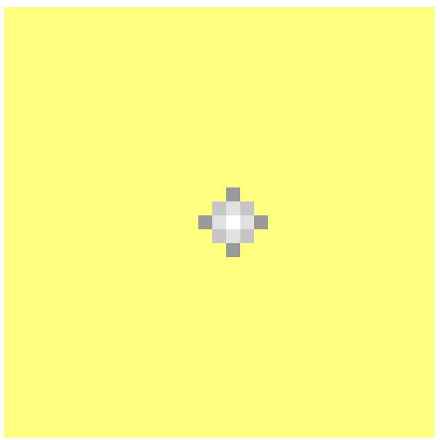
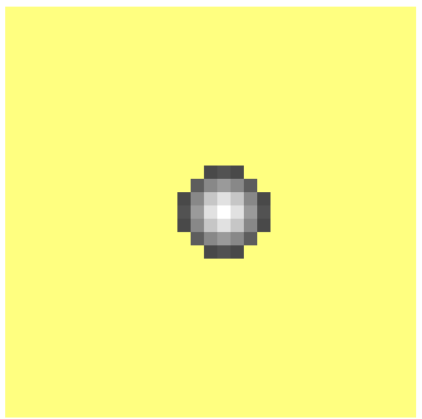
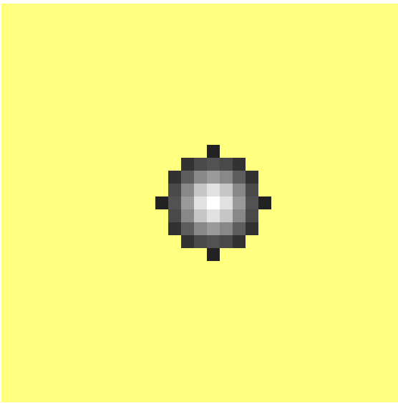
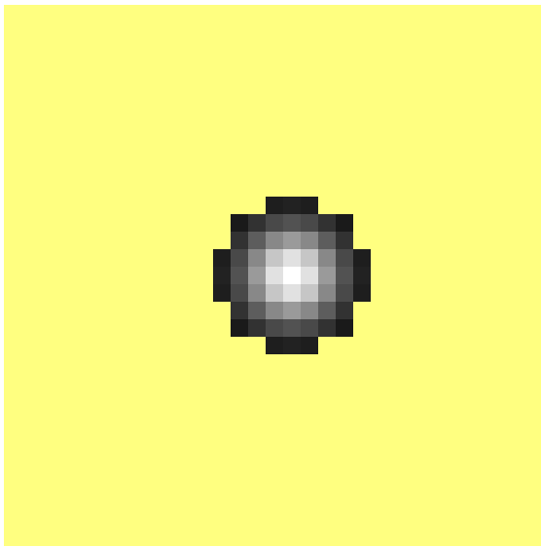
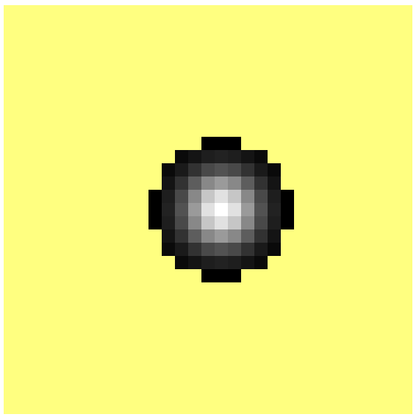
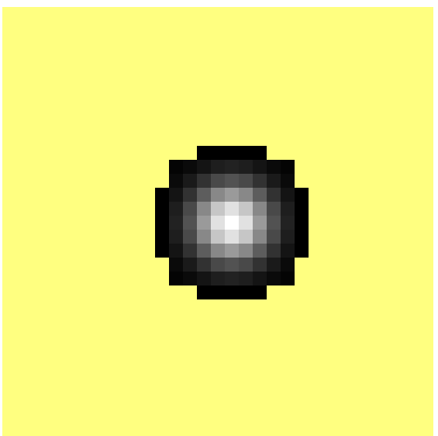
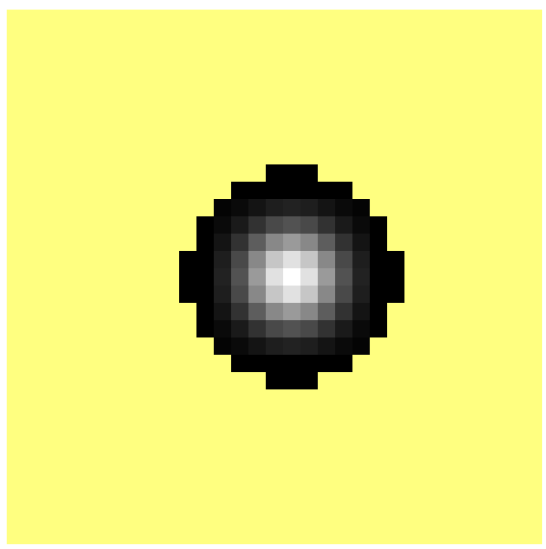
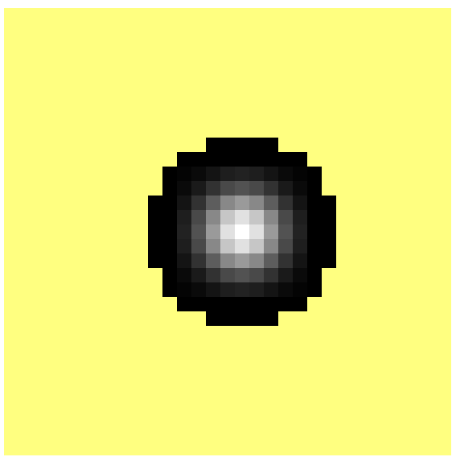
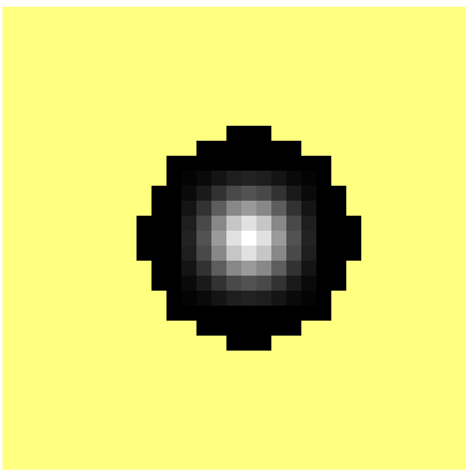
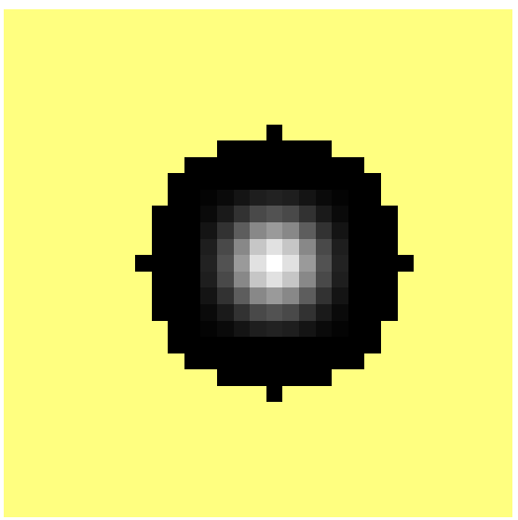
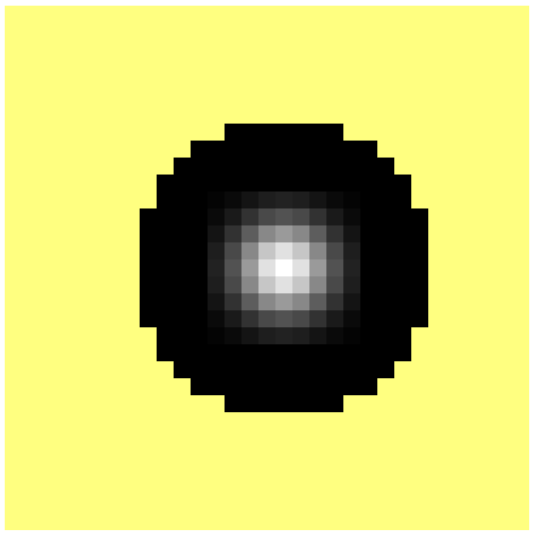
13 pixels
21 pixels
37 pixels
49 pixels
61 pixels
89 pixels
101 pixels
121 pixels
137 pixels
161 pixels
197 pixels
241 pixels
Nested fixed circular mask set: radii 2.0, 2.4, 3.2, 4.0, 4.3, 5.1, 5.7, 6.1, 6.5, 7.2, 8.0, 8.8

Slide 9
In PyMovie, a nest of 12 fixed radius mask apertures can be put in place with a single click
Notes:
This is a new feature in PyMovie as of version 3.7.7, which was released on June 30
We’re already at version 3.8.2, so it continues to evolve.

Slide 10
Next steps after placing nest of apertures
Step 1: run PyMovie to extract the set of light-curves and save them to a csv file
Step 2: Open that csv file in PyOTE
Step 3: In the Square-wave model tab, set the event finding parameters (either mark D and R regions if they are obvious, or set a minimum and maximum event duration)
Step 4: Do a ‘find event’ using the light-curve with the smallest radius mask.
Step 5: Repeat step 4 for each of the other light-curves with increasing radius masks
Note: For each Step 4 and Step 5 sequence, the metrics for the solution found are automatically written to a text file.
Step 6: Click the button on the SqWave tab to save the fit-metrics text file, converted to Excel .xlsx format, with a name of your choice.
Step 7: Examine the Excel file and choose the ‘best’ light-curve to use for your report.

Slide 11
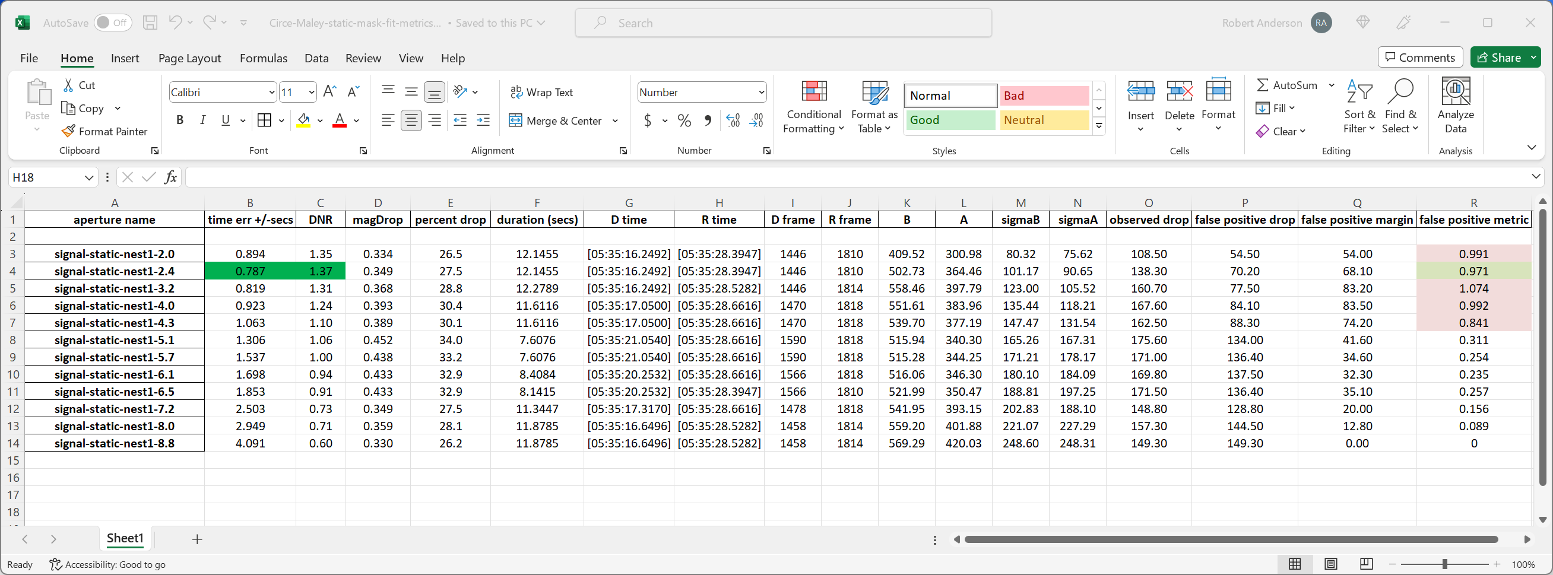
CIRCE-Maley analysis: circular mask set
Notes:
The choice here is guided by the edge time uncertainty metric (0.95 ci value) and is highlighted in green.
At the far right is the false-positive metric introduced earlier.
I’ll show that slide again …

Slide 12
false-positive metric = (Observed drop / Maximum noise produced drop) – 1.0

Slide 13
CIRCE-Maley analysis: circular mask set
Notes:
Here we can see that the top three entries all have an excellent false-positive metric.
We can also see that the ‘picked’ light curve does not have the highest value of this metric, but it is MORE THAN GOOD ENOUGH!
FYI: The Occult stated magDrop for this event was 0.5
A point I should make: the edge time values and the false-positive metric are the result of a simulation – repeat runs will therefore give slightly different values – so how reliable (repeatable) are these numbers?

Slide 14
Statistical study of repeat estimations of edge time uncertainties and false-positive metrics
Notes:
This tiny study shows that the edge time ‘jitter’ is at least an order of magnitude lower than the false-positive metric ‘jitter’.
The edge time metric is typically good to 2 and half digits – so it is repeatable and accurate.

Slide 15
We’re not done with the CIRCE-Maley case study…
So far, in the CIRCE-Maley case study, we have used the classical aperture photometry method of summing the pixel values enclosed in a circular mask and subtracting the sky background value to get the star signal value.
But other measurement methods are available: we’ll digress to another case study to introduce another method, then we’ll return to the CIRCE-Maley case study and add a few more light-curves that employ this additional measurement method.

Slide 16
A little history
The motivation behind the original development of PyMovie was to create a tool for dealing with videos that had been recorded in windy conditions.
Wind-shake videos often distort and smear the star image to such an extent that a fixed size circular mask, in order to count all the pixels comprising the star image, must be so large that many extra sky pixels get included as well, resulting in an overly noisy light curve.
The core idea in that original PyMovie version was to shape a mask that closely followed the contours of the star image, thus minimizing the number of extra sky pixels and giving a lower noise light-curve as a result.
PyMovie was barely operational when an occultation by Pluto was recorded in gusty wind conditions – that is our next case study.
Starting off with a video that graphically shows the problem on the next slide ...

Slide 17
Notes:
This short movie provides a good visual of the kind of wind shake that needed to be dealt with.

Slide 18
Dynamic mask calculated for frame 113 compared with a circular mask large enough to capture all star pixels
Notes:
Here’s one of the more outrageous examples (but not rare in this video) of star pixels being smeared by wind shake.

Slide 19
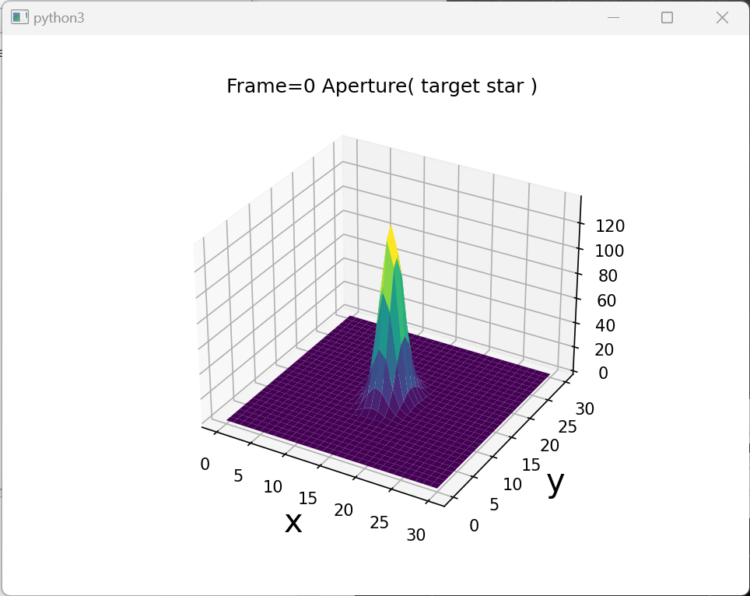
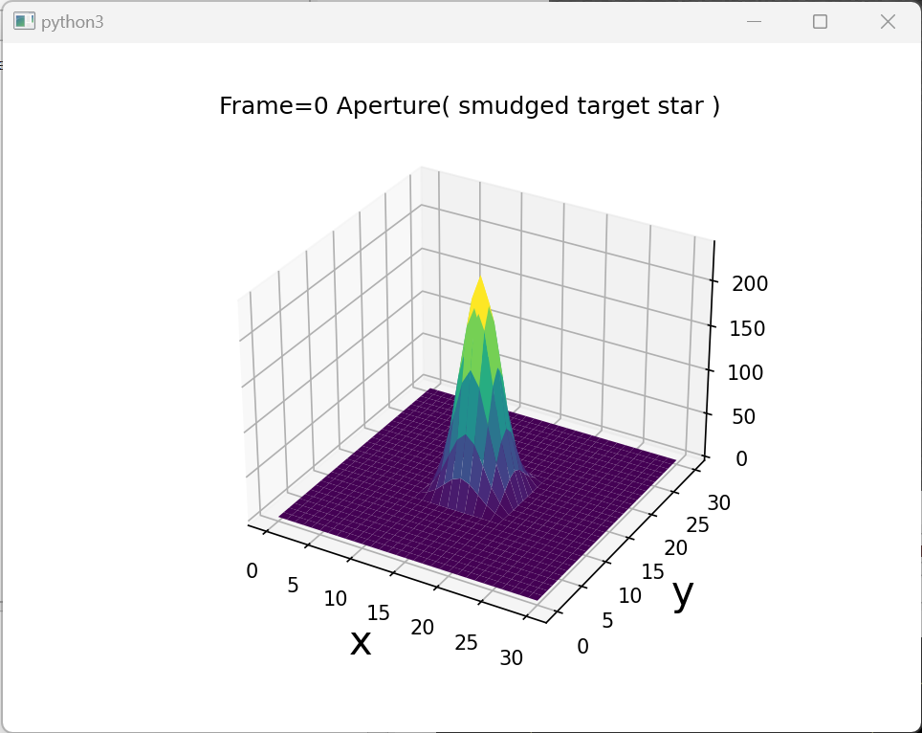
Steps in creating a dynamic mask:
Starting star image
Image smudged with a 5x5 Gaussian filter.
This smooths and extends the edges.
Notes:
I hope this 3D plot will help to visualize how the dynamic mask is calculated.

Slide 20
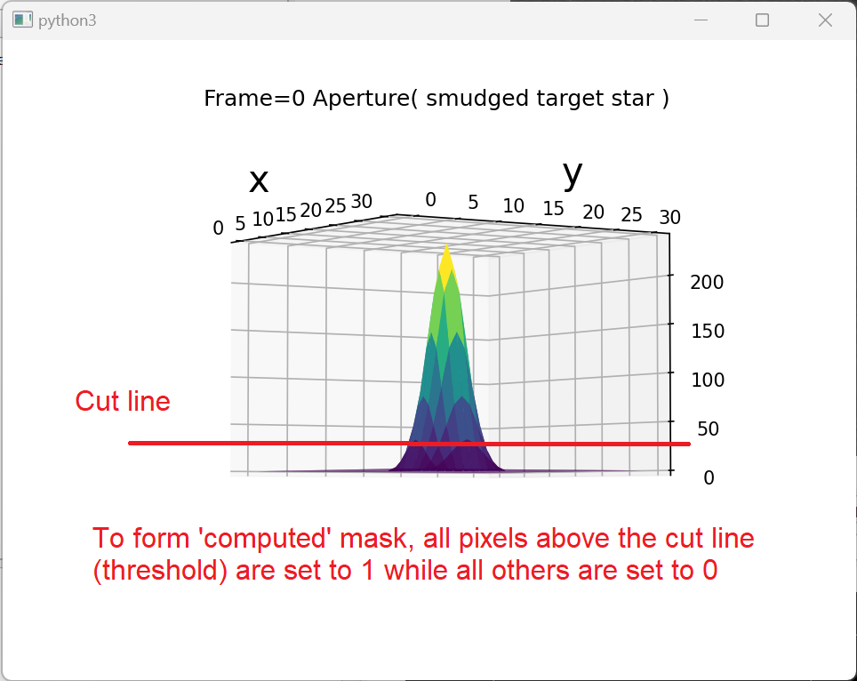
Final step in creating a dynamic mask:
In the final step of computing a dynamic mask, the threshold value provided by the user as a parameter is used to create the mask. Lower threshold values create larger masks; higher threshold values create smaller masks.

Slide 21
Pluto light curve extraction results: circular mask versus dynamic mask
Notes:
The researchers that shared and challenged the newly developed PyMovie with this video were quite happy with this result.
The PyMovie version number was 0.7.0 at this point in time.

Slide 22
Dynamic masks also help with speckled images - example from Kirk Bender 20230512_Eunomia recording (with permission) From MIRA 36” f10 telescope; no focal reducer; Watec 910HX
Notes:
I find this little movie rather entertaining, and it provides a good visual of another situation where a dynamic mask can produce lower noise extractions.

Slide 23
Caveat for dynamic mask usage in PyMovie
In order to compute a form fitting dynamic mask, the star must be bright enough that there are at least 9 pixels in the resulting computed mask.
If the computed mask contains less than 9 pixels, a fixed circular mask is substituted with a size selected by the user.
But the shift from a computed mask to a fixed mask can introduce a “glitch” (a dip or a spike).
This effect can be minimized by careful selection of the default circular mask, in which case this mode shift can be benign, but the user must check carefully that the light-curve extraction has not been compromised.
PyMovie helps with this with a color-coded light-curve plot that shows successful mask computations as red dots and in places where a default circular mask was substituted, a black triangle replaces the red dot as shown in the next slide.

Slide 24
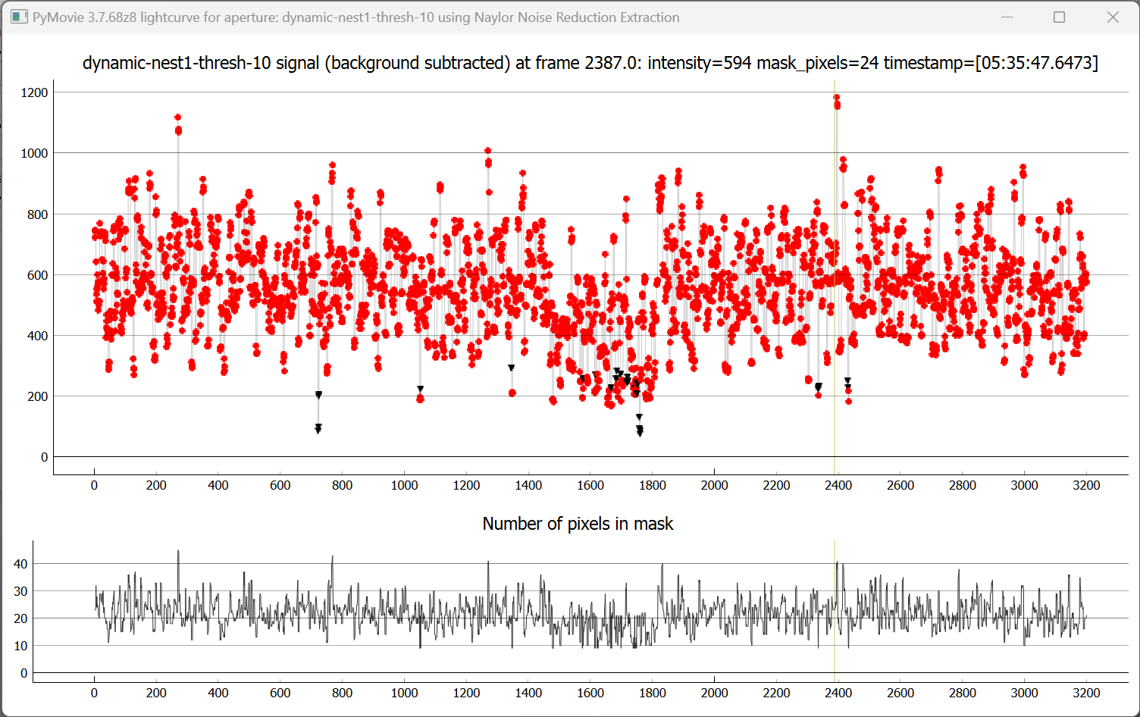
Notes:
Note: the position of the ‘event’ is quite apparent in the plot of the number of pixels in the computed mask.
This makes sense: where the star intensity decreases, the computed mask will shrink – that is, it will have fewer pixels.
NOTE: The black triangles show were the default circular mask had to be used – and those points are very similar to their neighbors, indicating the user made a good selection when the default size was specified during aperture placement.

Slide 25
Returning to CIRCE-Maley case study

Slide 26
In PyMovie, a nest of 6 dynamic mask apertures can be put in place with a single click
Notes:
Again, this is a new feature in PyMovie as of version 3.7.7 released on June 30

Slide 27
Next steps after placing nest of apertures
Step 1: run PyMovie to extract the set of light-curves and save them to a csv file
Step 2: Open that csv file in PyOTE
Step 3: In the Square-wave model tab, set the event finding parameters (either mark D and R regions if they are obvious, or set a minimum and maximum event duration)
Step 4: Do a ‘find event’ using the light-curve with the smallest threshold dynamic mask.
Step 5: Repeat step 4 for each of the other light-curves with increasing threshold dynamic masks
Step 6: Click the button on the SqWave tab to save the fit-metrics text file, converted to Excel .xlsx format, with a name of your choice.
Step 7: Examine the Excel file and choose the ‘best’ light-curve to use for your report.

Slide 28
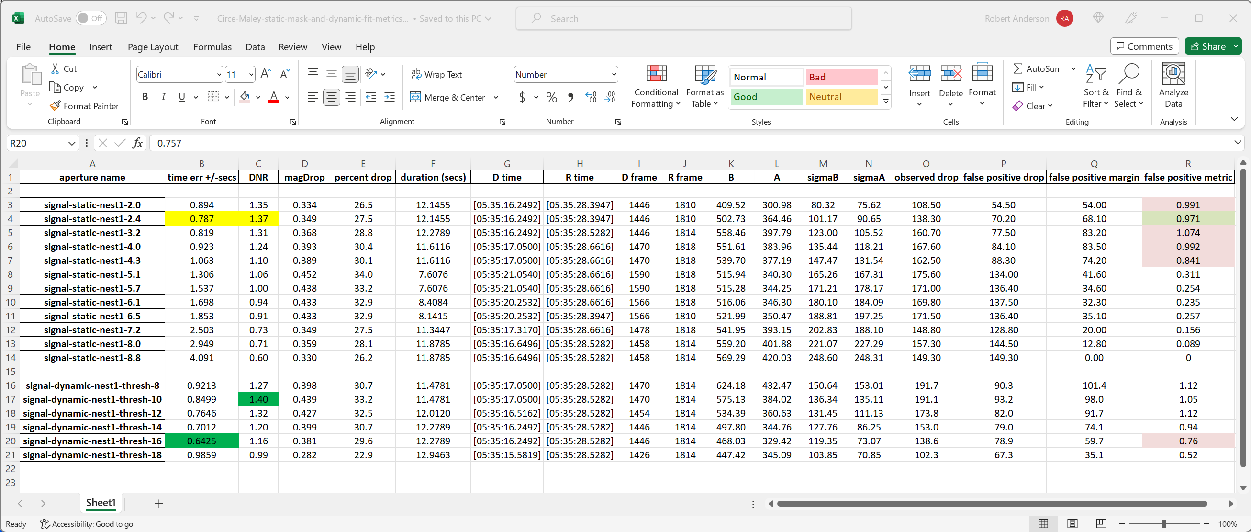
Notes:
The new extractions using the dynamic mask method have been added to our Excel metrics table --- and we have a new ‘best’ candidate light curve.

Slide 29
But - we’re still not done with the CIRCE-Maley case study
So far, in the CIRCE-Maley case study, we have used the classical aperture photometry method of summing the pixel values enclosed in a circular mask and subtracting the sky background value to get the star signal value and the dynamic, form fitting mask method developed originally for dealing with wind shake.
But there are yet other measurement methods possible, and we’ll digress to explain another method, then we’ll return to the CIRCE-Maley case study and add one more light-curve that employs this additional measurement method.

Slide 30
Tim Naylor paper titled: An optimal extraction algorithm for imaging photometry
Abstract
This paper is primarily an investigation of whether the ‘optimal extraction’ techniques used in CCD spectroscopy can be applied to imaging photometry. It is found that using such techniques provides a gain of around 10 per cent in signal-to-noise ratio over normal aperture photometry. …
Mon. Not. R. Astron. Soc. 296, 339-346 (1998)
Notes:
I didn’t want to burden this portion of my talk with a lot of arcane equations, so I’m going to hand-wave my way through what this paper says and how PyMovie uses one of the findings of his paper.
If you want the math, the paper is easily found and its not a very difficult read.
I want to point out that he only promises a gain of around 10 percent in SNR. That’s not a lot, but it’s still worth-while in some cases.
My experience is that the 10 percent gain is about right, sometimes a little less, sometimes a little more.

Slide 31
The ideas underlying ‘Naylor extraction’ (NRE)
The principal idea is that brighter pixels have a higher SNR (signal to noise ratio).

Slide 32
The ideas underlying ‘Naylor extraction’
The principal idea is that brighter pixels have a higher SNR (signal to noise ratio).
To use this idea, a set of weights are calculated and used to increase the influence of bright pixels in a star image and decrease the influence of dimmer pixels in summing the star image pixels.

Slide 33
The ideas underlying ‘Naylor extraction’
The principal idea is that brighter pixels have a higher SNR (signal to noise ratio).
To use this idea, a set of weights are calculated and used to increase the influence of bright pixels in a star image and decrease the influence of dimmer pixels in summing the star image pixels.
In standard aperture photometry the weights are set to 1 for pixels to be included in the sum, and 0 for all others --- these form the mask.

Slide 34
The ideas underlying ‘Naylor extraction’
The principal idea is that brighter pixels have a higher SNR (signal to noise ratio).
To use this idea, a set of weights are calculated and used to increase the influence of bright pixels in a star image and decrease the influence of dimmer pixels in summing the star image pixels.
In standard aperture photometry the weights are set to 1 for pixels to be included in the sum, and 0 for all others --- these form the mask.
Any set of weights that are bigger for brighter pixels and smaller for dimmer pixels will help. But is there an optimal set of weights?

Slide 35
Optimal weights for use in ‘Naylor extraction’ (NRE)
To develop a set of optimum weights, the psf of the star image is assumed to be a 2D Gaussian, which has an equation involving the peak value (Imax), an x width parameter, and a y width parameter. It is written as a function of r, the distance from the point where the function has its peak value.

Slide 36
Optimal weights for use in ‘Naylor extraction’ (NRE)
To develop a set of optimum weights, the psf of the star image is assumed to be a 2D Gaussian which has an equation involving the peak value (Imax), an x width parameter, and a y width parameter. It is written as a function of r, the distance from the point where the function has its peak value.
The next observation is that, given a pixel value and its corresponding distance from the center (r), Imax can be calculated from the analytic expression, given a set of x and y width parameters (which are derived from some frames at the start of the video).

Slide 37
Optimal weights for use in ‘Naylor extraction’ (NRE)
To develop a set of optimum weights, the psf of the star image is assumed to be a 2D Gaussian which has an equation involving the peak value (Imax), an x width parameter, and a y width parameter. It is written as a function of r, the distance from the point where the function has its peak value.
The next observation is that, given a pixel value and its corresponding distance from the center (r), Imax can be calculated from the analytic expression, given a set of x and y width parameters (which are derived from some frames at the start of the video).
So, given n pixel values and locations, one can calculate a set of n estimated Imax values (Imax[i]) – how to best combine these estimates?

Slide 38
Combining the Imax[i] values statistically
Statistically, the way to combine the n Imax[i] estimates to extract a best single value for Imax is to divide each Imax[i] by its variance, which penalizes the dim noisy pixels, sum the result, and apply a normalizing factor as required. That is, use a weighted least squares estimate with the weights inversely proportional to the variance of each estimate.

Slide 39
Combining Imax[i] statistically
Statistically, the way to combine the n Imax[i] estimates to extract a best single value for Imax is to divide each Imax[i] by its variance, which penalizes the dim noisy pixels, sum the result, and apply a normalizing factor as required. That is, use a weighted least squares estimate with the weights inversely proportional to the variance of each estimate.
Naylor gives two formulations for calculating optimal weights using the above method.

Slide 40
Combining Imax[i] statistically
Statistically, the way to combine the n Imax[i] estimates to extract a best single value for Imax is to divide each Imax[i] by its variance, which penalizes the dim noisy pixels, sum the result, and apply a normalizing factor as required. That is, use a weighted least squares estimate with the weights inversely proportional to the variance of each estimate.
Naylor gives two formulations for calculating optimal weights using the above method.
PyMovie uses the form that Naylor refers to as sky-limited.
In the sky-limited formulation, the pixel variances can be assumed equal and do not need to be calculated.

Slide 41
Combining Imax[i] statistically
As a result of the sky-limited assumption, the optimum weights turn out to have a particularly simple form: they are simply proportional to the magnitude of the 2D Gaussian psf profile
The sky-limited formulation used in PyMovie means that the “Naylor extraction method’ (NRE) is particularly well-suited to extracting light-curves from very dim stars and can be applied to occultations that go to zero.

Slide 42
Returning to CIRCE-Maley case study

Slide 43
In PyMovie, an aperture with parameters set properly for NRE extraction can be put in place with a single click
Notes:
Again, a new feature introduced in version 3.7.7 of PyMovie released June 30
Clicking this menu entry adds a properly named aperture
--- a naming convention is utilized to specify which star is to be used to determine the psf and which other stars should have the NRE measurement applied ---
with a proper threshold and default circular mask size (which is used during the experimental determination of the psf)

Slide 44
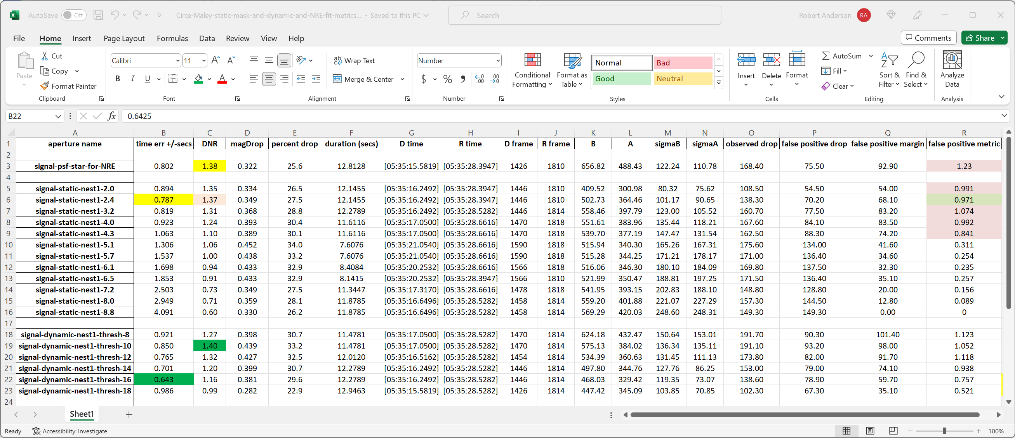
Notes:
The metrics for the NRE aperture extraction have been added to the Excel metrics table.
We do NOT have a new ‘best’ light curve, but the NRE result is pretty good.
That has been my experience: NRE extraction nearly always produces a good candidate – sometimes it is the best, but more often one of the other methods produces the actual best light curve.

Slide 45
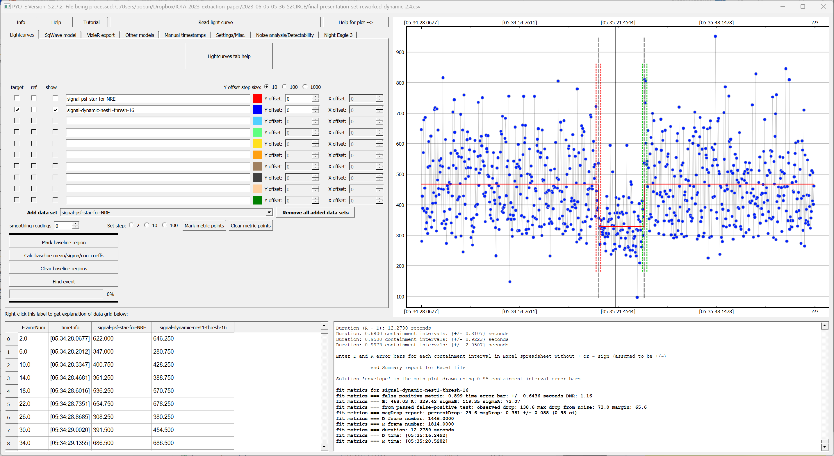
Notes:
And here is the event found in the best light curve.

Slide 46
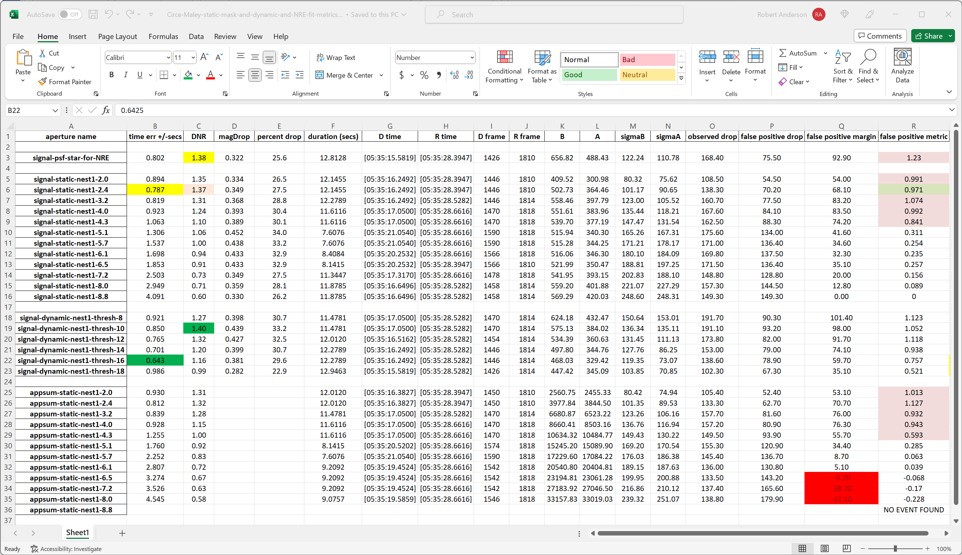
Notes:
Here’s a bonus slide.
It is sometimes said that one might get a lower noise light curve from the raw aperture sum --- because there is no background subtraction --- therefore there is no additional noise from that calculation and operation.
I cannot recall any example where that approach helped, so I examined the aperture sum metrics just to make sure that a better solution wasn’t being missed.
There is no improvement in noise and worse edge time uncertainties using the aperture sum light curves instead of the ‘signal’ light curves that have background subtraction applied.

Slide 47
Summary of method caveats:
None for static masks – always applicable
Dynamic (computed) masks work best with a star image that continuously allows a mask to be formed. When a mask cannot be formed, a transition to a default circular mask occurs and the user must be careful to set a default mask radius so that pixel count change at this transition does not cause trouble.
NRE (Naylor style noise reduction extraction) requires a well defined and stable psf (star image), so it will misbehave when applied to a wind shake video or a speckled video or a defocused video. In addition, it is common for observers to set up their telescope/camera optics so that the star image is under-sampled (to concentrate most of the star photons on just a few pixels), but NRE functions better with an over-sampled star image, so while it is often a competitive solution, it is frequently not the best.

Slide 48
Conclusion
The method caveats are worth keeping in mind, but usually the fit metrics will show when a method is not working/helping.
The most reliable metric is edge time uncertainty. It is repeatable with more than 2 digits of precision.
The supporting metric – DNR – correlates closely with edge time uncertainty, so is not an independent metric.
The indicator of ‘this is not noise’ is the false-positive metric which has the characteristic that small differences are unimportant, so this metric is not one that is normally useful for deciding between two extractions.

Slide 49
Thank you

