Slide 1
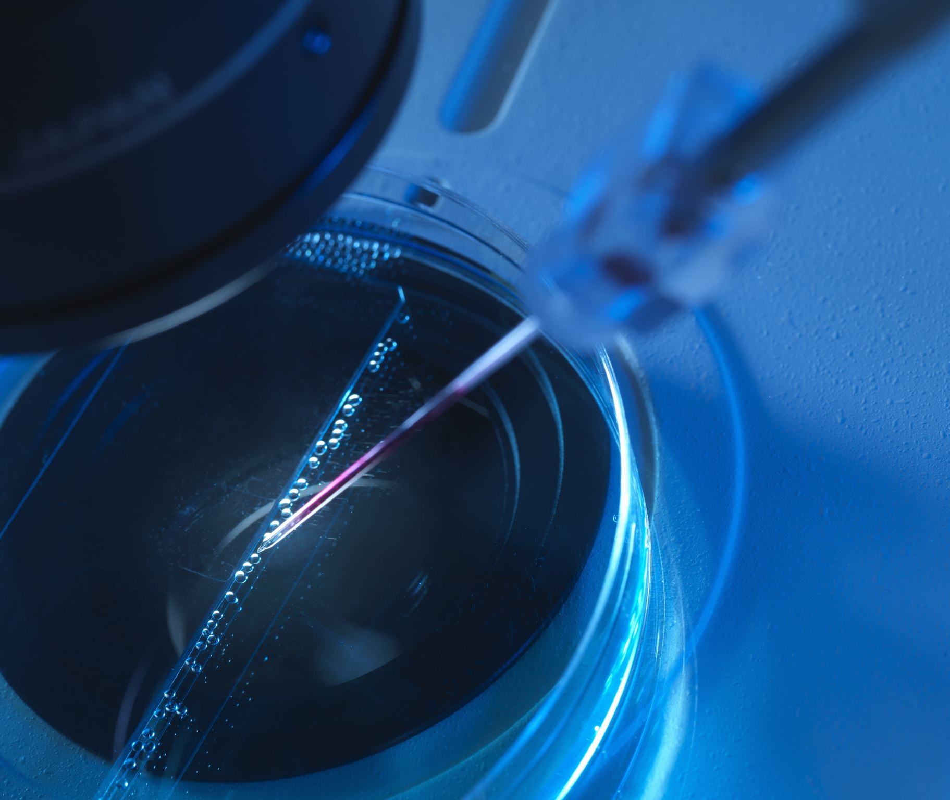
Calibrated synthetic videos for testing light curve extraction
Notes:
This talk is more of an announcement than the presentation of a paper.
The title uses the term “calibrated”. That is a bit of an odd term – what it means is that the underlying noiseless light curve is known as well as all the noise contributions – I just couldn’t think of a better term to imply this fact.

Slide 2
The need: a suite of calibrated synthetic test videos for objective evaluation of light curve extraction methods Public ‘share’ available at: https://occultations.org/observing/software/pymovie
The desire/need for a suite of test videos for comparing light curve extraction techniques has been expressed several times in IOTAoccultations via groups.io
Testing of new features in PyMovie required just such a suite

Slide 3
Simulation details
Each video is a sequence of FITS images enclosed in a folder.
The following factors are incorporated to make the simulation look like common occultation recordings:
Sky (mpsas -magnitude per square arc second)
Seeing (arcseconds)
Image ‘jitter’ (low-altitude turbulence)
Image speckling (high-altitude turbulence)
Telescope: diameter, effective focal length, obscuration area
Camera: pixel size, pixel count, read noise, dark noise, full-well depth, Qe, absolute photon-sensitivity, exposure time
Scintillation noise: site factor, zenith angle, observation altitude using a modified form of Young's Scintillation Approximation as described in:
https://academic.oup.com/mnras/article/452/2/1707/1067913
Notes:
Items 2, 3, and 4 are what I call scintillation effects. I distinguish scintillation effects from scintillation noise.
Qe = quantum efficiency
The modification to the Young’s Approximation for scintillation noise is ultimately just a linear factor of how much worse scintillation noise is at your observation site is than at the best observatories in the world. For the simulations included in this test suite, a factor of 4 was used.

Slide 4
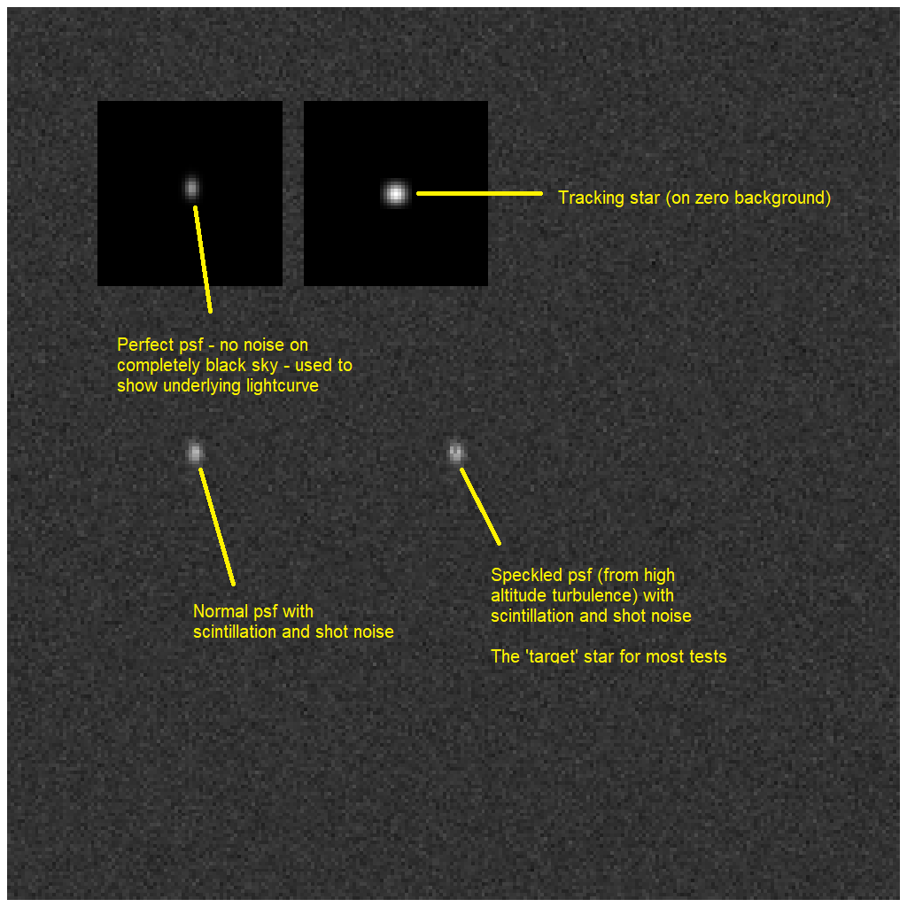
Roadmap for all test videos (This is from the pdf that is in the publicly shared folder)
Notes:
All videos start with an image like this.
Then, the ‘stars’ drift along a diagonal toward the lower right corner – to exercise the tracking ability of the extraction program.
One other thing that is not visually apparent, the background of the lower two star images are identical when sampled with a 41x41 aperture.

Slide 5
Close-up view of frame 1 (and a short movie)
Notes:
Here’s a close-up view and a short movie (this is actually a frame-by-frame stepping sequence to get around Zoom limitations – it gets rather unresponsive if you change a lot of pixels at once at a rapid rate)

Slide 6
Tracking star No turbulence effects No noise Perfect psf (short movie)
Notes:
This movie is really boring – because it is of the tracking star, which is being tracked, nothing appears to move.

Slide 7
Noiseless star: This gives us the underlying light curve (short movie)
Notes:
This little movie is more interesting. The jittering – image shifting position randomly - is caused by low-altitude turbulence. This also affects the psf – its shape changes when the center move by fractional pixels.

Slide 8
Normal star that is not affected by high-altitude turbulence (short movie)
Notes:
The shape of this star is affected by jittering of the psf center AND background noise.

Slide 9
Speckled star that is being affected by high-altitude turbulence (short movie)
Notes:
This star shape changes due to high-altitude turbulence, sometimes called speckling, as well as psf center jitter and background noise.

Slide 10
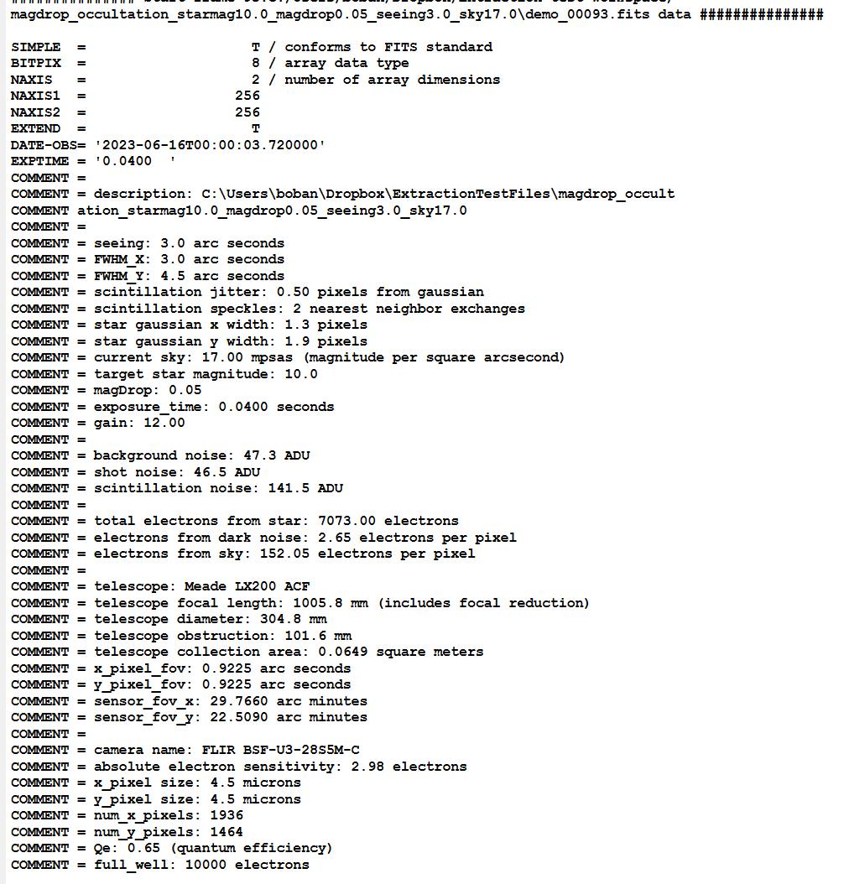
FITS meta-data (repeated in every frame)
Notes:
This meta-data is attached to every frame and provides a comprehensive list of the simulation parameters used for the video.
NOTE: scintillation noise dominates shot noise and background noise (sky plus camera dark noise) in all the videos
The camera simulated in these videos is one that I have acquired for bench testing – should be a good camera if a reasonable ‘optical impedance’ match can be made.

Slide 11
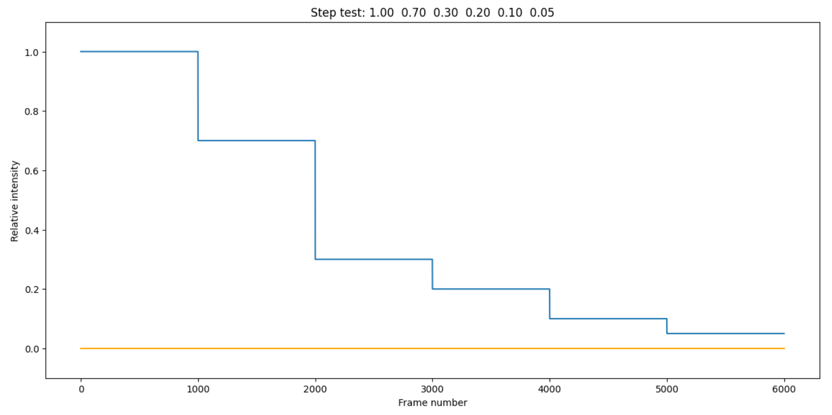
Folder name: stepped_levels_starmag10.0 Tests for accuracy of percent drop determinations

Slide 12
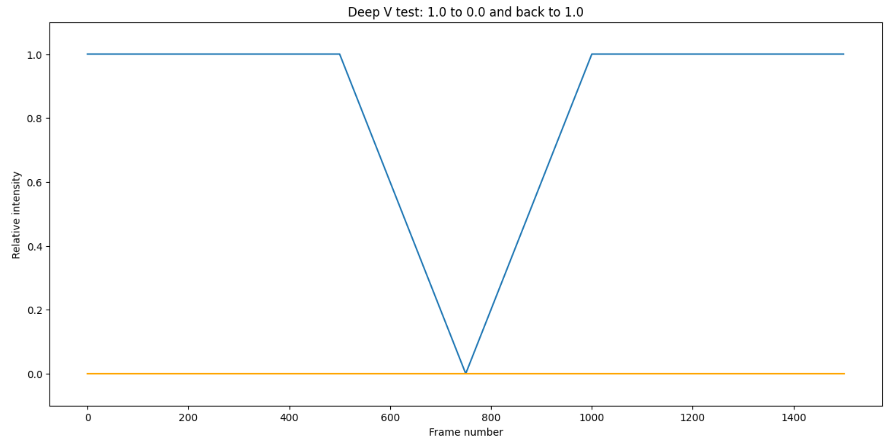
Folder name: deep_V_occultation_starmag10.0 Tests for any intensity distortions

Slide 13
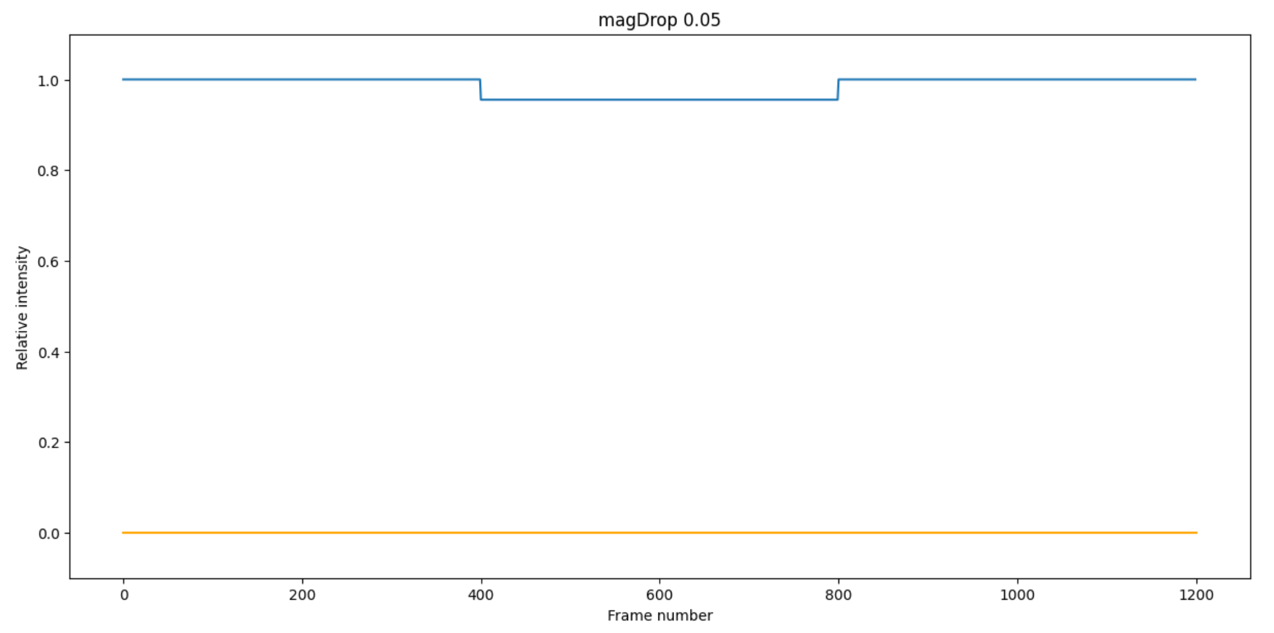
Folder name: magDrop_occultation_starmag10.0_magdrop0.05 Low magDrop (0.05) of bright star (D and R timing should be reliable)

Slide 14
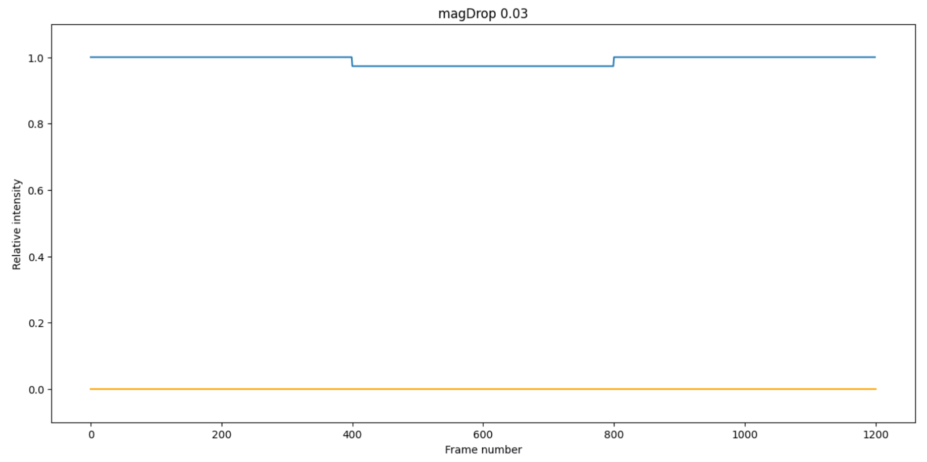
Folder name: magDrop_occultation_starmag10.0_magdrop0.03 Low magDrop (0.03) of bright star (challenges D and R timing)

Slide 15
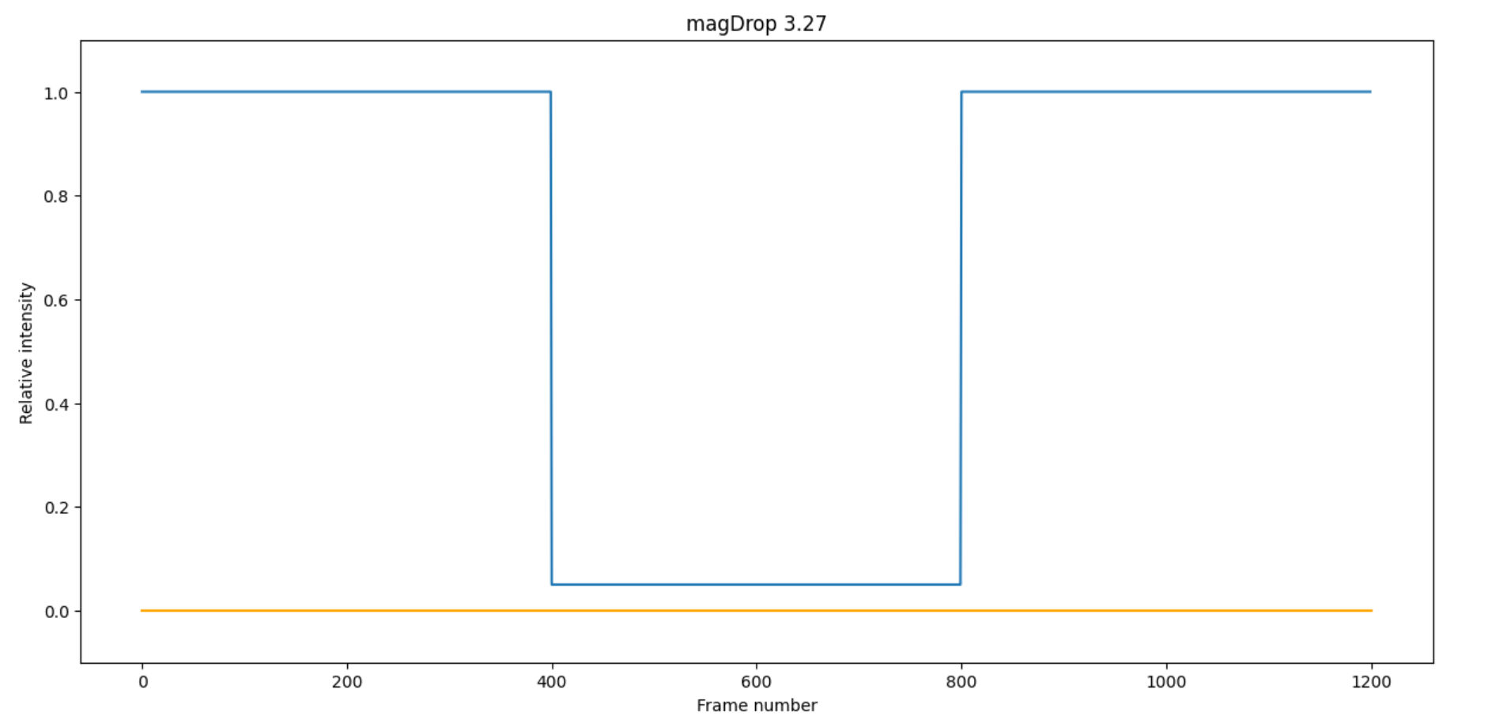
Folder name: magdrop_occultation_starmag10.0_magdrop95percent A deep occultation (95% drop) of bright star to test drop accuracy

Slide 16
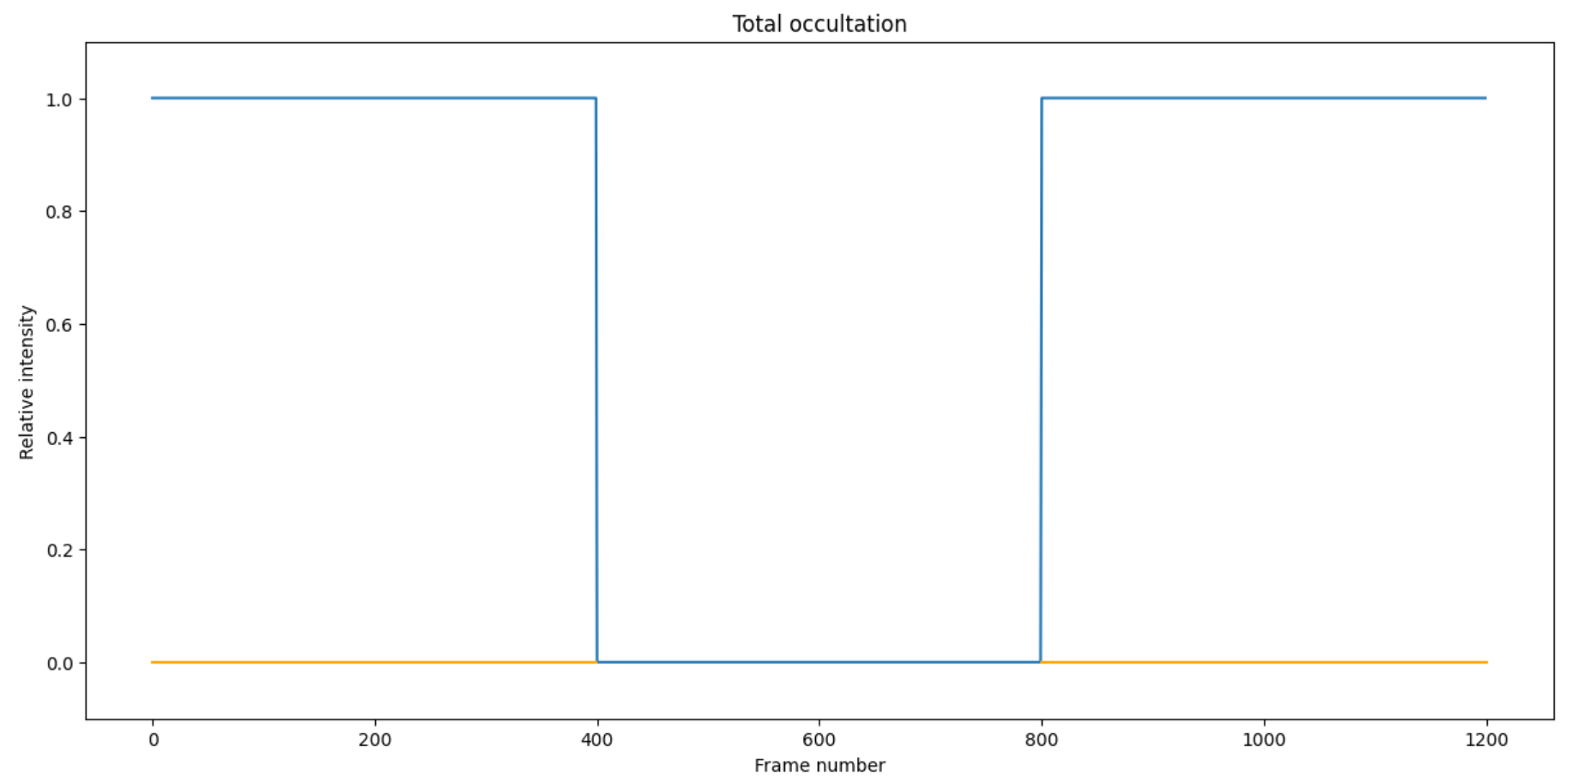
Folder name: total_occultation_starmag14.0 A complete occultation (100% drop) of a dim star

Slide 17
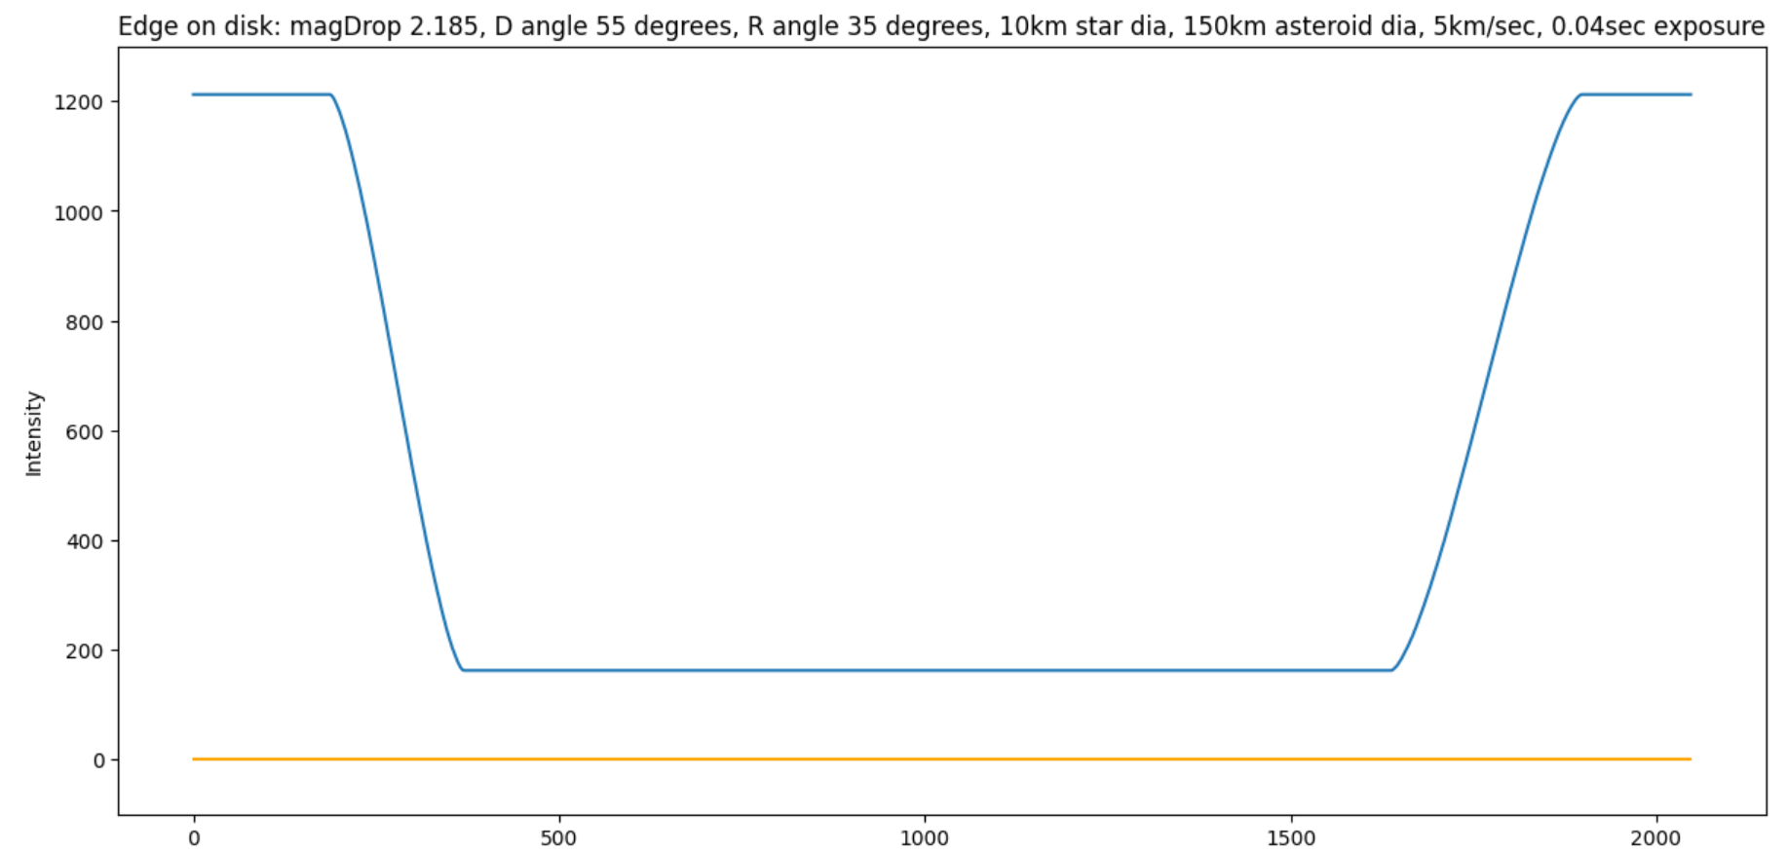
Folder name: penumbral_starmag10.0 A typical penumbral occultation when a large star disk is present

Slide 18
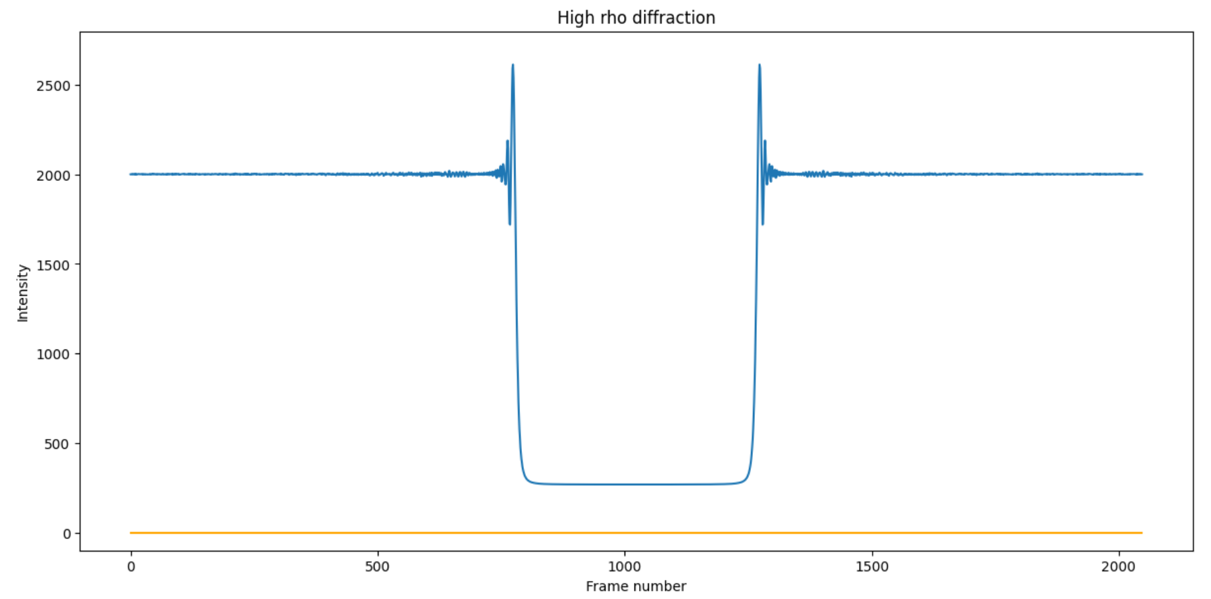
Folder name: diffraction_occultation_starmag10.0 An example diffraction occultation with a 2.185 magDrop

Slide 19
In conclusion
To get a copy of the files, go to …
https://occultations.org/observing/software/pymovie/
and click on calibrated synthetic test videos in the Additional documentation section
Notes:
If you want to use any of the test files described above, type the above link into your browser. There is a pdf file in that folder that repeats much of what was included in this little talk.

